Slide 1
Time Critical Data Delivery
Kenji Tsunoda

Slide 2
Background
TT-GISC-2017 asked Ken to measure the delay of time critical data delivery in WIS/GTS (end-to-end) to meet 2 minutes SLA of WIS
Brasilia, Offenbach, Toulouse and Ken discussed developing self monitoring procedure in WMO
Ken analyzed the report of Tsunami warning delivery test conducted by UNESCO/IOC/IOTWS
  They use actual GTS header WEIOii in their test
  It could be a tool to monitor the delay if we can join the communication test.

Slide 3
Study from the report of IOTWS communication test

Slide 4
IOTWS: Indian Ocean Tsunami Warning System
Four Tsunami regions
IOTWS conducts communication test with actual GTS headings twice a year, scheduled second Wed. of June and December.
11 GISCs are involved in IOTWS.
NEAMTWS
CARIBE
EWS
PTWS
IOTWS
Relevant GISCs are Beijing, Casablanca, Exeter, Jeddah, Melbourne, New Delhi, Offenbach, Pretoria, Tehran, Tokyo and Toulouse. (see Draft_ListOfNTWCwithP-GISC.xlsx)
CBS Ext. 2006 (final report)
  The Secretary-General recalled that, following the tragic Indian Ocean tsunami and the immediate action undertaken by WMO and its partners, the GTS had been identified as the backbone for the exchange of tsunami-related information and warnings

Slide 5




Communication tools
Dedicated (GTS)
Tsunami Service Provider (TSP)
National Tsunami
Warning Centre
(NTWC)
Tele
(fax)
Mobile
(SMS)
Internet
(email)
(web)
(WIS/GTS)
Trouble
GTS
FAX
SMS
Email
Web access/reporting
WIS/GTS?
GTS Headings
WEIO20 DEMS
WEIO22 WIIX
WEIO24 AMMC

Slide 6
Extract from the report of IOTWS communication test on 13 Dec 2017
5.2.1 GTS
The GTS reception rate was 74%, up from 68% in the previous test, and similar to most tests in the previous 4 years which were generally around 70-80%.
Sixteen of the 20 NTWCs received GTS messages, including Bangladesh which had not received any in the previous two tests. Maldives and Thailand did not receive any GTS messages although they had in the previous test, and Comoros and Iran again did not receive any GTS messages as in the previous test (Iran has no GTS connection).
TSP India's GTS messages were received by 16 NTWCs, and Australia's and Indonesia's by 15 NTWCs each.
GTS message delay times continued to be low in this test, with most messages received within 1-3 minutes and only a few messages delayed longer than this. The only significant delays reported were in two of TSP Indonesia's GTS messages to Pakistan, which were delayed by exactly 5 hours. It's possible this was a reporting error because the reception times match the local Pakistan times (UTC+5 hours).

Slide 7
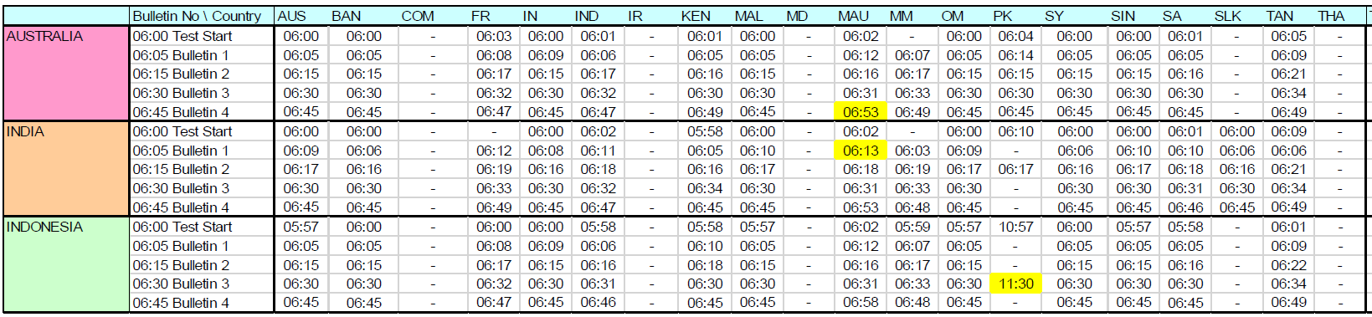
The GTS reception rate was 74%
Expect : (3 TSPs) X (5 messages) X (20 NTWCs) = 300 messages
Result : 221 message were received ....... 74% (by 20 NTWCs)
79 messaged were not received
AUS=Australia, BAN=Bangladesh, COM=Comoros, FR=France (La Reunion), IN=India, IND=Indonesia, IR=Iran, KEN=Kenya, MAL=Malaysia, MD=Maldives, MAU=Mauritius, MM=Myanmar, OM=Oman, PK=Pakistan, SY=Seychelles, SIN=Singapore, SA=South Africa, SLK=Sri Lanka, TAN=Tanzania, THA=Thailand

Slide 8
16 of 20 NTWCs received GTS msgs.
Expect : (3 TSPs) X (5 messages) X (16 NTWCs) = 240 messages
Result : 221 message were received ....... 92% (by 16 NTWCs)
Bangladesh which had not received any in the previous two tests.
Maldives and Thailand did not receive any GTS messages, they had in the previous test.
Comoros and Iran again did not receive.
Australia's and Indonesia's by 15 NTWCs each
AUS=Australia, BAN=Bangladesh, COM=Comoros, FR=France (La Reunion), IN=India, IND=Indonesia, IR=Iran, KEN=Kenya, MAL=Malaysia, MD=Maldives, MAU=Mauritius, MM=Myanmar, OM=Oman, PK=Pakistan, SY=Seychelles, SIN=Singapore, SA=South Africa, SLK=Sri Lanka, TAN=Tanzania, THA=Thailand

Slide 9
Test messages were delivered within 1 minute
[sample]: Australia to Bangladesh (13 Dec. 2017)
Australia
BoM
Melbourne
New Delhi
BMD
Bangladesh
NMC
(NC)
RTH
(DCPC)
GTS Sock.
RTH
(DCPC)
GTS Sock.
NMC
(NC)
TSP
NTWC
Internet
Leased
TX time
Msg-1: 06:00
Msg-2: 06:05
Msg-3: 06:15
Msg-4: 06:30
Msg-5: 06:45
Perfect!
RX time
Msg-1: 06:00
Msg-2: 06:05
Msg-3: 06:15
Msg-4: 06:30
Msg-5: 06:45
+0 min
+0 min
+0 min
+0 min
+0 min
GTS
All the test messages were received within a minute
Domestic
Notes:
This diagram shows the message delivery time from TSP (Non WMO centre) to NTWC (Non WMO centre).
All five Tsunami test messages from Australia to Bangladesh were delivered within a minute.
Delay over the GTS is not sure, but absolutely met requirement of 2 minutes delay.
It’s perfect!
TSP: Tsunami Service Provider
NTWC: National Tsunami Warning Centre

Slide 10
Test messages were delivered within 1-3 minutes
[sample] : Australia to Mauritius (13 Dec. 2017)
Australia
BoM
Melbourne
Toulouse
La Réunion
St. Denis
MMS
Mauritius
NMC
(NC)
RTH
(DCPC)
ftp
RTH
(DCPC)
ftp
NMC
(NC)
NMC
(NC)
TSP
TNWC
RMDCN
MPLS
TX time
Msg-1: 06:00
Msg-2: 06:05
Msg-3: 06:15
Msg-4: 06:30
Msg-5: 06:45
good!
Ave. 2.8 min
RX time
Msg-1: 06:02
Msg-2: 06:12
Msg-3: 06:16
Msg-4: 06:31
Msg-5: 06:53
+2 min
+2 min
+1 min
+1 min
+8 min
Almost of test messages were received within 3 minutes
GTS
  As for +8 minutes, difficult to find out a bottleneck from the IOTWS report (e.g. in domestic link (→) or GTS (→)?)
  What we can do?
Domestic
Notes:
This diagram shows the message delivery time from TSP (Non WMO member) to NTWC (Non WMO member).
All five Tsunami test messages from Australia to Mauritius were delivered to end user.
4 out of 5 messages were delivered within 2 minutes.
One message was delivered with 8 minutes delay.
I’m not sure, where is the delay, but average delay was 2.8 minutes, It’s so so Good!
TSP: Tsunami Service Provider
NTWC: National Tsunami Warning Centre

Slide 11
Between Socket and FTP
Both Socket and FTP delivered test messages within 1-3 minutes.
Socket
  was faster than FTP in this Tsunami comm. test
  is old and was withdrawn from the Manual on the GTS
WMO FTP (includes sftp, ftps)
  FTP is ISO standard protocol of file transfer
  WMO FTP potentially has a processing time for accumulation.
    warning should be exchanged on urgent channel (CCCCnnnnnnnn.ua).
    or, the file should be sent immediately when a GTS Priority 1 message (see paragraph 5, page 158 of Manual on the GTS.)

Slide 12
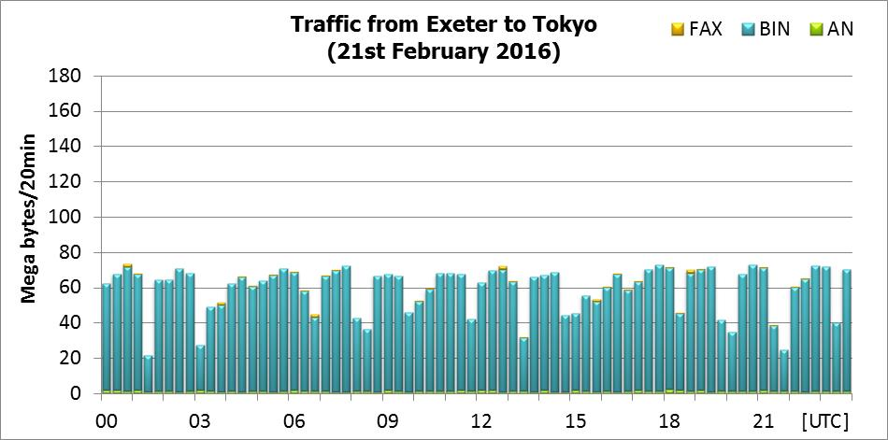
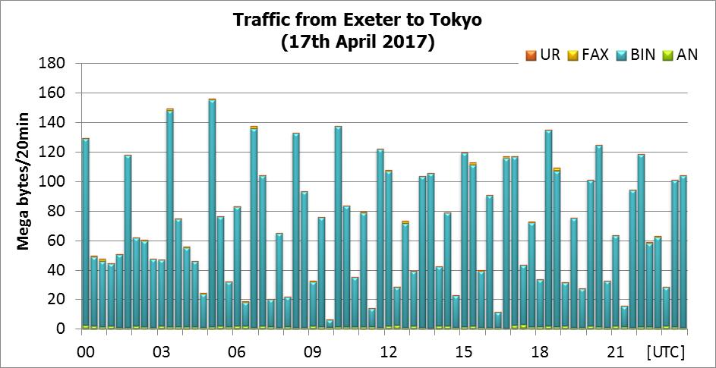
For Your Reference
Protocol Change
March 2017
WMO GTS Socket
WMO Batched FTP
1.6Mbps
WMO FTP is faster than Socket if it’s large amount of data.

Slide 13
Actions
Before next IOTWS test on 12 December 2018
  All GISCs to check its routing table for following bulletins to deliver right centres in tis AoR
    WEIO20DEMS, WEIO22WIIX, WEIO24AMMC
  Each Principal GISC of MD, THA, COM and IR to re-check its connectivity and review the result of 13 June 2018 test (UNESCO IOC will share before December)
  New Delhi to check the routing table for Tsunami warnings from Australia and Indonesia to SLK

Slide 14
Recommended text
The participants reviewed summarized result of the GTS delivery rate/delay in the IOTWS communication test on 13 Dec 2017. The meeting noted that almost messages through the GTS was delivered within 1-3 minutes , and at the moment, Tsunami community satisfied the delivery time end-to-end.
On the other hand, the reception rate was 74%, four out of 20 NTWCs did not receive the messages via GTS. The meeting noted that the it is important to establish/maintain all connections between GISC and DCPCs/NCs in AoR. Looking at remaining 16 out of 20 NTWCs did receive test messages and that’s reception rate was 92%.
The meeting considered actions to improve reception rate, and requested all GISCs to check routing tables to deliver WEIO20DEMS, WEIO22WIIX, WEIO24AMMC to relevant centres in its AoR, and to make sure its connections to the centres before Decemebr 2018 (next IOTWS test).
The participants reviewed the details of the GTS delay and understand that there are characteristics between WMO socket and WMO FTP. The meeting agreed that if we use WMO FTP, all GISCs/RTHs should use urgent channel (CCCCnnnnnnnn.ua), or transmit the priority-1 message immediately (see para 5, page 158 Manual on the GTS).

Slide 15
Monitor internal delay of WMO

Slide 16
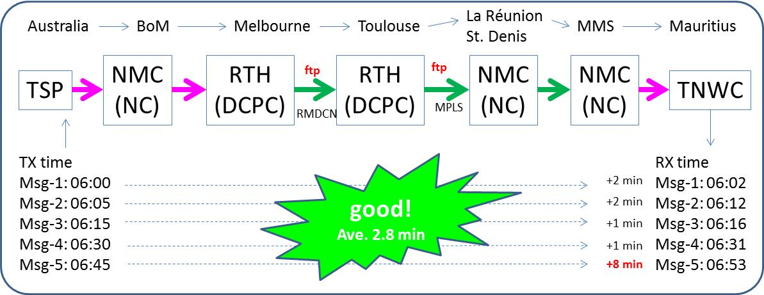
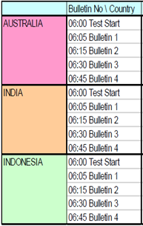

Can we say “meet 2-min SLA”?
(a)
(b)
<--- missing
<--- missing
<--- missing
Tsunami warning message have delayed 8 minutes
Where is bottleneck, in GTS or Domestic network?
6 of 15 messages were missed
Where is missing point, in GTS or Domestic network?
Generally, warning is issued one time.
If Australia issues a warning at 06:45? (will be 8 minutes later)
If India only issues a warning once? (delivery rate is 40%)

Slide 17

Discussion: how to monitor 2-min SLA
With UNESCO IOC
Develop Original Monitor
Pros
  Don’t need preparation
  Use actual warning header
  End-to-end
Cons
  Cannot cover landlocked nations
  Need coordination with UNESCO
  Each Tsunami group has different test procedure
Pros
  Can control everything
  Cover all WMO members
  To be a part of WIS monitoring
Cons
  Cannot use actual header, the result will be for dummy header
  Develop from A to Z
  Not sure, end-to-end

Slide 18
Recommended text
The meeting reviewed the problems in IOTWS communication test and noted that it’s difficult to find out the cause of delay and missing from the result of IOTWS.
The meeting considered two options
  Participation UNESCO IOC practices
  Development of WMO original monitor
The meeting agreed ........................

