Slide 1
use cases
how users and data producers interact on WIS

Slide 2
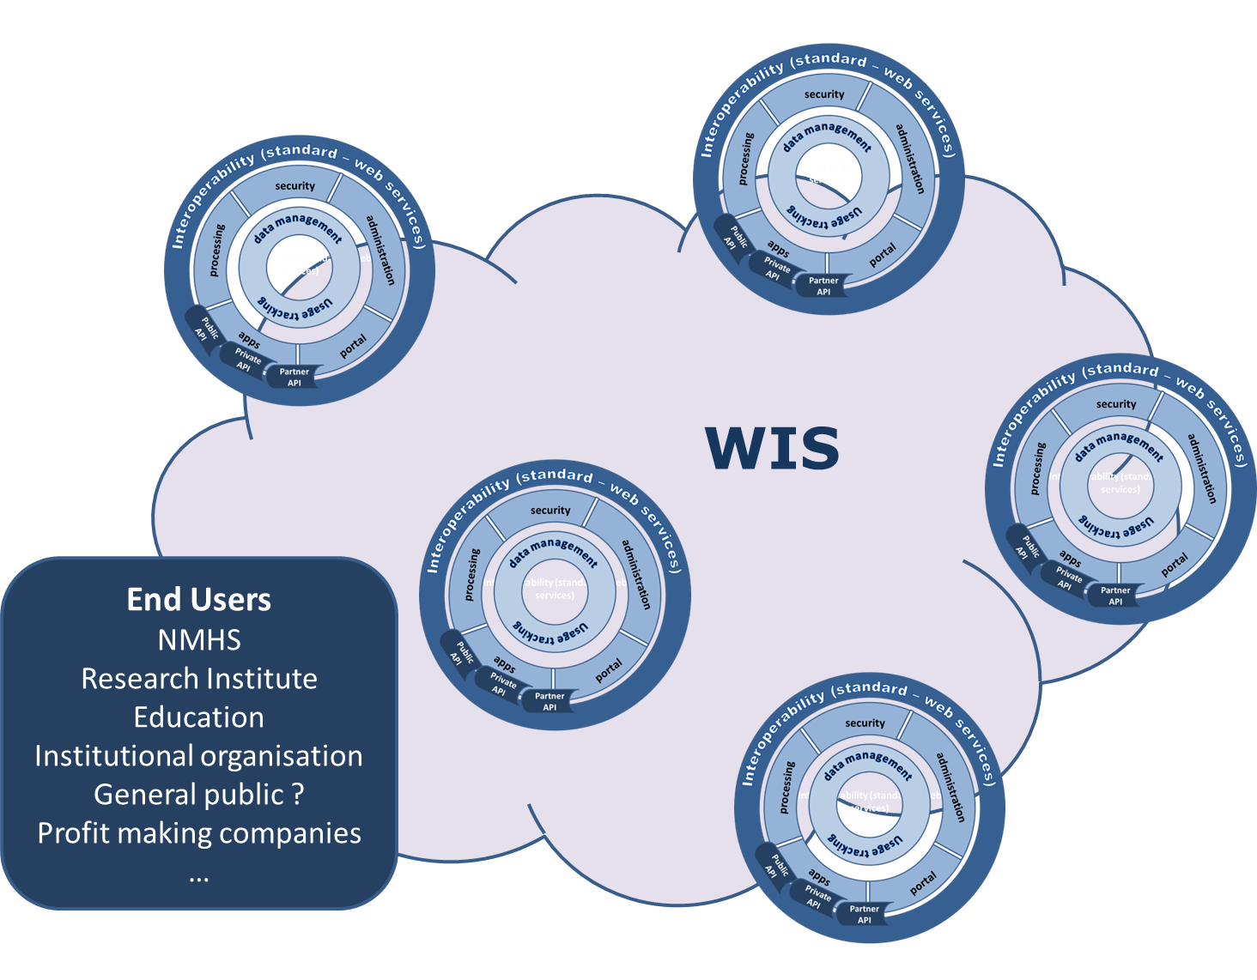
WIS 2.0 - The ecosystem !
Opened to new partners from different business (energie, health, value-added service provider..) to develop the use of WMO information

Slide 3
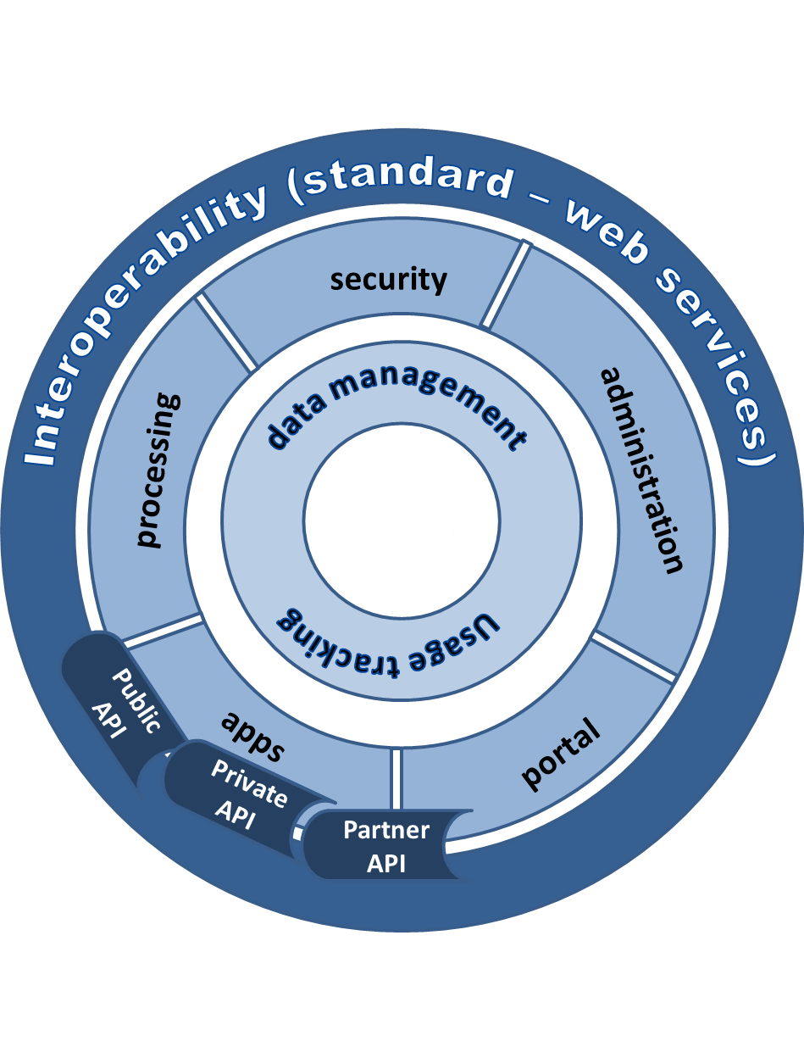
WIS 2.0 - the platform
A global information management, processing and sharing platform
Acquisition
Dissemination
Collaboration
Change in user behaviour from downloading a copy of information for local processing to using services that process the information at its source

Slide 4
Use Case 1
NMHS in developing country:
Introduce observation in WIS 2.0 eco-system
Run a LAM on defined area – access to infrastructure without having to maintain the infra
Use services from NWP Center to prepare a product for end user ( agriculture , aero)

Slide 5
Use case 2
NWP centre :
Want to run a HR global model
Need to get all in-situ observations (5’ or 1’) in real time
Need to get all radar data in real time
getting all raw data is too big
Provide services on NWP output

Slide 6
USE CASE 1
Services
WIS 2.0 is a policy framework that allows services to be used together as opposed to WIS 1.0 which is an infrastructure and is limited
Technical
Data exchange, Data contribution
Inclusive – what is the cost of adding a new centre or service? Data for free, management service
Need to enable data be provided in a timely manner – standards, technology/infrastructure, …
Access to provisioned environments (flexible - research and more static - operational)
Governance and General terms of use for service(s)
Appreciate the different types of users (different capabilities) and differences between public and commercial usage
Tools
Availability of general tools and possibility to integrate local tools
Discussion on ownership, IPR of algorithms, products
Establish open framework for enabling access to WIS members
Policy Framework
Data, output, services - use in public and commercial scenarios
User does not need to know where resources and services are provisioned
WIS 2.0 to allow services to be exploited by a wider community
WIS 2.0 needs to provide an attractive methodology for others to contribute their services – because this use case implies that someone has to pay the IT bill
That removes the need for WIS 2.0 to specify all of the technical details – contributors will want to solve this
WIS 2.0 to approach and encourage others to contribute their services

Slide 7
Use case 3
Use case related to GMAS
NMHS
Want to send notification/alarm on smartphone when a threshold is /(will be) reach

Slide 8
Use case 4
Global insurance company
Want to develop a new product
Need to run a study on reanalysis data from different Climate centres
getting all reanalysis data is too big

Slide 9
Use case 5
Use case economic analysis of flood impact
Want to evaluate the impact of flood on city
Need meterological, climate, urban and hydrology information

Slide 10
USE case 6
UN GIS analyst (official duty use – not commercial, individual)
Want to access rainfall datasets through data catalogue and/or common (commercial) search engine
Need to be associated with other datasets (land, population distribution, …)
Produce food security (food shortage projection) product
This use case addresses issues that are not of a real-time nature.
Access
WIS can be very constrained in terms of how it may improve access…
This use case needs to be implemented in a way that does not violate individual policies
It is currently possible to enable discovery of data, obtain a URL, and be redirected to a login page where data is not open
** Issue – handling authentication issues and striving toward seamless access..
Discovery
WIS can provide improvements in terms of discovery…
Technical requirements
Two types of service offerings
1) Directed search - Specific index/search based on known issue
2) Monitoring-analyzing trends in data request/use
Implies active management of list of issues with the community
Identify recurring issues-based searches
Open versus Trusted
1) In both open and trusted, the context/owner of the data is maintained
2) in Trusted, result set is limited to resources of known quality or authority – WMO acts as authority?
WMO to coordinate the implementation of targeted, issues-based searches with commercial search providers
Includes assembly of data, metadata, unstructured data across the contributing community for indexing
Individual data and information producers do not need to have the full picture – WMO identifies relevent resources/search criteria with search engine provider
May include metadata enrichment, registering site indexing with search providers
Potentially implement trusted searches as well (e.g. value-added service provided by providers)
Timeliness of service, currency of results – high degree of currency will cost…
WIS may want to work with private sector to provide complementary services.
WIS would want to work domain experts to identify essential variables/products to support directed searches, harvesting.
Enhancements to the technical spec: contract required to support a web crawler – doing this indexes content for non0directed and directed searches
HTML, sitemap, schema.org,…
Connect with W3C community standards
WIS should offer a complementary response in terms of search results instead of subsets
User searches for product A consisting of components A.1, A.2, A.3. WIS should provide a comprehensive response for all components A.1, A.2, A.3
Pre-conditions to fulfilling this use case would include WIS 2.0 identifying the relevant variables, data sources, and initiating the indexing of that data.

Slide 11
Break-out session
 | Group 1 | Group 2 | Group 3
Session A | UC1, UC2 | UC3, UC4 | UC5, UC6
Session B | UC3, UC4 | UC5, UC6 | UC1, UC2

