Slide 1
use cases
how users and data producers interact on WIS

Slide 2
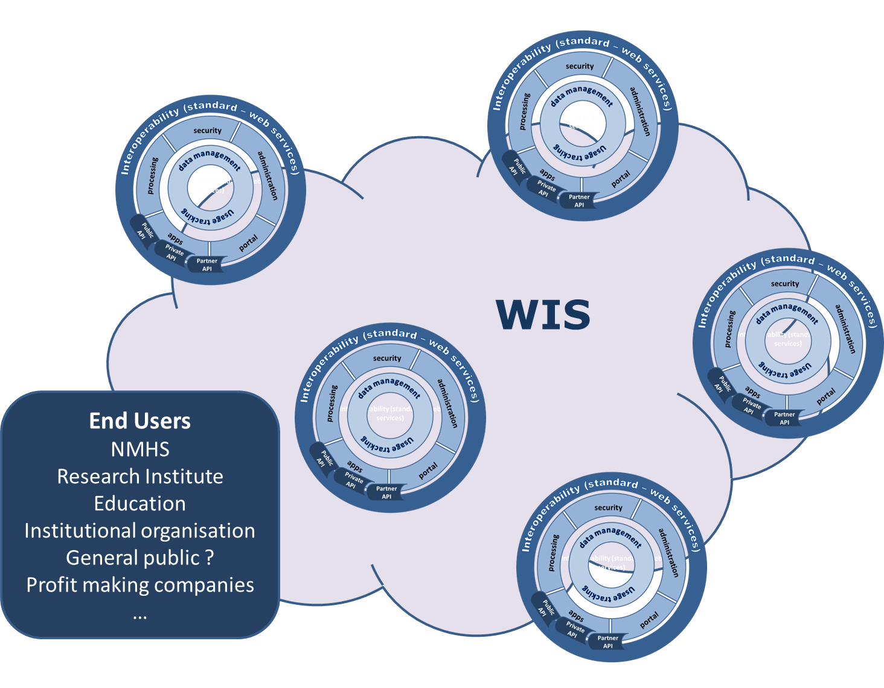
WIS 2.0 - The ecosystem !
Opened to new partners from different business (energie, health, value-added service provider..) to develop the use of WMO information

Slide 3
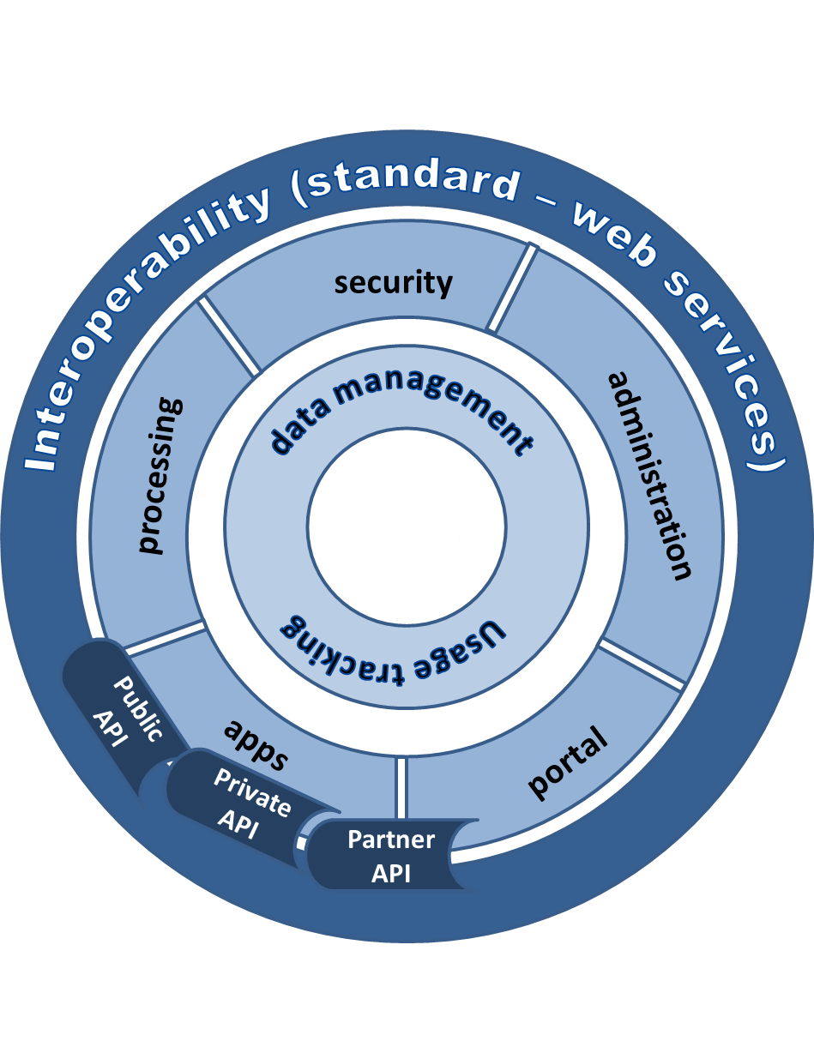
WIS 2.0 - the platform
A global information management, processing and sharing platform
Acquisition
Dissemination
Collaboration
Change in user behaviour from downloading a copy of information for local processing to using services that process the information at its source

Slide 4
Use Case 1
NMHS in developing country:
Introduce observation in WIS 2.0 eco-system
Run a LAM on defined area – access to infrastructure without having to maintain the infra
Use services from NWP Center to prepare a product for end user ( agriculture , aero)

Slide 5
Use case 2
NWP centre :
Want to run a HR global model
Need to get all in-situ observations (5’ or 1’) in real time
Need to get all radar data in real time
getting all raw data is too big
Provide services on NWP output

Slide 6
Use case 3
Use case related to GMAS
NMHS
Want to send notification/alarm on smartphone when a threshold is /(will be) reach

Slide 7
Use case 4
Global insurance company
Want to develop a new product
Need to run a study on reanalysis data from different Climate centres
getting all reanalysis data is too big

Slide 8
Use case 5
Use case economic analysis of flood impact
Want to evaluate the impact of flood on city
Need meterological, climate, urban and hydrology information

Slide 9
USE case 6
UN person
Want to access rainfall datasets through data catalogue and/or common search engine
Need to be associated with other datasets (land, population distribution, …)
Produce food security product

Slide 10
Break-out session
 | Group 1 | Group 2 | Group 3
Session A | UC1, UC2 | UC3, UC4 | UC5, UC6
Session B | UC3, UC4 | UC5, UC6 | UC1, UC2

