Slide 1
Implementation Status of the EUMETSAT Data Services Strategy
(for presentation during TT-eWIS)
Lothar Wolf
Data Services Competence Area Manager

Slide 2
Background (drivers & objectives)
Drivers:
Evolution of user needs and expectations
Increase of data volumes
Availability of “big data” technologies
Flexibility to address changes
Future-proof solutions
Objectives:
Establish a new Data Services Portfolio
Service-oriented interfaces to users
Using an interoperable, and generic IT & Service infrastructure
Based on well established standards
Support “data to the users” as well as “users to the data” services
Allow federation and cross domain data access

Slide 3
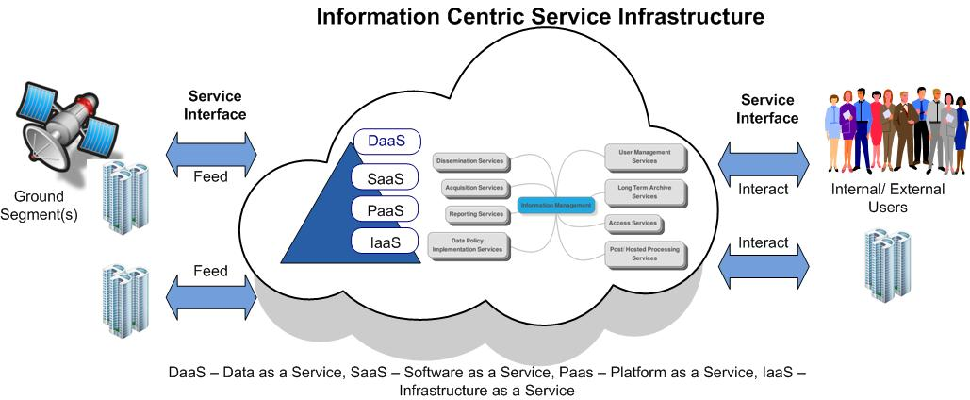
Vision

Slide 4
How to get there …
Format Conversion Toolbox (PF IV)
NRT (Push) Dissemination
Thematic processing
Hosted Processing (PF V)
EUMETCast Terrestrial
(PF II)
ICSI
EUMETSAT Ground Segment
U
s
e
r
s
Licensed Web Map Services (PF III)
Pull Data Access
Online Data Access(PF I)
Long Term Archive

Slide 5
Pathfinder/ Projects
PF-I: Online data access (OLDA)
PF-II: High volume data delivery via EUMETCast Terrestrial
PF-III: Licensed Web Map Services
PF-IV: Format conversion toolbox
PF-V: Hosted processing
PF-VI: SAF Data Access (study)
VII: EUMETSAT & ECMWF and Mercator-Ocean Partner DIAS

Slide 6
High Level Organisation
Framework Management
Phase I – Pathfinder Phase
Phase II – Operational Implementation
Requirements & Design
Procurement Activities
PF Execution & User feedback
Requirements & Design
Procurement Activities
Operations & User feedback
Evolution of Legal & Data Policy aspects
Feedback & Reporting to Delegate Bodies
Feedback & Reporting to Delegate Bodies
Reporting
Reporting
Workshop
Reporting
Approval
Reporting
Pathfinder Project I
Delegate Body Decision Point *
Operational
Implementation
Project
Pathfinder Project II
Pathfinder Project III
Pathfinder Project IV
* Decision on go-ahead with a baseline
Pathfinder Project V
Pathfinder Project VI
Internal Infrastructure Setup
Operational Ramp-up

Slide 7
Framework Scope
Management and Coordination of the overall activity
  Budget, Resources & HR;
  Risks, Constraints;
  Schedule;
  Cross project decencies, reviews;
  Deliverables
  Reporting

Slide 8
High Level Status
ICSI Platform Architecture Key Point (May 2017);
OLDA & WMS Architecture Key Point (July 2017);
ICSI & Pathfinder Services Design Review (October 2017);
Legal & Policy aspects assessments;
Security Requirements integration (October 2017);
OSAT for ICSI Platform January 2018.
*ICSI – Information Centric Service Infrastructure
*ICSI Platform – IaaS &PaaS
*OLDA – On-Line Data Access
*WMS – Web Mapping Service

Slide 9
Integrated development logic for Roadmap & DIAS
KO
Feedback from users
Architecture Checkpoint
Architectural Concept
Architecture Consolidation
18th May
Design Review
Initial design
Design
15th September
January 2018
Initial implementation
Implementation
Finalise implement.
Validation Readiness Review
Integration & Verification
Q1 – Q2 2018
ICSI platform Readiness Review
User Validation
Mid November
EUMETSAT, MO, ECMWF – DIAS

Slide 10
DIAS development heritage
EUMETSAT - Data Services Roadmap
Establish Information Centric Service Infrastructure (ICSI)
New data services & tools for EUMETSAT missions/ users
DIAS Demonstrator (V0)
Implementing a Distributed Cloud Service Infrastructure for demonstration purpose
Operational DIAS
Provide full services
API for industry services & market place.

Slide 11
DIAS Development Schedule

Slide 12
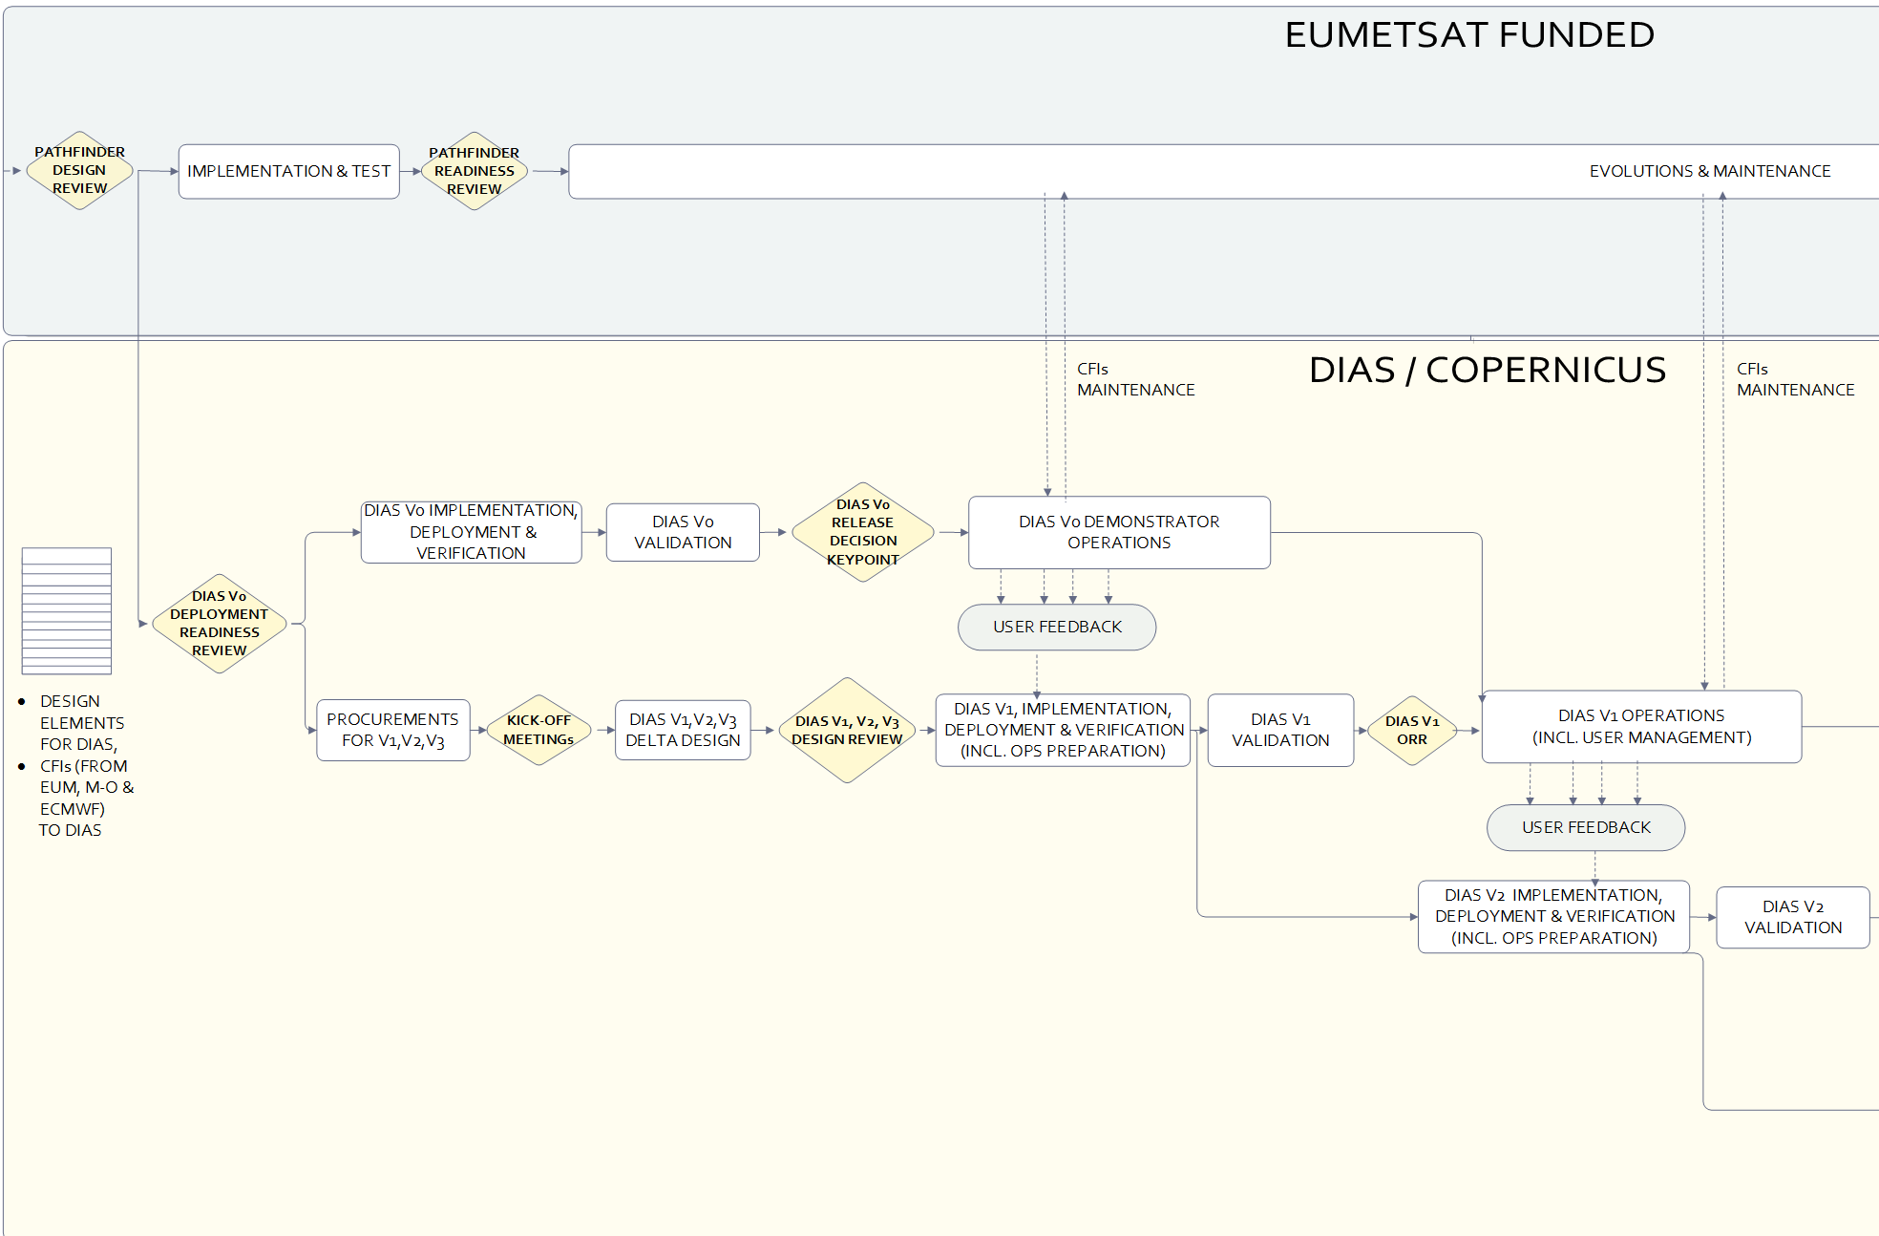
DIAS Development Logic

Slide 13
Roadmap Legal & Policy Activities (1)
Cloud Computing in view of risks and legal challenges associated with public commercial cloud computing, particularly in the context of an intergovernmental organisation;
Legal analysis of the 3 typical use cases of commercial cloud services in the context of the Pathfinders;
Data Policy analysis of the pathfinder services and suggested access conditions
Legal analysis for a set of overarching general access and usage terms and conditions for the Services

Slide 14
Roadmap User Validation Approach
Purpose:
  to gather user “feedback” on the output of the Pathfinder Projects and to derive recommendations towards the operational deployment of new data services;
  This feedback will assist EUMETSAT in shaping full scale deployment of the new data services.
Scope:
  assessment of the individual Pathfinder’s functionality
  capturing feedback on its future use within integrated data services in the operational phase.

Slide 15
Roadmap User Validation Approach
Methodology:
  UX - User Experience:
    Moderated In-Person and/or Remote Usability Testing;
    Online and in-person surveys;
  Other validation:
    Feedback from workshops (WMS and Hosted processing PFs foresee dedicated workshops with the validation group);
    Proposed to have a MS workshop to demonstrate the PFs;
  Support for the testing:
    Where applicable via industry support to perform the testing. prepare a test report and support the users directly

Slide 16
PF-I OLDA Scope
OLDA Pathfinder-I project is focused in:
  Providing End-Users with an access mechanism to mission data able to provide immediate direct download of real time data and products “as is”;
  Abstraction of data access from physical implementation;
  Simple User Interface, including fast registration via single-sign-on;
  Demonstrating of monitoring & reporting capabilities;
  Exploring of spatial subset & regional data access aspects;
  Assessing of how various Service Level Agreements with different user communities could be managed;
OLDA Pathfinder-I service will be made available to End-Users for the purpose of the demonstration based on an agreed "test" data set, addressing a broad range of user requirements and including sufficiently large volume of data to provide a suitable basis for demonstration/assessment, complying with the current EUMETSAT Data Policy.

Slide 17
PF-I OLDA Status
Design phase is on-going;
Preliminary design outputs (initial system requirements, service declarations and architectural concept) have been produced;
Successful Architecture check point on on 28 July;
System detailed design/ prototyping started in early August addressing:
  Complete OLDA system detailed design;
  Development sprints aimed to perform “pre-developments” on key design aspects for preparing the way for a iterative implementation phase, with a staggered release of OLDA services based on an agreed prioritisation;
OLDA service components planned to be available for integration at EUM premises starting from October until December 2017, following the agreed staged development logic;
OLDA service verification planned to start in early 2018.

Slide 18
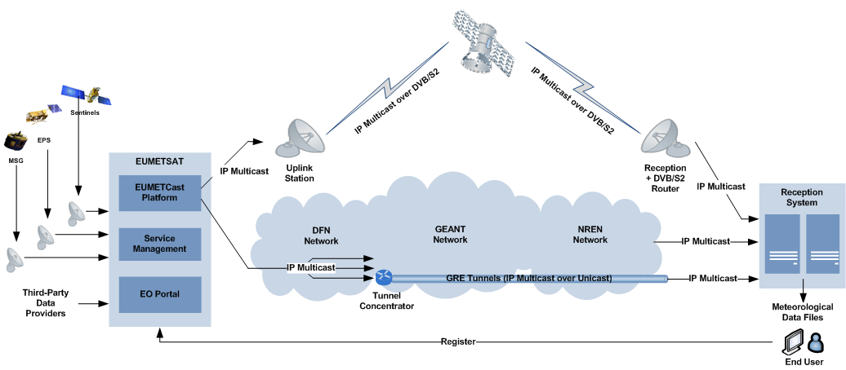
PF-II: High Volume Data Delivery via EUM Terrestrial
EUMETCast is a near real-time data dissemination service which is based on an IP multicast “push” concept and implemented using the TelliCast server and client applications

Slide 19
PF-II High Volume Data Delivery Scope
Assess/confirm the relevance of the EUMETCast-Terrestrial concept for:
  The delivery of high volume of data to international partners, on a best effort basis;
  The cost efficient delivery of large additional data sets that are needed only by a limited number of users;
  The delivery of temporary, trial or project-related time / non-time critical datasets to NMSs or expert user groups;
Demonstrate the capability of the system to serve as a backup to EUMETCast-Satellite for access to time-critical data for individual cases;
Provide a single and harmonized user interface across EUMETCast-Terrestrial and EUMETCast-Satellite exploited as a single-point managed service;
Specify a network provider wan concept that:
  provides a scalable service with respect to data volume and number of users;
  ensures the eligibility of traffic and users (i.e. in addition to accessing the service via the existing GEANT/NREN links any user shall be able to access the service via their Internet link);
  provides different levels of service accessibility and/or reliability to end users;
  includes a scalable monitoring and reporting functionality;

Slide 20
PF-II High Volume Data Delivery Status
Key Challenges:
  Design of the contractual setup with network providers (which is a hybrid consisting of academic/research networks and commercial ISPs);
  Design of a scalable monitoring and reporting functionality;
  Define a set of service levels for different qualities of service;
Status of Progress:
  Work is on-going to define the Engineering Work Packages with industry partners to:
  Specify the network provider concept;
  Verify the scalability of the server and client applications;
  Define suitable and sufficient monitoring and reporting tools;
  Define suitable methods to provide different qualities of service;
Next Steps:
  Assessment of prototype of EUM Terr on commercial Internet

Slide 21
PF-III Web Map Services Scope
Provision of visualisations in near real-time, generated from EUMETSAT open and licensed products;
Creation of an online holding of Licensed and non-Licensed visualizations;
Provide discovery services in the UI and from the WMS API to find the visualizations;
Tailoring of EUMETSAT visualisations for each users:
  Personalize visualisation and save in user’s profile;
  Share with a colleague;
Demonstrate provision of open and licensed data using OGC WFS and WCS:
  WFS (Web Feature Service): provision of point values and integration within Web Interface;
  WCS (Web Coverage Service): provision of data for a given time and area of Interest.

Slide 22
  PF-III Web Map Services Status - completed
EOWS WMS Workshops with industry support for requirements accessement & clarifications May 2017;
Trade Off Analyses for the Front End – Final Consolidated document delivered. Technologies have been selected;
Trade Off Analyses for the Back End – Final Consolidated document delivered. Technology have been selected;
Succesful Architecture Concept Checkpoint review (July 2017);
  WMS System Concept and Top-Level Architecture Document;
  WMS System Requirements Document;
  WMS Service Declaration;
Priorities for the upcomming activities have been provieded and agreed;
  Web Services Engineers: GSI/C/OE, GSI/C/OB
  System engineer support: GSI/C/NE
  User Service Representatives: USC/MHi, USC//T/IP

Slide 23
  PF-III Web Map Services Status – on going
Preparation of a WMS Design Workshop;
Definition of the WMS Products to be made available in the GUI;
Support to the User Validation process definition;
Consolidation of WMS User and HL Requirements.
  Web Services Engineers: GSI/C/OE, GSI/C/OB
  System engineer support: GSI/C/NE
  User Service Representatives: USC/MHi, USC//T/IP

Slide 24
PF-IV (Product Customization Toolbox) Scope
Entails for the re-formatting and customization of EUMETSAT products;
To be accessible for all EUMETSAT users that wants to convert from EUMETSAT internal format to a variety of industry standard formats (NetCDF, HDF, JPEG200, etc.);
To customize the products in a way that allow the products ingestion in user applications, to do so the toolbox mainly allow:
  Changing the product projection;
  Selecting specific regions of interest (ROI);
  Extracting data layer (bands information, etc.);
  Generating Quicklooks;
  Re-sampling;
The major challenge is having a design which is robust, extendable and intuitive that can be used all of our users (WOCA/WORA):
  Toolbox provides an API, a Command Line Interface (CLI) and web services;

Slide 25
PF-IV (Product Customization Toolbox) Status
The user requirements document is mature: First version has been published;
The ITT process has been finished for selecting the company supporting EUMETSAT during the pathfinder implementation;
The project is currently evolving slightly behind the schedule :
  KOM with the company selected has not yet taken place;
  It is expected to be held by end of July in a date TBC;
Next milestones will be:
  Analysis of the State of the Art of technologies, for its integration on the toolbox, and System Requirement elicitation by the end of October 2017;
  A rapid and iterative design and prototyping of the main; functionalities targeted by the user validation expected by end Q1 2018.

Slide 26
PF-V Hosted Processing Scope
To prototype a future service and corresponding architecture for allowing external and internal users to access EUMETSAT’s archive of images & products for their own development and processing needs utilising EUMETSAT resources & tools

Slide 27
PF-V Hosted Processing Status
The project is in the design stage;
A concept infrastructure design has been reviewed;
The project is now focussing on non-infrastructure elements;
The legal aspects have been discussed with the view to detailing the use cases leading to a draft user agreement document;
The user representatives are discussing real processing operations as potential use cases.

Slide 28
PF-VI SAF Scope
The main objective is to analyse possible concepts for harmonising access to SAF products and assess implications, using the OSI SAF for testing purposes, whose data are already archived in the EUMETSAT Data Centre and hence locally available for Pathfinders;
This will capitalise, where appropriate, on the other Pathfinders, in particular through the inclusion of SAF OSI products in Pathfinder I (OLDA) and Pathfinder III (Web Services), the use of the Tool box (Pathfinder IV) to convert formats of SAF products, and the application of processing software selected under Pathfinder V (Hosted processing) to SAF products, including SAF software for the generation of some SAF products;
Demonstrate how the technologies exploited in the PFs could be of relevance to SAF products and data access;
Definition of concepts that could be applied across the SAF Network.
Essentially this PF will demonstrate the user benefits of the full integration & cross usage of all prospective services envisaged by the Data Service Roadmap

Slide 29
PF-VI SAF Status
The project is in its initiation phase;
Kick-off in September 2017;
First work element will be on selection of appropriate OSI-SAF products;
Initial focus on integration of the selected product into WMS and OLDA service;
In a second phase the usage of the product within PF-IV and PF-V context, i.e. production of a region of interest within a hosted processing environment;
The overall outcome of the demonstrator would be a general template of implementation steps and service integrations on how SAF products in general could benefit from the new services defined by the Data Services Roadmap.

Slide 30
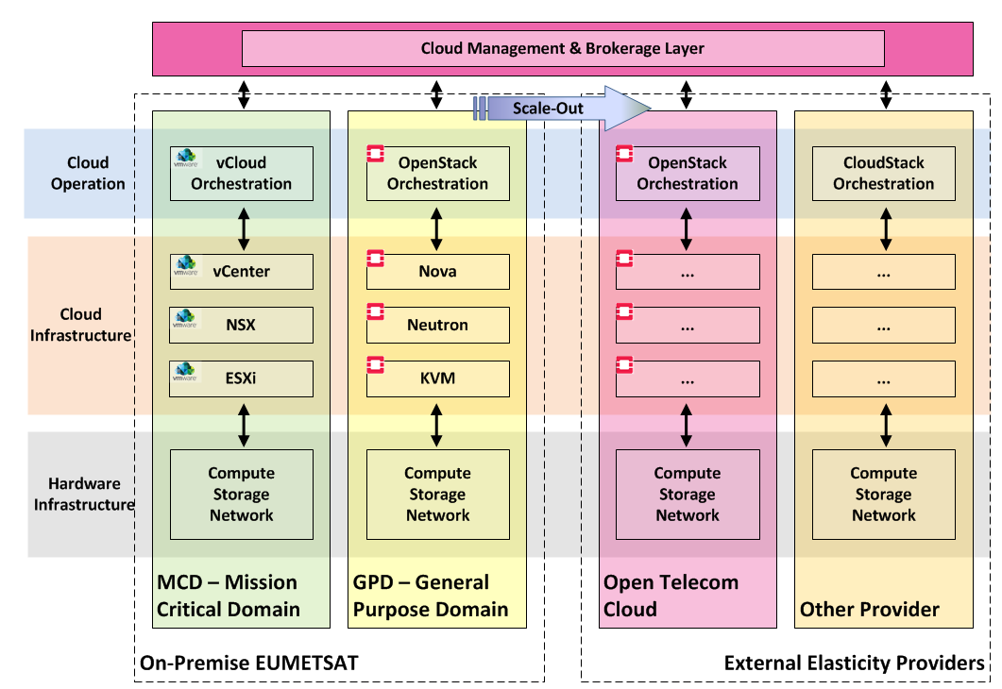
ICSI/DCSI System Architecture - I

Slide 31
ICSI/DCSI System Architecture - II

Slide 32
EUMETSAT DIAS Implementation Scope
Implementation of a Data and Information Access Services (DIAS) instance on the basis of DC;
Decentralised implementation encompassing:
  EUMETSAT, ECMWF and Mercator Ocean;
  Commercial 3rd Party cloud provider;
Focus on "users to the data" service;
Benefitting of today's big data technologies;
Unified access to ALL Sentinel data and Copernicus services information.

Slide 33
Targeted DIAS user community - Actors & Roles
Notes:
Other Systems (DIAS)

Slide 34
DIAS Use Cases
* - Use Cases covered in V0

Slide 35
DIAS Functional Blocks & Responsibility Distribution

Slide 36
Tools and processing services (ECMWF)
Catalogue of Images
Satellite
VM
Hadoop cluster
VM1
VM2
VM3
VM4
VM5
…
Climate
VM
Apache-Spark cluster
Ocean
VM
….
VM
VM1
VM2
VM3
VM4
VM5
…
Instantiate
ECMWF
EUMETSAT
MERCATOR
Public Cloud
Apache-Spark cluster
Climate
VM
VM1
VM2
VM3
VM4
VM5
…
Data and Products
Catalogue
Common Data
Access API
EUMETSAT
ECMWF
MERCATOR
ESA
…

Slide 37
EUMETSAT - DIAS V0 System
Built on EUMETSAT Data Services Roadmap concepts (DCSI)
Sites are high speed interconnected (LAN speed)
Central Cloud Broker to manage *aaS Layers
Data access via PoP (Point of Presence)
Harmonised data access services
Central portal for federation
An industrial cloud provider provides inner elasticity

Slide 38
DIAS – OpenStack based

Slide 39
DIAS V0 – DCSI + DCSI Platform

Slide 40
DIAS V1 Eco-System

Slide 41
Next steps
ICSI & DCSI Infrastructure deployment
User Validation Readiness Review Q1
User Validation from April 2018
DIAS V0 Readiness Review July 2018
Begin operational level implementation of the Roadmap Q4 2018
Begin DIAS V1 operational implemenation Q1 2019

