Slide 1
OpenWIS Pilot Study Briefing
Steve Olson
OpenWIS Technical Committee, Chair
November 21, 2017

Slide 2
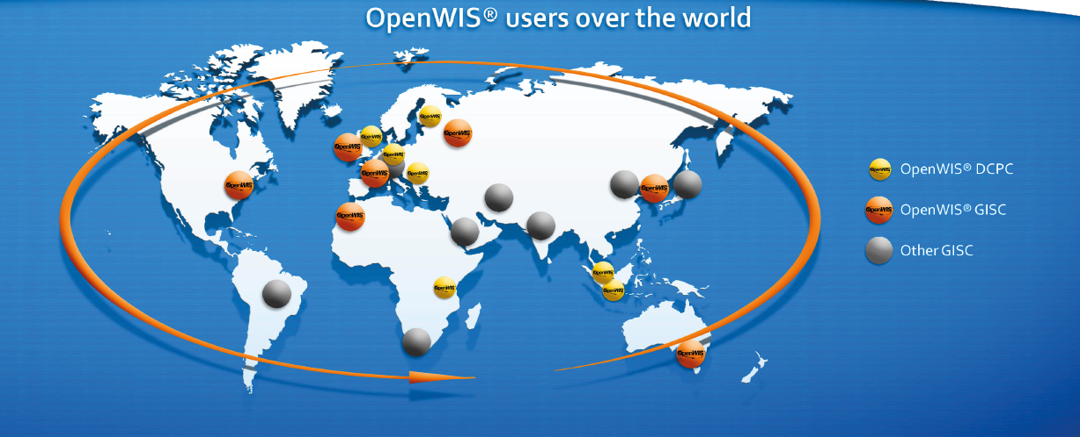
Introduction of OpenWIS Association
International non-profit organization that facilitates collaboration on development, promotion and sharing of open source software for exchange of global meteorological information
Created in 2011 with 4 founding members (Australia, France, Korea and UK) and 1 service provider (MFI)
Strategic partners (US, Finland and India) added later
Established to provide technical solution for WIS compliance

Slide 3
OpenWIS Association Governance
The basic governance laid out in Articles of Association and Internal Rules
The OpenWIS Association hosts multiple open source software development projects supporting/enabling exchange of global meteorological information.
Uses GitHub platform for collaborative development.
The rules and expectations for participating are defined in the Technical Rules and the Code of Conduct.
As stated in Article 11: Management Structure, there are three main bodies responsible for governance within the OpenWIS Association:
the Board;
the Steering Committee; and
the Technical Committee.
Recently added a discussion forum.

Slide 4
OpenWIS the project
OpenWIS is also open source software used for the exchange of global meteorological information and a sustainable solution for WIS compliance
Global Information System Centers (GISC)
Data Collection or Production Centers (DCPCs)
National Centers (NCs)
The first version was released in 2012. A continuous improvement (CI) process continues to be used
Latest stable release is 3.14.8 and is available on github
https://github.com/OpenWIS/openwis/tree/release/openwis-3.14.8

Slide 5
Recent OpenWIS Activities
Created Contributor License Agreement (CLA) to encourage participation in open source builds
Created public facing user discussion forum (discourse)
Redesigned public facing webpages for OpenWIS association and projects
Use github to post various “branches” of software before CI build in cloud
Completion of documentation
Make OpenWIS even more open source

Slide 6
Examining framework for next OpenWIS release
Self inspection (understand strengths, weakness and shortcomings
Visibility, accessibility, data offerings, technologies used, ease of use
Modular approach to architecture
Development with eye towards WIS 2.0 draft tech spec.
Initial step forward involved a “WIS 2.0 like” Pilot Study, with the intent of briefing this at CBS Teco 2018!

Slide 7
WIS 2.0 Pilot Study Backdrop
Pilot Project Statement of Need/User Stories
Imagine a WIS based on a set of common standards layered on top of each other and in which all data is stored in the cloud as static files (e.g: TCP/IP, HTTP, URL)
Imagine that access to this WIS is easy, even on basic infrastructure (e.g.: internet only.
Imagine that finding the data you want through common commercial search engines is simple and does not rely on a deep understanding of complex metadata (eg: because the metadata is stored as tags in human readable web-pages and is routinely indexed by web crawlers)
Imagine that making new static file data available through WIS and ensuring that it's simple metadata gets indexed automatically is easy, even on basic infrastructure.
Imagine that, once you have found the data you are looking for, subscribing to updates or routine delivery of that data is easy.
Imagine that you have to demonstrate the concept of such a WIS to the TECO conference in early 2018 and that you have to easily convince the audience of the benefits such a WIS would bring.

Slide 8
WIS 2.0 Pilot Study Narrative
Mouktar is responsible for recording weather observations in the Tadjourah region of Djibouti. Data is collected for a number of locations: Tadjoura Port, Lac Assal, Dorra, Assa Gaïla
Each day, observation data is sent to Mouktar via SMS message. Mouktar enters the information for each location into a separate tabular data file (CSV format) and copies the updated files to his Web server to publish the data online.
Mouktar has created a Web page describing each dataset - providing metadata in a human readable form.
Mouktar is relying on commercial search engines to make these datasets discoverable.
Additionally, Mouktar has registered these datasets with WIS as authoritative data and registered with an Authoritative WIS Catalogue.
The "Authoritative WIS Catalogue" periodically crawls the registered Web sites, extracts the pertinent information from the structured markup and creates/updates a record for each registered dataset (or other resource).
Users are interested in incorporate weather observation data into their weather forecast model verification analysis.
Data used in model to forecast potential for crop damage given certain weather.
Users subscribe to feed that notifies them when potential crop damage could occur

Slide 9
WIS 2.0 Pilot Study requirements
R1 → All data/metadata storage and processing occurs on AWS/RDS R2 → There exists a back-end user interface for the Djibouti administrator to upload new data/metadata R3 → No data/metadata editing will occur R4 → Once the metadata is uploaded to the system, an HTML page is dynamically generated (by using an XSD maybe?) and that page will be available to search engines. R5 → The HTML page mentioned above will also contain a link that will forward users to another page, in which they will be able to subscribe to data, or manually download it. R6 → Subscription dissemination will take place though FTP and email. R7 → The data for subscriptions will be forwarded to the end-users as soon as they are uploaded by the Djibouti administrator (i.e. no time-based subscriptions).

Slide 10
WIS 2.0 Pilot Study demo outcome/themes
Subscription to the publically published data services / message queues (Pub/Sub, MQs) for data ingest purposes
Graphical interaction with data as a means of understanding (Use of APIs)
Web-based data acquisition for authorized users (Publish data to MQs)
Integration of Automatic Weather Station and Quality Control (Pub/Sub, Data Collection, Data Processing, Use of APIs)
Value added service based on processing of incoming data from #4 (Use of APIs)
Users subscribe and notified when crop damage is likely via twitter

Slide 11
CBS Teco
Public facing web page for demo given scenario described.
Light weight underlying web services will be used
Demo will focus on 1 months data, which will be ingested into web services
Data and services will be discoverable
Demo highlights key aspects of draft WIS 2.0 technical specification

Slide 12
Questions

