Slide 1
First meeting of the Expert Team on the Evolution of WIS
21 – 23 November 2017, Geneva, Switzerland
IODE Ocean Data Portal – towards interoperability with WIS
Sergey Belov
Head of laboratory, Ph.D.
RIHMI-WDC (Russia), belov@meteo.ru

Slide 2
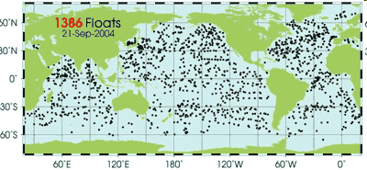
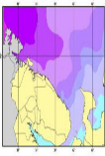
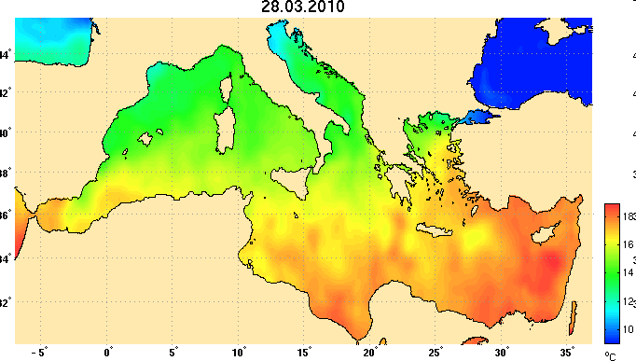
Objectives
International Oceanographic Data and Information Exchange (IODE)
IODE facilitates the exchange of oceanographic data and information between participating Member States, and serves the needs of users for data and information products.
IODE Ocean Data Portal (ODP)
Facilitate and promote the exchange and dissemination of marine data and services;
Provide the seamless access to marine data to NODCs across the IODE network through the discovery, evaluation and access to data via web based services;
Identify and recommend standards to provide interoperability with IODE data centres to allow shared use of metadata, data and products.
Notes:
As many of you may know, The International Oceanographic Data and Information Exchange (IODE) was established by in 1961. It strives to enhance marine research, exploitation, and development through exchange of data and information between member states. Supports a variety of programs including standards development, technology, data access, capacity building (education). Adheres to the IOC data policy – Free and open access to data and information
(click)
IODE Ocean Data Portal is one of the IODE projects, formally established in 2007 and started its operation in 2009.
The major underlying principles of the IODE Ocean Data Portal are Interoperability, Non-intervention and Free access to data and services.
In 2013, a resolution was passed that will result in all member states of the IODE to enable access to data through the ODP, so the ODP is now considered as an IODE platform for data share and exchange.

Slide 3
History of IODE ODP
2007 – Start of JCOMM End-to-End Data Management Pilot Project
2009 – Start of IODE Ocean Data Portal project (ODP V1)
2013 – Opening of Partnership Centre for IODE ODP (ODP V2)

Slide 4
Benefits of the IODE ODP
The ODP provides benefits to both data providers and data users:
Benefits for data providers
Scalable environment to support the capacity of the data provider’s environment
Supported technology for data discovery, evaluation, and access
Standards (discovery metadata, vocabularies, code lists)
Improved interoperability with other major marine data systems
Access to advice and support from a team engaged with relevant technical and data management expertise within the global community
Benefits for data users
One-stop shop for data and web services (discover, access, download)
Increased visibility for one’s research data
Increased visibility of the researcher within the marine domain (Ocean Experts)
4
Standards
Notes:
The role of the ODP is to simplify the process of making data openly available to the marine community through the delivery of supported technical solutions (software), support for data providers, and training.
Following benefits can be considered from the data providers prospective while sharing data and information through the IODE ODP:
Scalable environment to support the capacity of the data provider’s environment
It Promotes defacto standards
Is Engaged with other IODE data systems
Supported technology for data discovery, evaluation, and access
Improved visibility of data and geospatial web services
Improved interoperability with other major marine data systems
Operational assistance and support from the technical point of view
(click)
The benefits for data and information users (I am broadening those also meaning products and services) includes:
One-stop shop for data and web services
Increased visibility for one’s research data
Increased visibility of the researcher within the marine domain (Ocean Experts)
(click)
But one of the major benefits for both sides, even sometimes invisible for them, is that The ODP adopts and support major standards from ISO and the Open Geospatial Consortium (OGC) in order to maximize the interoperability between the ODP and other major data systems. By doing this, ODP can provide access to data from many major platforms within a single portal.

Slide 5
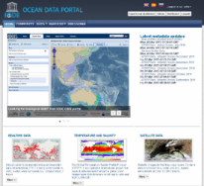
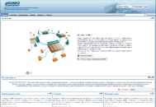
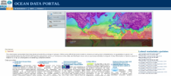
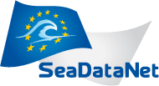
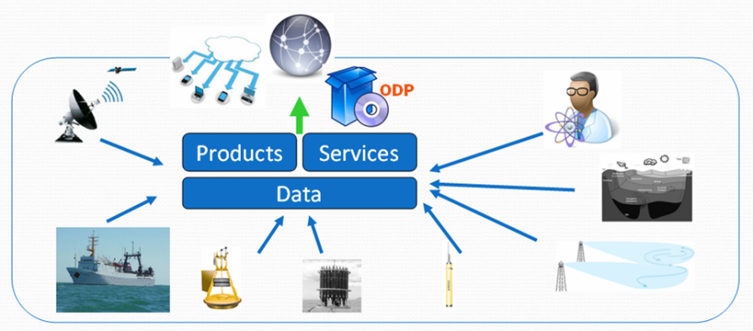
ODP components
ODP TOOLKIT
ODP PORTAL
INTEROPERABILITY PACKAGE
TECHNICAL AND TRAINING SUPPORT
DATA AND INFORMATION
5
Notes:
The inhomogenity of data sources, data storage types and formats and it's integration in most cases will be separated on individual issues to deal with. Not in case of IODE ODP. ODP is delivering tools to connect and describe such data and information, provide capabilities to discover it, present and download. So called ODP toolkit is developed to handle these functions and far more beyond them.
One the major components within OPD is an interoperability package called to provide interoperability arrangements, as well as means and tools for system to system conversation. Such components are becoming very critical to reduce or even avoid duplication of efforts when required data and information already exists and provided by some programme, project or initiative.

Slide 6
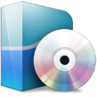
ODP components
The ODP is comprised of 3 major classes:
ODP Toolkit
Interoperability
package
Technical and
Educational
Support
Integration
Discovery
Access
Download
Dissemination
Control
Standardization
Scalability
……
Metadata “crosswalk” rules
Discovery metadata
services
Machine-to-machine
Interfaces
Partnership Centre for ODP –
support and maintenance
IODE Ocean Teacher courses
(online materials,
video courses, etc.)
Notes:
The ODP is comprised of 3 major components:
ODP toolkit – plug-and-pay base back-office software stack supports the deployment of ODP nodes via virtual machine packages maintained by the ODP Partnership Centre. It also includes Portal - web portal component that may be extended and stylized to support node requirements.
Interoperability package – specialized interoperability arrangements developed between ODP and other major systems such as SDN, WMO, EMODNet
Technical and Training Support - In parallel with the physical infrastructure components, the Partnership Centre for the ODP provides development/technical support and training support through the IODE Ocean Teacher Academy.

Slide 7
ODP Toolkit
Global node
Security
Management
Monitoring
Regional node
Service Bus
Portal
Presentation
Portlets
National node
GIS server
Data Cache
Integration,
delivery,
exchange
Integration Server
Data Provider

Slide 8
ODP Toolkit – Service model
queries
consumers
Discovery
interfaces
results
orders
ODP network of data providers
Delivery
Services
FTP
Email
HTTP
push
Data
services
SOAP
HTTP
REST
CSW
FTP
pull
OGC WxS

Slide 9
ODP framework tech features
Implemented
Metadata-driven and event-based system
Metadata always corresponds to actual data (temporal, spatial, vertical extents)
Use or common vocabularies (BODC, ISO, WMO, etc.)
Data source availability and connectivity check on routine basis
netCDF as data transport
Support for JSON, ASCII (CSV, TSV), XML, geoRSS formats
Support for data push - FTP, Email, SOAP, data pull - HTTP REST, SOAP
On-fly OGC WxS service publication from data
Enterprise service bus
Web GUI for all components
Components packed as virtual machines
High-availability cluster model
Fully open-source and LGPL middleware

Slide 10
ODP framework tech features
Planned
SPARQL endpoints
OWL, RDF support
In-memory data grid services
Federated search services
Embedded integration with ERDDAP
Embedded integration with brokering services

Slide 11
ODP Interoperability Package
Metadata compatibility
Format to format conversion
Crosswalk mapping rules (including code lists, keywords, etc.)
Data access regulations
Agreed types of access and use constraints
Agreed list of data sets to be shared & exchanges
Service interaction layer
Portal to portal
Machine-t0-machine

Slide 12
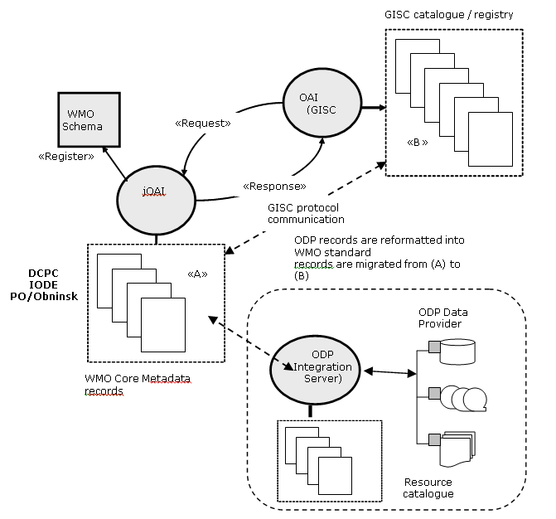
ODP Interoperability Package
Each ODP node is capable “out of the box”
provide WMO Core Metadata 1.3 (along with the basic ISO 19139 metadata) – both export and import of metadata
supports metadata & data integrity check
provide OAI-PMH protocol
supports push and pull data access
provide 24h cache capabilities
support WMO file naming convention
ODP node can operate as DCPC

Slide 13
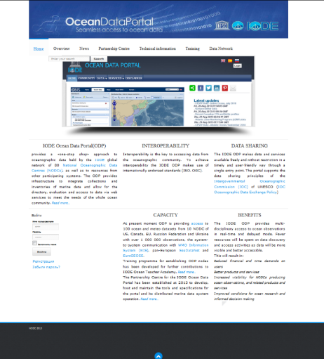
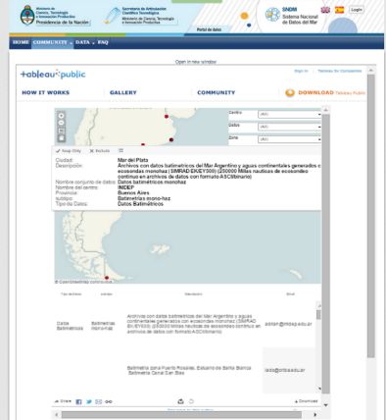
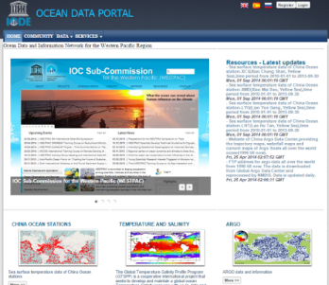
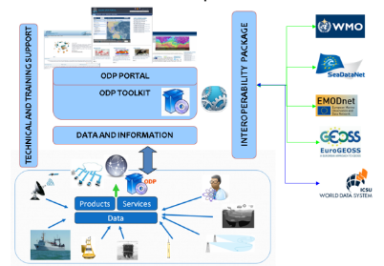
IODE ODP project progress
Following nodes have been established
IODE ODP Global node (RIHMI-WDC)
IODE ODINWESTPAC Regional node (NMDIS, China)
IODE ODINAFRICA Regional node (KMFRI, Kenya)
IODE Regional/national node of Sistema Nacional Datos del Mar (SNDM, Argentina)
16 data providers from Russia, Argentina, Kenya, Canada, USA and other countries providing access to more than 500 data sets.
IODE ODP contributes EC Horizon2020 Ocean Data Interoperability Platform project by providing access to harmonized data and information from EU, USA and Australia (http://www.oceandataportal.net/portal/portal/odp2/interoperability).
In 2016 Russian segment of GOOS has been created based on IODE ODP http://www.oceandataportal.net/portal/portal/goos/data
IODE ODP is registered as JCOMM DCPC in WIS database

Slide 14
International Oceanographic Data and Information Exchange (IODE): http://www.iode.org
Ocean Data Portal Web Site: http://www.oceandataportal.org
Ocean Data Portal Global Portal: http://www.oceandataportal.net
14
Notes:
You are very much welcome to visit some links presented on this slide.

