Slide 1
Promoting WIS implementation in RA I
Rabia Merrouchi
Agenda item number 3
Task Team on Evolution of WIS
TT-eWIS2017
21-23 November 2017, Geneva

Slide 2
Efforts deployed
Capacity building:
Several Training workshops were organized for French and English speaking countries of RA I
RA-I WIS related Workshop
October 2015, Casablanca (GISC Casablanca)
November 2015, Nairobi (GISC Casablanca and Pretoria)
January 2017, Pretoria (GISC Pretoria)
June 2017, Toulouse France (GISC-Toulouse, RA VI)
RA-I Sub-Regional Workshop for WIGOS and WIS Implementation
Harare, June 2013
Casablanca, November 2013
Abidjan, November 2013
Brazzaville, May 2014
Arucha, June 2014

Slide 3
Efforts deployed
Outreach Activities:
WIS web page
WIS promoting materials (flyers and posters)
Documentation
Public Access to WIS documentation and regulatory materials
(WIS presentations, WIS WIKI, WIS Manual and Guide)

Slide 4
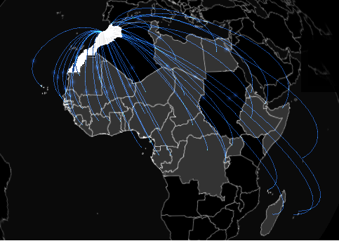
RA I WIS Registered WIS centers AoR of GISC - CASABLANCA
Data Collection or Production Center:
RCC: ACMAD + Casablanca
RTH: Dakar, Niamey, Cairo, Congo
RTC: Cairo+ Agrhymet (Niamey)
RSMC: Dakkar, La Reunion, Cairo, ACMAD
RMIC/RIC: RIC Morocco, RIC Egypt
ASECNA: Aviation center
National Centers
38 countries

Slide 5
RA I WIS Registered WIS centers GISC - CASABLANCA
Data Collection or Production Center:
0 DCPC submitted to ET-CAC
National Centers
38 NC approved by Cg/EC
Messages received by the helpdesk of GISC Casablanca: 0
Only 58 users registered in GISC Casablanca, most of them during WIS training workshops

Slide 6
RA I WIS Registered WIS centers GISC - CASABLANCA
Weaknesses:
Late involvement of NMS Morocco in WIS matters (letter of willingness in 2010 but real involvement since July 2013);
GISC Casablanca has been quite slow to be operational (from July 2013 to February 2017);
Lack of 100% dedicated resources for GISC Casablanca;
Great number of NCs and DCPCs linked to GISC Casablanca for which it will be necessary to put in place appropriate mechanisms of communication;

Slide 7
RA I WIS Registered WIS centers GISC - CASABLANCA
Strengths:
Back up with GISC of Toulouse (agreement to be signed in December);
Part of the RMDCN network;
Young and trained staff for the GISC of Casablanca;
New AMSS supporting secure protocols;
Dedicated redundant physical solution for the WIS,
GISC Casablanca took part to all ET-WISC and TT-GISC meetings and Teleconfs since 2013;
GISC Casablanca is responding favorably to any request from NCs and DCPCs under his AoR;
Effective contribution to WMO capacity development activities in WIS matters;
Good interaction with GISCs of Toulouse, Offenbach and Tokyo

Slide 8
RA I WIS Registered WIS centers DCPCs and NCs
Weaknesses:
Lack of awareness of the role of the WIS and of its technical specifications (in contradiction with the national commitment within WIS) : WHY?
Confusion between technical benefit and other benefits favoring a migratory flow towards GISCs of developed countries: WHY? (political constraints)
Most of DCPCs were defined at an early stage of WIS implementation;
Difficulties to define the appropriate metadata (WHAT?);
(exp: metadata for RIC or for RTC????.... From CIMO perspectives RIC and RMIC should not apply as WIS DCPCs) ;
Weak involvement of WIS national focal points (WHO?);
NC metadata limited to those prepared for the GTS

Slide 9
Promoting WIS implementation in RA I
Data access and sharing
Metadata Generation
Telecom Infrastructure

Slide 10
Promoting WIS implementation in RA I
Metadata generation :
Promoting the use of the Excel2wis tool as recommended by CBS 16;
(official letter is under signature + reference to WIS WIKI documentation for METADATA generation and to Openwis GitHub web page)
Preparing metadata templates based on common products and services provided by regional centers (RTH, RCC, RSMC, RMCC, NWP…);
(template to be prepared based on metadata generated by similar Regional center in developed countries already approved as DCPCs)
GISC Casablanca is willing to conduct pilot project for its NWP and RCC DCPCs (support from GISC Toulouse will be highly appreciated);
(specific scripts to modify static records such as: focal point, geographical localization, identity of the origin….etc)
List of WIS focal points to be updated and published in the WIS web page

Slide 11
Promoting WIS implementation in RA I
DATA Access and Sharing:
Promoting Machine2Machine data exchange trough our AMSS and in the near future trough WMO Cloud,
Promoting the use of specialized web portals for open data access:
Marine services for west African countries
Numerical weather products for North and west Africa
Promoting the use of GISC Casablanca Openwis interface;

Slide 12
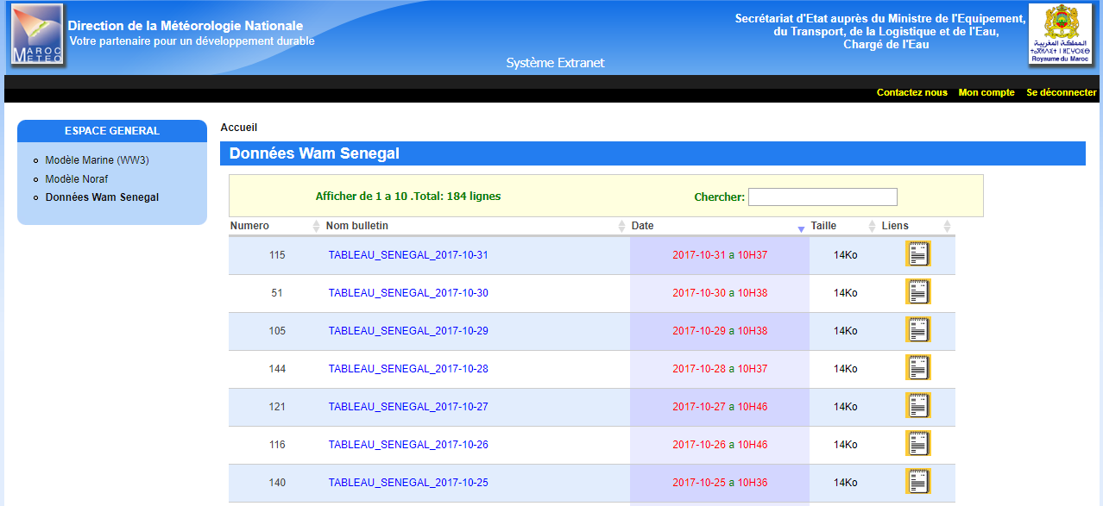
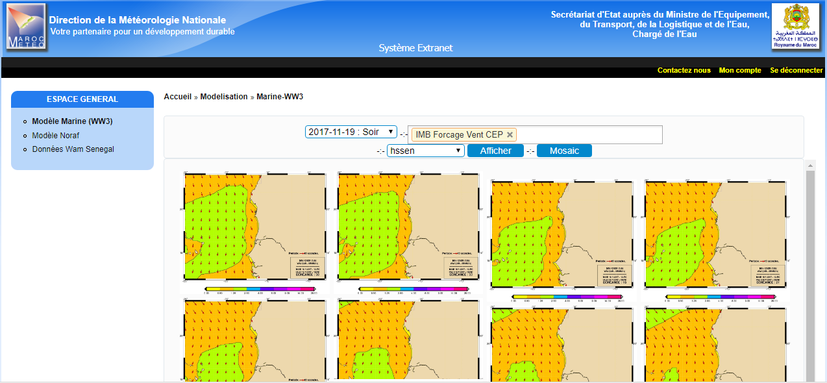
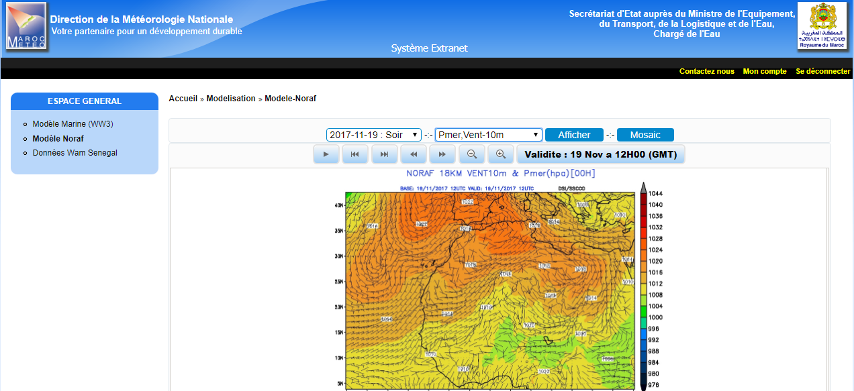

Slide 13
Promoting WIS implementation in RA I
Telecommunication Infrastructure:
Encouraging data exchange between countries members of the RMDCN (exp: Algeria and Tunisia)
Promoting VPN internet connection: guidance from WMO,
Promoting Open GTS projects for Africa (JCOMM experience),
Promoting establishment of dedicated cloud in Africa…

Slide 14
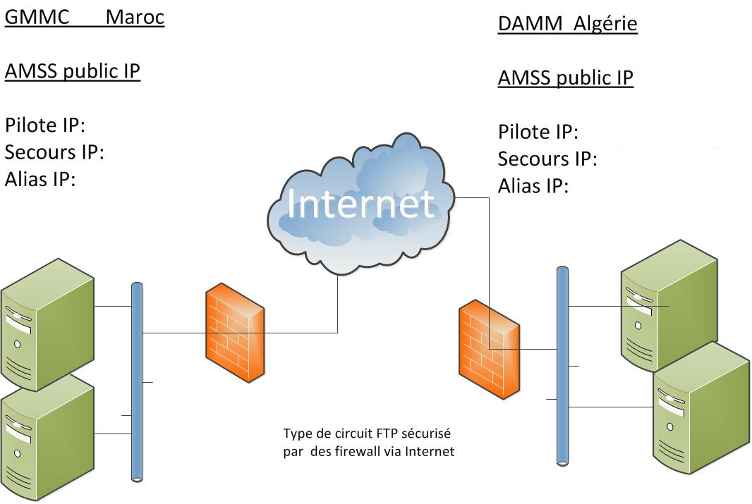
Promoting WIS implementation in RA I
Telecommunication Infrastructure:

Slide 15
Promoting WIS implementation in RA I
Telecommunication Infrastructure:

Slide 16
Thank you
Merci

