Slide 1
Ocean Data and Information System
Tobias Spears
Agenda item number XXX
Task Team on Evolution of WIS
TT-eWIS2017
21-23 November 2017, Geneva

Slide 2
A bit of context

Slide 3
The Marine community
Marine data networks (e.g. GOOS)
National Oceanographic Data Centres
Associate Data Units
Individual centres
Marine services (e.g. Argo)
Industry and academic partners
The community continues to grow…

Slide 4
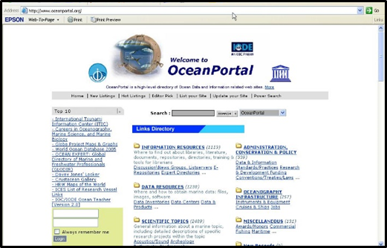
What do we want?
A universal data and information system which
  at a minimum, provides discovery and access capabilities
  Ideally, provides a level of integrated access to data and information
In short, we want the internet to do what we thought it would do 10 years ago
IODE OceanPortal Closed in 2009
  Labour intensive to maintain inventory of sites
  Thought that search engines would solve the problem
Notes:
The IODE OceanPortal was the most frequently visited page on the IODE web site ~10 years ago.

Slide 5
How far have we come - a quick example
Data exchange - FTP, SFTP, HTTP, HTTPS, OAI-PMH, OGC and other web services, RSS and other feeds, REST, OpenSearch, SPARQL, SRU, linked data, SOS
Metadata - text (standardized and non-standardized), XML (standardized and non-standardized), HTML, RDF/OWL, HTML Microdata, JSON (standardized and non-standardized)
Metadata standards - Dublin Core, DIF, FGDC, ISO (various profiles), Darwin Core, Schema.org (standardized)
Catalogue service – OGC CSW, OpenSearch, proprietary APIs, search engine provider, standalone lists, or non-existent
Semantics - standalone vocabularies (managed and unmanaged), vocabulary services (managed and unmanaged), ** faceting **, ** Machine Learning - Semantic and other enrichment (e.g. NLP, recommenders, …)**
PIDs - Many (people, organizations, DOI, pURLs)
Notes:
Blue = ~10 - 15+ years ago
Green = ~10+ years ago + now
Purple = Now + additional capabilities
Red = what we reduced

Slide 6
Key trends
Legacy practices continue to persist
Moving to more web-centric approaches
Continue to add more sophistication – more solutions to the same problem
Attempting to introduce simplicity by enforcing complexity (e.g. one size fits all solutions)
Not respecting the capability maturity of participants (usually the data and information producers, or the technical teams tasked with connecting them with the global community)

Slide 7
The result
Limited buy-in - why work with you when I can participate in a competing effort more easily?
Limited participation due barriers on many levels
Non-conformity to 'agreed upon' standards
Non-conformity to 'agreed upon' service levels
Not attain the global view

Slide 8
Ocean data and information system

Slide 9
Ocean Data and Information System (ODIS)
A team of external auditors was engaged by UNESCO in 2016 to undertake an audit of aspects of Intergovernmental Oceanographic Commission (IOC) operations, including Information exchange system and marine data management
There is no common database for all marine sciences, which is certainly un attainable when one considers the amount, complexity and heterogeneity of the information to be assembled, but there is also no common portal for all marine sciences that connects all websites and relevant disciplines through web links. IOC could submit a draft resolution calling for Member States to work together to construct a universal information system and ocean data portal.
Recommendation No. 15 from the audit. The External Auditor recommends that a draft resolution be submitted to the IOC Assembly calling for Member States to work together, with the support of IOC, to construct a universal information system and ocean data portal, along with a cost-benefit analysis prepared in advance by the IODE project.

Slide 10
Concept paper
Concept paper was developed in response to the audit and presented at IODE XXIV, focusing initially on data and information discovery and access
Outlined some of the technical and other key barriers which limit any attempt to implement a system such as the one recommended in the report
Elaborated on observations from the audit and some of the associated root causes
Described the support required to address the issues and recommendations from the audit
Presented a conceptual model that could progress towards a unified marine data and information system
Notes:
https://www.iode.org/components/com_oe/oe.php?task=download&id=34002&version=1.0&lang=1&format=2

Slide 11
Highlight - barriers to participation
Disparities in representation
Disparities in technical capabilities and knowledge
Disparities in technical environment/capacity
Disparities in human capacity
The last three bullets can be linked to latest status updates from regional updates to ET-WISC – November 2017

Slide 12
In order to progress
Conceptual model considered key aspects to
  Portal implementation
  Metadata brokering and mediation
  Data brokering and access
  Data assembly, submission and provider support
  Supported by standards and best practices

Slide 13
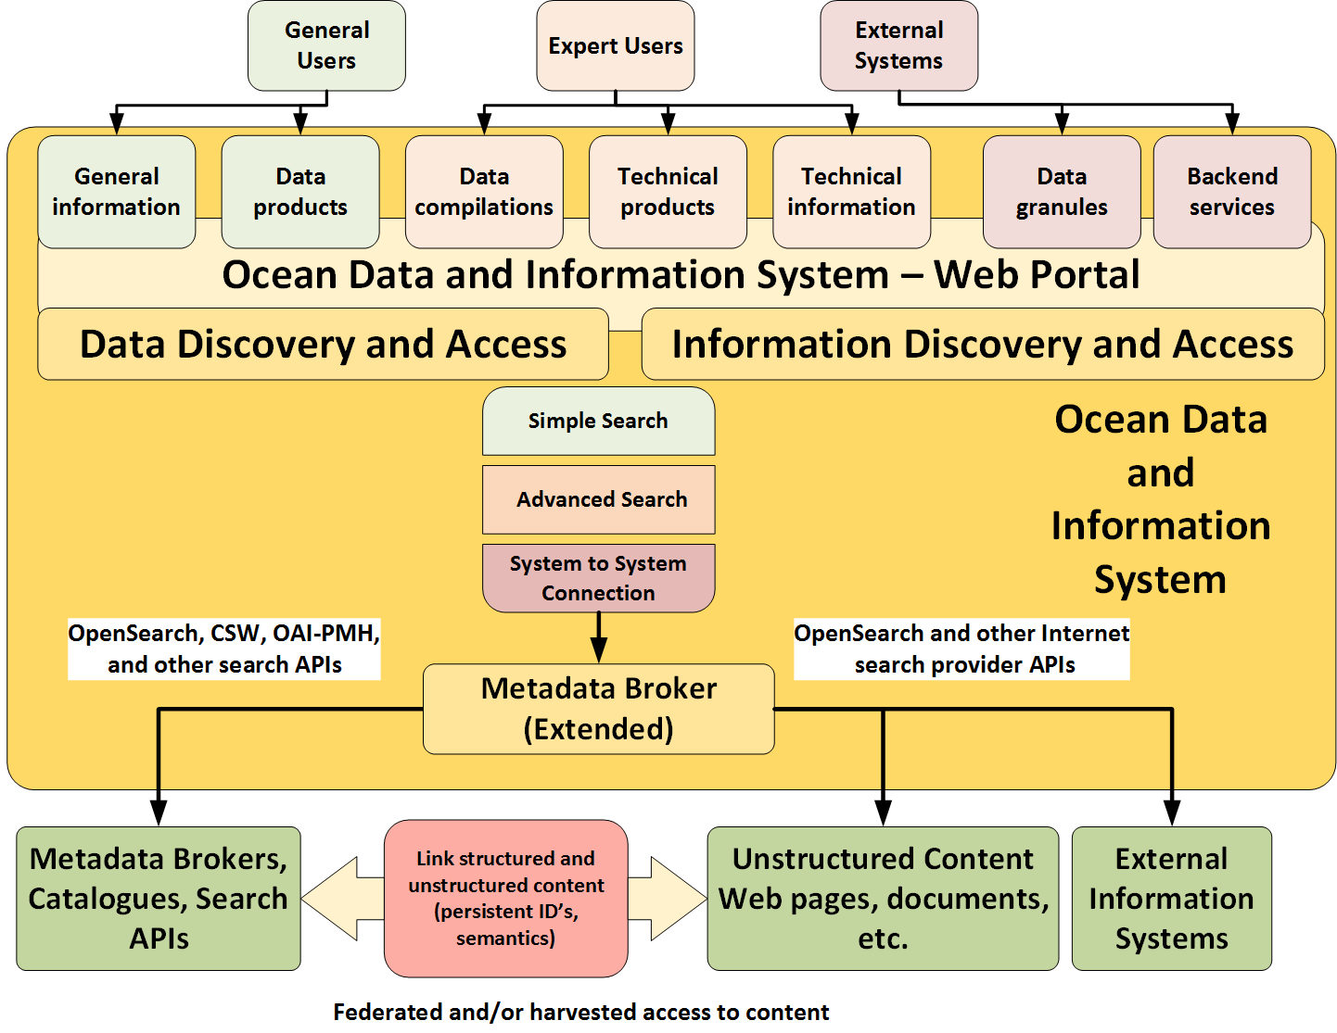
ODIS – System Perspective
Inclusive user community – not just the experts…
Recognizes the potential for user focused (data, information, products) and system focused (services, APIs, …) outputs from an inclusive federation tier.
Recommended a federated approach to data and information
Recognized the need for support across content standards and protocols
Recognized the need for standards and best practices at multiple levels.
Need to integrate heterogeneous content crossing domains, content standards, and interfaces…
Consistent with the vision for the Web…
Notes:
Key points:
Group acknowledged that a global discovery portal would provide high value to users
Solutions for federating search/access to metadata and information continue to develop and should be pursued as baseline capabilities, but that integration of data is not at a state to consider
The Ocean Data and Information System is put forward as an activity to support the marine community and respond to IOC, but it is not expected that IODE would develop this – advanced and resourced stakeholders working in this space should be engaged to implement ODIS

Slide 14
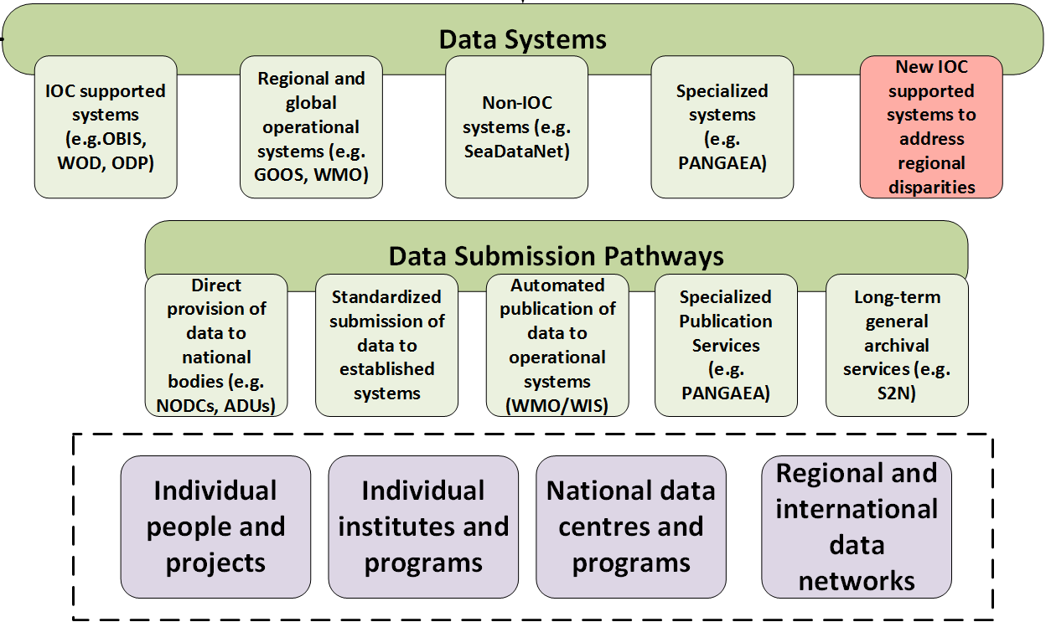
ODIS – Contributor perspective
Recognized the need to work with individual centre/system providers and aggregators
Recognized the need to work within and outside the IOC community
Recognized the data is being exchanged through multiple channels, ranging from manual submission through automated processed.
Recognized the need to submit small (individuals) and large (full data networks) data producers
Recognized the need for standards and best practices at multiple levels.
Notes:
Key points:
Work to engage with partners within and outside the IOC to promote and support the publication of data and information in open and interoperable forms
Work with communities within and outside the IOC to develop/promote/adopt standards and best practices which ultimately supports the exposure of data and information within the ODIS
Work with IOC and non-IOC partners to address barriers to participation

Slide 15
Results of IODE XXIV (March 2017)
Decides that IODE will work with existing stakeholders, linked and not linked to the IOC, to improve the accessibility and interoperability of existing data and information, and to contribute to the development of a global ocean data and information system, to be referred to as the IOC Ocean Data and Information System, leveraging established solutions where possible
Decides further to establish an inter-sessional working group to develop a follow-up concept paper for the Ocean Data and Information System, with the Terms of Reference attached in Annex A to this Decision. (ToR included in notes for this slide)
The end goal is to establish the Ocean Data and Information System such that it is inclusive and is implemented to support stakeholders at all levels.
Notes:
ToR For Working Group
The IWG-ODIS will:
Prepare a brief introductory document summarising the Ocean Data and Information System Concept Paper (IOC/IODE-XXIV/6.2.1, 19 March 2017), including general proposal of benefits and impacts, for the 29th session of the IOC Assembly in June 2017;
Identify and recommend a strategy to move towards the implementation of a universal marine data and information system in response to the 2016 external audit of the IOC and its activities;
Further develop the concept paper to construct a universal information system and data portal, to be known initially as the IOC Ocean Data and Information System (ODIS), based on the Ocean Data and Information System Concept Paper (IOC/IODE-XXIV/6.2.1, 19 March 2017) and feedback from the 29th Session of the IOC Assembly;
Liaise and collaborate with other IOC programmes and with JCOMM, to ensure ODIS is inclusive and supports stakeholders at all levels;
Develop a cost-benefit analysis for ODIS to determine potential infrastructure, development, implementation, and maintenance costs;
Define the scope of ODIS in areas such as content coverage, system coverage and search, access, and visualization capabilities;
Finalize and submit the Concept Paper for consideration and approval by IODE-XXV.

Slide 16
Connections to wmo

Slide 17
Inter-Programme Expert Team for Integrated Marine Meteorological and Oceanographic Services within WMO and IOC Information Systems (IPET-MOIS)
Decides to continue work started by TT-MOWIS though a dedicated expert team – IPET-MOIS, who can take charge of all technical aspects related to the registration within WIS of marine candidate centres,
Recommends that the new IPET-MOIS work closely with the IODE Intersessional Working Group for the Ocean Data and Information System (IODE IWG for ODIS) to leverage the success of the WIS operating model;
Recommends that IPET-MOIS and IODE IWG for ODIS work closely with CBS on the implementation and further development of WIS
Requests the co-presidents of JCOMM to coordinate with the CBS president to strengthen the collaboration and benefit between integrating marine meteorology and oceanographic information into WIS.
Notes:
Decision paper for JCOMM 5:
Recalling the approval by the JCOMM Management Committee at its thirteenth session (2017), of the Guidance Document and recommendation for candidate WIS NCs to be created,
Recalling also the decision of the JCOMM Management Committee at its thirteenth session (2017), that the work should be continued through a dedicated Expert Team who can take charge of all technical aspects related to the registration within WIS of marine candidate centres,
Having been informed that CBS-16 (2016) welcomed the initiative of JCOMM to nominate experts that could take part in the CBS-WIS expert teams,
Decides to establish the Inter-Programme Expert Team for Integrated Marine Meteorological and Oceanographic Services within WMO and IOC Information Systems (IPET-MOIS) under the Data Management Programme Area, with the Terms of Reference provided in draft Resolution 12.2/3 (JCOMM-5);
Recommends that the new IPET-MOIS work closely with the IODE Intersessional Working Group for the Ocean Data and Information System (IODE IWG for ODIS) to leverage the success of the WIS operating model;
Recommends further, these teams (IPET-MOIS and IODE IWG for ODIS) to work closely with CBS on the implementation and further development of WIS, in order to ensure greater interoperability of operational marine meteorological data and services.
Requests the co-presidents of JCOMM to coordinate with the CBS president to strengthen the collaboration and benefit between integrating marine meteorology and oceanographic information into WIS.

Slide 18
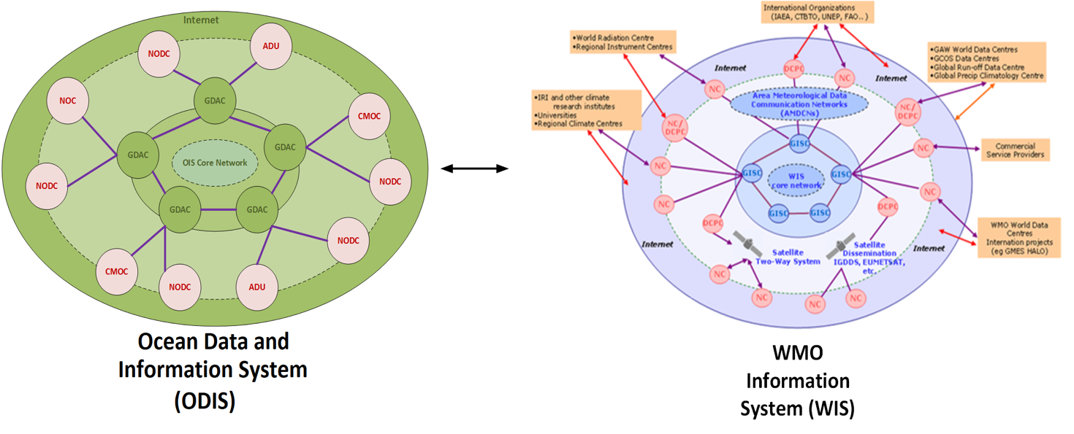
Marine and WMO network structures
Marine centres will form part of the WIS network, the WIS network will form part of the global marine network…
IPET-MOIS
Notes:
CMOC = Centres for Marine Meteorological and Oceanographic Climate
Key marine players include government, academia, and industry stakeholders:
Global centres such as ARGO buoy program, Biological and Chemical Oceanography Data Management Office (BCO DMO), Copernicus Marine Environment Monitoring Service , …
Regional/thematic programs such as GOOS Regional Alliances
National centres such as National Oceanographic Data Centres (NODC) and Associate Data Units (ADU)

Slide 19
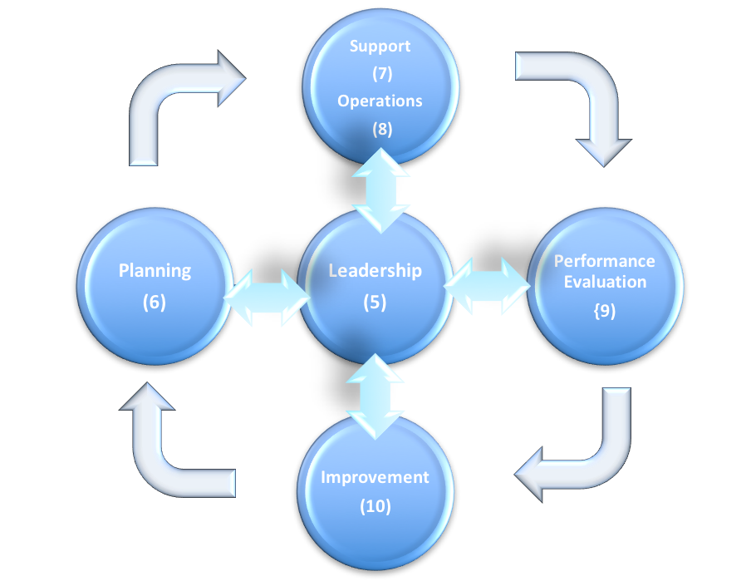
Expert Team for WIS Centre Audits and Certification (ET-CAC)
ET-CAC previously focused on WIS centres -ET-CAC owned the audit framework, specification, and results – auditors were WIS centre domain experts
ET-CAC now supporting any centre/service – no longer required to be the domain experts
ET-CAC now owns/maintains the audit framework (not domain specific) and the centre/service being audited (domain experts) owns the specification, results
ET-CAC to provide guidance to system and process owners in developing audit specification and application of risk based assessment framework
ET-CAC to coordinate/schedule audits and to undertake audits with domain experts
Under the new ToR, ET-CAC is well positioned to support certification of marine centres to be integrated into WIS.
Notes:
Proposed ToRs for ET-CAC
Develop and maintain an audit framework for the assessment of WMO Centres based on the WMO provisions for Quality Management (WMO-No. 49, Part VII) and ISO 9001:2015 - the WMO Framework for Audit and Evaluation of International Operational Facilities
Provide guidance to system and process owners regarding the specification of assessment criteria based on a risk-based approach for inclusion within the audit framework
Coordinate and schedule audits of operational centres in response to instructions from CBS, other relevant WMO bodies and other cooperating international organizations
In collaboration with nominated subject matter experts, conduct audits of operational centres, in accordance with the audit framework.
Review audit activities to identify opportunities for improvement in audit procedures and their implementation, reporting to OPAG-ISS.

Slide 20
Where to go from here

Slide 21
Embrace complementary efforts – some examples
Technology - GeoNetwork, pycsw, CKAN, ERDDAP, ODP, GEOSS Common Infrastructure (CAT, DAB), GeoServer/ArcGIS Server, …
Systems - GEOSS, GOOS, SeaDataNet/Cloud, …
Standards - WMO Core, Harmonized North American Profile of ISO 19115, Darwin Core, ...
Best Practices – ISO, OGC, W3C, others

Slide 22
Conclusions
Consider the users and the providers
Break down barriers to participation – be inclusive, collaborate
Variety is a reality
Ensure data is well managed through the data lifecycle
Know your requirements and service levels

Slide 23

Thank you
Merci

