Slide 1
Update on IPET-CM activities
Inter-Programme Expert Team on Codes Maintenance
ICT-ISS
30 April 2019

Slide 2
Outcome of 2018 meeting
GRIB2/BUFR4/CCT proposals
Development of the next edition of GRIB
Refinements of proposals submitted to CBS-16
Developments of new functionalities
Development of the next edition of BUFR
Review of requirements
BUFR Edition 4 will continue to be used for MTDCF
Collaboration with the Inter-Programme Expert Team on Operational Weather Radar (IPET-OWR)

Slide 3
Outcome of 2019 meeting
GRIB2/BUFR4/CCT proposals
Development of the next edition of BUFR
Requirement of ISO 19156 compliance
Explore the possibility of using the new edition of GRIB for the universal data representation
Produce data samples to investigate the possibility
Support of CF Conventions in WMO Programmes
The team supports the initiative of having a workshop to decide the governance needed for future WMO CF profile.

Slide 4
Outcome of 2019 meeting
Development of Reporting Practices
Involvement of all WMO Programmes
Part of WMO’s regulatory materials
The Team will play a coordination role in establishing a mechanism for all WMO Programmes to develop and maintain documentation of Reporting Practices.
This item should be covered by the Terms of Reference of a new team.
Compliance to Technical Regulations
Regional Representatives on migration to TDCF have been designated by all Regional Associations.
The Team continues to support Members in this area including migration to TDCF

Slide 5
Manual on Codes
Fast-track 2018-1 (2 May 2018)
Adoption between CBS sessions 2018 (7 November 2018)
Pre-operational (23 August 2018)
Fast-track 2018-2 (7 November 2018)
Fast-track 2019-1 (15 May 2019: waiting for implementation)
Adoption between CBS sessions 2019 (6 November 2019: waiting for implementation)
* Since 2018, Category of Amendments is indicated for each proposal on a trial basis to help people who approve the proposals understand the range and level of impacts of Manual amendments.

Slide 6
Toward WIS 2.0
Maintain alignments of strategy for development of a new edition of GRIB and BUFR in the context of WIS 2.0 to achieve required interoperability in data formats.

Slide 7
Impact of Constituent Body Reform
Fast track procedure 2020-1 and Adoption between CBS sessions 2020 for amending the Manual on Codes can be affected by the Reform.
Consolidation of proposals by the Team: end of 2019
Approval process: beginning of 2020
Implementation: May (FT2020-1) and November 2020
Amendments proposed by the Team needs to be approved by the ICT-ISS Chair and the CBS President.

Slide 8
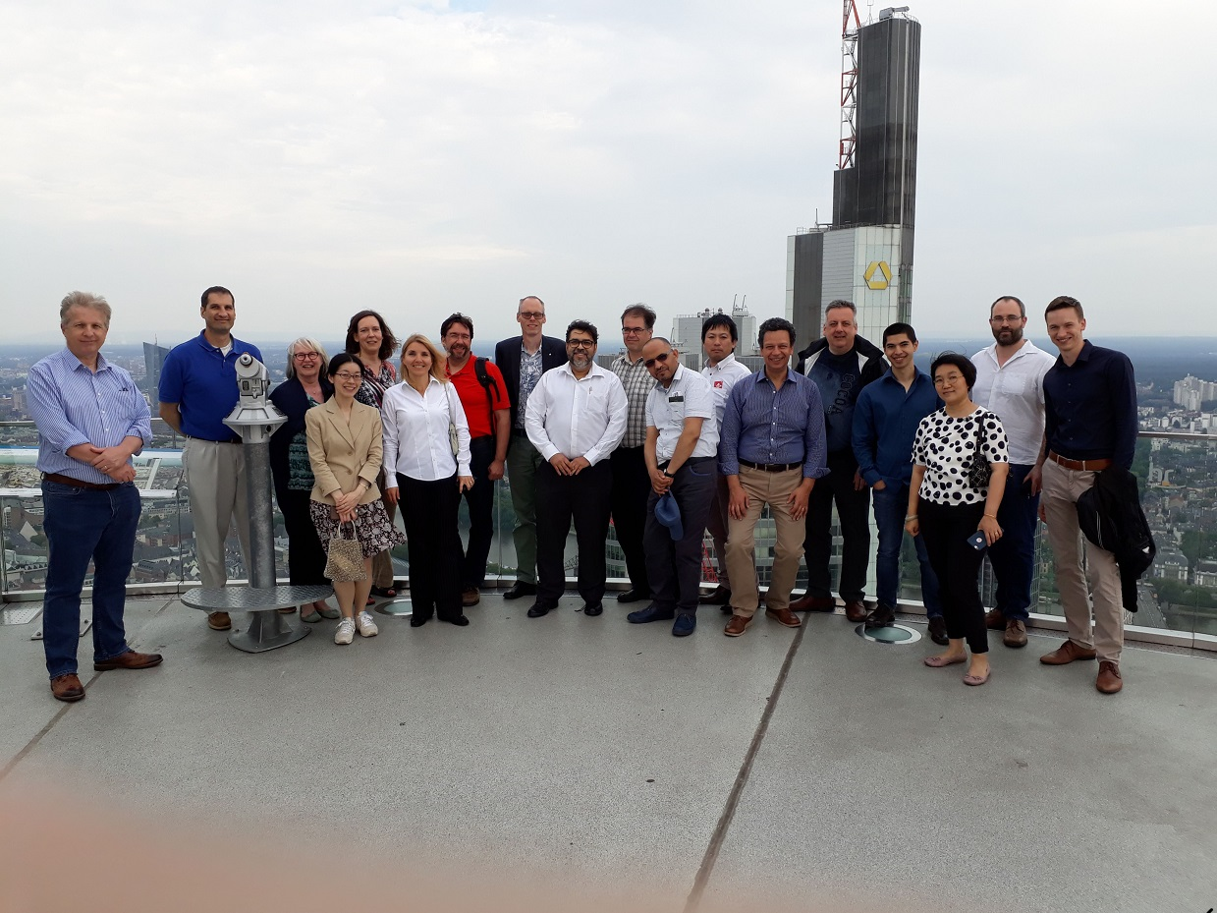
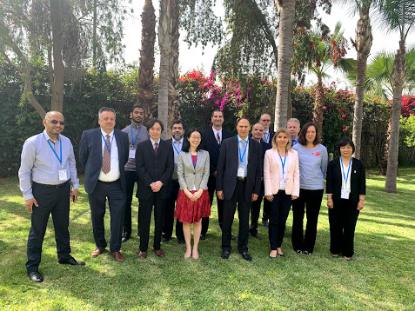
The 3rd Meeting in Marrakech, May 15-19, 2019, by the kind host of Maroc Météo
The 2nd Meeting in Offenbach, May 28 – June 1, 2018, by the kind host of DWD

Slide 9
Thank you
Merci

