Slide 1
TT-GISC report
CBS-16 period

Slide 2
TT-GISC Structure and membership
Re-established under the ET-WISC (in 2016)
TT-GISC ToR and Work Plan was updated
Membership
1 Chair
24 members (including a rep. from all GISCs)
Sub-groups
Launched 8 Work packages to address following key issues
Part-C, User-Interface, User-Federation, GISC-Committee, Metadata-Consistency, WIS-Monitoring, Capacity-Develop and Tech-Reg-Updating

Slide 3
TT-GISC Status (1)
Statement
All 15 GISCs stated “operational”
GISC-GISC connectivity (as of Sep. 2018)
“1” GISC Offenbach connected to all 14 GISCs (100%)
“7” GISCs connected to 8-13 GISCs (57-93%)
Remaining “7” GISCs connected to 2-7 GISCs (14-50%)
GISC – GISC backup status
“6” GISCs are in operational
“7” GISCs are under negotiating and developing
“1” GISC is not yet

Slide 4
TT-GISC Status (2)
Meetings
TT-GISC-2017 13-17 Nov., Geneva (joint with WISC/CTS)
TT-GISC-2018 18-20 Sep., Casablanca, Morocco
Plan: TT-GISC-2019 26-29 Aug., Offenbach, Germany
Metadata sync
There are inconsistency between GISCs
Testing a solution to avoid inconsistency
Capacity development activities (2016-2018)
9 GISCs provided training opportunities for their area of responsibility
There were three types of workshop
Workshop held at GISC
On-site training
Remote online training

Slide 5
Achievements
Drafted recommendations (amendment of No.1060 and 1061) to be approved by Cg-18
GISC Watch
Started from 1st May 2018 according to the fortnight roster and using issue ticketing system with support from GISC Brasilia. All GISC are well attending.
GISC Beijing and Tokyo started providing WIS common dashboard (WCD) on an operational basis
Started supporting Upper-Air BUFR issues with using the GISC ticketing system
Established GISC Operation page to share operational guidance/status/procedures
Established Training Aids page to share training materials and activities

Slide 6
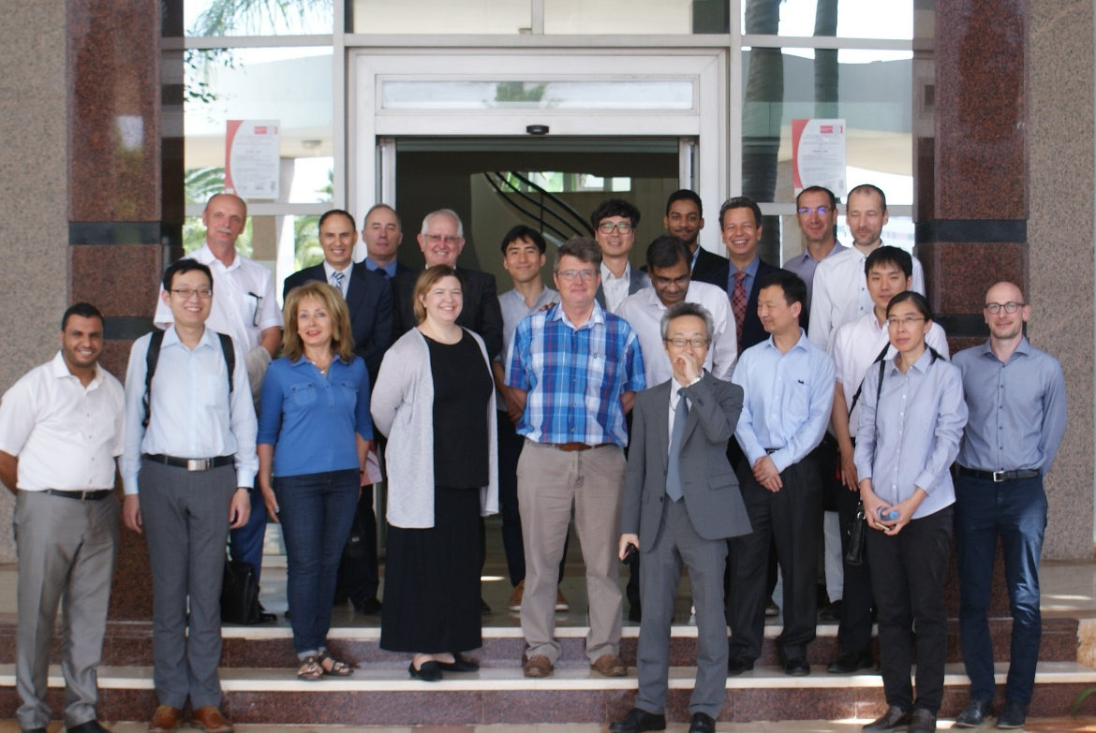
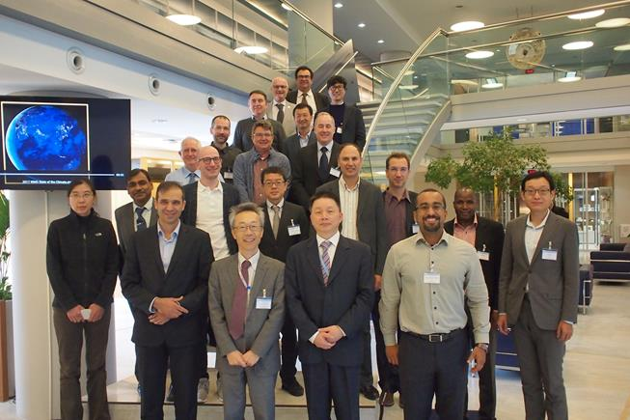
Thank you for your attention
TT-GISC-2018, Casablanca
TT-GISC-2017, Geneva

Slide 7
GISC backup matrix
Operational
Planned (under developing)
Negotiating
To be confirmed(one-side info.)
As of TT-GISC 2018
GISC (2?)
Exeter
GISC (2)
Moscow
GISC (2)
Beijing
GISC (3)
Tokyo
GISC (3?)
Offenbach
GISC (2)
Seoul
GISC (3)
Toulouse
GISC (?)
Jeddah
GISC (1)
Casablanca
GISC (1?)
Tehran
GISC(2?)
Pretoria
GISC (1)
New Delhi
GISC (1)
Washington
GISC (2)
Brasilia
GISC (3)
Melbourne
Back

Slide 8
Training activities for their AoR
As of Sep. 2018
 | 2016 | 2017 | 2018 |  | (Plan) 2019
Beijing | OST(2) | WS | OST(2)
Brasilia
Casablanca |  |  | ROT and WS |  | plan WS
Exeter |  | JWS with LFPW | JWS with LFPW
Jeddah
Melbourne
Moscow |  | ROT | ROT |  | plan ROT
New Delhi |  |  |  |  | plan WS
Offenbach | OST(2) | OST | OST(2) |  | plan WS
Pretoria |  | WS
Seoul | WS | ROT and WS | WS |  | plan WS
Teheran
Tokyo | WS | OST(2) | OST(3) |  | plan WS
Toulouse |  | JWS with EGRR | JWS with EGGR |  | plan ROT
Washington |  |  |  |  | plan WS
WS : Workshop
JWS : Joint Workshop
OST : On-Site Training
ROT : Remote Online Training
Source: GISC status reports
Back

Slide 9
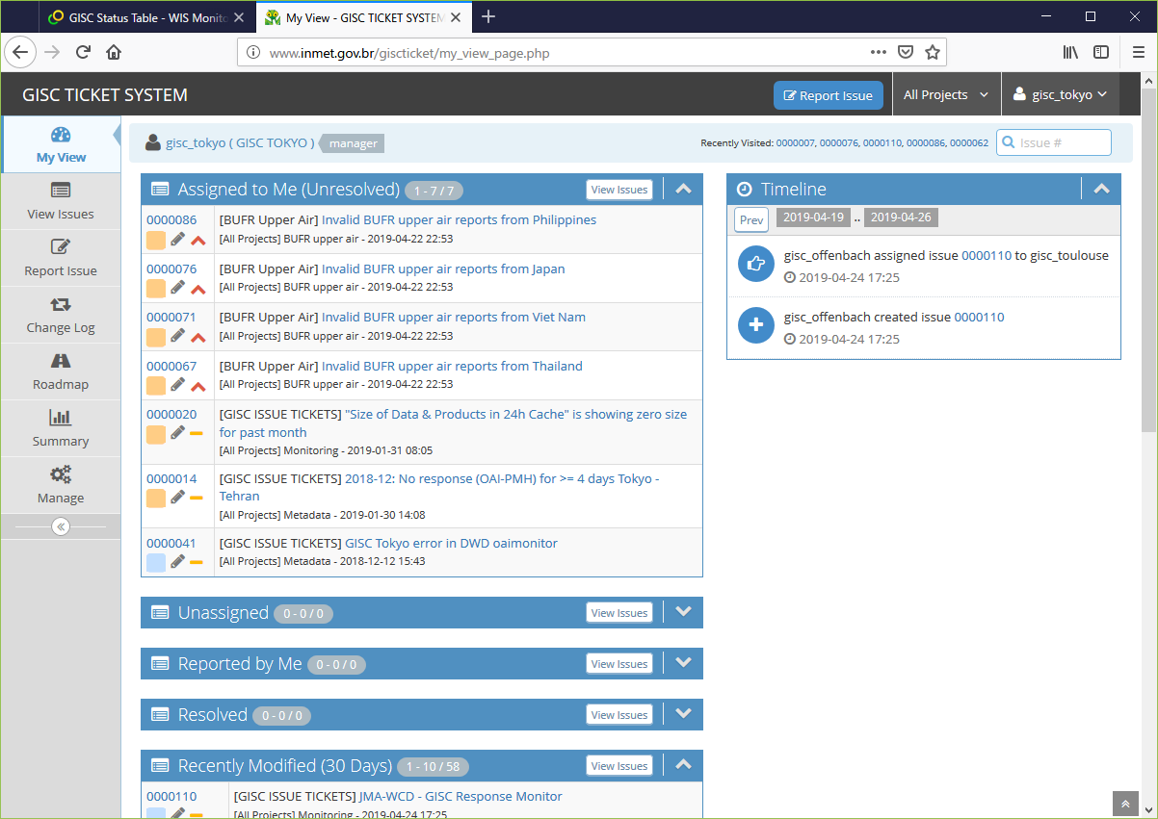
GISC Ticketing System (Mantis)
http://www.inmet.gov.br/giscticket/login_page.php
Back

