Slide 1
ICT-ISS 2019
Report from Task Team on evolution of WIS (TT-eWIS)
April 2019

Slide 2
Highlights 2018-2019
CBS TECO 2018: WIS 2.0 Implementation Approach [Inf 5(1)]
TT-eWIS-2018 (Beijing, 14-16 November) [meeting report]
CBS Consultation 2018: WIS 2.0 Implementation Approach (revised) [Doc 2(3) (EN)] – ‘demonstration project’ information incomplete (Annex III) << update required
WMO Bulletin [article, pp12-16] Data Sharing for Sustainable Development: WIS 2.0
WMO Future Technology Workshop (Geneva, 19-21 March) [meeting report]
Annex 4 to item 6.2 (Cg-18): statement from the WMO Future Technology Workshop [see Annex A of the meeting report]
Cg-18: seeking endorsement of WIS 2.0 approach & delegation of final approval to EC

Slide 3
WIS 2.0
Data sharing infrastructure for all of WMO
2019
2020
2021
2022
2023
2024
Approach endorsed by Cg
Final approval by EC
Experimental implementation
Technical regulation approved
Initial operating capability
Notes:
WIS 2.0 is our response to these drivers.
It builds on the first generation of the WMO Information System – and the Global Telecommunication System before that,
WIS 2.0 reaffirms the original intent of WIS: to open up access to environmental data and products.
WIS 2.0 is an evolution rather than a revolution: the roles of WIS Centres and the majority of current WIS functions are largely unchanged.
It will provide users with improved discovery of, and seamless access to, diverse authoritative information from a wide range of sources.
Intended to support international data sharing, the technologies of WIS2.0 are equally applicable in the national context
… there will not be any regulation driving national adoption
… instead we expect to see consolidation of national and international approaches over time
… as Members recognise the widespread applicability of these approaches
… noting that many Members have already adopted the WIS 2.0 technologies in their national context

Slide 4
“
WIS 2.0: Prioritizes use of public telecoms networks.”
UN SDG 9.c: affordable, universal Internet access by 2020
Increased choice for connection for telecommunications infrastructure; locally available technology options; lower costs; impact of 5G network rollout?
Work with GISC to consider network reliability, security and availability within AMDCN – particularly for safety-critical applications
Notes:
Adoption of Internet enables people to make the best local choice for a connection – leveraging technology that is often commonly available and well understood
…
In many locations, Internet is reliable enough for safety critical applications – provided applications are built to be fault tolerant; may need to combine with [high-performance] managed networks to ensure quality of service (QoS)
GISCs operate Area Meteorological Data Communications Network (AMDCN) considering reliability, security, and availability – high-performance managed networks may be necessary
Software Defined Wide-Area Networks (SD-WAN) enable Internet and managed networks to be used together to provide reliable connectivity at reasonable cost

Slide 5
“
WIS 2.0: Adopts Web technologies ...”
Use the Web to share data …
“the World’s most successful distributed information system” (W3C)
Industry practices
Royalty free, open standards
Improved data discovery with search engines
Notes:
The core change for WIS 2.0 is use the Web to share data and information.
According to the World Wide Web Consortium (W3C) “the Web is the World’s most successful distributed information system.”
With Web technology at its core, WIS 2.0 will use widely adopted open standards and leverage industry best practices.
… Firstly, this will allow the global user community to conveniently discover, access and use authoritative weather, water and climate information.
… Secondly, it will be simpler for NMHSs to partner with others to deliver services to end-users due to sharing the same base technology.

Slide 6
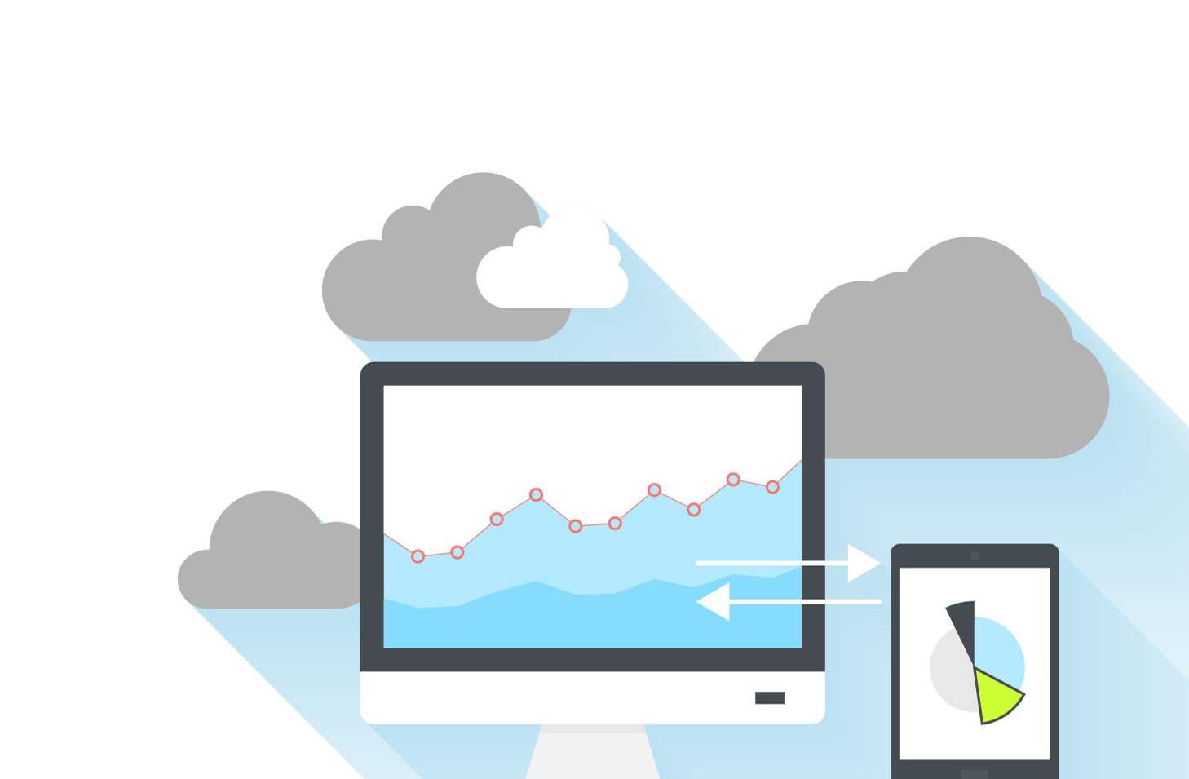
“
WIS 2.0: uses Web services for publishing data”
Data is published via Web services – Web applications that allow computer programmes to access or interact with that data …
Access control and security are built-in to Web technology
0101001010100101001010111110101001010001010100101001010100101000001010101010001010010010101001010
010010101011101010101010001010111010111110101001001010010100101000101010110100110101010000100100010
101011101001011101010100010100010100100100100100111111010010101010010100001010010101001000100010010
Notes:
WIS is no longer about pushing data around the network – it’s about exposing what you have using Web services
The WMO review of emerging data issues finds that Web services are one of the technologies that “present new operating concepts that will improve operational efficiency, information sharing and service delivery, and enable users to more effectively exploit data.” Is there a map of centres we can publish?
In WIS 2.0, participating centres will provide Web services that enable users to access and interact with data.
When designing their Web services, publishers should consider the capability of users to work with the data. Instead of expecting users to download entire datasets for local processing, WIS centres should provide Web services that allow users to download only the data or information they actually need; for example, extracting only the geographic subset of data of interest to the user.
Whereas the current WIS focused on operational data, the services which can be made available in WIS 2.0 also enable centres to share historical data and offer access to archives, where appropriate, to support the needs of all WMO programmes.
…
Providing data using the Web does not automatically mean that those resources are freely available to all without restrictions on use.
Access controls and security developed for on-line banking, eCommerce applications and many more
Web technologies allow for authentication and authorization where necessary: the provider retains control of who can access published resources and can require users to accept a license specifying the terms and conditions under which those resources can be used before allowing them access.

Slide 7
“
WIS 2.0: adds open standard message protocols to the GTS.”
1001010010010100101000101010
10101101110100101001010
1001010010010101110101101110100101001010
Real-time data sharing … Like ‘WhatsApp for weather’
1001010010101101110100101001010
Publish your data via a Web service
10010100100101010101010011010101110100101001010
1001110
Everyone who wants access can ask to subscribe
1001010010010101110101101110100101001010
Data streamed in real-time as soon as available
1001010010010101111101101001010
Notes:
WhatsApp: simple, secure, reliable messaging
“publish-subscribe” messaging protocols make it simpler to distribute to data in real-time to many consumers
Satellite-based data dissemination still needed where there is no Internet connectivity; e.g. GEONETCast

Slide 8
“
WIS 2.0: adds open standard message protocols to the GTS.”
1001010010010100101000101010
10101101110100101001010
1001010010010101110101101110100101001010
Global addressing means no need for routeing via intermediate centres
Direct exchange between provider and consumer
Faster transmission
Phase out routeing tables
1001010010101101110100101001010
10010100100101010101010011010101110100101001010
1001110
1001010010010101110101101110100101001010
1001010010010101111101101001010
Notes:
Routeing of messages is handled by the telecommunications network
No longer any need for Message Switching Systems to route messages via intermediate centres
Telecommunications network will find the optimum path from provider to consumer
Faster transmission because there is no latency introduced at intermediate nodes
Phasing out routeing tables will reduce configuration effort for NMHS

Slide 9
What about Big Data?
100101001001011110100101001010
What happens when data from other centres is too big to move?
> data volumes are getting bigger
WIS 2.0 encourages use of cloud technology to enable users to exploit big data …
Cloud-hosted data platforms provide processing capacity and ready-made tooling
Don’t download: use data in-situ
Notes:
Satellites, radars and numerical models are producing more data than ever before, yet WMO Congress concluded in 2015 that most Members are “ill-prepared” for this change. Storage, management and processing of so-called “big-data” requires expensive infrastructure.
Another challenge is that data volumes are becoming so large that it is impractical to download the data fast enough to meet operational requirements.
Data is becoming too big to move; the response is to move the processing to the data (a concept also know as "data gravity")
WIS 2.0 does not require the use of cloud;
… rather WIS 2.0 implementation will encourage WIS centres to adopt cloud technologies where it is appropriate to meet their users’ needs.
There will not be technical regulation saying “cloud must be used.”
Instead, we hope to see a gradual adoption of these technologies because it makes sense to do so.
Cloud platforms' provisioning of infrastructure and software as a service readily enables users to execute their data processing adjacent to the data
… downloading only the resulting products, or
… exposing complex, data-hungry computations through simple, easy to consume services
Data is processed on the data provider's infrastructure to create a product that is small enough to be conveniently downloaded and used
Data users no longer need to procure and maintain infrastructure for local processing.
Where data processing is complex, intensive or requires a lot of user-specific configuration, WIS centres should consider use of cloud technologies to underpin their services.

Slide 10
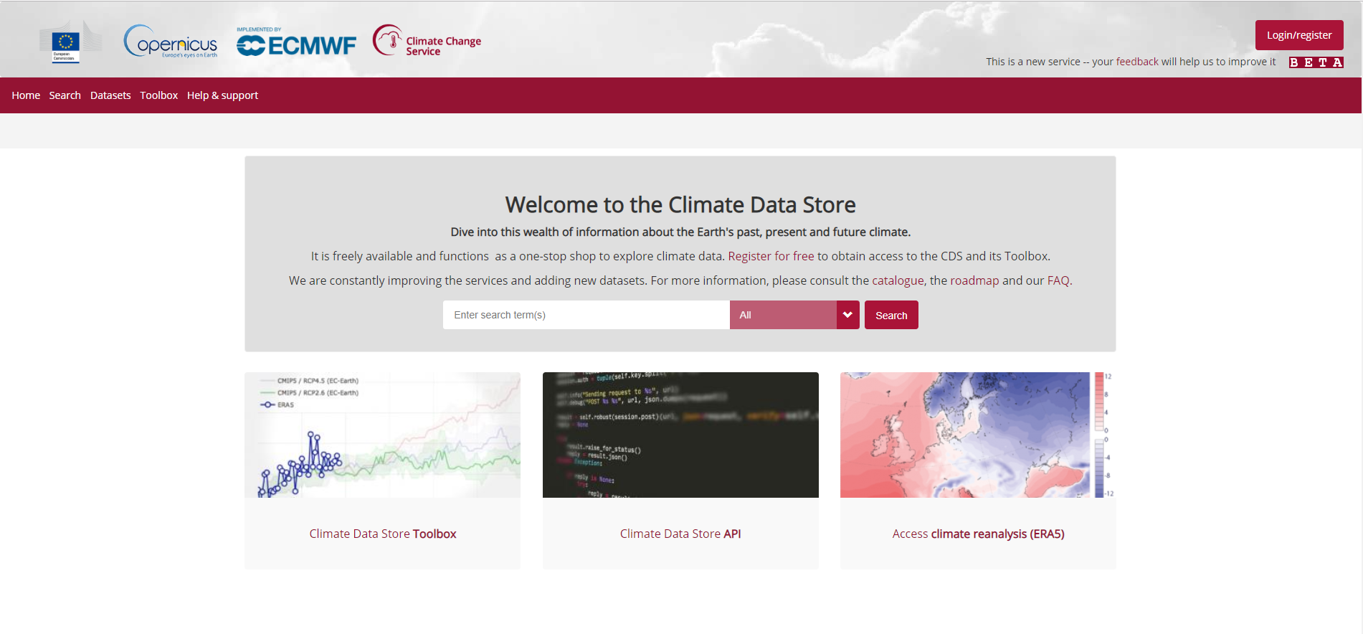
Example: Copernicus Climate Data Store (ECMWF)
source: https://cds.climate.copernicus.eu/#!/home
Notes:
Cloud technologies are still new to many Members.
… Best practices on use of cloud and details of successful cloud implementations will be shared among Members.
… Additionally, the proposed WIS 2.0 implementation programme aims to provide capacity building opportunities to support cloud adoption.
ECMWF’s Copernicus Climate Data Store https://cds.climate.copernicus.eu/#!/home provide cloud-hosted data platforms with processing capacity and ready-made tooling (a toolbox and APIs) that allows [authorised] users to work with the data in-situ without needing download it for local processing.
The CDS is designed to provide Web-based access to, and interaction with, petabytes of existing climate datasets: observations plus global and regional re-analyses and climate projections.
The CDS provides a “toolbox” that enables developers using a Web browser to write high-level python code to process CDS datasets and visualize the results, thereby creating specific applications that are delivered to end users as Web services.
… Crucially, this application code executes on a private cloud infrastructure with high-speed access to massive volumes of data, scaling elastically to meet users’ collective demands.
… Using the CDS, end-users can gain insight from climate data with minimal effort.
… The term “elastic” is important in reference to the cloud where applications can grow and shrink their infrastructure use in response to users’ collective demands.

Slide 11
WIS 2.0
Providing better access to more meteorological data –
Supporting delivery of better services to citizens and government

