Slide 1
Radio frequencies and space weather
David Jackson
SG-RFC Meeting, Geneva, 24-27 January 2017

Slide 2
Outline
Space weather phenomena and impacts
WMO observing requirements and RFs used for observations
  Ionosphere
  Solar / solar wind

Slide 3
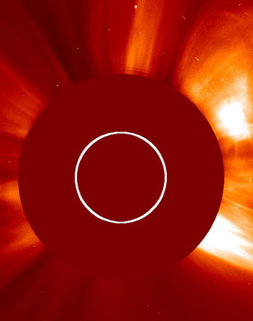
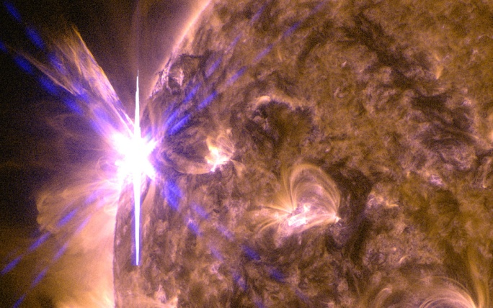
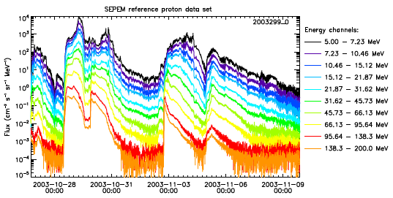
Types of space weather
GEOMAGNETIC STORMS
Mainly related to CMEs - huge explosions of magnetic field and plasma from the Sun. 1-4 days to reach Earth
CMEs impact beyond magnetopause. Southward Bz => stronger storms
SOLAR FLARES
Bursts of EM radiation reach Earth in 8 minutes
RADIATION STORMS
HE/LE electrons and solar protons associated with CMEs or flares (15 mins -1 day to reach Earth)
Notes:
WSA = Wang – Sheeley – Arge (WSA) WSA Enlil solar wind propagation model (eg Pizzo et al, 2011)

Slide 4
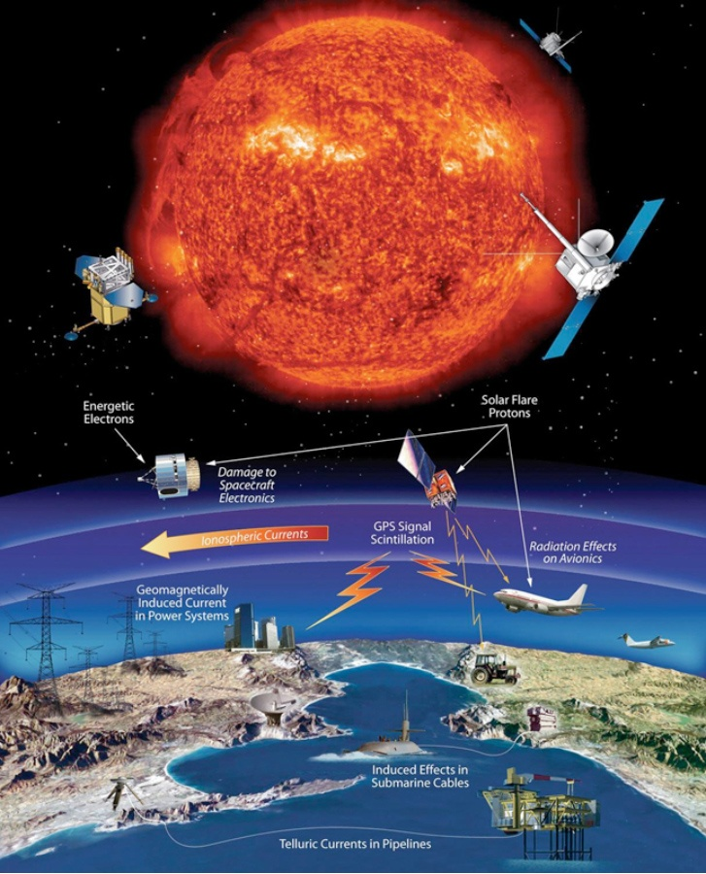
Space weather effects
Storm type | Travel time - Earth | Physical impact | Technological impact
Geo-magnetic | 18-96h | GICs Increased ionisation in ionosphere Heating in the thermosphere | Power grid outages, etc GPS, HF comms. Satellite and other hardware damage (eg surface charging) Satellite orbits (drag, collision risk)
Charged particle | 10mins – 1 day | Increased radiation levels Damage to sensitive electronics Increased ionisation in ionosphere | Radiation health hazard (astronauts, aircrew) Satellite heating and instrument noise, avionics, digital chips As above - HF comms out for up to few days in polar regions
Solar radiation | 8mins | HF radio signal interference Heating in the thermosphere | HF comms (~mins-hrs, sunlit side) As above

Slide 5
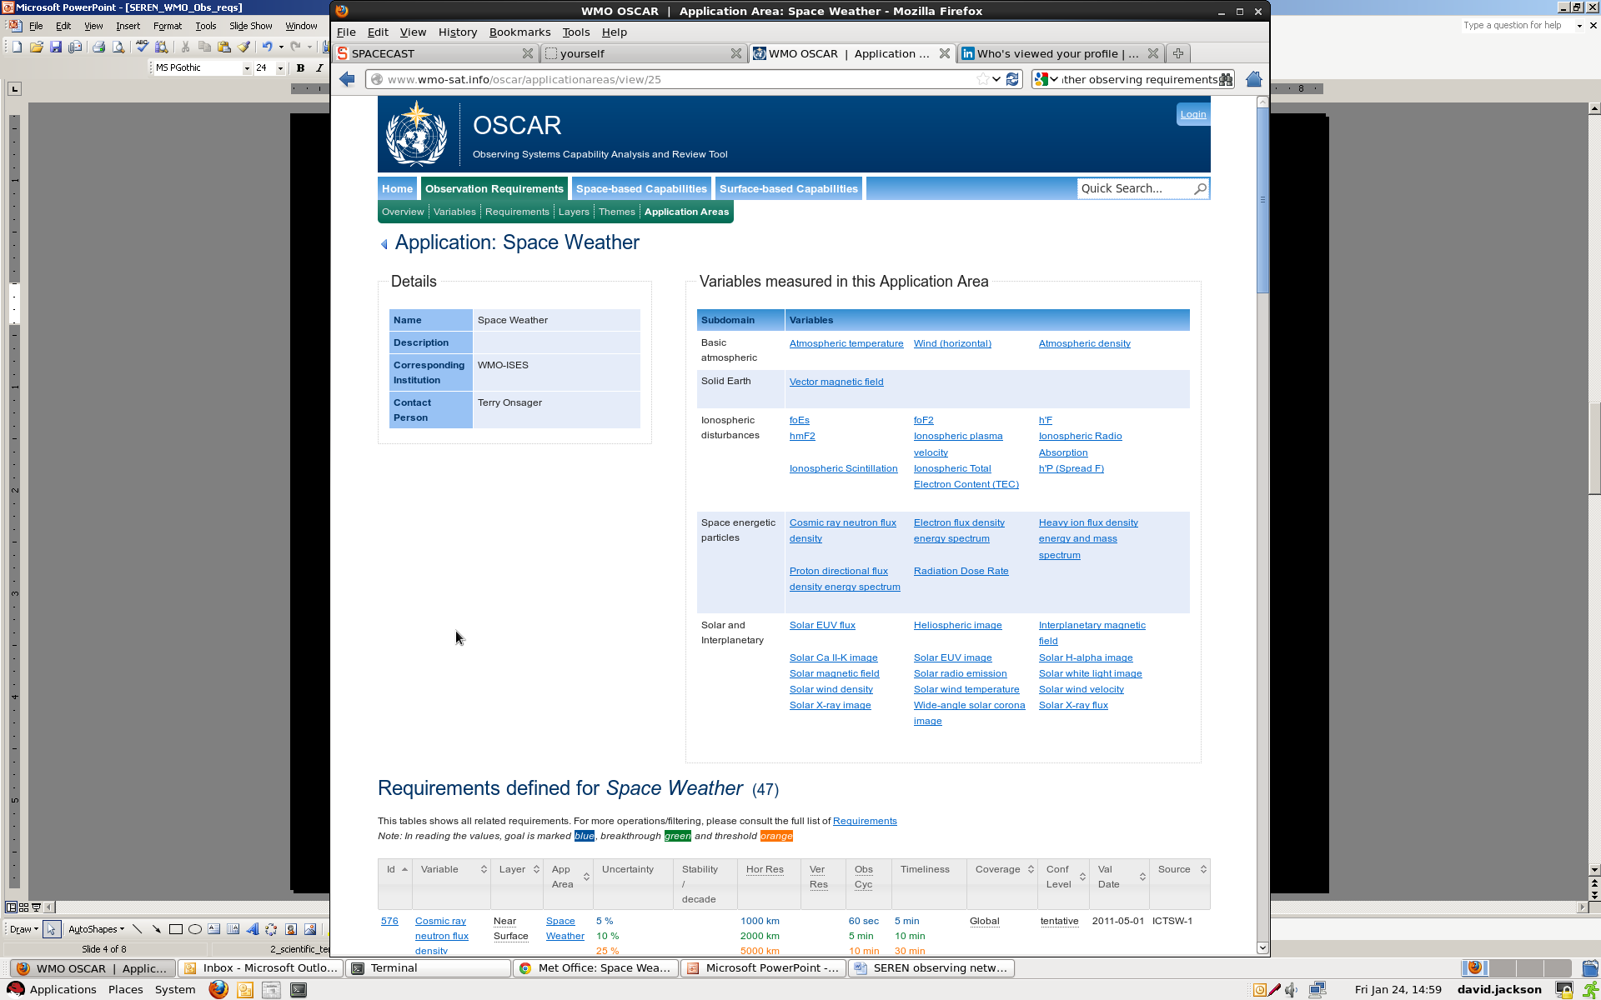
WMO Space Weather Observing Requirements
List of observations required for space weather operations – rolling requirements
Observations using RF typically in Ionosphere and Solar / solar wind subdomains
http://www.wmo-sat.info/oscar/applicationareas/view/25

Slide 6
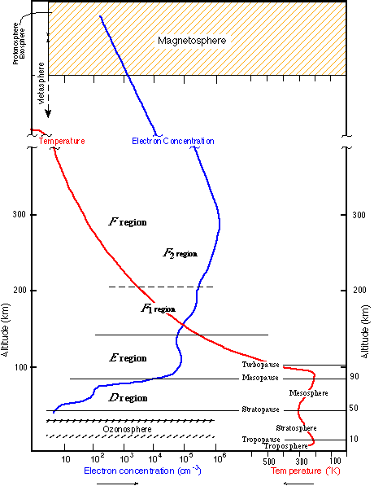
Ionosphere Observing Requirements
foEs, foF2, h’F, hmF2, Spread F – frequency / height of E, F2, bottom of F layer – ionosonde (active RF)
TEC (N_{e}) – GNSS (ground and RO) (passive RF)
Scintillation – GNSS (passive RF)
Absorption – often riometer (passive RF)
Plasma velocity – radar (active RF)
Radar also good for N_{e}, etc

Slide 7
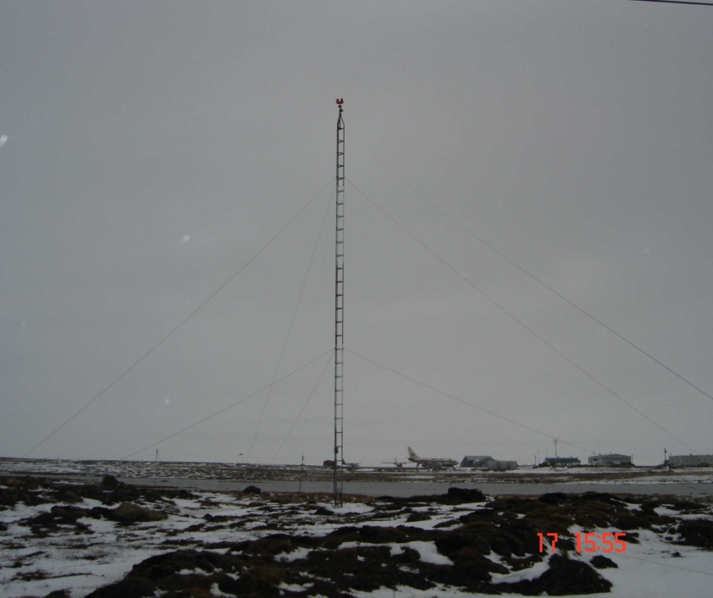
Active Ionospheric observations
Ionosondes
  Typically 1-30 MHz
  Ground-based stations worldwide (~70)
  Sounds out profile up to F region peak by sending EM waves in freq range towards the ionosphere. Echoes are detected by receiver near the transmitter.
  Virtual height estimated from time to receive the echo, electron density derived from reflected frequency.
Operational use
No radio emission within 1 km
No HV power line within 100 m

Slide 8
Active Ionospheric observations - Radar
SUPERDARN
  9-16 MHz, High latitudes
  Plasma velocity, gravity waves, etc
Incoherent scatter
  MHz: 200-240, 480-520, 910-950, 449-450, 430-450
  EISCAT(3D) – Fennoscandia; AMISR – Canada
  N_{e}, plasma velocity, etc
Potential Operational use
EISCAT_3D will have:
Peak power 5 MW
Ave power up to 1.25 MW
Notes:
Coherent scatter means that you can detect scattering from a medium with spatial variations – you can get constructive interference patterns at a scale down to half the radar wavelength.
Why EISCAT 3D – 3 stations in NO, SWE, FIN together will be used to make 3d observations using phased arrays – 10000 antennae at each site

Slide 9
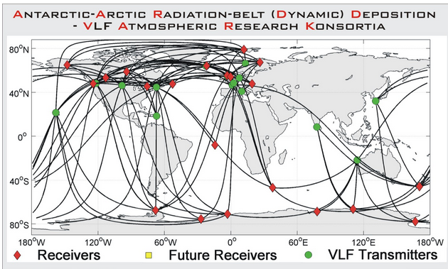
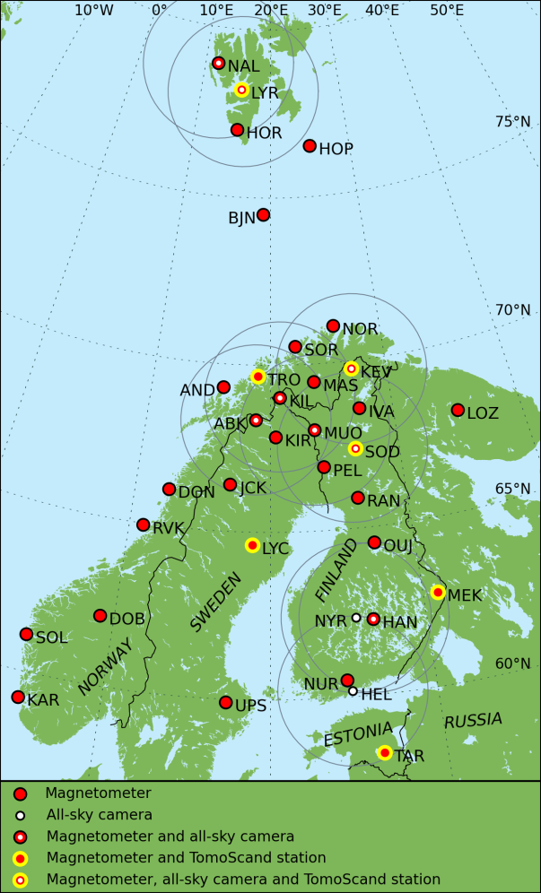
Active Ionospheric observations
AARDVARK network – VLF 13-30 kHz
  Trapped around 30-85km and received long distance from source – electron density/particle precipitation
Oblique Iono.sounders – 3-~100 MHz
  Australia, Korea(?)
  Bit like ionosonde but oblique view v
MIRACLE (140-160 MHz, 390-410 MHz)
  Tomography receivers using Beacon transmission from LEO satellites
  Northern Europe

Slide 10
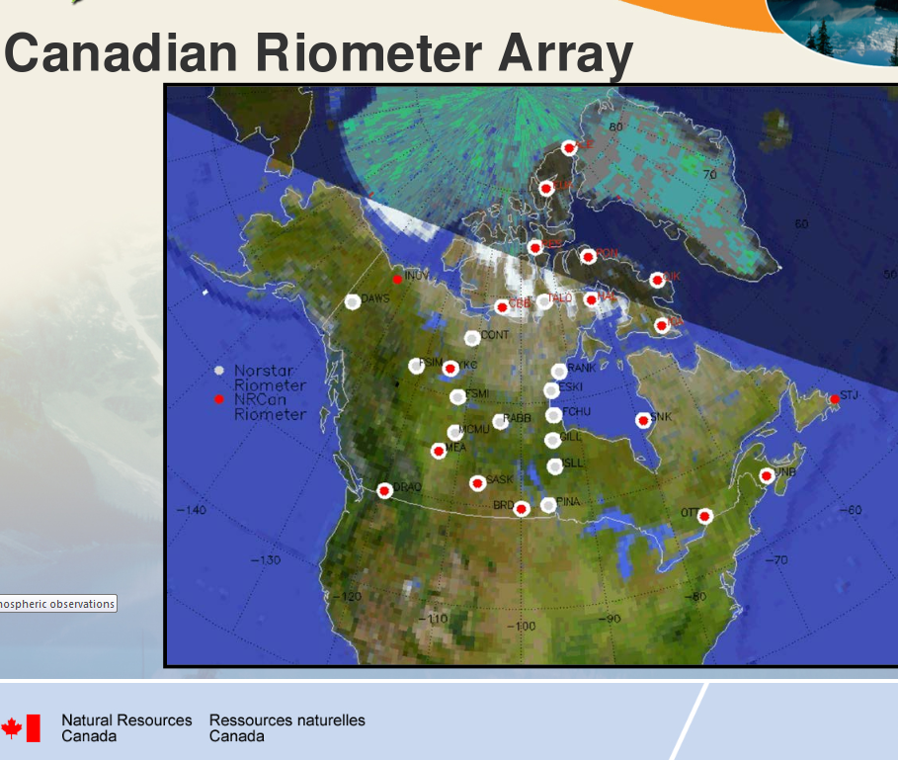
Passive Ionospheric observations
Riometers – 20-50 MHz (usually 30 or 38.2 MHz)
  Absorption (of HF) in D region (50-90km)
  High lats, US, Canada
Operational use

Slide 11
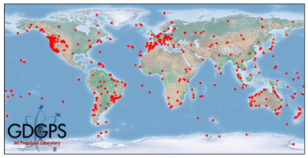
Passive Ionospheric observations
GNSS (typically 1.1-1.6 MHz)
  Electron density: Ground based (continents) & GNSS RO (eg COSMIC)
  Scintillation monitors (100x more frequent sampling
Operational use

Slide 12
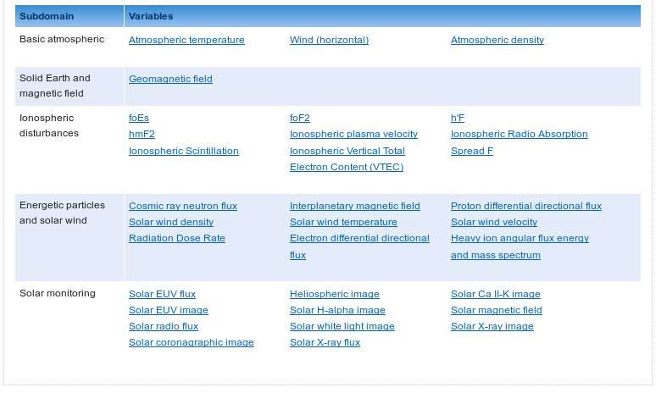
Solar / solar wind observations
Radio flux observations – solar phenomena and monitoring of solar variability
Radio telescopes – inference of solar wind velocity and density

Slide 13
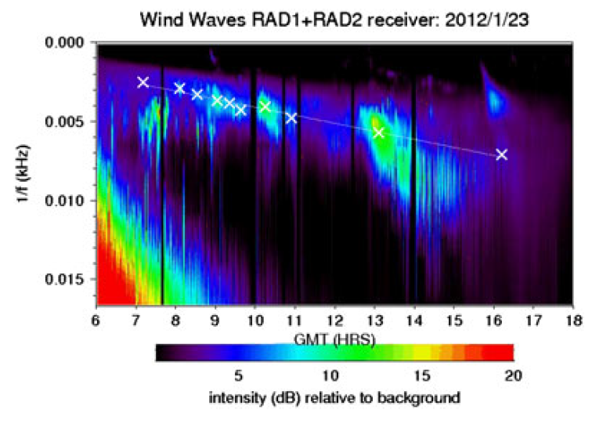
Solar Radio Bursts
Type | Description | Duration | Range | Notes
I | Noise storms | 1 burst ~ 1s; storms: hours-days | 80-200 MHz
II | Slow drift bursts | 3-30 min | 20-150 MHz | Flare and CME detection. CME shock wave speed from freq. drift.
III | Fast drift bursts | 1-3 s (or 1-5 mins for group, mins-hrs for storm) | 10kHz-1GHz | Impulsive phase of flare. Infer velocities in solar corona
IV | Broadband continuum | Moving: 30m-2h. Stationary: hrs-days | Moving: 20-400 MHz. Stationary: 20-2000 MHz | Moving emission corresponds roughly to CME speed
V | Continuum | 1-3 mins | 10-200 MHz | Follows some Type III SRBs – gradual decay phase of flare
Can be used to identify space weather phenomena
Also Types VI and VII – extension of types III and V

Slide 14
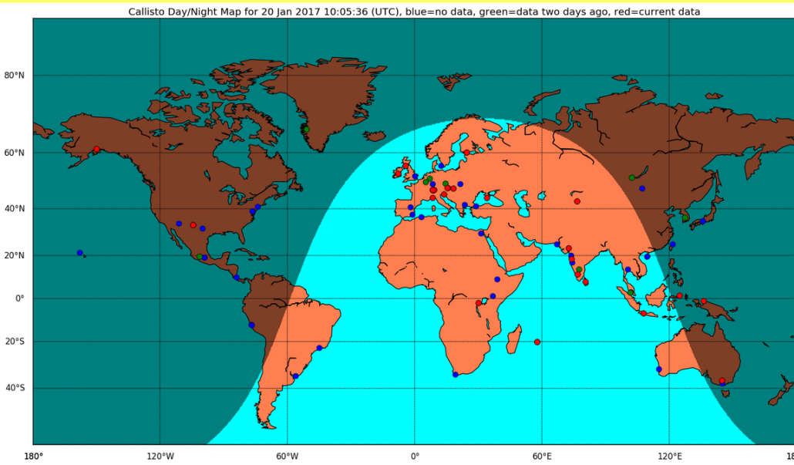
Spectrographs
eCallisto
  http://www.e-callisto.org/
  Variable frequency range – typically 10-45 to 450-870 MHz
  Radio noise and antenna size issues
Other spectrographs
  AUS, J,SK,BE,GR, F
  Similar range as eCallisto. Some up to 3 GHz or 9 GHz
Mainly research – but some (eg J, US, AUS) used to identify CMEs and flares

Slide 15
Solar Obs – discrete Frequencies
Radio Flux Monitoring
Solar Electro-Optical Network – 245, 410, 610, 1415, 2695, 4995, 8800, 15400 MHz)
  US, AUS, Italy
Canada (Belgium) – 6 bands from 1400 MHz-10,7000 GHz
  Including F10.7 (2750-2850 MHz) – key index for solar variability
Radio Heliograph: France, Japan (150, 236, 327, 410, 432 MHz)
Interplanetary Scintillation (next page)

Slide 16
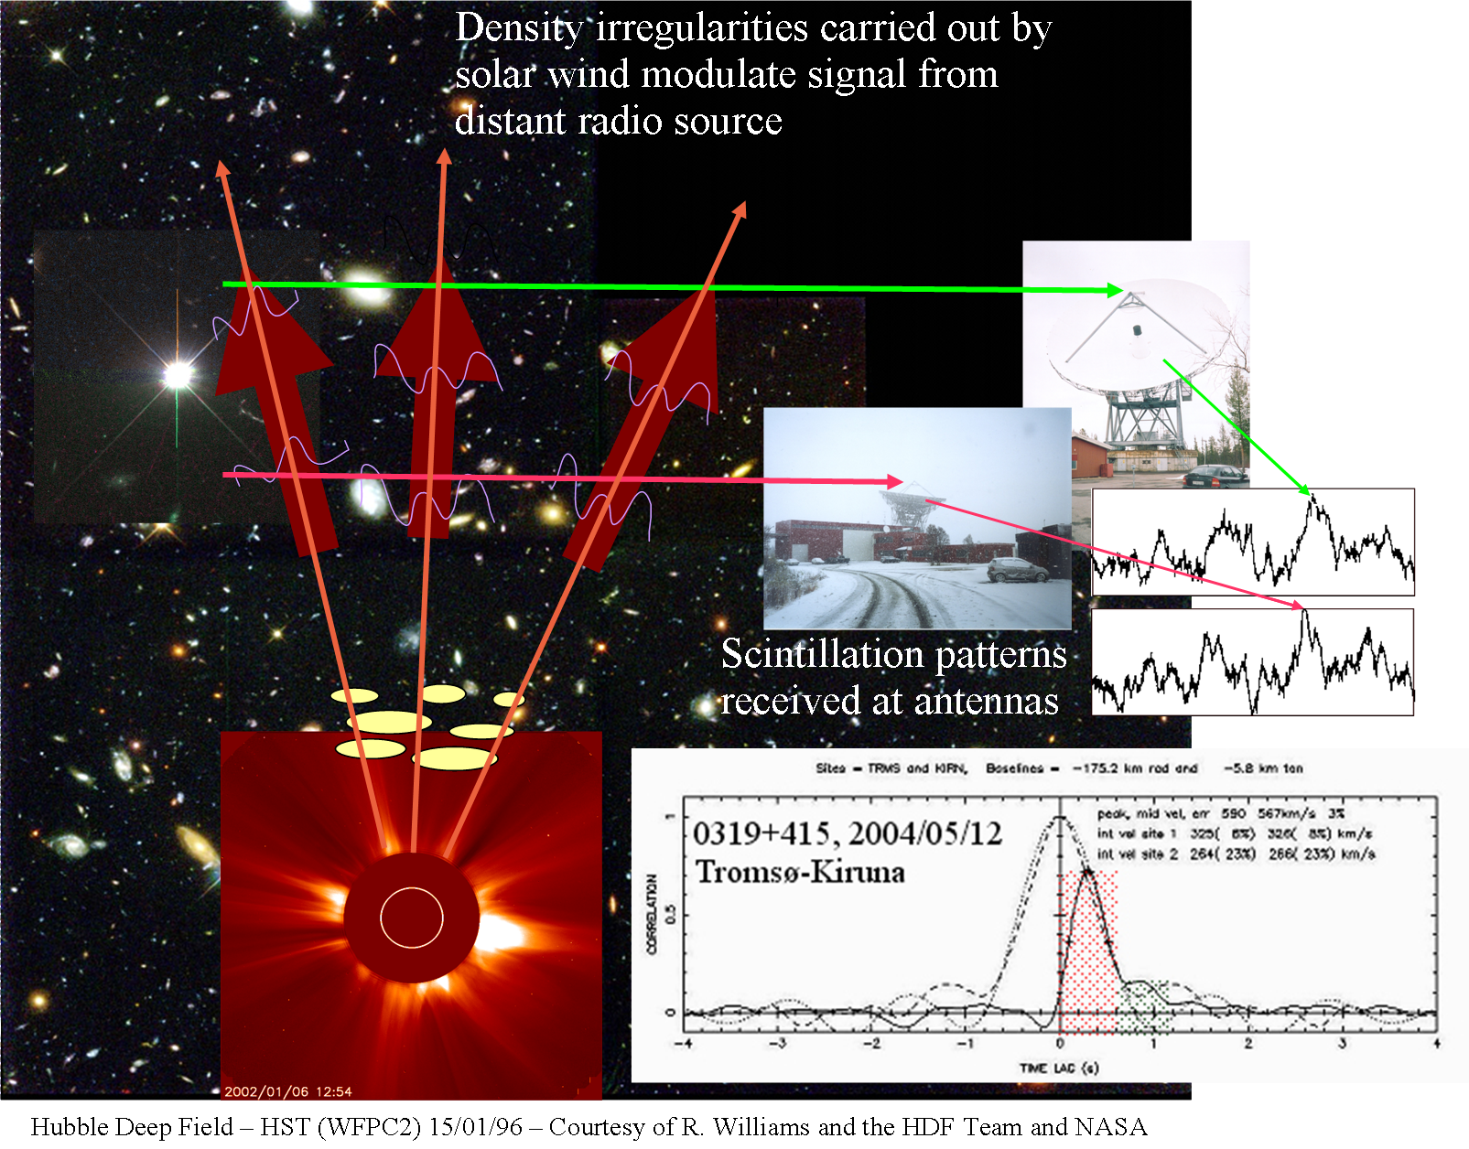
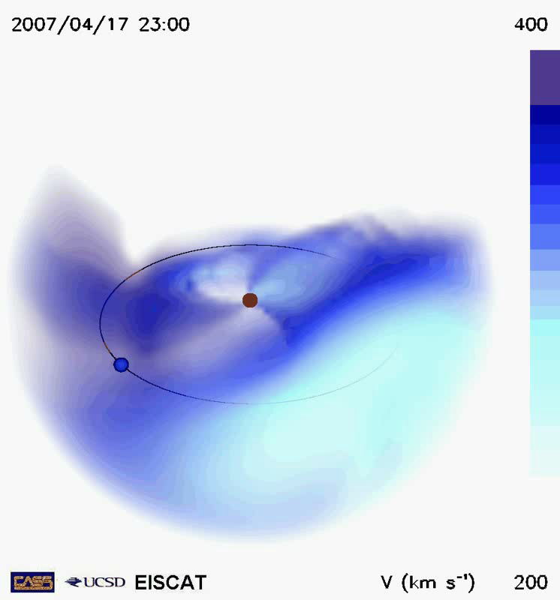
Introduction to IPS
Radio signals received at each site are very similar except for a small time-lag.
The cross-correlation function can be used to infer the solar wind velocity(s) across the line of sight (LOS).
(Not to scale)
3-D Reconstructions of ICMEs / solar wind – moving towards operational Space Weather
Thanks to Mario Bisi, Richard Fallows and Bernie Jackson

Slide 17
Observing Summary (not exclusive)
>10 MHz
Low band
LOFAR IPS (all latitudes)
High band
<250 MHz
STEREO HI1 & HI2 (<30º of ecliptic)
327 MHz
(Ooty, Jeju also)
934 MHz – 1400 MHz
1400 MHz
SMEI (all latitudes)
327 MHz – Japan, India, Korea; 140 MHz – Mexico; 111 MHz – Russia; < 250 MHz LOFAR (Europe)
Thanks to Mario Bisi
Notes:
Variation in phase increases as observing freq increases – so higher freq will be more sensitive to regions closer to Sun

Slide 18
Extra slides

