Slide 1

WIS Strategy – WIS 2.0
Submitted by: Matteo Dell’Acqua(CBS)
(Doc 5b)
Inter-Commission Task Team on the WMO information system
(ICTT-WIS)
WMO, Geneva. 12-13 Sept 2016

Slide 2
WIS status
Network infrastructure, process and procedure to discover, access and exchange data
WIS intended to support all WMO Programmes;
  Reality is that only WWW is well represented
WIS is a network for expert (centres from WWW)
  Difficult to put new data on WIS
  Difficult to find data
  Difficult to know that WIS exist and to understand what WIS is
In its current form, the WIS, and mainly the GTS, is a niche infrastructure that supports the expert meteorological community

Slide 3
Trends
Constant increase in the flow of data to exchange and information to be disseminated to our various users mean that it is necessary to re-think how data is managed and shared
  Data volumes created by earth observing and numerical prediction systems continue to grow considerably faster than the performance of telecommunications networks
  Other sources of information are becoming available that may have data volumes that exceed those of traditional data sources, such as indirect information and crowd sourcing
Users expect to access weather, water and climate information and services through the same mechanisms that they use for other types of information, using familiar interfaces and applications
Users will combine mobile, cloud and social technologies to access a much wider range of information sources and to collaborate in new and different ways

Slide 4
Trends – con’t
Common data sharing platforms and technology are a prerequisite
  Risk reduction and emergency response requires collaboration with multiple agencies
  Assessing the impact of environmental hazards requires meteorological data to be combined with other socio-economic data
Changes in data supply patterns and user expectations present new challenges that the current WIS struggles to meet
At the same time, changes in technology present new opportunities.

Slide 5
Opportunities
Increasing use of the Web as a data sharing platform
Commercial infrastructure providers offer
  stable, secure and cost-effective ‘cloud’ hosting of virtualized computing resources
  ‘content distribution networks’ (CDN)
Search engines (Google, Bing, Yahoo etc.) remain the common entry point for consumer discovery of information
Application Programming Interfaces (APIs) and Web Services are now very common solutions for exchange of data
Messaging services and protocols offer new opportunities for sharing meteorological data in real-time based on common industry practices
Use of analytics and user feedback to drive improvement of user experience
Applications such as Dropbox indicate that file distribution services have become commoditized and are no longer the domain of specialized applications such as GTS message switching

Slide 6
WIS 2.0 vision
WIS 2.0 will provide users with seamless access to diverse information from a wide range of sources and will enable weather, water and climate information to be related to socioeconomic context.
Through an open eco-system of tools, applications and services, WIS 2.0 will allow all information providers to publish and share their data, products and services and all users to develop value added services and new products.

Slide 7
WIS 2.0
Information System operated by Members built on commercially available services and industry standards
  To exchange at the right moment the relevant information
  Redundant, resilient, efficient and scalable infrastructure
  With an applications/services layer based on standard interfaces for data exchange
  A global catalogue of information and services
  And Ready to support SMAC (Social, Mobile, Analytics (Big Data), Cloud) and IoT

Slide 8
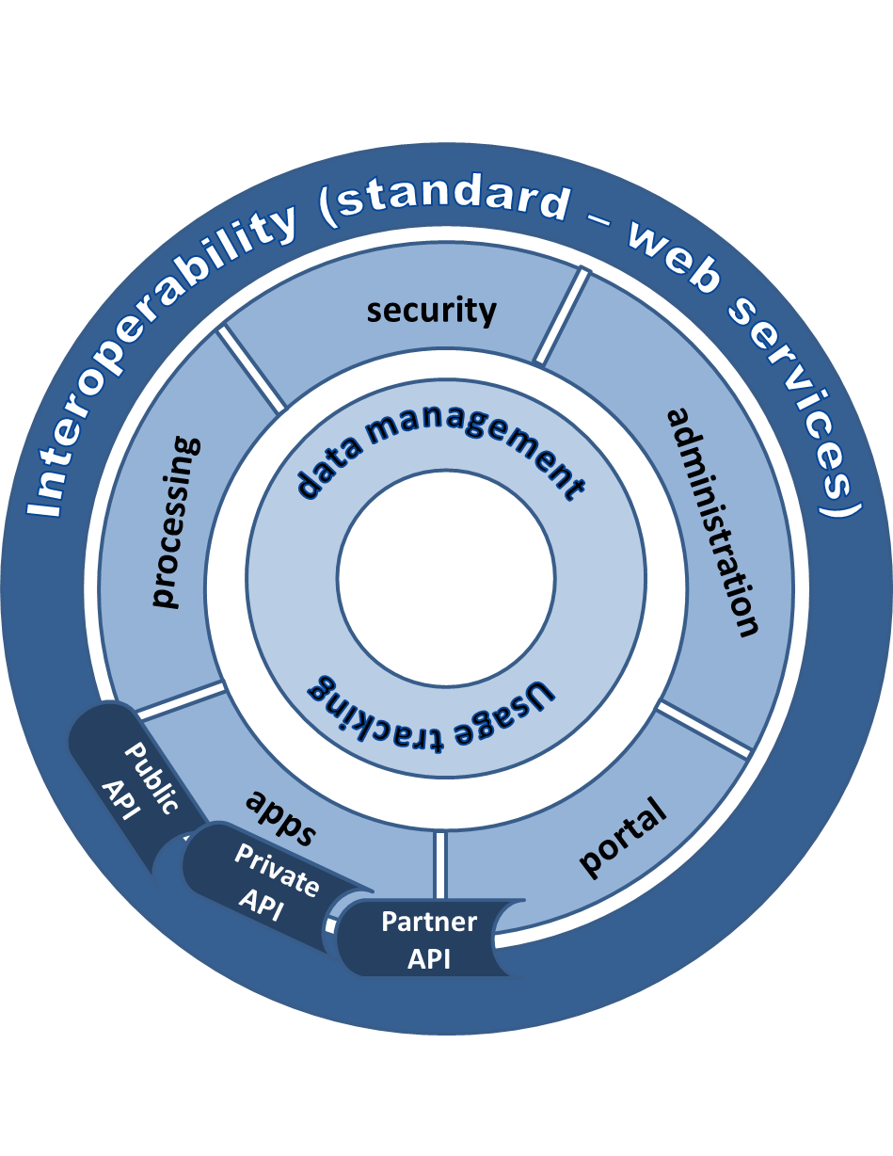
WIS 2.0 - the plateform
Acquisition
Dissemination
Collaboration
Change in user behaviour from downloading a copy of information for local processing to using services that process the information at its source

Slide 9
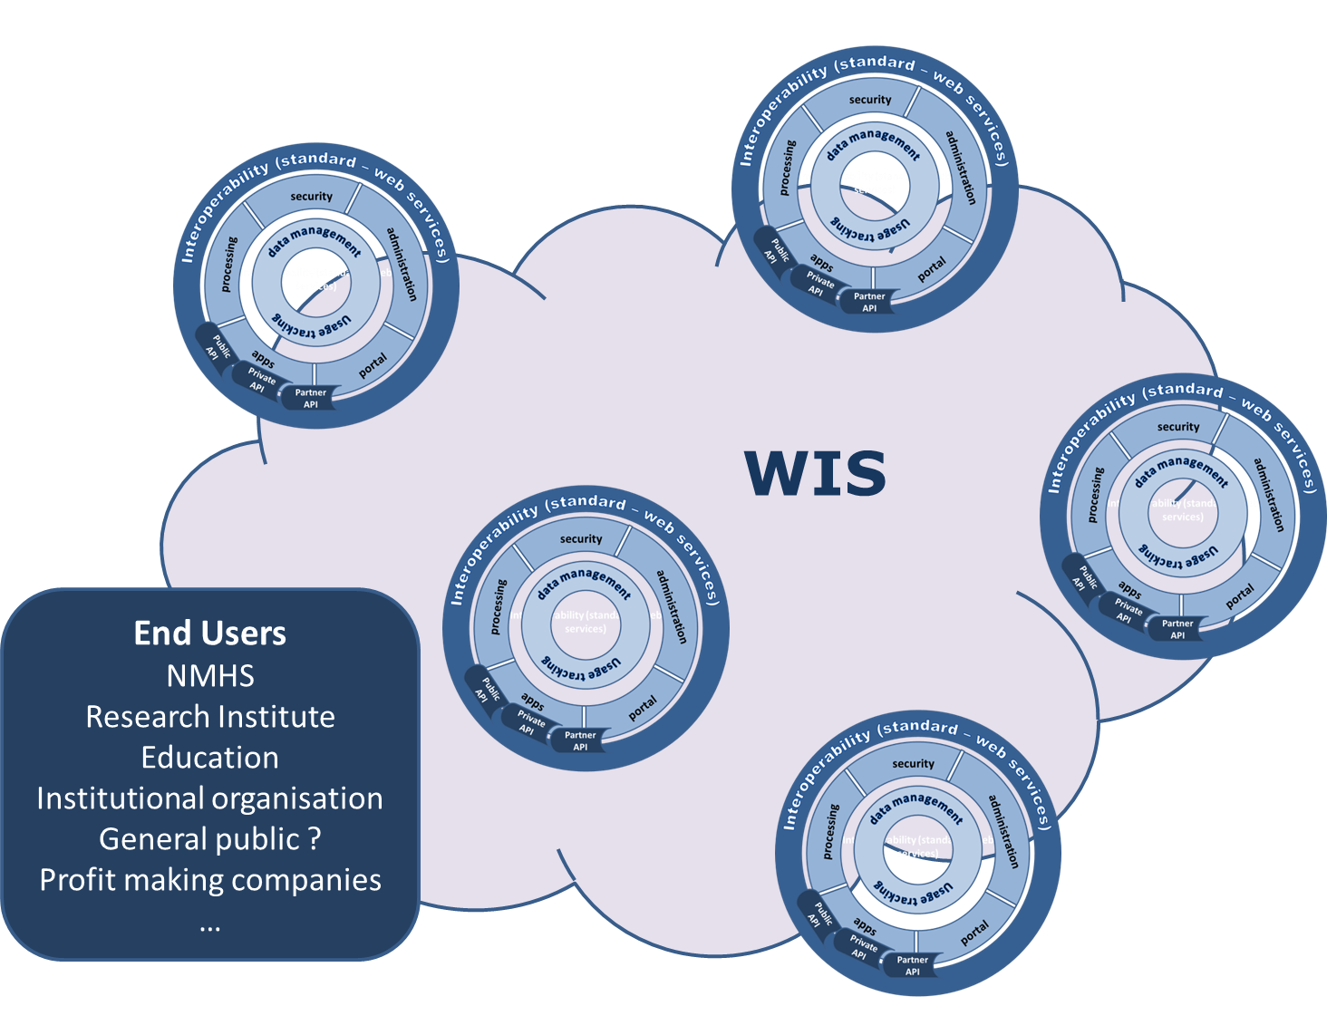
WIS 2.0 - The cloud !
Opened to new partners from different business (energie, health, ..) to develop the use of WMO information

Slide 10
WIS 2.0 Governance
National Centres and Data Collection or Production Centres remain the primary centres within WIS 2.0 as these are the centres that collect data, generate content and deliver services
WIS 2.0 will continue relying on the contribution of GISCs
  Their role will evolve from infrastructure provision to focus on providing more-effective support to centres in their area of responsibility
WIS 2.0 governance will need to address issues such as:
  data life cycle management,
  data licensing and access,
  information security,
  cost sharing and contract management with commercial infrastructure suppliers,
  resource allocation (e.g. compute, storage) within shared components,
  private sector participation.

Slide 11
Task Team on the evolution of WIS
ToRs
  Develop an implementation plan, with schedule and key deliverables, that is in line with the WIS 2.0 strategy and guide implementation of the plan that is approved
  Consolidate stakeholder requirements
  Communicate with stakeholders about the strategy and plan

Slide 12

Thank you for your attention

