Slide 1
WIS Strategy – Life Cycle Data Management
Submitted by: Matteo Dell’Acqua(CBS) (Doc 06a)
Inter-Commission Task Team on the WMO information system
(ICTT-WIS) WMO, Geneva. 12-13 Sept 2016

Slide 2
WIS 2.0
Information System operated by Members built on commercially available services and industry standards
To exchange at the right moment the relevant information
Redundant, resilient, efficient and scalable infrastructure
With an applications/services layer based on standard interfaces for data exchange
A global catalogue of information and services
And Ready to support SMAC (Social, Mobile, Analytics (Big Data), Cloud) and IoT
All WIS data will be
Managed
Documented
Discoverable
Accessible
Easy to use
Compatible services and format

Slide 3
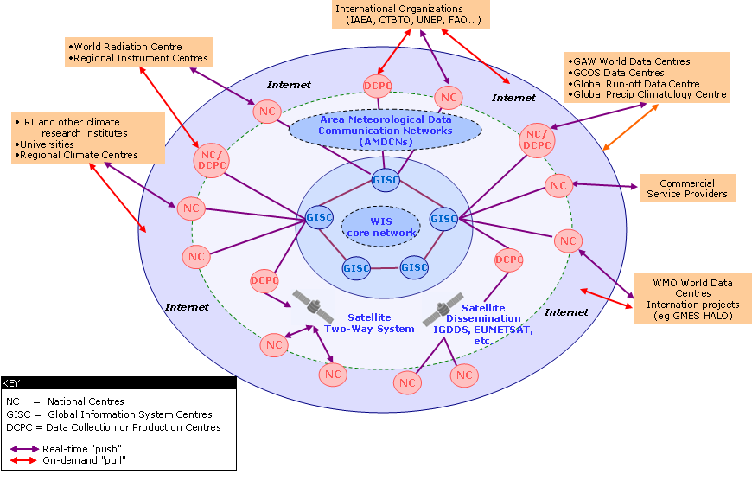
WIS 2.0 - Data Lifecycle Management
Information activities
Create
Documenting
Store
Cataloging
Quality control
Share
Acquisition, dissemination, access services
Use
Processing services
Usage tracking
Archive
Preservation
Destroy
WIS 2.0 platform will be complemented by a set of principles to encourage best-practice in data life cycle management by the WMO community

Slide 4
Potential requirements for WIS Part C
Row Nº. | Topic | Source
1 | Provide assistance to Members in matters concerning all stages of management of information. | Cg-17 4.2.3(1).19
2 | Guidance on best practice in the collection or creation of information (including ensuring that the information is fit for purpose), | Cg-17 4.2.3(1).19
3 | Guidance on managing storage of information, sharing information (including the definition and enforcement of restrictions on use of the information), | Cg-17 4.2.3(1).19
4 | Guidance on use of the information to deliver benefits from it. | Cg-17 4.2.3(1).19
5 | Guidance on long-term preservation (archiving) of information. | Cg-17 4.2.3(1).19
6 | Guidance on disposing of information that is no longer required (including guidance on how decisions on disposal should be made). | Cg-17 4.2.3(1).19
7 | Auditable standards relevant to information management to be applied by data centres managing information on behalf of WMO Programmes where these would enhance the ability of Members to derive benefit from information. (Also: Setting and auditing standards for centres that hold information in support of WMO Programmes – CBS Ext.(2014) Recommendation 24). | Cg-17 4.2.3(1).19
8 | Provide arrangements for long-term retention of information to meet the future needs of WMO Programmes. | Cg-17 4.2.3(1).19
9 | (Investigate requirements for) a standard method of identifying objects within WMO | CBE Ext.(2014) Recommendation 24

Slide 5
Task Team on Information Management
ToRs
Collaborate with technical commissions to review available information management practices and develop and document appropriate standards and practices in information management;
Recommend procedures for the long term maintenance and development of standards and best practices related to information management;
Replace the “Guide on World Weather Watch Data Management (WMO No. 788)” with a new guide on best practices for information management across all WMO programmes;
Propose updates to incorporate standards and practices for information management under WIS Part C in the Manual on WIS (WMO No. 1060) and Guide to the WIS (WMO No. 1061);
Recommend updates to the WIS competencies related to information management and associated training and learning guides.

Slide 6
Thank you for your attention

