Slide 1

Expectations of WIS from CCl/ Task Team on the Definition of Extreme Weather and Climate Events

Slide 2
TT-DEWCE Targeting……
Develop an inter-operable data base for regional extreme weather and climate events;
Provide a WMO portal which links to national products and reports on extreme weather and climate events.

Slide 3
Database for recording extremes
recording of the extreme events should be undertaken in a consistent and systematic way so that integration of information from national data bases to regional databases and vice versa is made with a minimum transformation and interface software

Slide 4
    Data Base Model
The database model provides a general structure used for the information on extremes that is required to be stored in a data base in an operational mode. This subsection describes key elements in the logical structure of the database and in which manner data can be stored, organized, and manipulated.
It is recommended (but not necessary) for NMHSs that the database be built as part of a single integrated and administrated Climate Data Management Systems (CDMS, Climate Data Management System Specifications, WMO-No 1131, 2014).
The Structure should consist of: metadata records and data records.
Metadata Records
They describe the context in which the recording of the hazards and extremes was done, including administrative information and brief citation and reference of the methodology and the data type used to record the extreme event in the data base.
Data Records
It is the data that helps characterize the various aspects of the extreme events, such as duration, location, magnitude and extent.

Slide 5
Cataloguing of extremes
The catalogue should contain standard content, which needs to be maintained based on WMO technical regulations.
The review of the Catalogue will be decided by the CCl in collaboration with CBS, the CAgM and the CHy.
It is recommended that the Catalogue be published as an appendix of the WMO Manual on Global Data Processing and Forecasting System (GDPFS).
For operational use of the catalogue, it is recommended that a web searchable version be made online through the global portal on hazards and extremes.

Slide 6
The proposed approach for coding extreme events
The table below proposes the coding for identifying and characterizing weather and climate extreme events.
Table 4.2
Events Code: See catalogue in Appendix
Region: WMO definition of the region: RA-1, RA-2,…,RA-6
Country: Country code using ISO Standard.
Metadata Record | Event Code | Region | Country
Data Record 1 | Date | General Position | Position Extreme Value-1 | …. | Position Extreme Value-n | Max Magnitude | Extent
Data Record 2 | Start date | End Date | General Position | Min Lat | Max Lat | W Long | E Long | Severity | Total Extent

Slide 7
First-stage Portal
Links to published national monthly, seasonal and annual climate summaries.
Links to known, stable sources of national-level information on extreme events
Providing the capacity for NMHSs to upload information on high-impact events taking place in their country, using a defined catalogue of extreme weather and climate events and data base model.
Analyses, using GTS data, of extreme values at the monthly timescale.
An extension of the existing global and continental records portal, currently hosted by Arizona State University, to cover national and location-specific record information.
A list of recommended documents that can help members in reporting about the extremes.
A link to the recommended software for calculations with a downloading possibility.
It is expected, that the host will need to play a reasonably active role in collecting and curating content; some countries will actively send material but other material will need to be actively sought if the portal is to have reasonable global coverage.

Slide 8
A simple case of persistent precipitation extremes provided by Chen and Zhai (2013).
Figure S5.A typical case of persistent precipitation extremes, which occurred during 1stJuly -11th July 1991. Shadings indicate accumulated precipitation (mm), and red triangles label the stations which experienced at least three consecutive days with heavy precipitation of at least 50mm day⁻¹

Slide 9
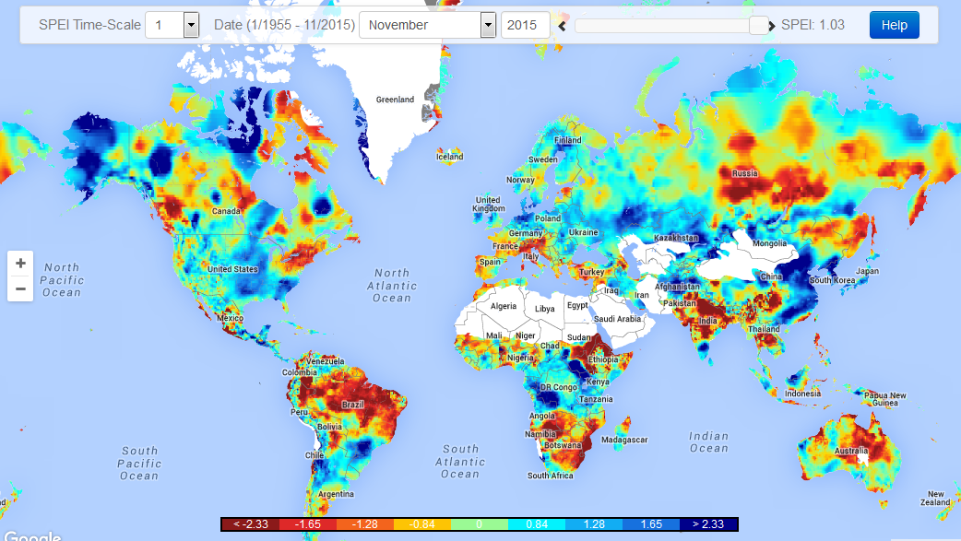
Global SPEI Drought Monitor
(Source: Consejo Superior de Investigaciones Científicas [CSIC ])

Slide 10
Expectations
Collect and exchange observed daily observations, especially Tmax, Tmin and Precipitation data;
Record the regional extreme events, including graphics and archive information;
Support establishing Portal on extreme event monitoring
Deliver monitoring and assessment information to users

Slide 11
Thanks!

Slide 12
