Slide 1

Perspective of WIS from CAgM
Submitted by: Byong Lee(CAgM)
(Doc 3n)
Inter-Commission Task Team on the WMO information system
(ICTT-WIS)
WMO, Geneva. 12-13 Sept 2016

Slide 2

Contents
WIS Governance
Participation in WIS
Future WIS Services
WIS Strategy
Recommendations

Slide 3
1. WIS Governance
CAgM is developing new products and information streams
  e.g. GEO data
How can CAgM get WIS to exchange the data on its core network or serve the data from its cache.
What happens if GISCs won’t agree.
How do we add services

Slide 4
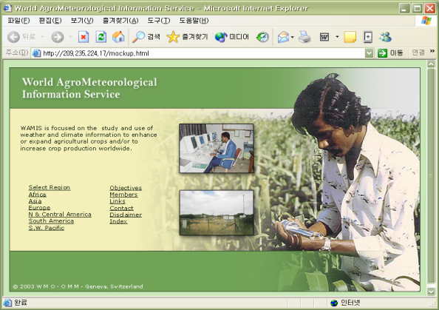

Current/Potential services via CAgM
WAMIS – 1st Step for information sharing
Web Portal information sharing
XML-based service : standard schema development
Machine translation : multi-lingual interfaces
Operational applications based on Web service architecture
Tutorial interfaces for real practices
GRID Portal Resource sharing
Forecast-based AgMet Services for researcher / extension
Benchmarking on AMBER (DWD), expanding with DSAT
NCAR (GDAS, MM5), DWD (GME, LM) as NWPs
Super ensemble of Seasonal Forecasts (APCC / KMA, etc.)
GISC / DCPC dedicated to WAMIS will be established (NCAR, DWD)
LIS (NASA) as a framework for LSM (GDS / LAS + GRID)

Slide 5
CAgM/GIAM with GFCS
Global Initiatives in AgroMeteorology
Climate Services
Information Systems
(CSIS)
WAMIS II
Climate User Interface
Programme
(UIP)
Capacity
Development
(CD)
GAMPP
GFAMS
GCREAM
Research,
Modeling and
Prediction
(RMP)
GAMOS
Observations &
Monitoring
(OBS)
Global Federation of AgMet Society (GFAMS) UIP, RMP
Global Center of Research, Excellency in AgMet (GCREAM) CD
Global AgMet Pilot Projects (GAMPP) RMP, CD
Global AgMet Outlook System (GAMOS) GAPON OBS, RMP
WAMIS next phase (WAMIS II) CSIS, UIP
- World AgroMeteorological Information Service

Slide 6
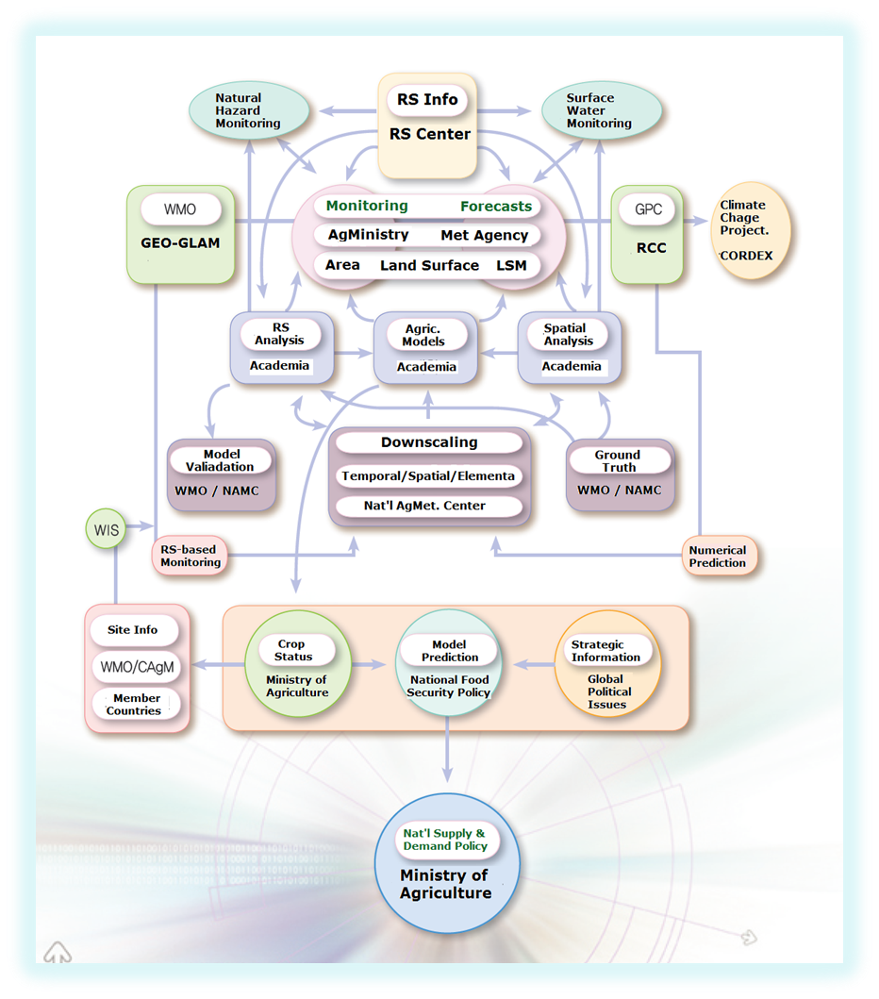
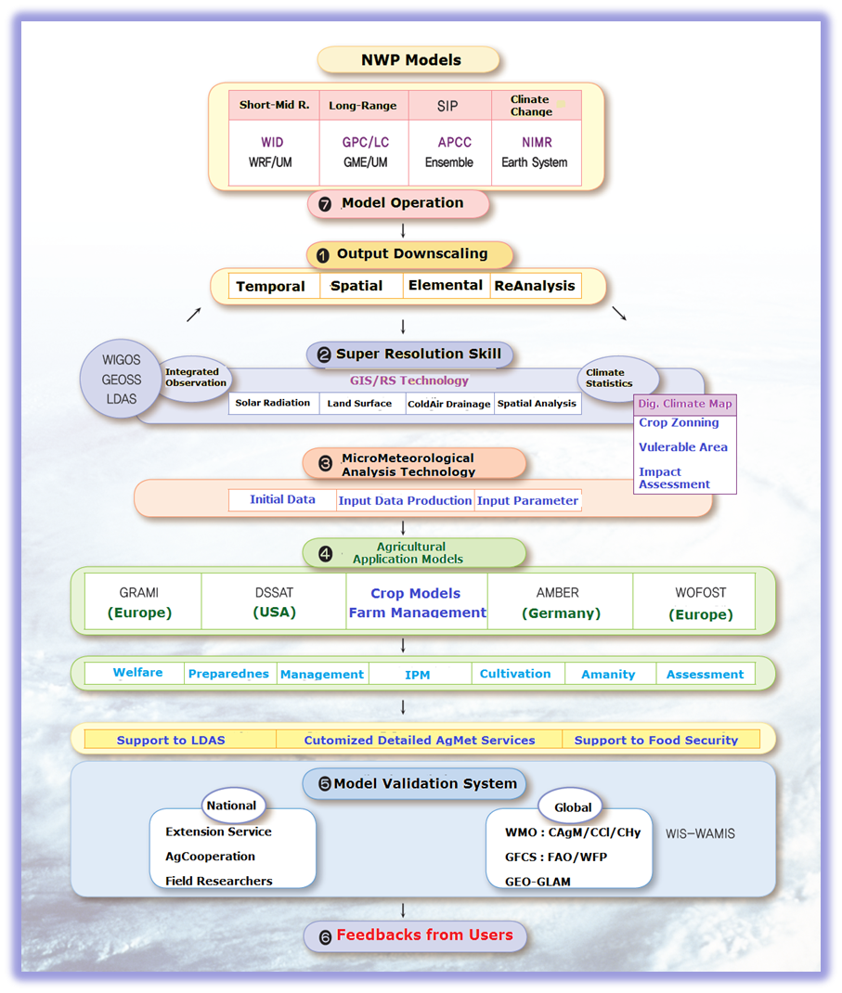
Core Climate Services : In-situ/RS/NWPs based
From now-casting
To climate change projection

Slide 7
2. Participation in WIS
How do we get CAgM experts involved in WIS
  Metadata profile not reflected in WIS
  How do CAgM apply WMO profile eg flux data
  Experts not from WMO community
How can WIS make it easier for CAgM to develop an operate GDPFS type services and centres
  Modelling, automated warnings, etc
  Cloud based services

Slide 8
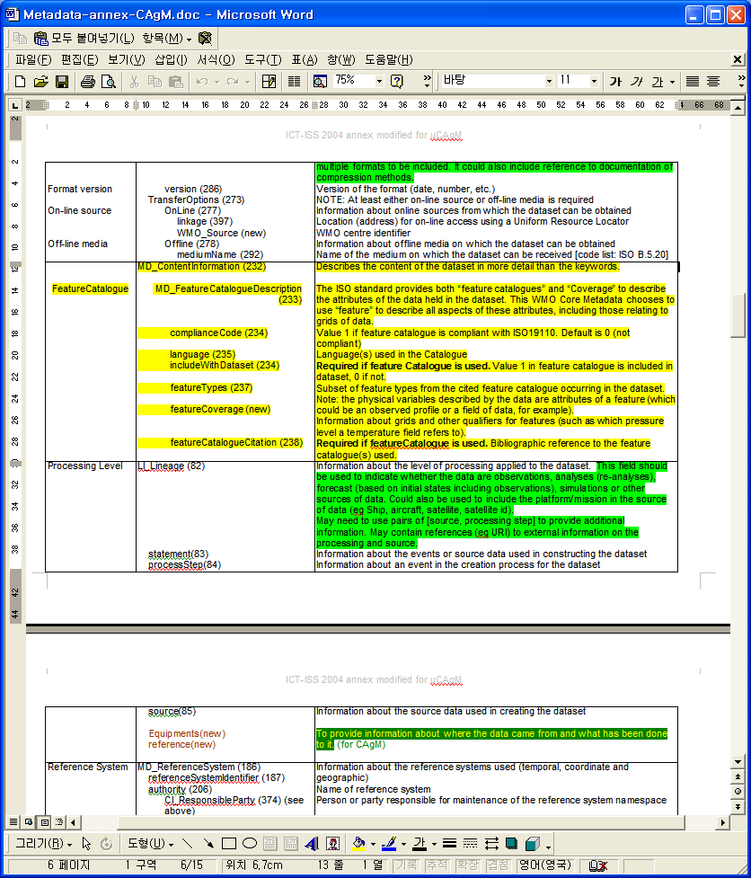
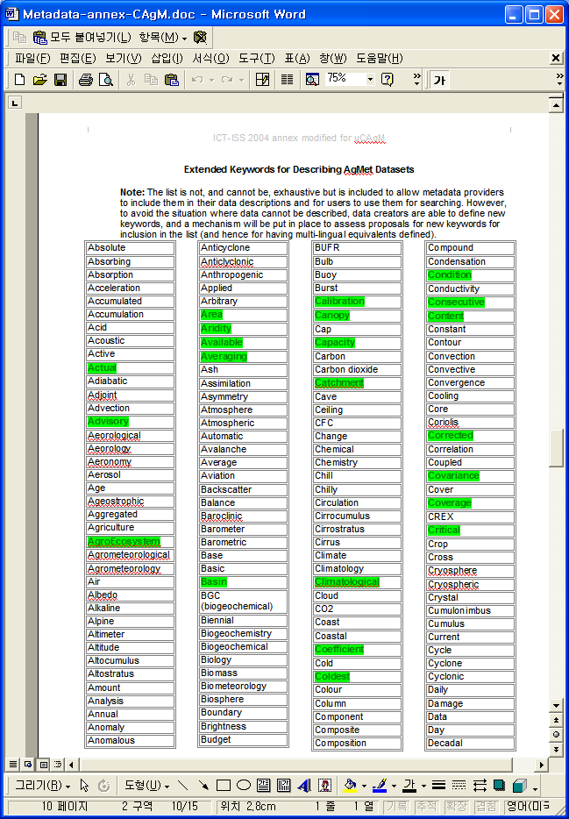

CAgM MetaData Management
Prototypes of Extended WMO Metadata Core Profile
Keywords

Slide 9
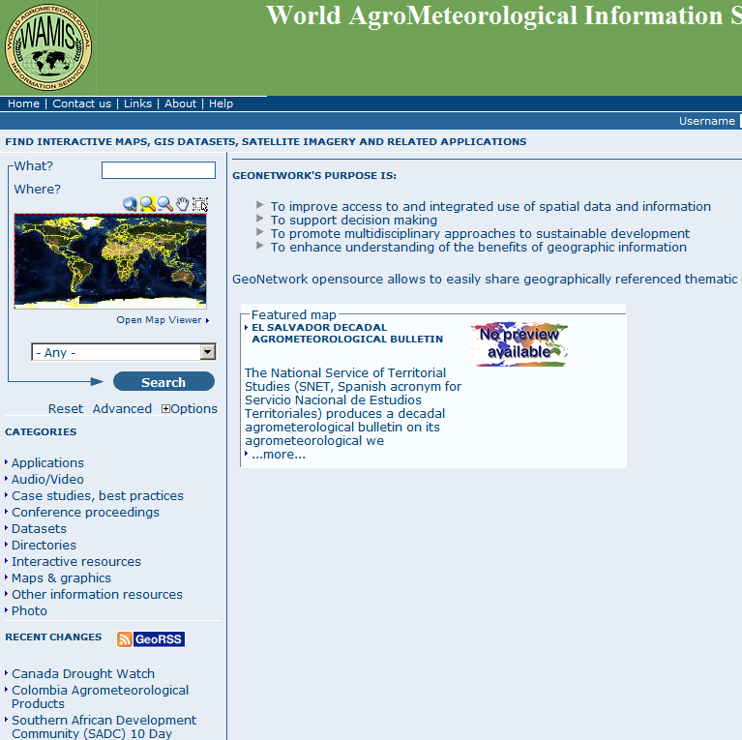
WAMIS Search (GeoNetwork)

Slide 10
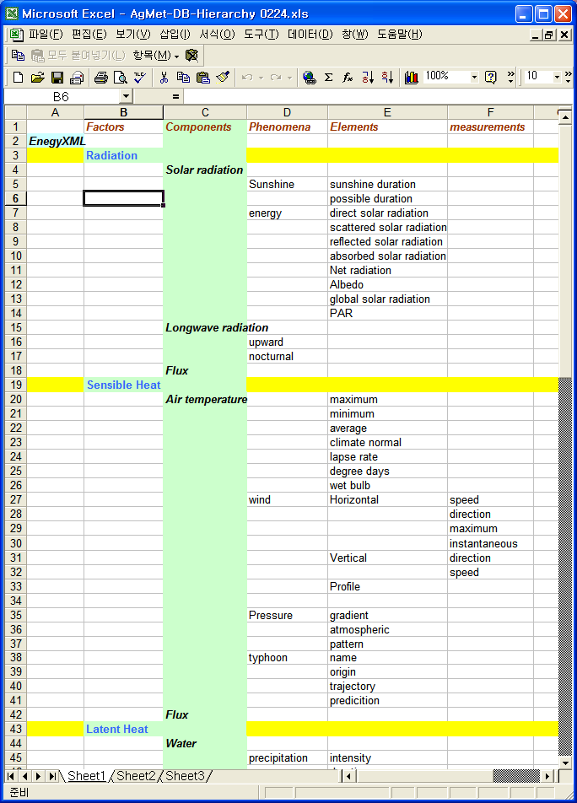
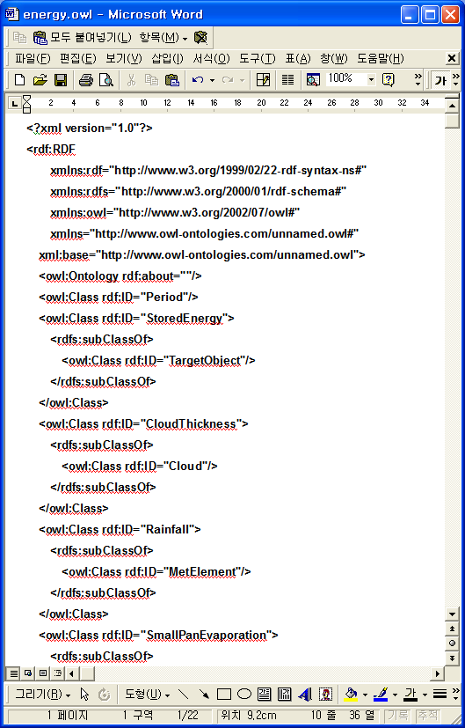
Hierarchy of weather elements
RDF/OWL presentation

Slide 11
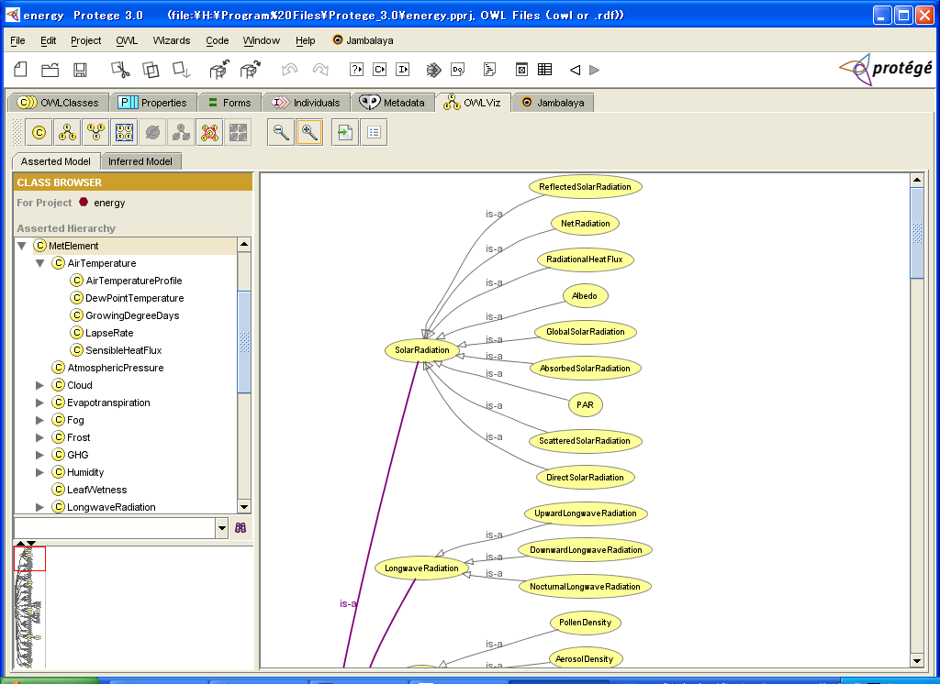
Prototype of Ontology using extended keywords

Slide 12
3. Future WIS services
Cloud based services
  Processing / storage / dissemination
  Public (or private) partnerships
    e.g. provision of cloud infrastructure
ICT expertise.
  Can WIS provide guidance on managing IT infrastructure like it does with communication infrastructure
  Is this still GDPFS?
Many web based services already being developed in CAgM, e.g. data services, GIS online

Slide 13
Components of WAMIS II
Data Grid
GRID
Computing • Data • Access
Cloud
Computing
GTS/WIS
GISC
WAMIS
ICT Infrastructure
DCPC
NCAR
NCDC
TIGGE
(Joint)GISC
UNIDAT
Computation • Research
KMA/KISTI
Data Broker
OpenWIS
GDS
WAMIS Grid Portal
User Interface
GridSphere
NWP Outputs
LAS
Climate Projection
SIP
GDAPS / GME
RDAPS / GME : WRF
Mesoscale model
Nowcasting
Historical (Legacy) data
Non-Meteorological Data
END-USERS
Pilot Projects
WAMIS
.
.
.
.
MME
AMBER
DSSAT
GIS RS
AgModels
LDAS/LIS
Flux, GHG
Surface Flux
Vegetation
Soil Profile
Services
(WAMISs)
Applied
Meteorology
DCPC-WAMIS : KMA
Cloud Computing-KISTI
NWP Models - PKNU
AgModels - NCAM

Slide 14
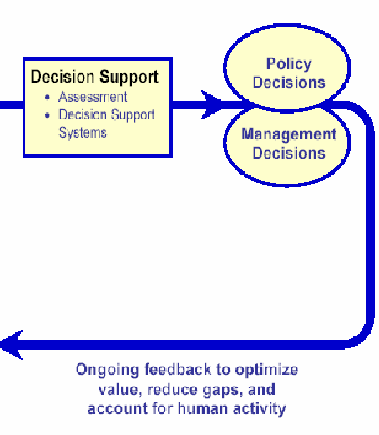
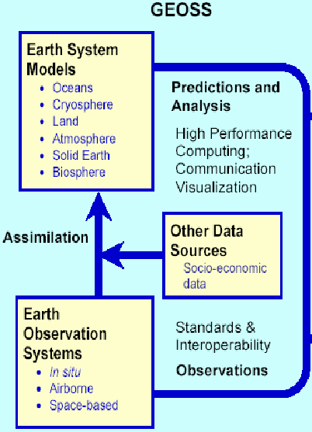
JCOMM-GMC-WAMIS–GEOSS
Data Buoy Cooperation Panel
(DBCP)
Ship Observations Team
(SOT)
-Ship of Opportunity Programme
(SOOP)
-Voluntary Observing Ships
(VOS)
-Automated Shipboard
Aerological Programme (ASAP)
OceanSITES Deep Ocean
Times-series and Reference
Station network
Argo network of
sub-surface profiling floats
Impact Assessment
Emergence Response
User Applications
GEO
Common Infrastructure
JCOMMOPS
DCPC
Data/Production
DCPC-GMC
DCPC-WAMIS
Cloud ICT
Grid Portal
Web Service
WAMIS
Servers
Science DMZ
Mutual Backup
GISC
METASERVER
JCOMM
CAgM

Slide 15
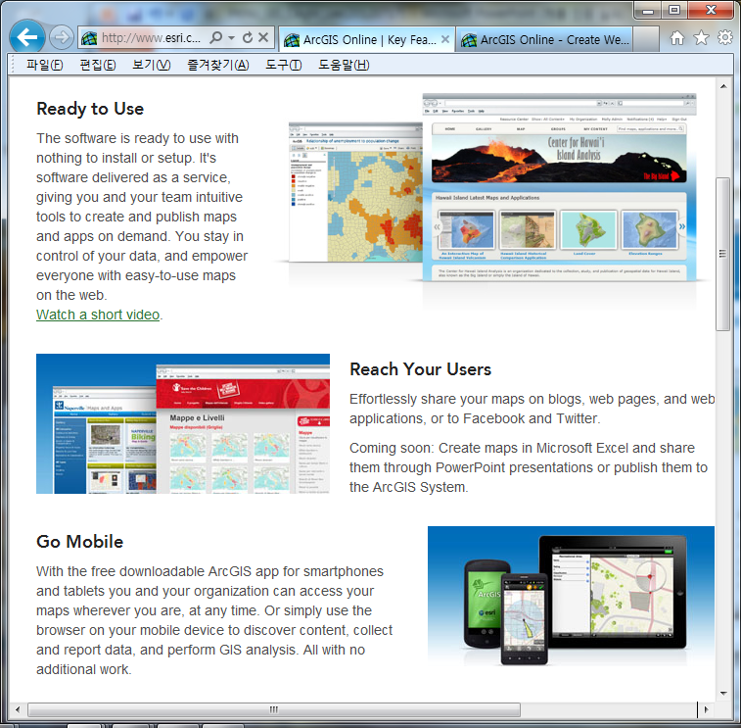
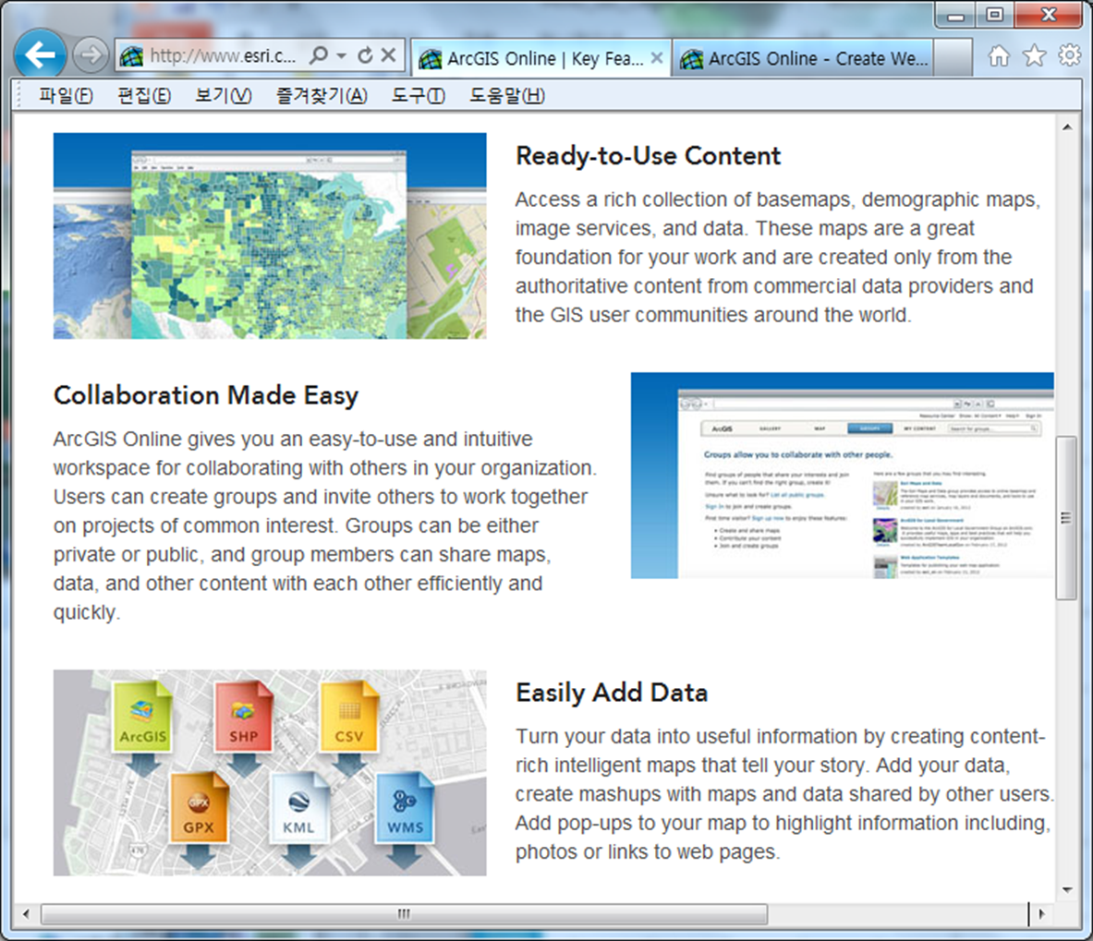
GIS OnLine

Slide 16

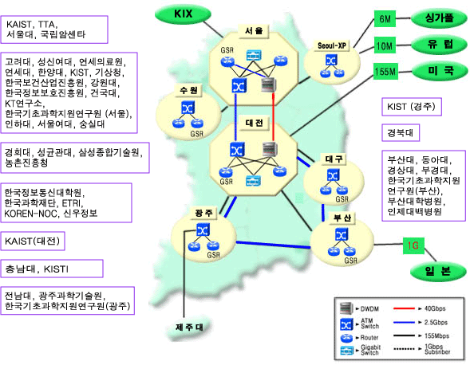
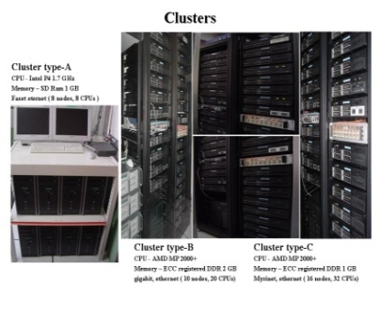
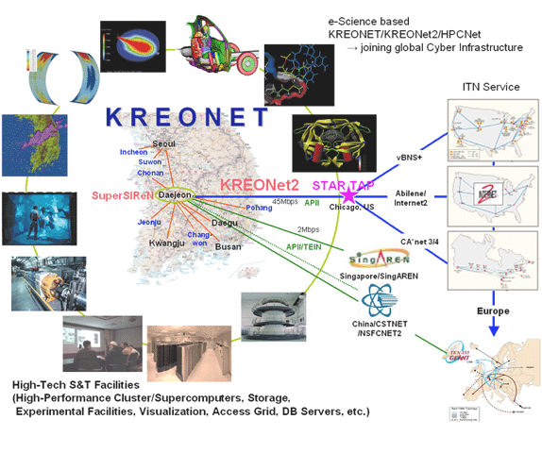
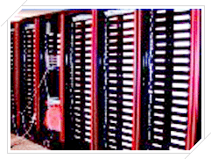

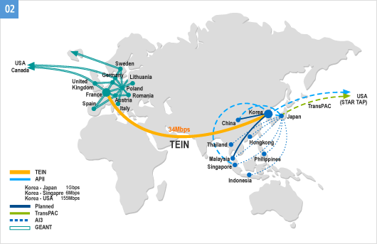
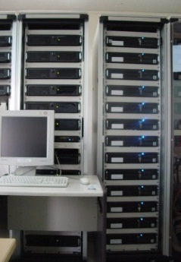
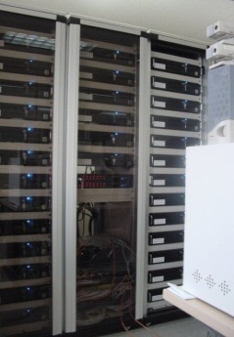
ICT resource sharing system
KOREN
uMeteo-K testbed
KISTI Cluster
KISTI Cluster
KISTI Cluster
TEIN
KT Cluster
KT Cluster
16
* ICT : Information, Communication Technology

Slide 17



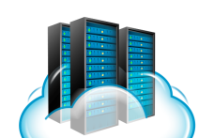




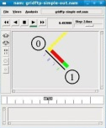

Collaborative ICT Platform
COREEN
SW
HW/SW
Collaboration
Large Data
Transfer
Communication
R&D facilities
Identity
User Interface
Advanced
Science
Advanced
Engineer
High Level
Education
Industry
Notes:
연구망 사용촉진 – 도와 주는 개념
경부선 서울역 회의실 vs KREONET 협업플랫폼 서비스

Slide 18
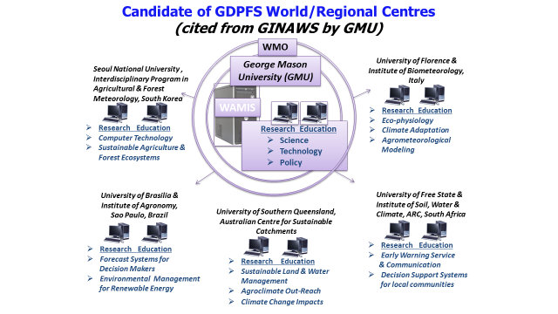
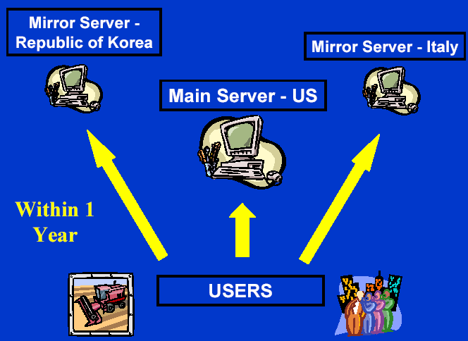

ICT Sharable Platform of WAMIS II
KISTI
Science DMZ
WAMIS
DWD
KMA
INMET
QMD
NCAR
NUIST
KMA-KISTI
Science DMZ
WAMIS
DCPC
-WAMIS
GRID /
Cloud
GISC
Seoul (KMA) : Offenbach (DWD)
Mutual Backup
DCPC
-GMC
WAMIS Portal
Australia, Brazil

Slide 19
CAgM
WIS
GFCS
GISC-Seoul
GIS-OnLine : ESRI
Cloud Computing – KISTI/PLSI
AGMIP
Crop Models
WAMIS DCPC
Agric
WMO
AgModels
DSSAT/AMBER
NWP models
WAMIS II
3+3+?
CSIS
UIP
GPC LC
LRF MME
CD
GAMPP
6+?
GFAMS
11+?
GCREAM
8+?
Candidates :
1~3 regional pilot projects
in each RA
RMP
K-NWP : KMA/NIMR
WISE : Urban/rual met..
SSPM : CAS/KMA
GAMOS
Phenoloy
GHG Flux
Soil moisture
OBS
NASNET
Phenology Monitoring
Ground truth information
ISB/CP, KMA/NIMR
Fluxnet/AsiaFlux
FAO, IRI, EU, USA
NASA -NEX
WIGOS
GTOS
GLAM

Slide 20

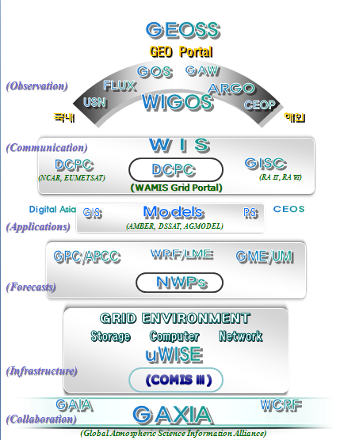
WIS-anchored System Architecture of CAgM

Slide 21
GRIAM : NUIST-CAgM-GEO
Global Research Institute of Applied Meteorology
Agro
Met
Center
CAgM GIAM
Urban
Met
Center
WMO HIW
Service
Innovation
Center
WMO S2S
Ecology
Met
Center
GIAM GCR
WMO DRR
GIAM / GFCS
GEOGLAM
GFCS / GCR
GFCS AgFS
GEO-GLAM
GFCS DRR
WMO DRR
GRIAM at NUIST, China
-Global Research Institute of Applied Meteorology
-targeting on WMO endorsements through contributions to GFCS implementation

Slide 22
Backgrounds of GAMEOS as Novel GDPFS Centres
Emerging Requirements
  Climate Service innovation for Agriculture & Food Security
  Early warnings for climate extremes
  Application of S2S for climate variability
  Interfaces between models, among stakeholders
  2) Technological challenges for better Climate Services :
  - Accessibility to non-meteorological data on time
  - RS/NWP need downscaling in space, time and elements
  - ICT resources for additional data production
  3) Implementation Strategies for better service provision:
  - Dedicated data collection & production centres
  - Virtual ICT infrastructure to share among members
  - User interface with GIS-Online under GRID/Cloud computing
WMO CAgM
GDPFS meeting

Slide 23
Functions of GAMEOS(1)
Global centres
Operational activities for downscaling on NWP outputs for applications in the agriculture and food security sectors including S2s in space, time and element
Operational activities for Reanalysis on historical/in-situ data including non-meteorological data (i.e. crop monitoring) from remote sensing platforms.
Operational data services for high resolution AgroMeteorological products and supplementary RS information (on a semi-real time basis)
Operation activities for ICT sharable platforms under cloud environments with GIS-online interfaces for agricultural and food security applications
WMO CAgM
GDPFS meeting

Slide 24
Functions of GAMEOS(2)
Regional Centres
Operational services for AgroMeteorological Bulletin archival and dissemination,
Operational activities for Early Warning services on AgroMeteorological hazards/extremes, based on region specific needs:
Operational data services to support regional AgroMeteorological Outlook services;
Training in the use of operational AgroMeteorological products and services including promising tools:
WMO CAgM
GDPFS meeting

Slide 25
4. WIS Strategy
Need to include CAgM’s needs
How to get the right experts
  eg from the whole Ag community not just NMHS
Need a plan to secure shared ICT resources in the future

Slide 26
WMO
Structural
Schematics with partnerships from CAgM Perspective

Slide 27
5. Recommended Text for Report
[Include here suggested text for inclusion in Report.]

Slide 28
Discussion Materials on WAMIS II
Current Status :
Services
Infrastructure
User Interface
Tools
Data
Resources
Outreach
Feedbacks
Partnerships
Implementation Strategy
Identification – Inventory / Resources
Coordination – Cases, Pilot projects
Integration – legacy systems
Cooperation – within WAMIS / with Partner services
Governance – Operation, Management
Follow-Ups – future implementation

Slide 29
Draft Recommendations (1/3)
Establishment of closer collaborations with external partners in securing necessary resources, e.g. finance, ICT infrastructure and governance, through bilateral agreements. (KISTI/PKNU, NCAR, NASA, ESRI, ISB, KMA, APCC, NWS ..)
Reports on review over current status of linkages between NWPs and AgModels, especially for input data/parameters which are essential for calibration/validation/operation of AgMet applications
Establishment of Task Team to facilitate WAMIS next phase implementation through the provision of technical supports to outcomes from WAMIS II expert team meeting.

Slide 30
Draft Recommendations (2/3)
Pilot projects to demonstrate potential applications by NWP-based AgMet service, especially for sub-seasonal, seasonal forecasts and climate projections with appropriate temporal, spatial and elemental enhancements to meet the requirements from AgMet community.
Institutionalization of WAMIS into an official project under AGMP of WMO for better implementation and seamless operation for promising candidate of GFCS CSIS in the sector of Agriculture and Food security.
Multilingual translation or symbolic description mechanism/function could be incorporated into WAMIS next phase for better exchange of data and products among Members with different languages or illiteracy problems through WAMIS.

Slide 31
Draft Recommendations (3/3)
Early implementation of dedicated DCPC of WIS to WAMIS II will be greatly beneficial in providing a platform for data collection, processing, archival, retrieval through interlinks with external Data Clearing House such as GEO-Portal for sharing of non-meteorological information as a gateway to the globe (similar concept to WIS/GISC within AgMet community/Members, each WAMIS server can be DCPC in each RA)
Computer resource sharing architecture can be considered together with GIS-Online under cloud computing environment and user friendly interface for convenient communications with end users including feedbacks.

Slide 32

lle
Climate Change
c
r
Climate Change
Charge
Challenge
Chance

Slide 33
Thank you for your attention

