Slide 1

Statements from CAeM
Submitted by: Commission for Aeronautical Meteorology (CAeM)
(Doc 3c)
Inter-Commission Task Team on the WMO information system
(ICTT-WIS)
WMO, Geneva. 12-13 Sept 2016

Slide 2
The AeM world today
Requirements for MET services in support of international air navigation are defined
in the Annex 3 to the Convention on International Civil Aviation.
Current structure of offices designated by agreement to provide meteorological
information and/or service to air navigation :
World Area Forecast System with two WAFCs
Volcanic Ash Advisory Centres
Tropical Cyclone Advisory Centres
Meteorological Watch Offices
(Aerodrome) meteorological offices
Other MET information services could also be
provided by individual States to aviation
users on a commercial basis
or under national regulation.

Slide 3
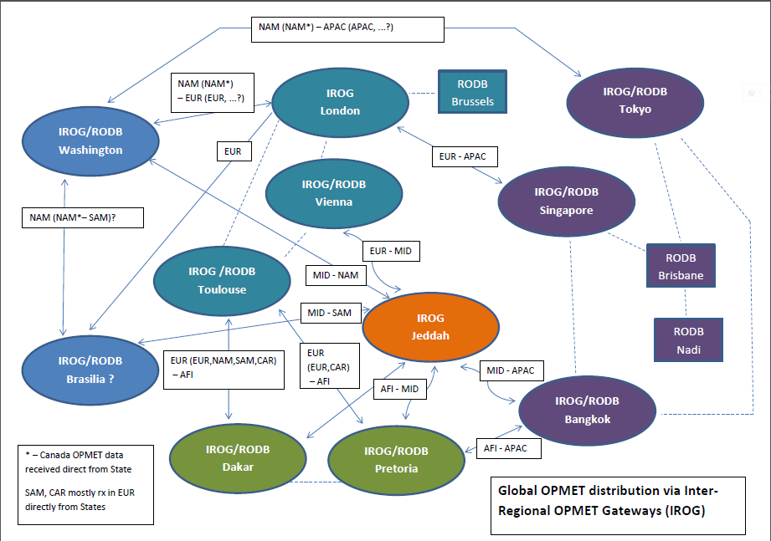
AeM Information Management today
Current worldwide information dissemination and delivery system : AFTN
Aeronautical Fixed Telecommunication Network
SADIS
WIFS
3

Slide 4
What’s happening on ICAO side ?
ICAO Global Air Navigation Plan (GANP) :
the overarching framework incl. key civil aviation policy principles
GANP objective : to increase capacity and improve efficiency of the global civil aviation system whilst improving or at least maintaining safety.
New edition in 2013 that includes the Aviation System Block Upgrade (ASBU) methodology for implementation of key principles. Framework, Modules, associated technology Roadmaps covering inter alia, communications, surveillance, navigation, information management and avionics.
Where is meteorology ?
4

Slide 5
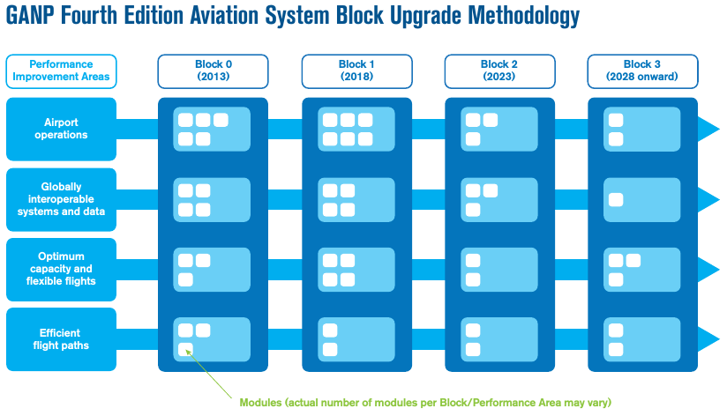
What’s happening on ICAO side ?
BO-AMET
B1-AMET
?
B2-AMET
?
HERE !
B3-AMET
MET modules :
B0-AMET Meteorological Information Supporting Enhanced Operational Efficiency and Safety
B1-AMET Enhanced Operational Decisions through Integrated Meteorological Information
(planning and near-term service)
B3-AMET Enhanced Operational Decisions through Integrated Meteorological Information
(near-term and immediate service)
5

Slide 6
What’s happening on ICAO side ?
Main concept in MET modules: integration of new or enhanced MET information
Implies a transition from the current product-centric environment to an information-centric environment
The ATM/Aviation world has stronger needs to ensure a safer, more efficient, cost effective air navigation
=> New MET services need to be developed e.g. for Space Weather information
=> Fundamental changes in existing services e.g. for hazardous weather information
=> Compliance to the new Air Navigation System environment: the System Wide Information Management (SWIM)
6

Slide 7
Information Management discussion
On the WMO side:
CAeM
ET-ISA
CBS
TT-AvXML
IPET-DRMM
ICTT-WIS
Others ?
…others? CHy, CCl …?
On the ICAO side:
MET Panel
WG-MIE
WG-MISD
WG-MRI
WG-MOG
Other Panels
IMP/WGs
ATMRPP/WGs
CP/WGs
ATMOPSP/WGs
…others?

Slide 8
What is the SWIM ?
Definition: Standards, infrastructure and governance enabling the management of ATM-related information and its exchange between qualified parties via interoperable services.
ICAO Manual on SWIM concept Doc 10039
Main principles:
  Information should be of the right quality, provided at the right time and delivered to the right place
  Separation of information provision and information consumption to the extent possible
  Use of open standards
  Use of interoperable services
8

Slide 9
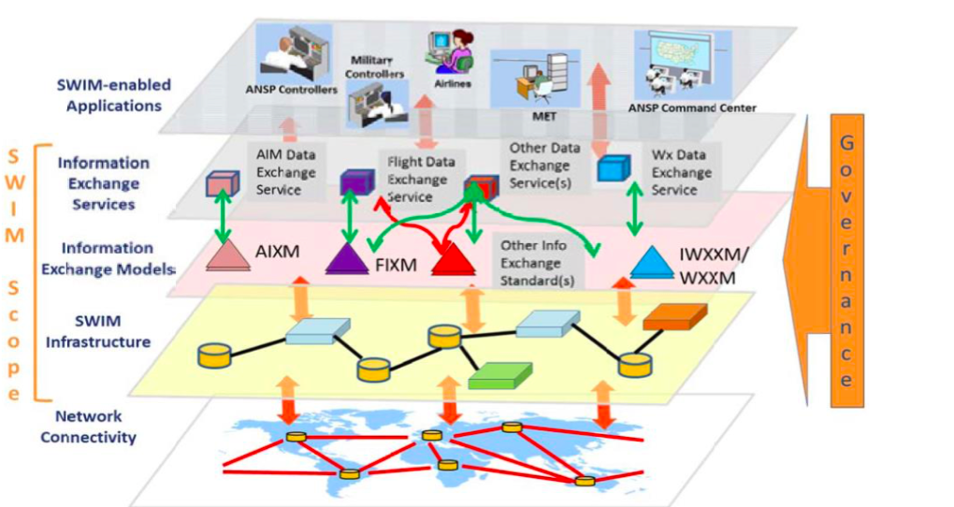
What is the SWIM ?
9

Slide 10
SWIM & AeM Service Providers
Consequences for AeM Service Providers (METSP) (1/2):
Transition from the AFTN to the AMHS :
ATS Message Handling System also known as Aeronautical Message Handling System
Application of IWXXM : ICAO weather (WX) information eXchange Model
New model for reporting weather information. IWXXM includes XML/GML-based representations for products standardized in ICAO Annex 3 and WMO Doc. No. 49, Vol II, such as METAR/SPECI, TAF, SIGMET, AIRMET, Tropical Cyclone Advisory and Volcanic Ash Advisory. XML/GML schemes defined by the CBS TT-AvXML. https://wiswiki.wmo.int/tiki-index.php?page=IWXXM-2
Strong impact on MET information providers and on IM structure
(Recommendation in Nov 2016 ; Standard in Nov 2018 ! Applicability in 2020 ?)
- ICAO documentation to assist States : Concept of Operations for the Transition of OPMET Data Exchange using IWXXM (EUR Doc 033) ….
10

Slide 11
SWIM & AeM Service Providers
Consequences for AeM Service Providers (METSP) (2/2):
One of the SWIM principles is the use of interoperable services to allow machine to machine communication:
OGC Webservices (WFS, WCS, WMS …)
Strong impact on MET information providers
and on AeM Information Management
(structure & services)
Recommendation in Nov 2016 ; Standard in Nov 2018
11

Slide 12
SWIM & WIS
SWIM is becoming a prerequisite for any information service to the aviation community
Need to ensure compatibility/interoperability between WIS and SWIM insofar as the aviation MET components are concerned (e.g. metadata)
As METSP may implement SWIM-compliant information systems to deliver MET data to aviation users, should these systems be considered as WIS ‘nodes’ ?
CAeM expectation : ICTT-WIS to consider this need so that appropriate groups from the CBS address it in coordination with the CAeM and ICAO
=> Information paper to be submitted by AeM for CBS-16
12

Slide 13
Aeronautical MET data
Current status of Aeronautical MET date in the WIS is ‘Other’
WMO Data License Code = ‘WMOOther’
Data that is not covered by WMO Resolution 25 or WMO Resolution 40;
e.g. aviation OPMET data. Data marked with "WMO Other" data policy shall be
treated like "WMO Additional" where a more precise definition of the data policy
may be additionally supplied within the metadata. In all cases it shall be the
responsibility of the data consumer to ensure that they understand the data
policy specified by the data provider - which may necessitate dialogue with the
data publisher for confirmation of terms and conditions.
WMOOther vs. WMOAdditional or WMOEssential :
Aeronautical MET data is not free !
But is for global exchange and restricted to aviation users (ATM, airlines, airports)
CAeM expectation : ICTT-WIS or appropriate CBS groups to consider the need
for a new WIS status for aeronautical MET data in coordination with
the CAeM and ICAO
13

Slide 14
Recommended Text for Report
[Include here suggested text for inclusion in Report.]
The meeting noted the CAeM expectations with regard to the WIS :
ICTT-WIS to consider the need to ensure compatibility/interoperability between WIS and SWIM insofar as the aviation MET components are concerned so that appropriate groups from the CBS address it in coordination with the CAeM and ICAO
ICTT-WIS or appropriate CBS groups to consider the need for a new WIS status for aeronautical MET data in coordination with the CAeM and ICAO

Slide 15

Thank you for your attention

