Slide 1

Statements from CHy
Submitted by: Commission for Hydrology (CHy)
(Doc 3d)
Inter-Commission Task Team on the WMO information system
(ICTT-WIS)
WMO, Geneva. 12-13 Sept 2016

Slide 2
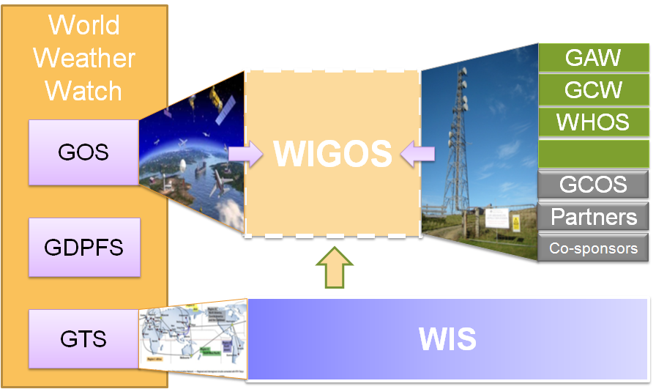
WMO INTEGRATED GLOBAL OBSERVING SYSTEM (WIGOS) and
WMO HYDROLOGICAL OBSERVING SYSTEM (WHOS)
In June 2015 the President of CHy informed Cg-17 of CHy proposal to develop WHOS as the CHy contribution to WIGOS
  Congress welcomed the effort and urged the president of CHy to continue guiding WHOS to full implementation
  Congress urged the promotion of WHOS among NHSs and the hydrological community

Slide 3
WMO Hydrological Observing System (WHOS)
Implementation:
Phase 1:
Map interface with links to those NHSs that make their real-time and historical stage and discharge data available online. implemented in August 2015.
Phase 2:
A fully WIS/WIGOS compliant services-oriented framework linking hydrologic data providers and users through a hydrologic information system enabling data registration, data discovery, and data access.
Beta version for CHy-15 review and endorsement (Dec 2016)
Initial implementation for EC approval (June 2018)

Slide 4
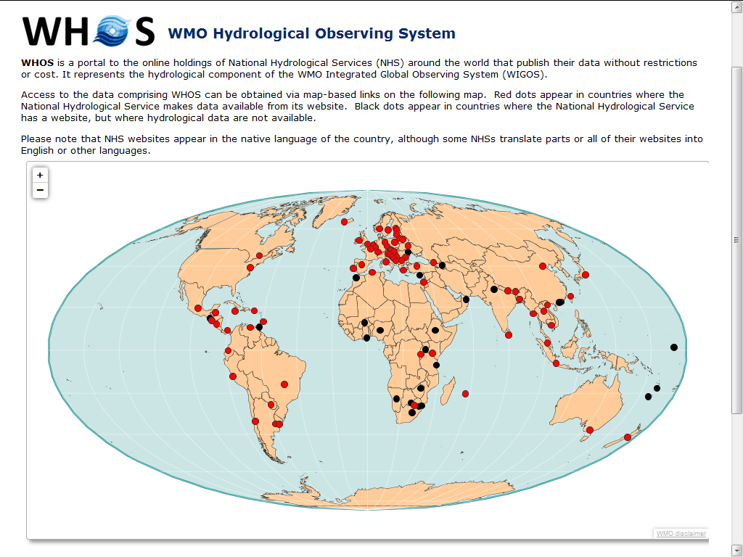
http://www.wmo.int/pages/prog/hwrp/chy/whos/index.php

Slide 5
WHOS PHASE 2

Slide 6
WHOS phase 2: Road Further Ahead in Hydrology
Using WMO and OGC Standards
HydroCatalog
(register)
CSW
HydroProvider
WFS
SOS2
(WaterML 2)
HydroClient

Slide 7
WaterML2 and SOS2
EPA
Locations
GetSites
GetSiteInfo
GetVariableInfo
GetValues
Data
Variables
UT
Date Ranges
USGS
Data
Data
WaterML2
Data
Repositories
SOS2
Web Service
Client
TRANSFORM
EXTRACT
LOAD
SOS2 is how you ask for data
WaterML2 is the format of what comes back

Slide 8
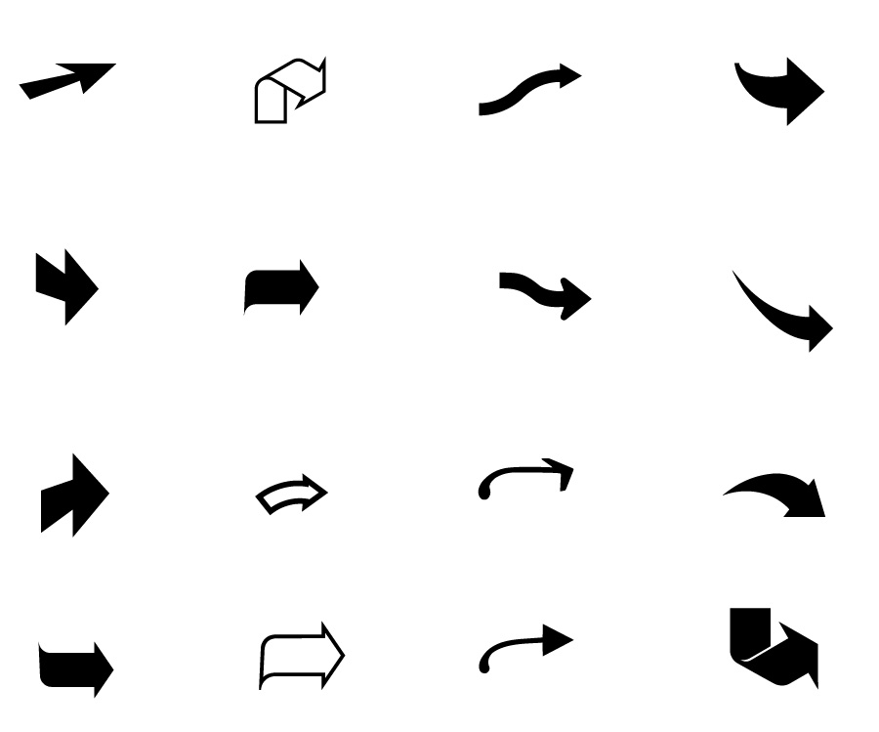



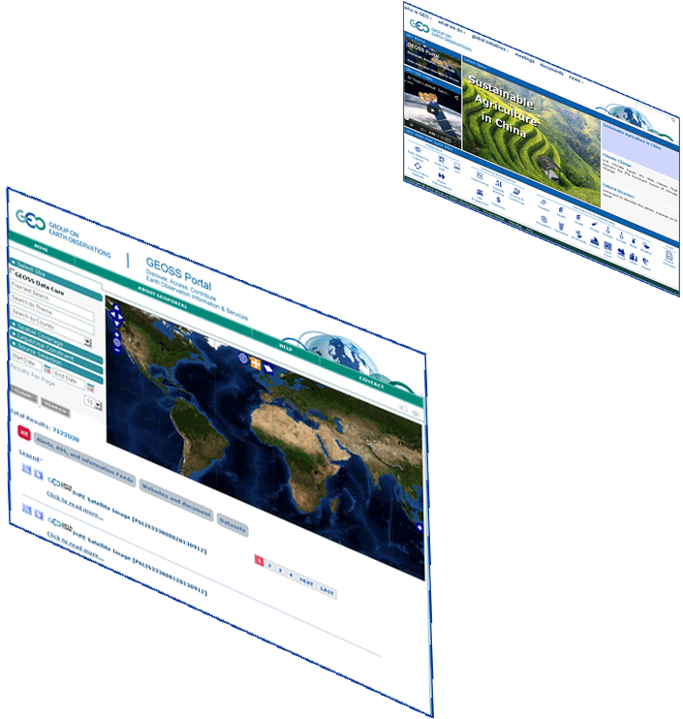
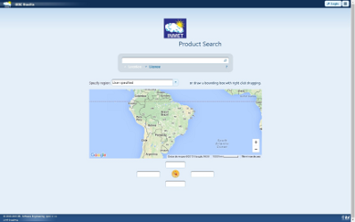


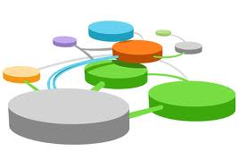





Hydrologic Information System in the Plata basin
CIC
Home Page
GISC Brasilia
Home Page
Argentina
Bolivia
PLATA HIS Portal
5 national
brokered systems
Brasil
Paraguay
Broker
and
Mediator
Systems
Registry
Semantic engines
Uruguay
...
.. .
Brokered Data Providers (capacities, systems, networks, etc.)
.. .
.. .
Hydrologic tools (tested interoperability)

Slide 9
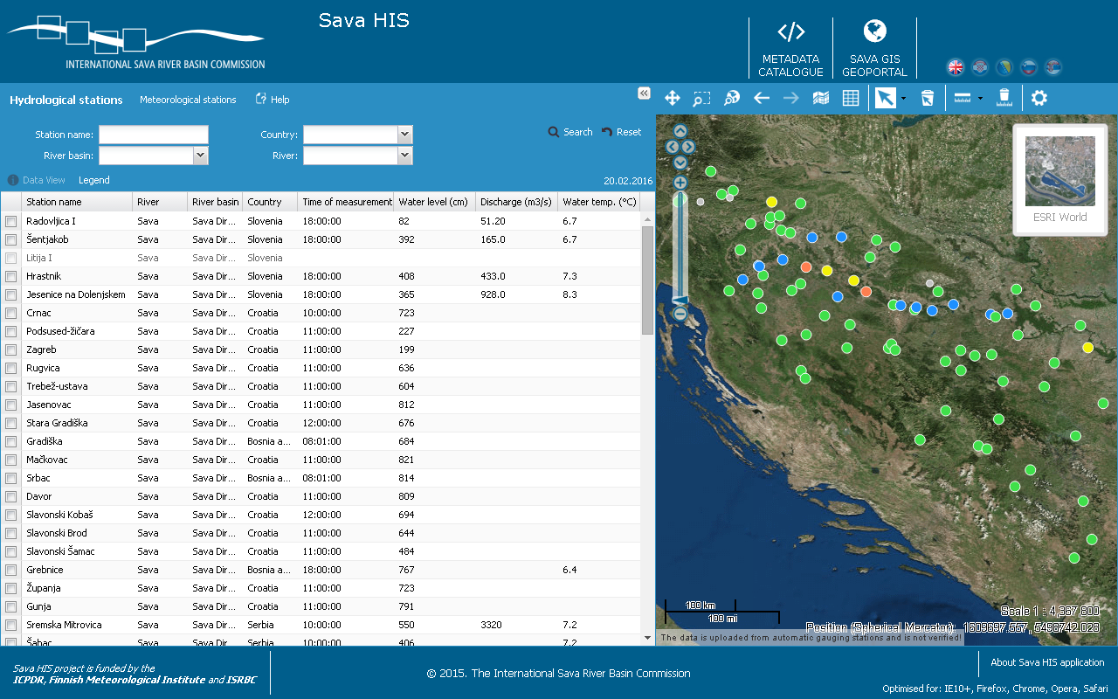
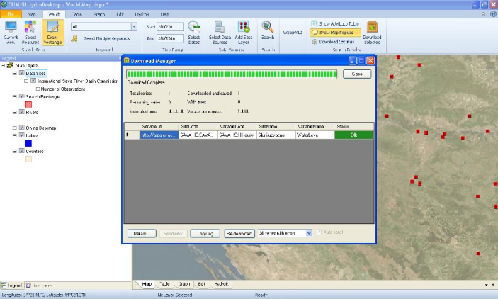
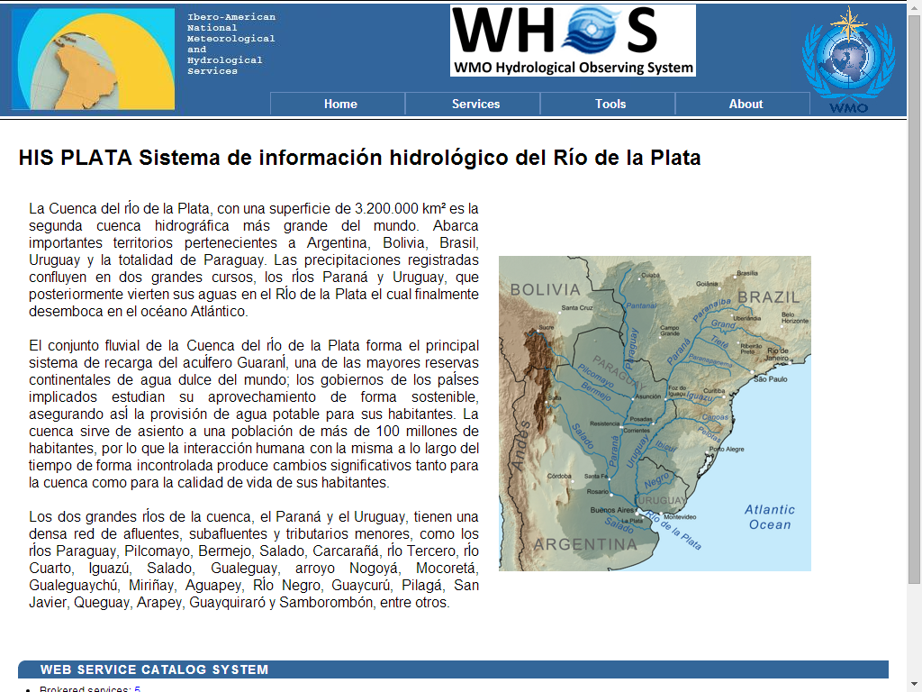
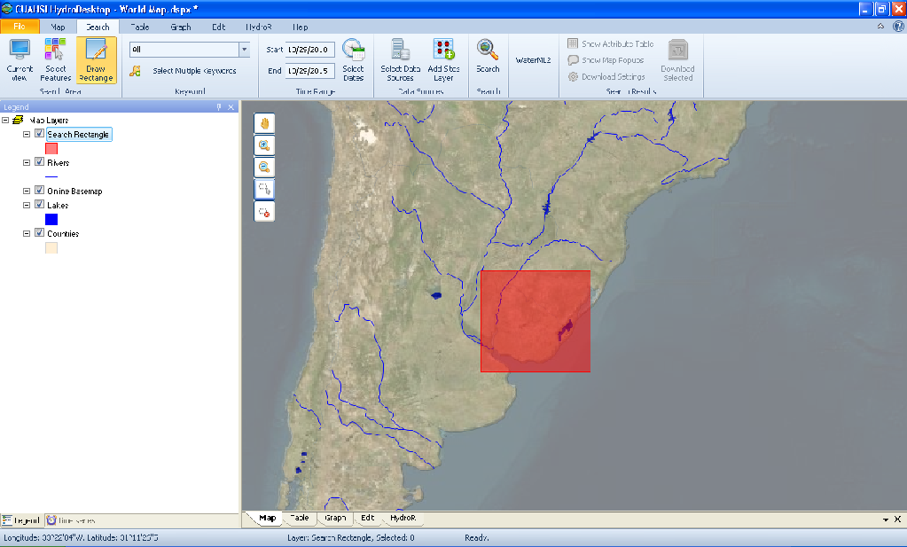
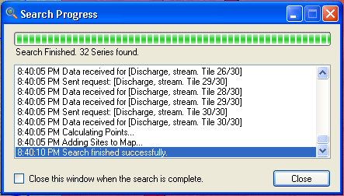
FROM DEMONSTRATIONS TO OPERATIONAL SYSTEMS
The Sava HIS
The Plata HIS

Slide 10
WMO/OGC Hydrology Domain Working Group
WaterML2 suite
TimeseriesML 1.0
Timeseries
(OGC IS 15-042r3)
(OGC IS 15-043r3)
WaterML2Part2: Ratings, Gaugings, Sections
(OGC IS 15-018r1)
WaterML2Part1:
Timeseries
Observation
(OGC IS 10-126r4)
WaterML2Part3:
Water Quality Observation (OGC BP 14-003)
SOS 2.0
Hydrology Profile
(OGC BP 14-004r1)
Hydrologic Information Standards:
of hydrologic (water) features
WaterML2Part4: Groundwater Features GroundwaterML2 (OGC IS 16-XXX)
Identification,
Observation,
Representation
…(RiverML)…:
Channel Geometry
(continuation tbd)
WaterML2Part5: Surface Water Features
HY_Features
(OGC IS 16-XXX)
SoilML component:
Soil-water (collaboration tbd)
WaterML2PartX: River Network Topology
(OGC IS YY-XXX)
CSML3 component:
Atmospheric-water
(collaboration tbd)

Slide 11
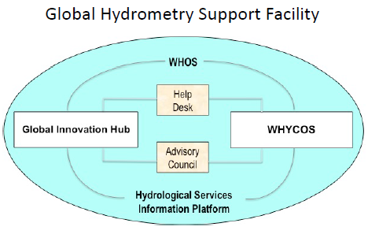
Hydrometry at WMO: towards a new paradigm
Needs
New developments and additional information
Baseline data
New technologies

Slide 12
CONCLUSIONS

Slide 13
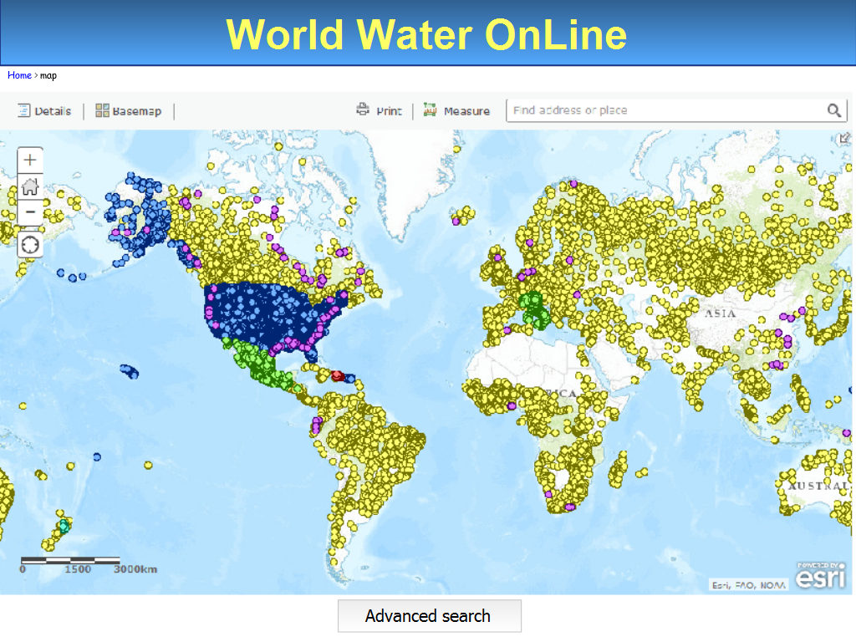

Slide 14
Some items from CHy
Hydrological data sharing is essential for improved water resources management and hydrological data availability/accessibility is fundamental to the transparent management of the resource
Many of the hydrological data providers cannot afford all the developments and\or applications compliant to standardized formats and service types. In this context, WHOS will be developed in support of NHSs for their direct participation into WIS\WIGOS
Some tests between WHOS and WIS with selected GISCs (Offenbach, Washington, Brasilia and Melbourne) were successful, but additional testing will improve the integration of WHOS into WIS
Data discovery could be dramatically augmented taking into account hydrological semantics and attributes of hydrological observations
A cloud facility would be very helpful for the development and maintenance of WHOS and its infrastructure could be shared with the WIS community
Interoperability should improve tools and techniques for the optimization of hydrological data collection and dissemination, fostering hydrological applications, including real time operations
Exchange of hydrological and related data have to be increased at national, regional and international levels. Training on standardized data exchange for both hydrological data providers and users would provide many benefits

Slide 15
Recommended Text for Report
The meeting noted that [extract key points from conclusion]

Slide 16

Thank you for your attention

