Slide 1
WIS overview
Submitted by: Secretariat (Doc 02b)
Inter-Commission Task Team on the WMO information system
(ICTT-WIS) WMO, Geneva. 12-13 Sept 2016

Slide 2
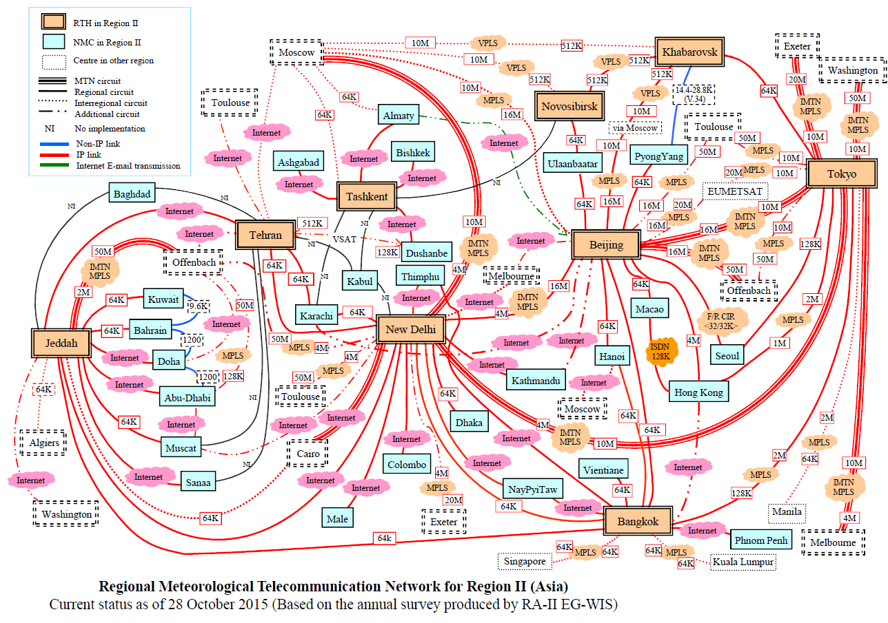
Notes:
We are all familiar with the GTS component of WIS which to date has remained largely unchanged. A centre publishes information to its RTH which passes the information to an RTH on the MTN which then sends it on to its upstream RTH on the MTN and onto other RTHs that have to send the data to other centres. However, this is about to change as we start to make use of the WIS core network where a centre sends information to its GISC, either directly or via an RTH which then sends the data to all GISCs who send to the centres in their area of responsibility.

Slide 3
WIS Routeing Roadmap
RTH(DCPC)
23: Novosibirsk24: Khabarovsk,
65: Moscow*
GISC
Moscow
RTH(DCPC)
61: Exeter*
GISC
Exeter
GISC
Beijing
RTH(DCPC)
28: Beijing*
RTH(DCPC)
12. Nairobi*
62: Norrköping
64: Offenbach*
67. Prague*
66: Rome
68: Vienna
69. Sofia*
GISC
Tokyo
RTH(DCPC)
25: Tokyo*
26: Bangkok
GISC
Offenbach
GISC
Seoul
RTH(DCPC)
22: Tashkent
GISC
Toulouse
RTH(DCPC)
63: Toulouse*
16. Algiers*
WIS Core Network
GISC
Jeddah
RTH(DCPC)
29: Jeddah*
GISC
Casablanca
RTH(DCPC)
11. Cairo*
15. Dakar* 17. Brazzaville
18. Niamey
GISC
Tehran
RTH(DCPC)
21: Tehran
GISC
Pretoria
GISC
New Delhi
RTH(DCPC)
14: Pretoria
GISC
Washington
GISC
Brasilia
GISC
Melbourne
RTH(DCPC)
27: New Delhi*
RTH(DCPC)
41: Washington*
RTH(DCPC)
31: Brasilia*, 32: Buenos Aires*
33: Maracay
RTH(DCPC)
51: Melbourne*
52: Wellington
Notes:
The new GTS routeing is expect to look something like this. In this way getting data from one centre to all others can be done in 3 hops. Centre to GISC, GISC to all other GISCs, then GISC to centres in its AoR. It is expected that the RTHs will soon become backup links between their centres and their GISC rather than the primary link. However, the GTS is only one communication channel in WIS.

Slide 4
Dissemination of warnings
There are many technologies involved
These include fixed and mobile technology; land and space based.
Authoritative Warning Service Provider
GTS (including satellite broadcast, etc)
FAX
SMS
Internet (email, FTP, etc)
Authoritative Warning
Recipient
Notes:
There are many technologies involved in the collection of observations and dissemination forecasts and warnings.
They include fixed and mobile technology, both terrestrial and space based but can be categorized into four basic paths being: the GTS, Fax, SMS and the internet, both email, ftp and so on.
Many WMO programmes are already making use of these but I want to show you how WIS can take this even further.

Slide 5
Dissemination of warnings in WIS
WIS incorporates all dissemination types.
Opens the way for using our common infrastructure for “all hazards warnings”
Partnerships
Authoritative Warning Service Provider
GTS (including satellite broadcast, etc)
FAX
SMS
Internet (email, FTP, etc)
Authoritative Warning
Recipient
Notes:
WIS incorporates all dissemination types, and supports special warning related protocols such as the OASIS/ITU/ISO common alerting protocol.
Most importantly, WIS opens the way for allowing partners to work with us to form warning services that function as if they were an integrated service.
This is done through use of the common infrastructure and importantly, use of agreed information management and practices necessary for the interoperability between partners systems and NMHSs.

Slide 6
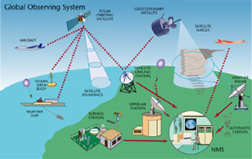
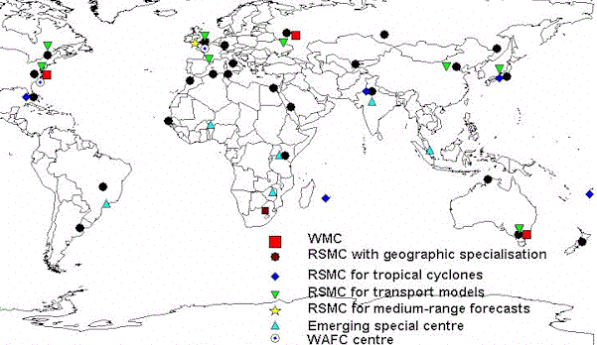
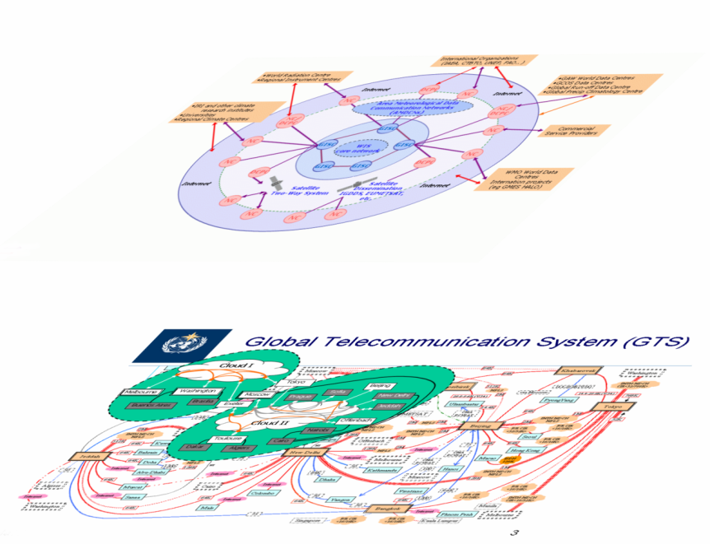
Internationally coordinated network of WMO
GDPFS
WIGOS
WIS / GTS
Partnerships
WMO Programmes
Notes:
WIS is an internationally coordinated network that allows WMO programmes and partners to work with WIGOS and GDPFS to provide better and more sustainable services.

Slide 7
Current status of WIS
Centres
358 data centres and 15 GISCs in WIS
224 National Centres
134 Data collection or production centres
342 endorsed by Cg/EC
Networks
Moving to make better use of WIS
Looking at cloud based solutions
Tech Regulations
Manuals and guides in place, being refined (eg Governance, QMS, etc)
How to manage historic links to World Wx Watch
Do we merge GTS manual & guides into WIS manual and guides
New WIS Part C – Information Management
Guidance on best practices across all programmes.
WIS 2.0
What will WIS 2.0 look like, and how to get there
Notes:
There are 358 data centres in WIS plus 15 GISCs. 224 of these data centres are NCs, 134 DCPCs. More centres are joining or planning to join and be a contributor in WIS
As WIS evolves, we will see more centres communicating directly with their GISC, enabling faster distribution and collection of data.
CBS is evaluating new technologies that could result in faster and more cost effective exchange of information. One promising solution is more use of cloud based systems as well as communications.
Cg-17 has tasked WIS to now broaden its scope by addressing information management across WMO programmes and producing guidance on best practices and standardising where applicable.

Slide 8
WIS Implementation
National WIS knowledge by Region (Percentage of region responses)
Level of national implementation by region (Percentage of region responses)
1 – Little or no knowledge of WIS
5 – Extensive knowledge of WIS
Notes:
So just how far have Members come. Here we can see that although the Members are showing an increase in WIS understanding across the regions, significant number of Members have little or only some of the new functionality in place. We really need to work on building WIS competencies and assisting Members to get them in place.

Slide 9
Conclusion
WIS is an enabler for all WMO priorities, including
Multi hazard early warning systems
Regional WIS Implementation Plans are there to ensure all Members implement and benefit from WIS
Need to prioritise ensuring all countries understand WIS and have implemented at least some new functionality
Make implementing WIS a core part of any national or regional strategy for establishing other services
Remember, at a national level, WIS is largely a matter of staff competencies and effort.
Make WIS implementation a high priority for all NMHS
Utilize GISC infrastructure, support and training
WIS is operational and its components are still evolving
More Members are understanding and implementing WIS
They are starting to benefit from WIS
Need to address
WIS governance issues now and
put in place a strategy to see how WIS is in the future and how to get there

Slide 10
Recommended Text for Report
The meeting noted that [extract key points from conclusion]

Slide 11
Thank you for your attention

