Slide 1
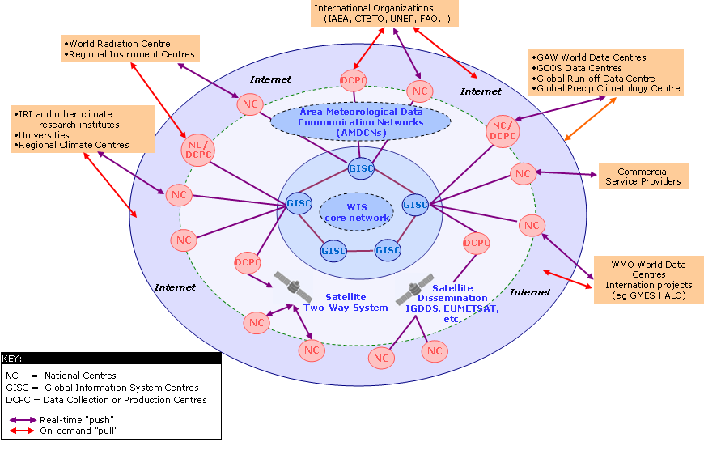
Evolution of WIS
Information activities
Create
Store
Share
Use
Archive
Destroy

