Slide 1
Tips on using WebEx
WIS department
WMO; WIS

Slide 2
Tips for users

Slide 3
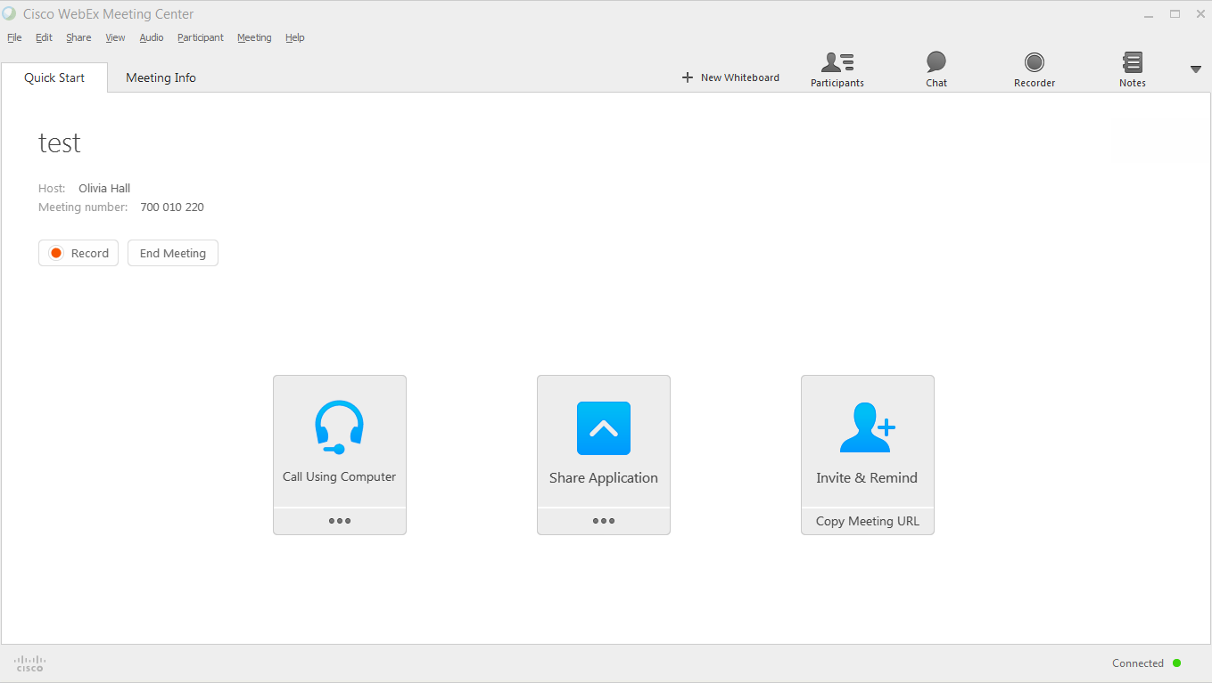
Initial display
Plug in your headset before you start WebEx. If you cannot make your audio work, try leaving the meeting and re-joining.
Meeting organizer only
Choose your audio- click on dots
Presenter – click on dots to choose what to display

Slide 4
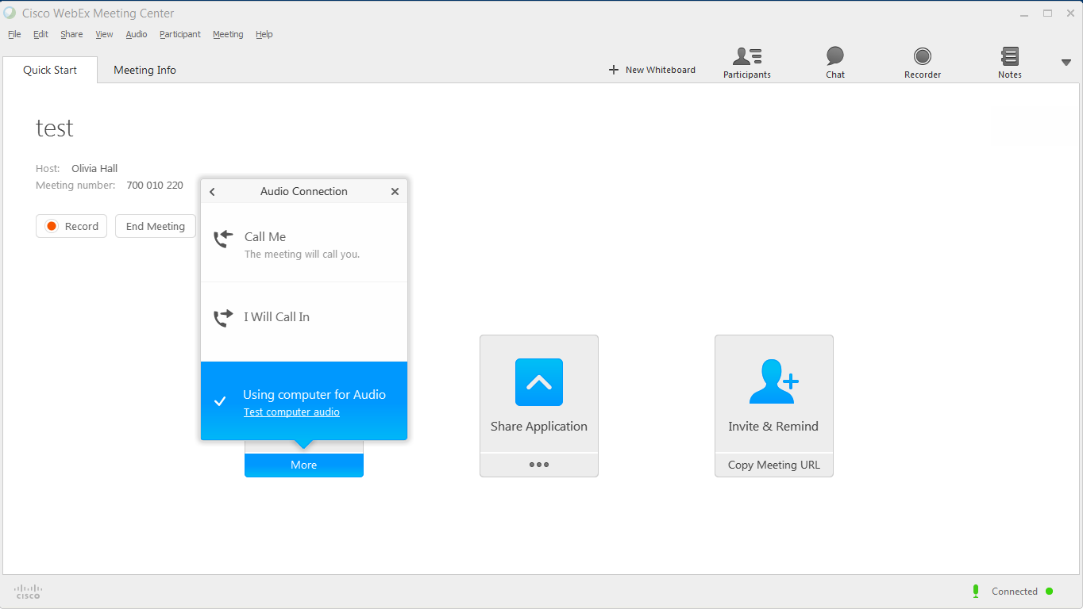
Page title here
WebEx phones you
You phone WebEx
Use computer microphone/speakers

Slide 5
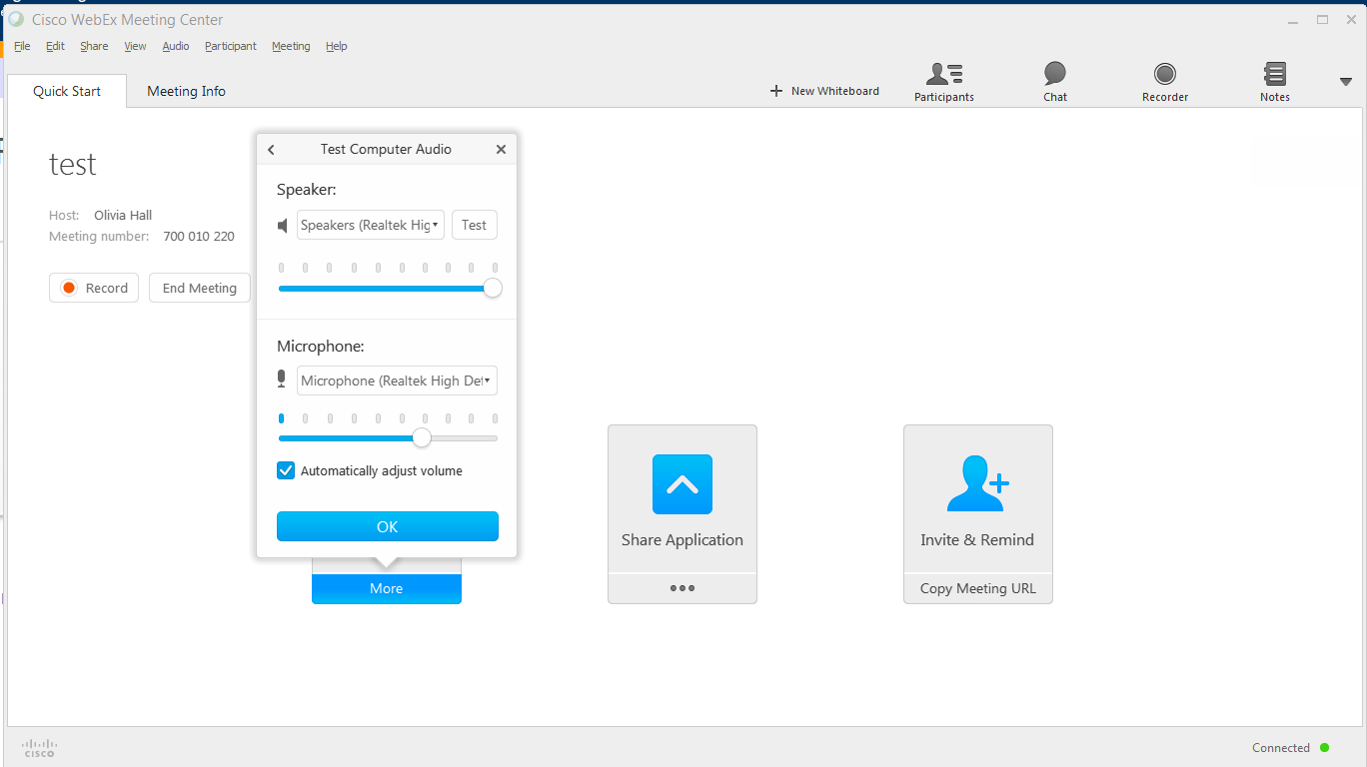
Set up your computer sound and microphone
Select the right speakers!
Press test to check speaker levels
Test microphone works
You may have several microphones to choose from

Slide 6
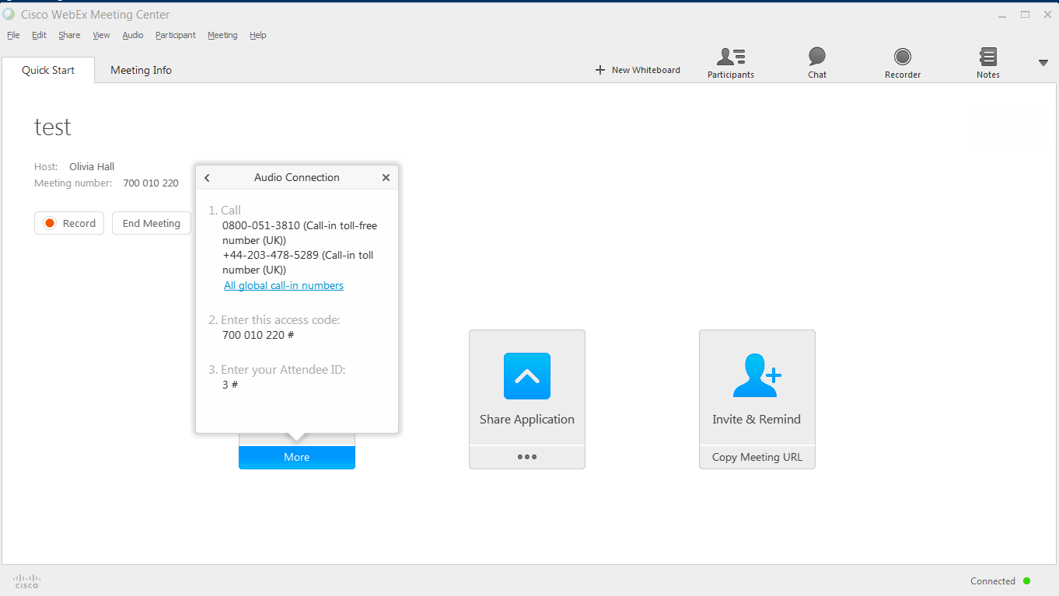
You phone WebEx
Where to find number to call
Meeting number
Your meeting participant number

Slide 7
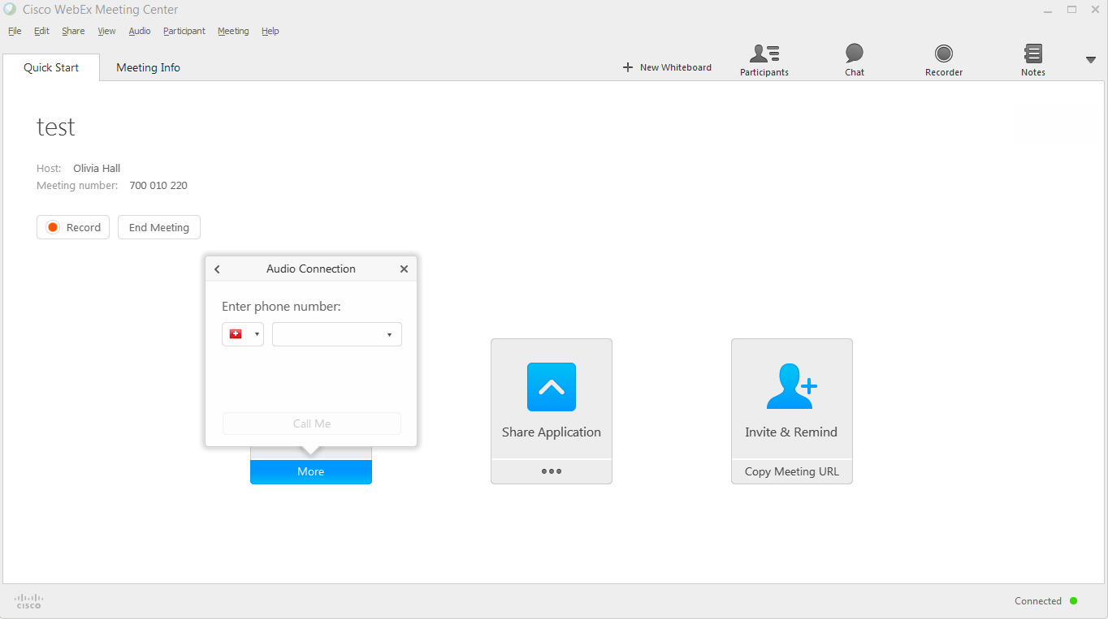
WebEx phones you
Phone number in country – no leading zero
Choose the country code – you need to know flags!

Slide 8
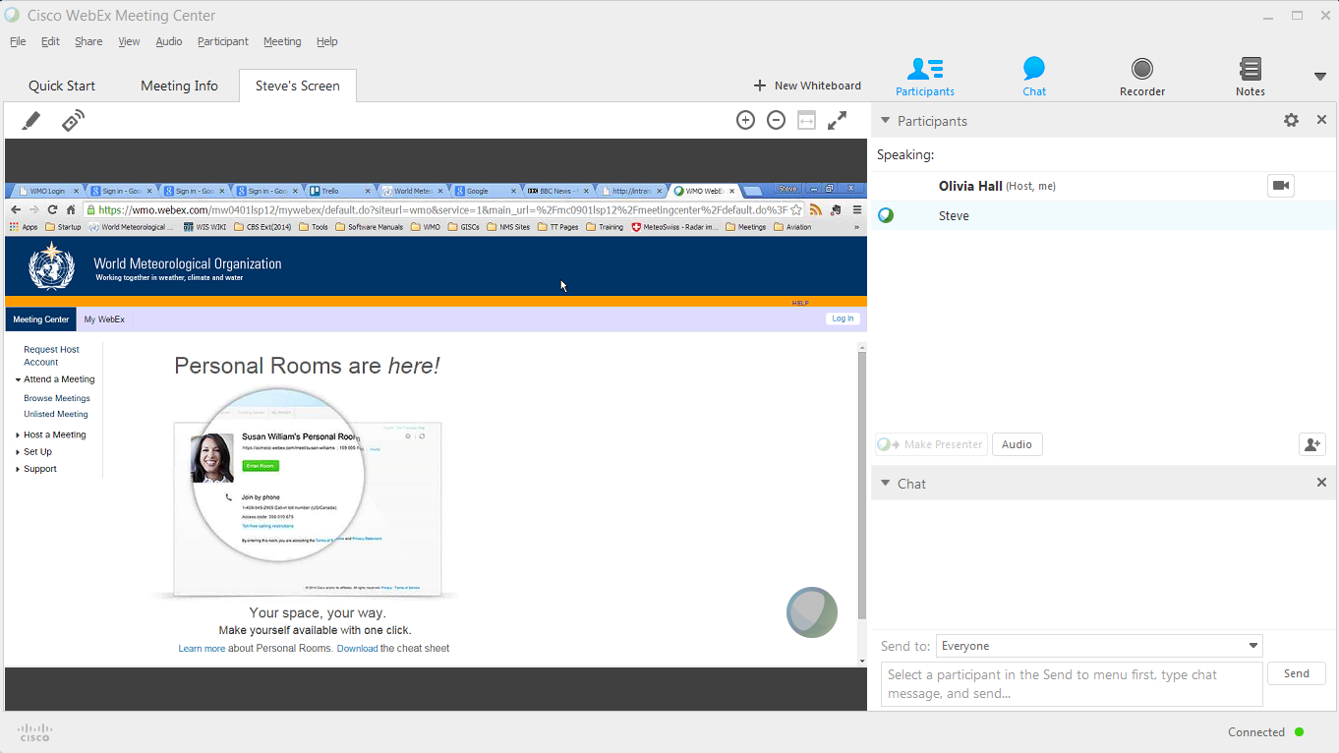
How to move around session information
Tab takes you back to opening screen
Tab for screen being shared with you
Show chat window
Meeting details tab
Show participants list
Full screen mode

Slide 9
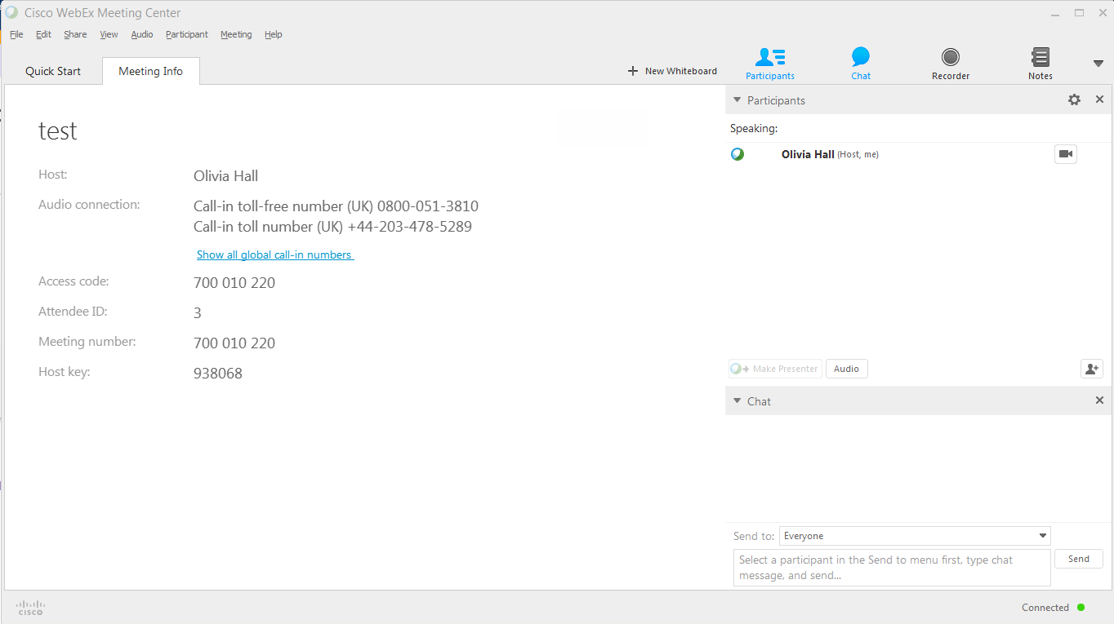
Meeting information view
List of participants
The “ball” shows who is presenting. The host, and the person presenting, can change presenter by “moving the ball.”
Chat messages

Slide 10
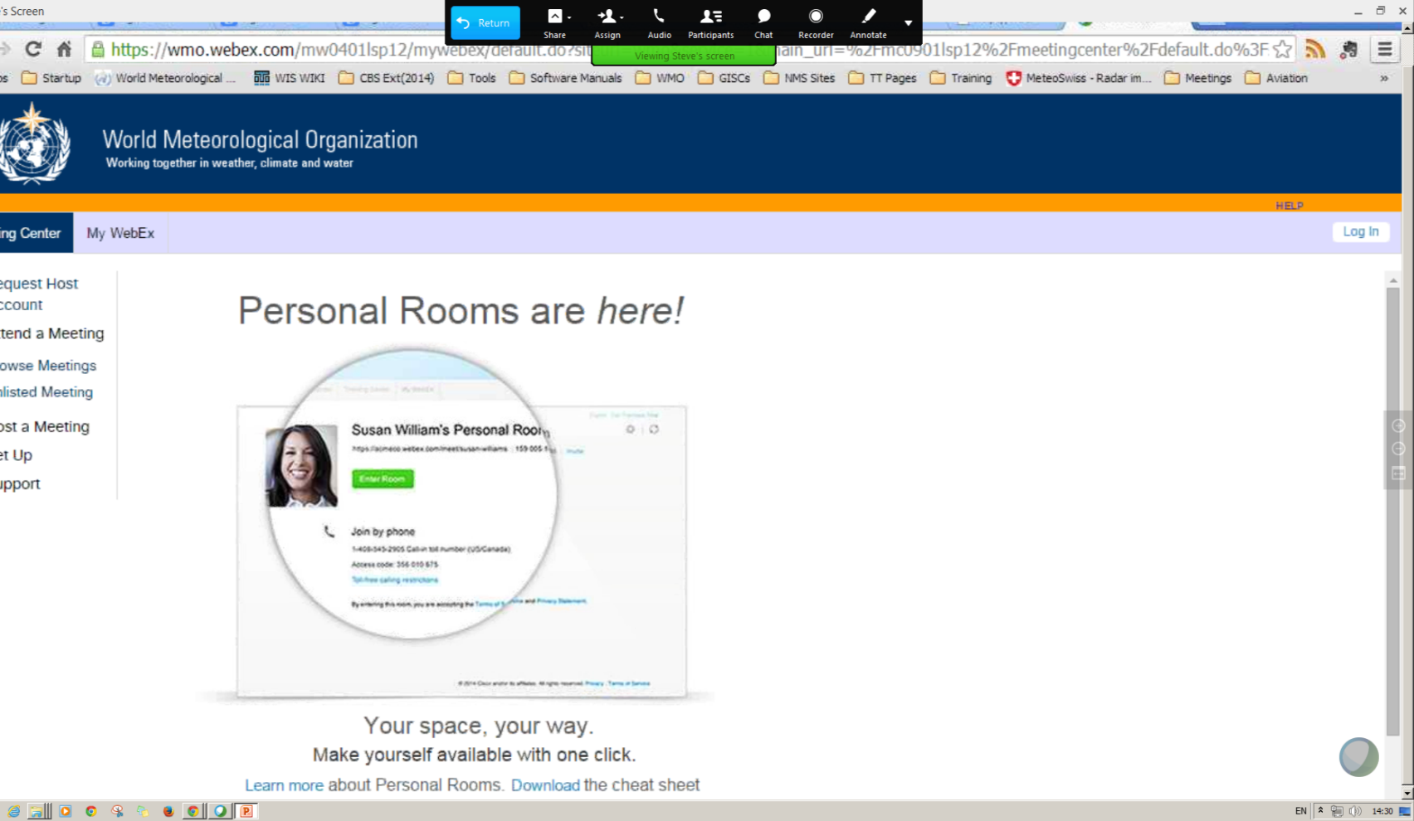
Finding the controls when full screen
Move your pointer to the top of the screen and the menu appears
Participants and chat appear in separate windows

Slide 11
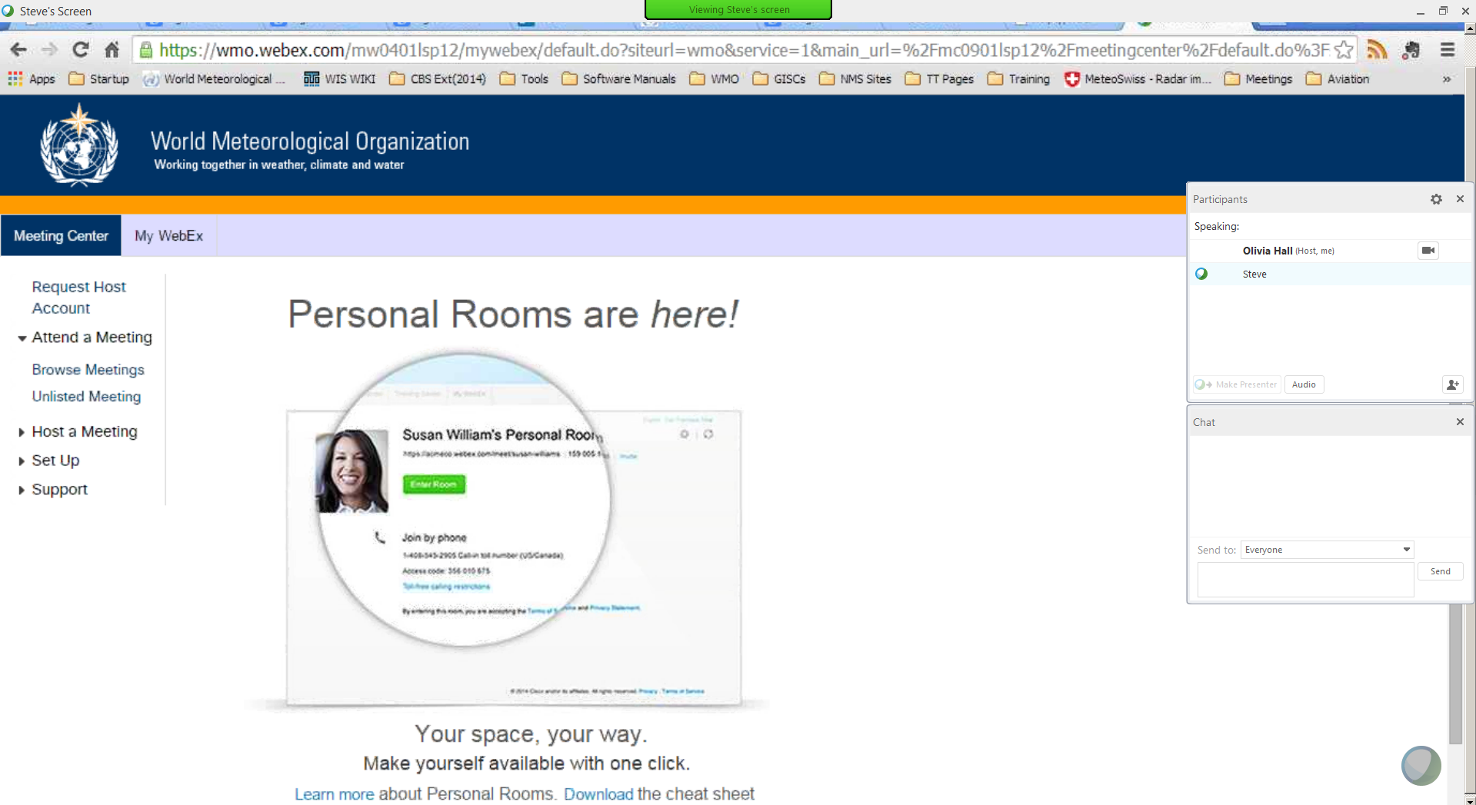
Other useful controls
Choose which of your webcams to use with the settings cog
If you are a participant (not the host), you will see a picture of a hand at the bottom of the participants pane – push it and the organizer will see on the participants list that you want to speak. Remember to push it again to turn it off.
Turn your webcam on or off here

Slide 12
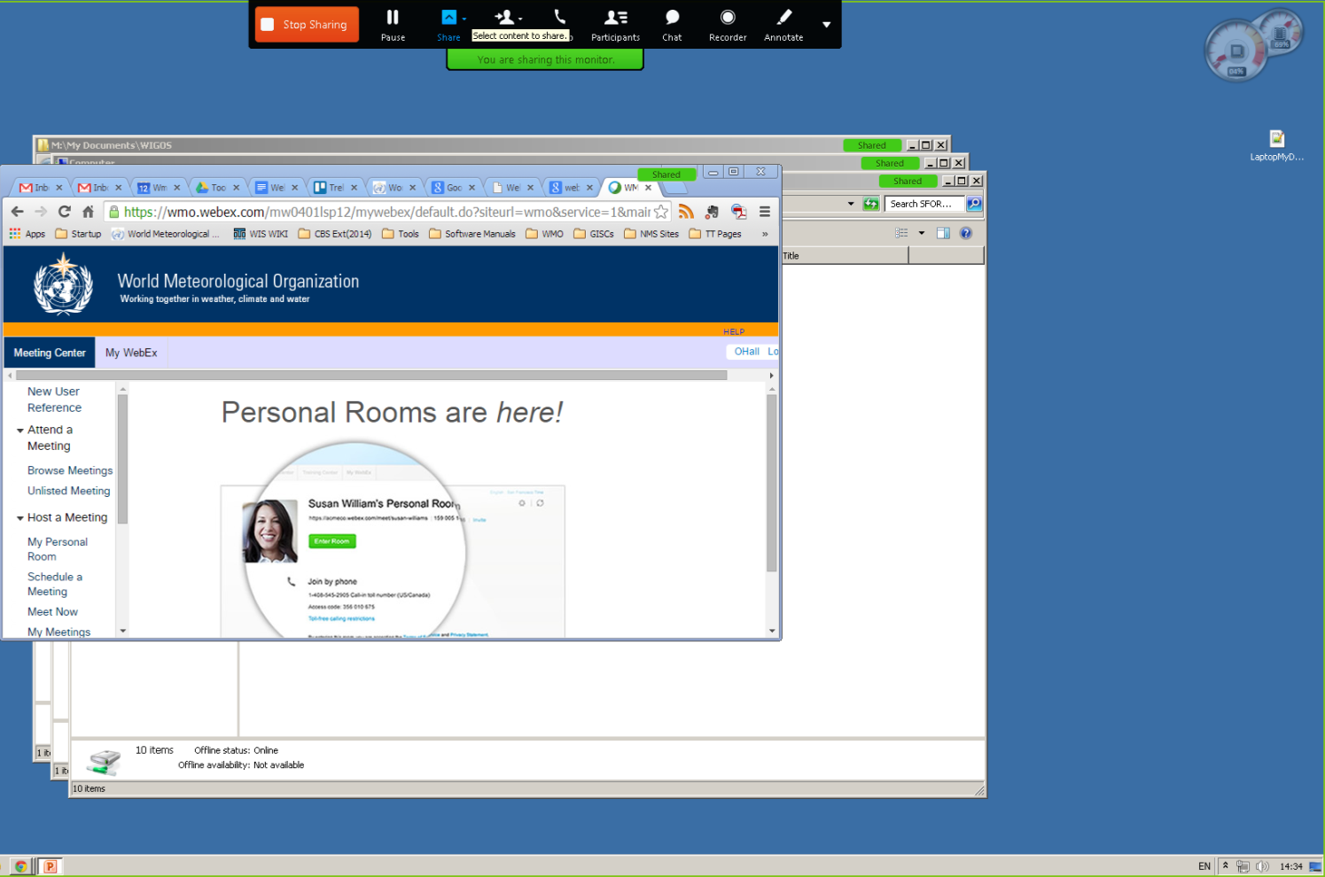
Controlling sharing
Stop sharing does just what it says!
You can share your whole screen (only one monitor if you have more than one), or just a window from an application
Don’t minimize the application!

Slide 13
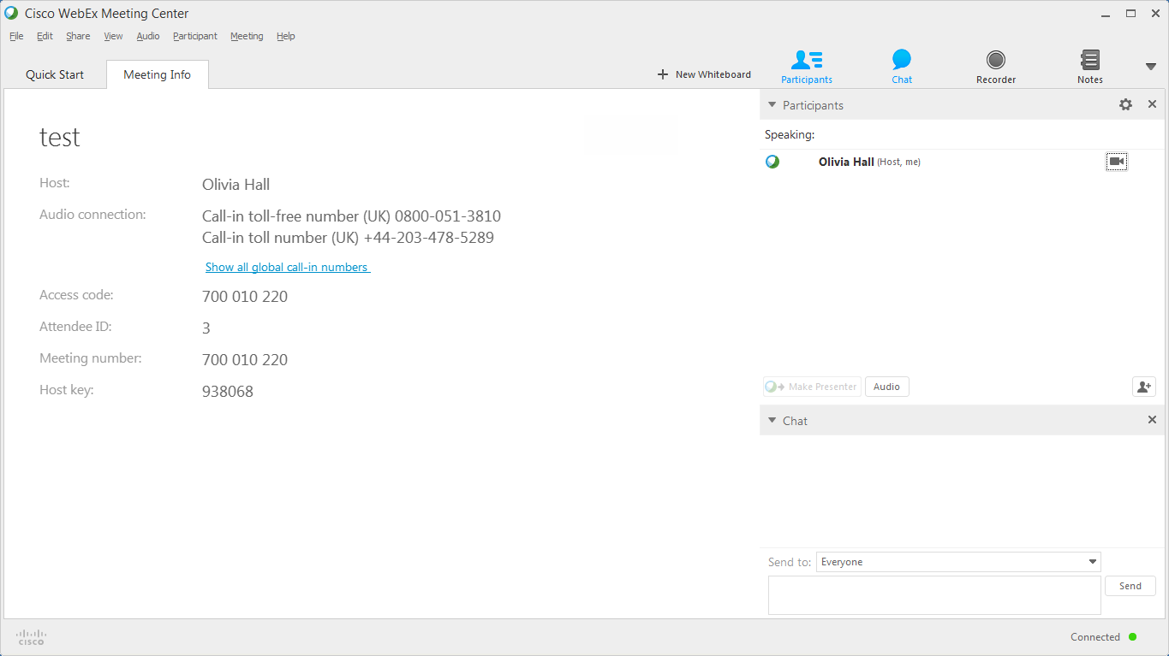
Leaving the meeting
Leave the meeting using the File..leave meeting menu item

Slide 14
Tips for presenters

Slide 15
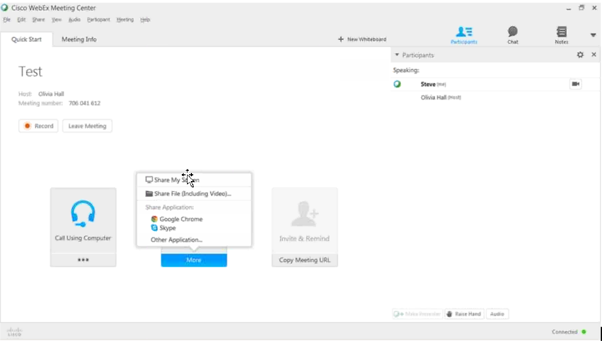
Sharing your screen
Whole screen (if you have 2 monitors you will be asked which one).
Choose a window to share
You can pass the presenter role to someone else – move the “ball.”
Open a file and display its contents.
Choose sharing options.
When you share your screen, the WebEx windows (Participants, chat, main WebEx app) will not be shown –but the area they cover will be shown by grey rectangles,

Slide 16
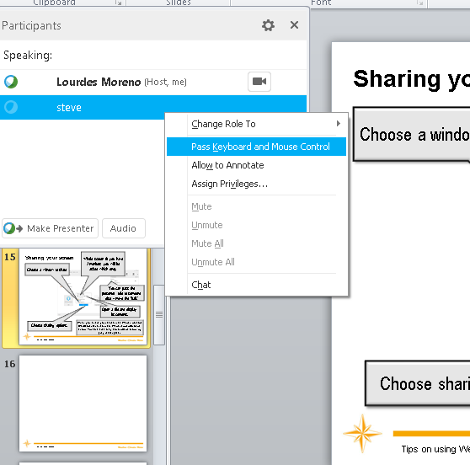
Allow someone to control your computer
You can use the participants list to….
…allow someone to control your computer (eg type into a document that is being shared)
Get back control by clicking anywhere with your mouse.

Slide 17
Tips for hosts

Slide 18
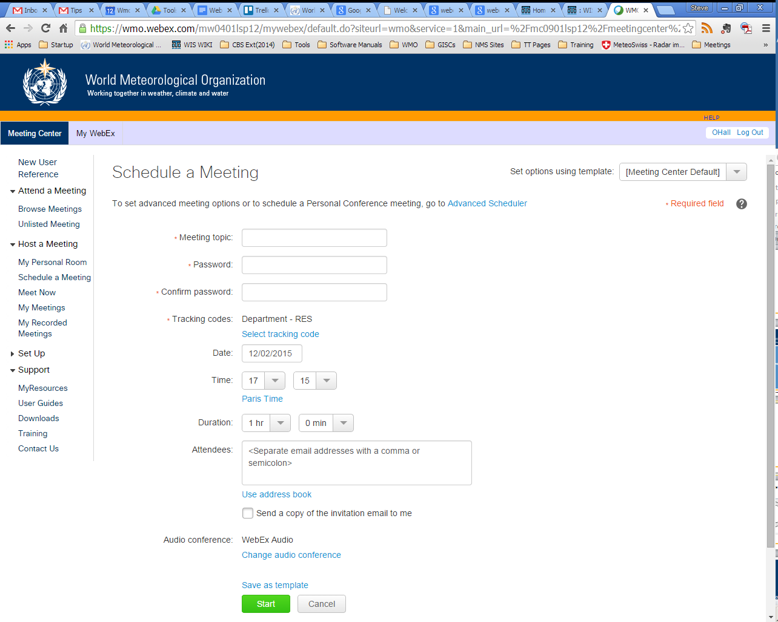
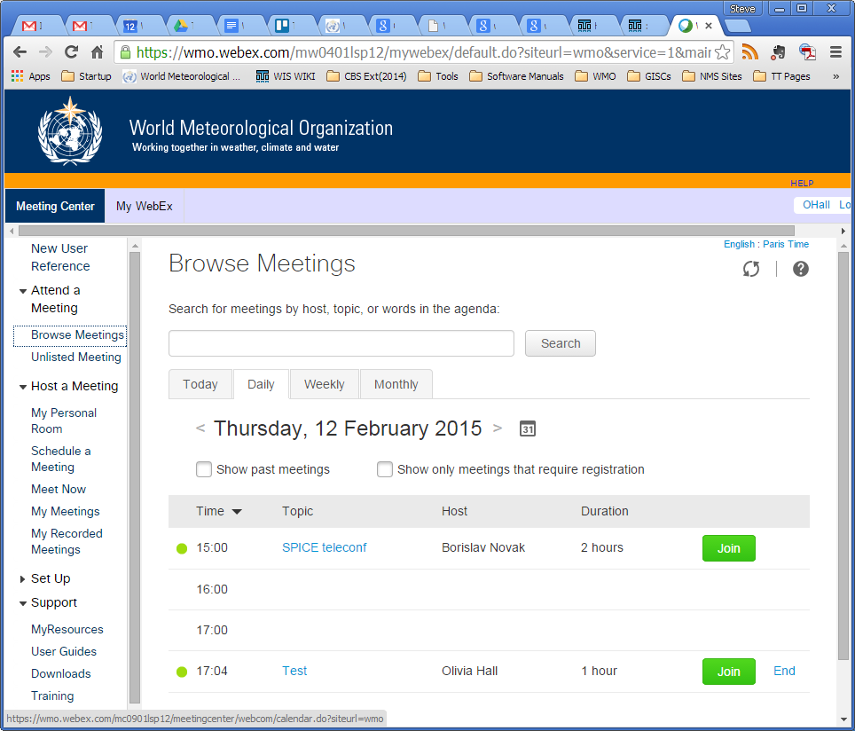
Setting up a meeting
Don’t log on to a second computer to prepare your next meeting. Starting a second meeting belonging to a username ends the first meeting.
Remember to set the account code.
Include your own email account – so you have all the details emailed to you.
When logged on, click on a meeting title and then on “more information” to get the meeting number and password.

Slide 19
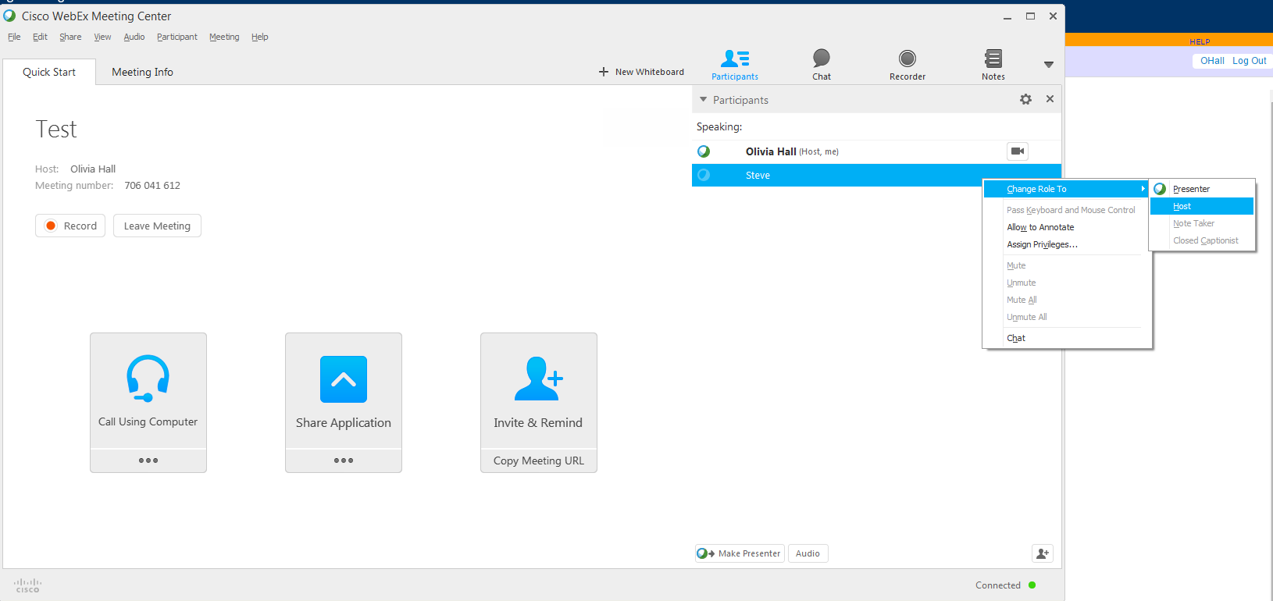
Controls for hosts
Change someone’s role
Right click on a participant to bring up the sub-menu.
You can change presenter from this menu
If you need to leave the meeting, pass the Host role to someone else so you do not stop the meeting when you quit.

Slide 20
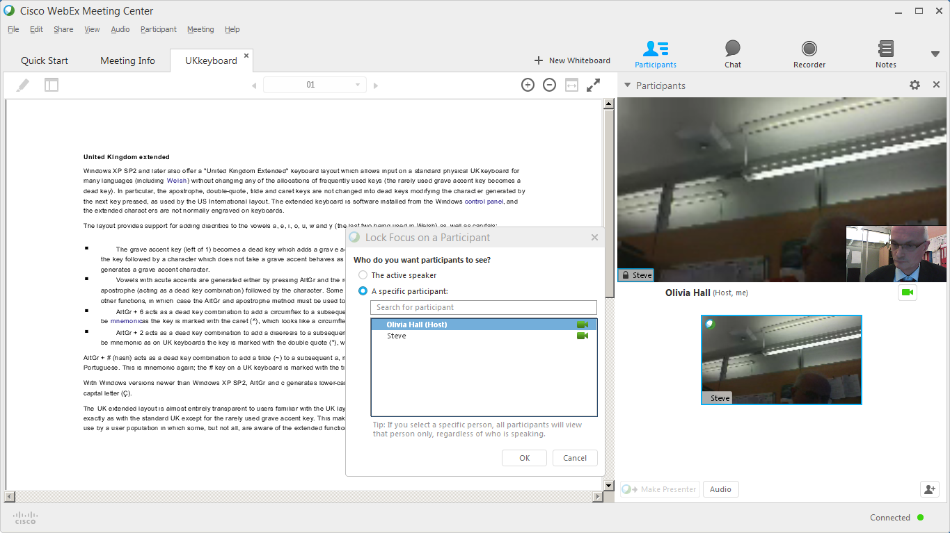
You can choose to always show one webcam
By default, WebEx shows the webcam of whoever is speaking. You can lock the main display to a webcam you choose.
Click on the name in the main webcam display
Choose which webcam to display
Webcams eat bandwidth. If audio is poor, ask people to turn off their webcams.

Slide 21
Use two sessions
Juggling the roles of meeting host and presenter is difficult
Log on using two computers (eg desktop and laptop) – one as the meeting host, and the other to use as normal during the meeting.
follow chats, control participation, monitor whether people have their hands up without disrupting the display
make sure that the audio/video is working
You might want to have someone with you to control the session if you are presenting.

Slide 22
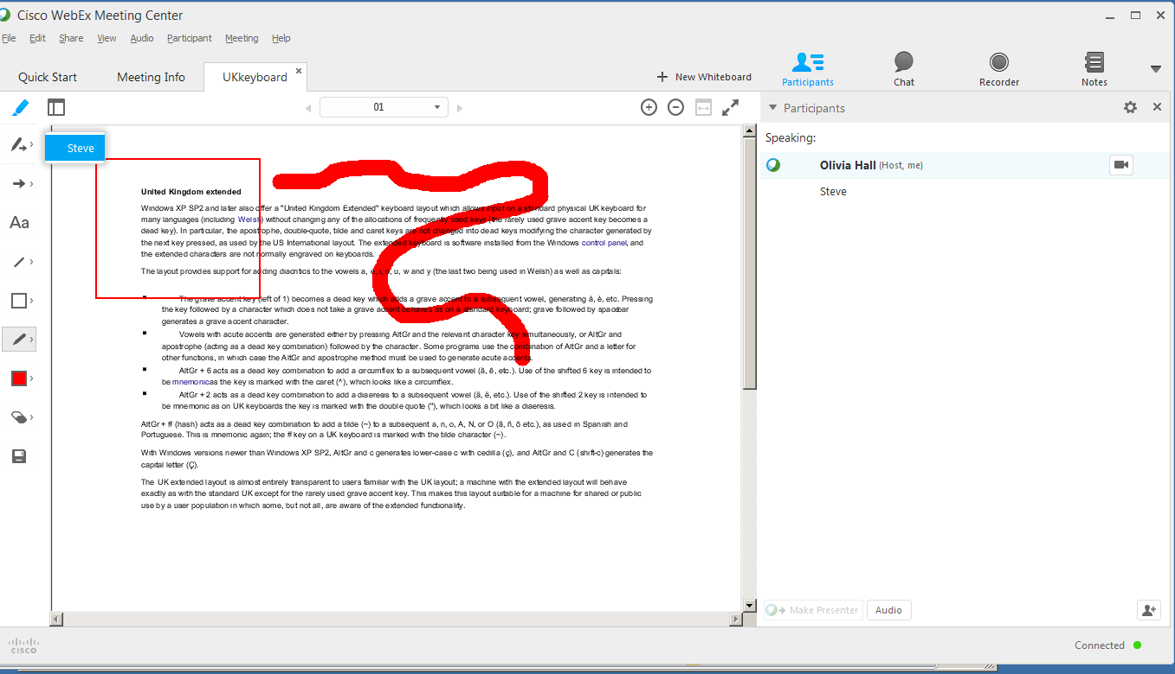
Annotations
Click to allow annotations
Allow someone to annotate the document
Save annotations (you can choose pdf)
Pens, shapes are available

Slide 23
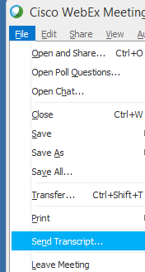
Remembering your meeting
You can email the chat (and optionally documents shown) to participants
You can record the display and audio
All users can type text notes

Slide 24
Thank you for your attention
wis-help@wmo.int

