Slide 1
Status of WCD development
at GISC Tokyo
GISC Tokyo
28th Jan, 2015

Slide 2
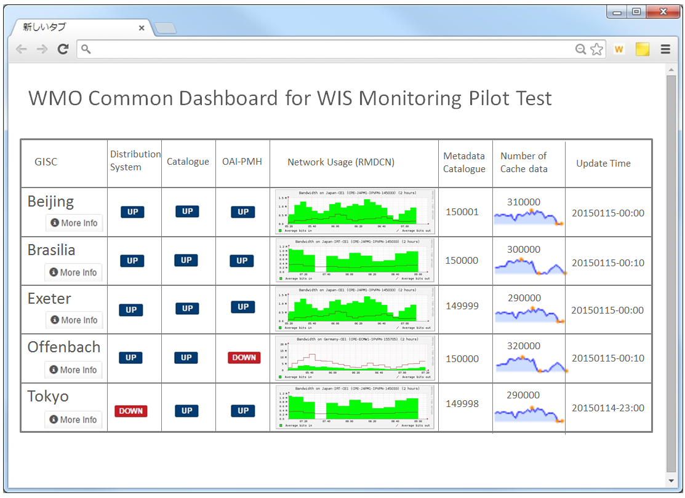
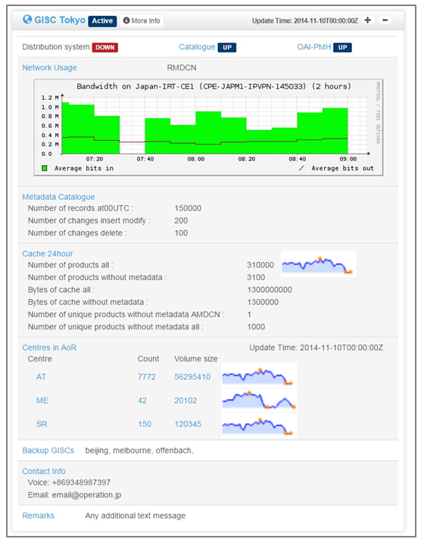
Simple illustration of dashboard in JMA
[Top window]
[Detail window]
[Features]
Dashboard fetches all GISCs’ JSON files available on the Internet.
Top window shows main metrics value and status of all GISCs in tabular format, which is BoM’s initial idea.
Detail window shows all information of one GISC, which includes metrics value of centres in AoR of the GISC.
Any metrics value and status can be shown by time-series graph, as needed.

Slide 3
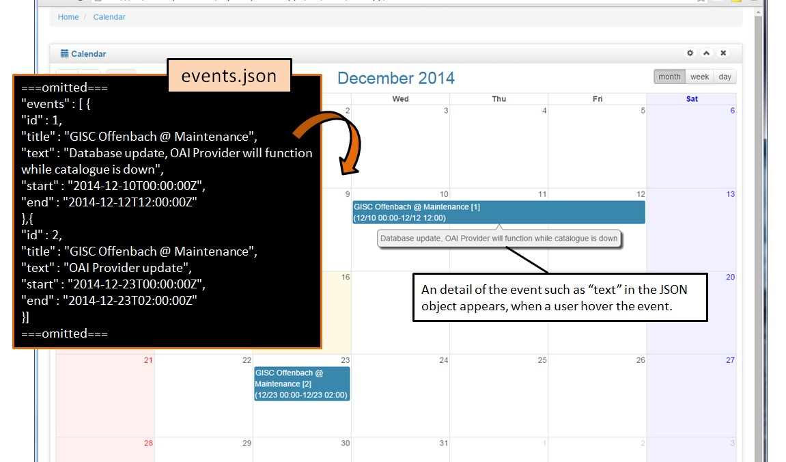
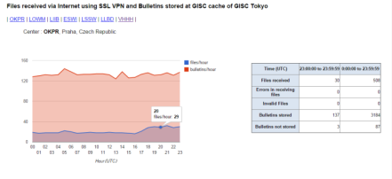
[Calendar window]
[Features]
Calendar window shows schedule of all GISCs, such as maintenance.
Calendar window reflects “events.json” of each GISC.
[GISC Tokyo’s own monitoring page]
http://www.wis-jma.go.jp/iwgmonitor/iwgmonitor.jsp

Slide 4
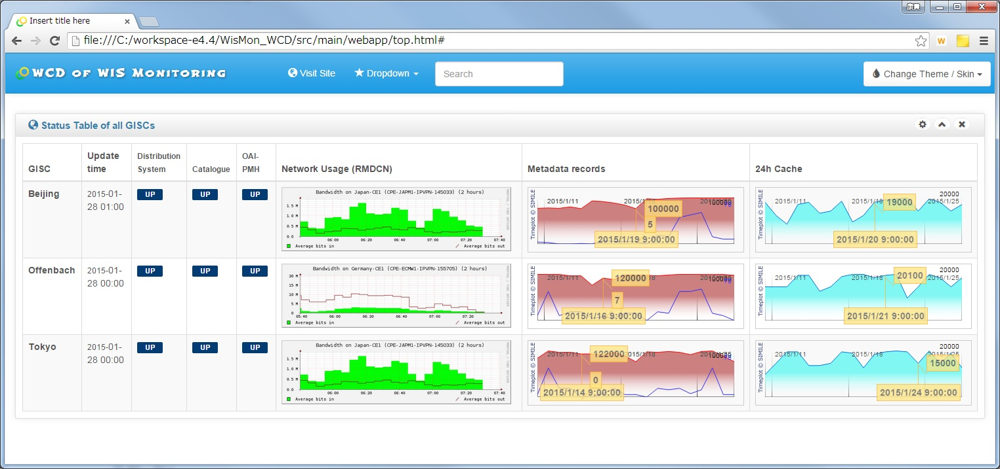
Image capture of top page - Under development -
sample data
sample data
Of course, JMA is refining it.
[Schedule for dashboard]
- First version of the dashboard is available [by 27/2/2015]
- Test phase: Fix bugs and reflect metric values correctly [by 5/2015]

