Slide 1
The WMO Integrated Global Observing System (WIGOS) Pre-operational Phase
RA-III Working Group on Infrastructure
Asuncion, Oct 5-9 2015
Dr. Lars Peter Riishojgaard,
WIGOS Project Manager, WMO Secretariat

Slide 2
Outline
What is WIGOS
Why do we need it?
Status of the WIGOS Framework
Regional level
The next four years: The WIGOS Pre-Operational Phase
Summary and conclusions
WMO

Slide 3
What is WIGOS?
WMO foundational activity addressing the observing needs of the weather, climate, water and environmental services of its Members
A framework for integrating all WMO observing systems and WMO contributions to co-sponsored observing systems under a common regulatory and management framework
Together with the WMO Information System (WIS), WIGOS is a WMO contribution to GEOSS.
WIGOS is not:
Replacing or taking over existing observing systems, which will continue to be owned and operated by a diverse array of organizations and programmes, national as well as international.

Slide 4
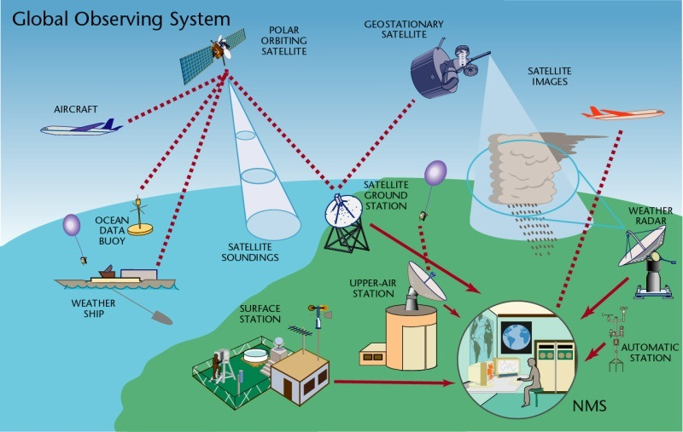
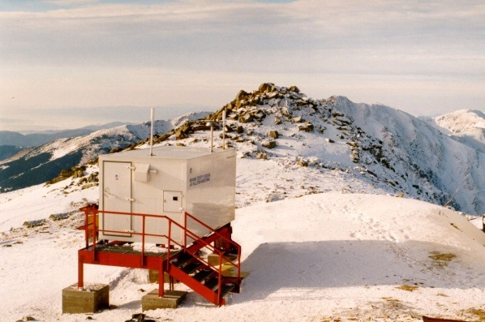
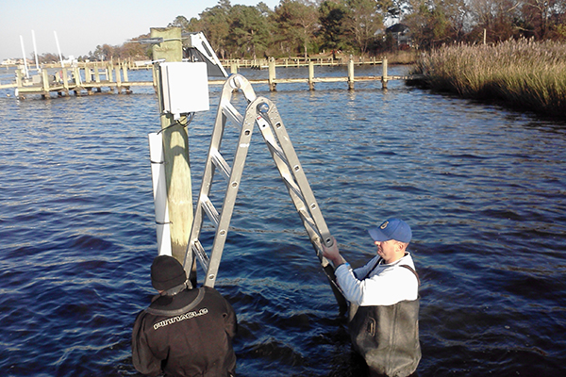
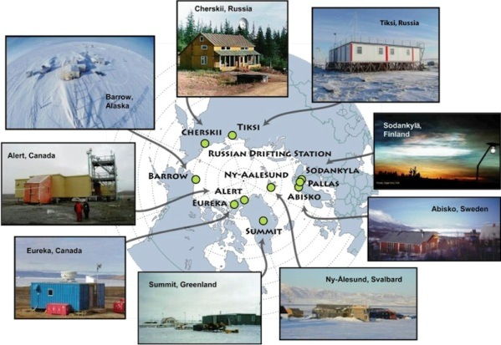
WIGOS Component Systems
Global Observing System (WWW/GOS)
Observing component of Global Atmospheric Watch (GAW)
WMO Hydrological Observations (including WHYCOS)
Observing component of Global Cryosphere Watch (GCW)

Slide 5
Why do we need WIGOS?
I. NMHS mandate typically broader now than when the World Weather Watch and the GOS were created, including e.g.
Climate monitoring, climate change, mitigation
Air quality, atmospheric composition from urban to planetary scales
Oceans
Cryosphere
Water resources
II. Technical and scientific advances:
Observing technology
Telecommunications
Numerical modeling and data assimilation
Increased user demand to access and use observations in decision making

Slide 6
Why do we need WIGOS?
III. Economic realities
Budgetary pressure on many NMHS, in spite of growing mandate and increasing demand for services
Efficiency by exploiting synergies
Integration of observing networks across disciplines (e.g. weather and climate)
Integration across organizational boundaries, e.g. between different national ministries/departments operating observing systems
Integration across technological boundaries, e.g. between surface- and space-based systems
Basic principle: One observation, many applications, many users

Slide 7
WIGOS Implementation Phase
WMO 16th Congress (2011): Implementation of WIGOS
Key deliverables for the 17th Congress (2015): Draft Technical Regulations on WIGOS; link here
Draft Manual on WIGOS; link here
WIGOS Metadata Standard; link here
Regional Implementation Plans
Proposal for the Pre-Operational Phase of WIGOS (2016-19)
All deliverables were approved by Cg-17

Slide 8
Regional WIGOS Implementation Plans
(R-WIPs)
R-WIPs developed for all WMO Regions by Regional WIGOS Task Teams or Working Groups, typically helped along by dedicated WIGOS Workshops
All WMO Regional Associations have approved their R-WIPs (Region III during its 16th Session in Asuncion in 2014)
Important now to align national priorities, VCP request and donor-funded projects with the respective R-WIP to the extent possible
Regional Working Structures to oversee and coordinate the WIGOS implementation are still developing, and differ from region to region
In Region III, WG-ITD is responsible

Slide 9
RA-III WIGOS Implementation Plan
(R-WIP-III)
Lists a number of regional activities with deliverables
Many are generic in nature (identical language in all plans)
Specific RA-III Projects mentioned in the WIP:
Mechanisms to integrate observing systems with RA IV
Develop an implementation plan for a regional radar network, taking account of experience in Region IV
WIGOS-SAS (see also presentation by Arimatea)
Unique WIGOS demonstration project covering the Plata Basin, with a strong hydrological component
Additional opportunities for improving upper air network over RA-III, e.g. via AMDAR (next slide)

Slide 10
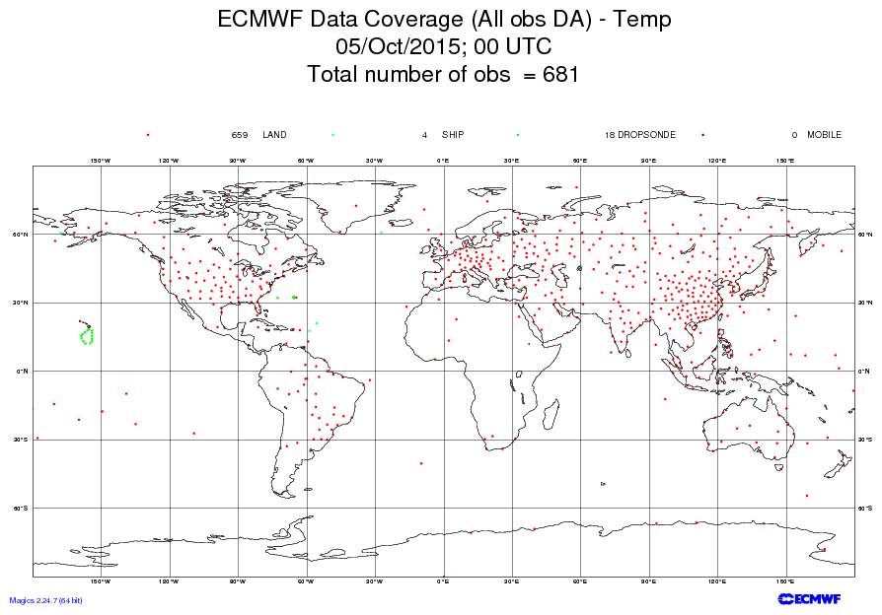
RAOB network;
(more observations
would be better)

Slide 11
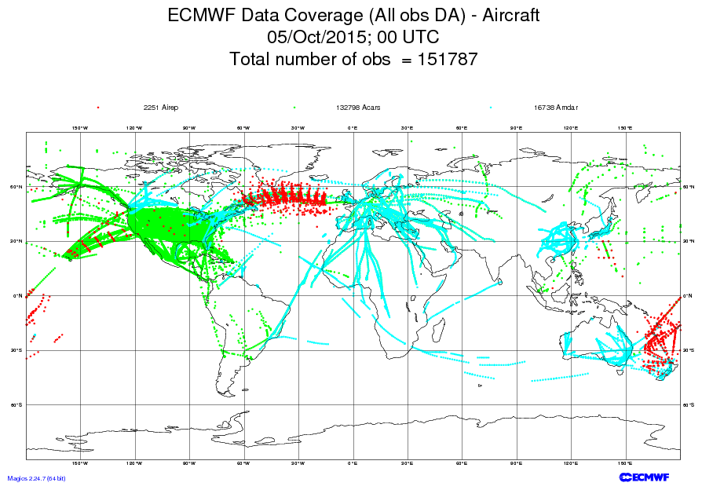
AMDAR and similar programs
provides opportunity for additional
upper air observations; currently
less developed in South America

Slide 12
The WIGOS Pre-Operational Phase (2016-2019)
Approved by WMO Congress-17
Increased emphasis on regional and national activities
Five main priority areas:
WIGOS Regulatory Material, supplemented with necessary guidance material
WIGOS Information Resource, including the Observing Systems Capabilities analysis and Review tool (OSCAR), especially OSCAR/Surface
WIGOS Data Quality Monitoring System (WDQMS)
Regional Structure; Regional WIGOS Centers
National WIGOS Implementation, coordination and governance mechanisms

Slide 13
Near-term impacts on NMHS operations
WIGOS Metadata
OSCAR & Volume A transition
WIGOS station identifiers
WIGOS Data Quality Monitoring System

Slide 14
I. Regulatory Material
The ”Manual on WIGOS” will be updated in 2019, with two main new elements:
Full integration of the Manual on the Global Observing System, which will be retired at that point
New material on Regional Basic Observing Networks (RBON), which will integrate the existing RBSN and RBCNs and include additional observing systems, such as radars, wind profilers ….

Slide 15
I. Guidance Material
The “Guide to WIGOS” will include material on (as matters of priority):
WIGOS Information Resource (WIR), including OSCAR/Surface
WIGOS Data Quality Monitoring System (also data availability)
WIGOS Regional Centres; roles and responsibilities, establishment, partners, review and accreditation process ..
Development of National Partnerships, with both public and private enties, integration of third-party data
Development of a National Observing Strategy
Design, procurement and operation of observational networks, especially AWS
Integration of space-based observations
…

Slide 16
II. WIR (OSCAR/Surface)
The implementation of the new WIGOS Metadata Standard: a modern, electronic, searchable inventory of all observing stations/platforms under WIGOS
Developed jointly by WMO and MeteoSwiss, with the Swiss government providing the major part of the funding
OSCAR/Surface will replace Volume A, but will also include information from similar inventories for other (non-GOS) components of WIGOS
Education and training Members in populating, editing and using OSCAR/Surface is a major focus area for 2016-2019
Will require full implementation of new WIGOS Station Identifiers (approved by Cg-17 as part of Manual on WIGOS)

Slide 17
WIGOS Metadata
(loosely defined as “ancillary information that is necessary for optimally using the observation”; more stringent definition can be found in WIGOS Metadata Standard)
10 categories,
90 elements,
All stored in OSCAR/Surface
# | Category | Description
1 | observed quantity | Specifies the basic characteristics of the observed quantity and the resulting data sets.
2 | purpose of observation | Specifies the main application area(s) of the observation and the observing program(s) the observation is affiliated to.
3 | data quality | Specifies the data quality and traceability of the observation.
4 | environment | Describes the geographical environment within which the observation is made. It also provides an unstructured element for additional meta-information that is considered relevant for adequate use of the data and that is not captured anywhere else in this standard.
5 | data processing and reporting | Specifies how raw data are transferred into the reported physical quantities and reported to the users.
6 | sampling and analysis | Specifies how sampling and/or analysis are used to derive the reported observation or how a specimen was collected
7 | station/platform | Specifies the environmental monitoring facility, including fixed station, moving equipment or remote sensing platform, at which the observation was made.
8 | method of observation | Specifies the method of observation and describes characteristics of the instrument(s) used to make the observation. If multiple instruments used to generate the observation, then this category should be repeated.
9 | ownership and data policy | Specifies who is responsible for the observation and owns it.
10 | contact | Specifies where information about the observation or dataset can be obtained.
Notes:
Reliable & trusted Observations: Timely, Quality assured, Quality controlled, Well documented, Compatible

Slide 18
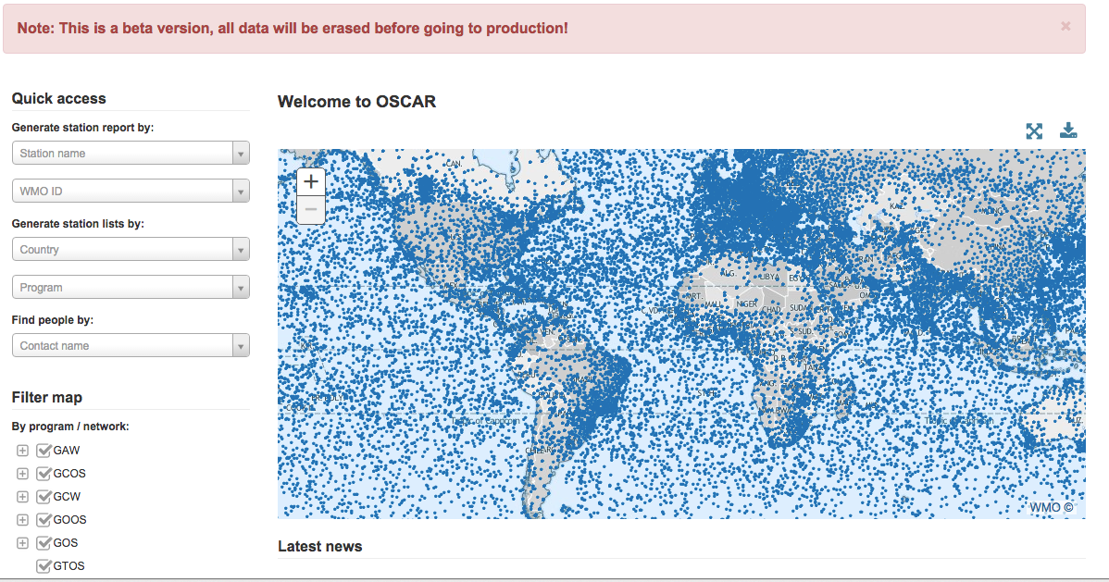
Screenshot from OSCAR/Surface beta-test version

Slide 19
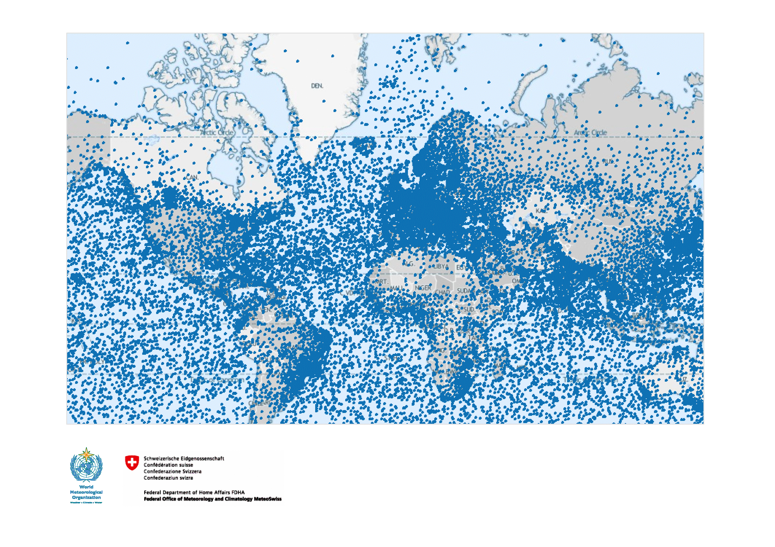
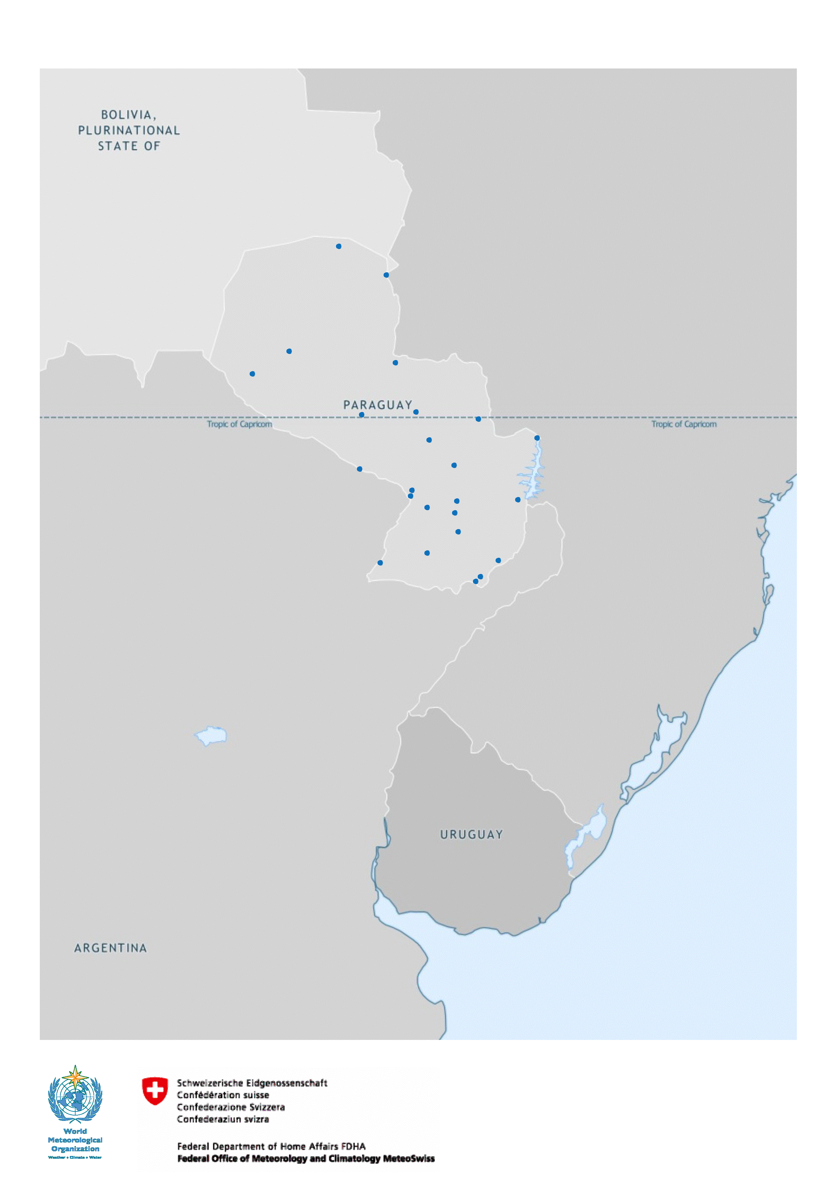
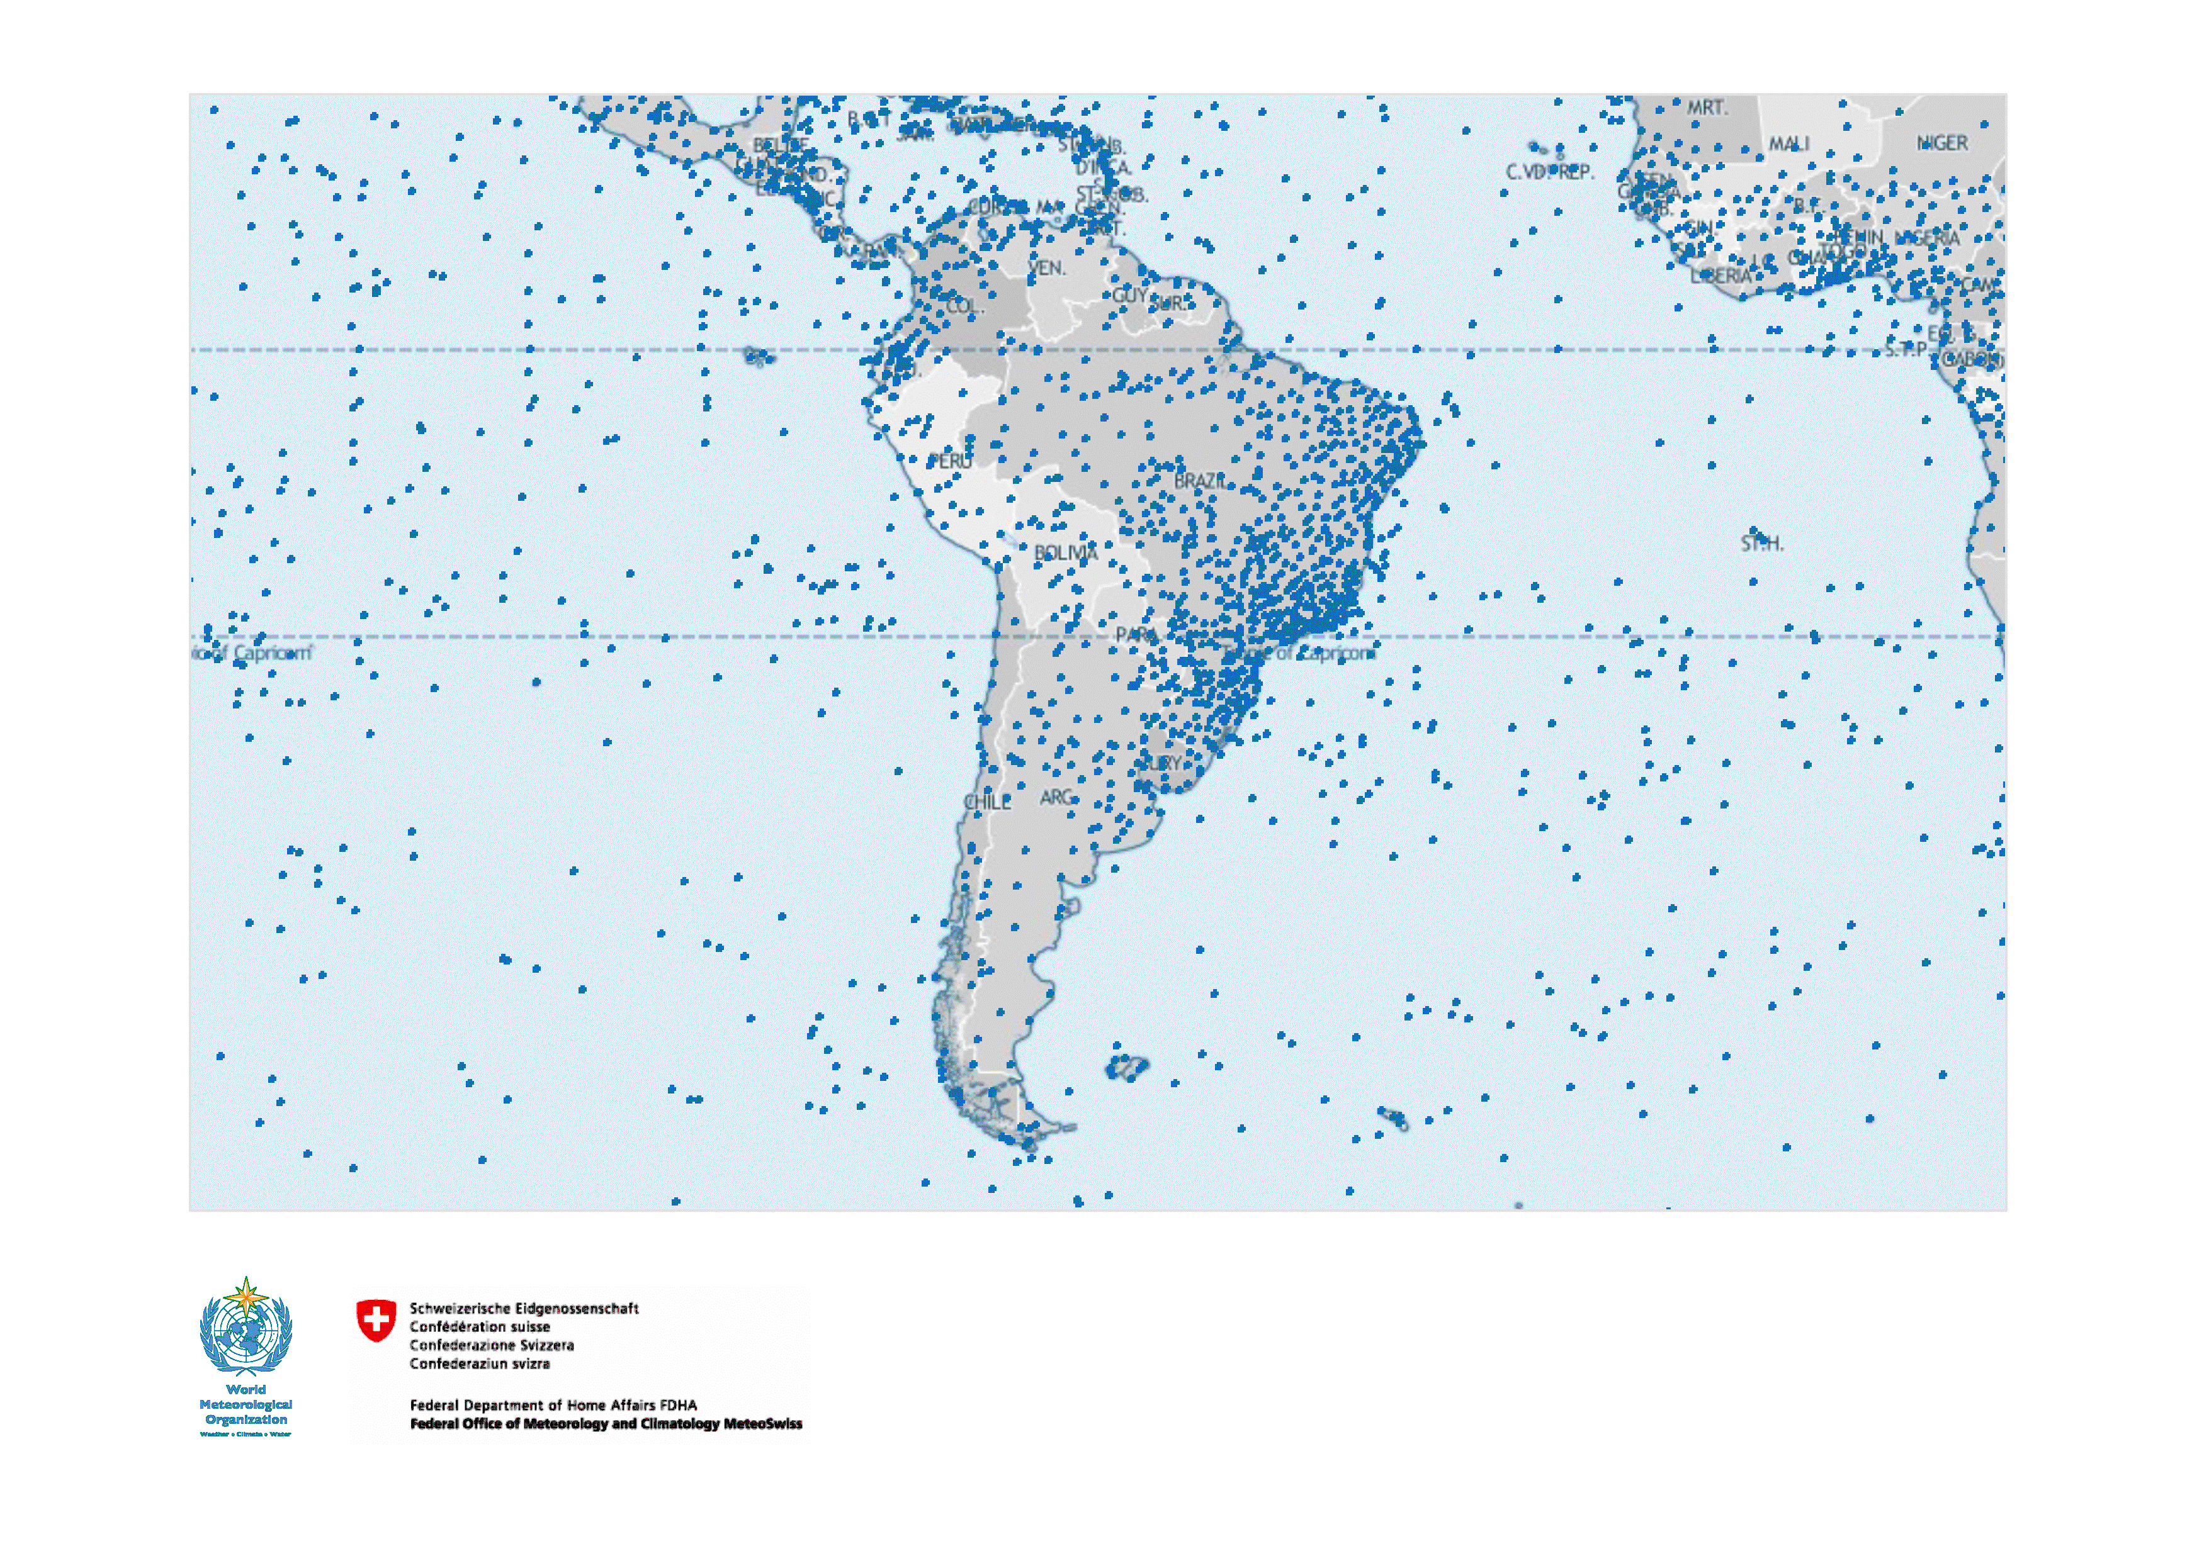
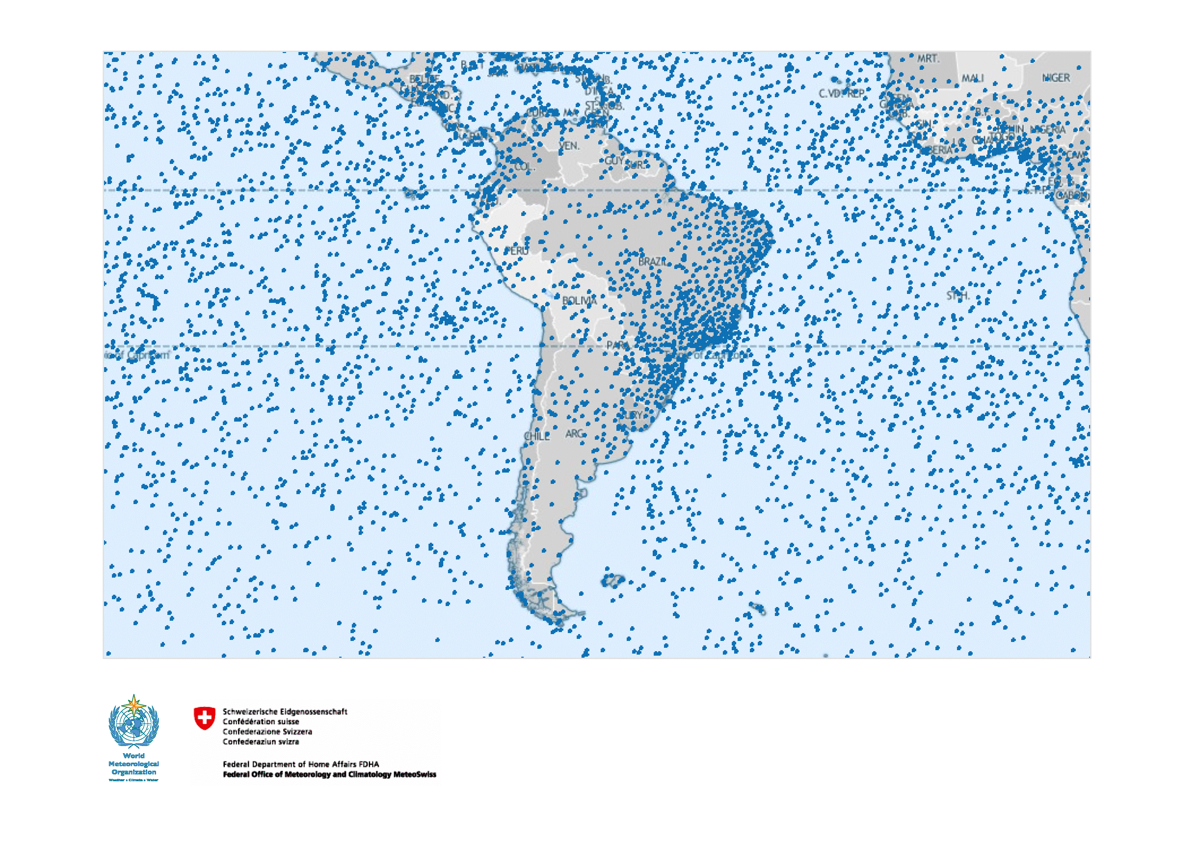
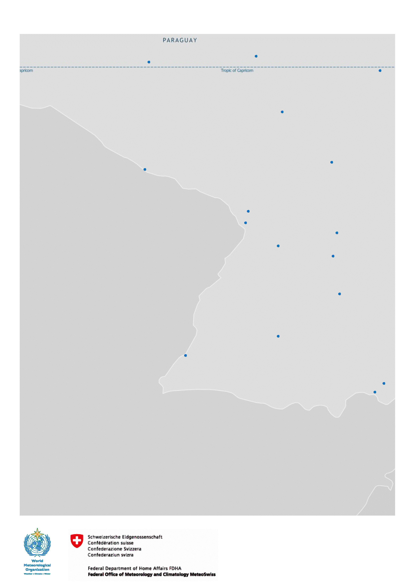

Slide 20
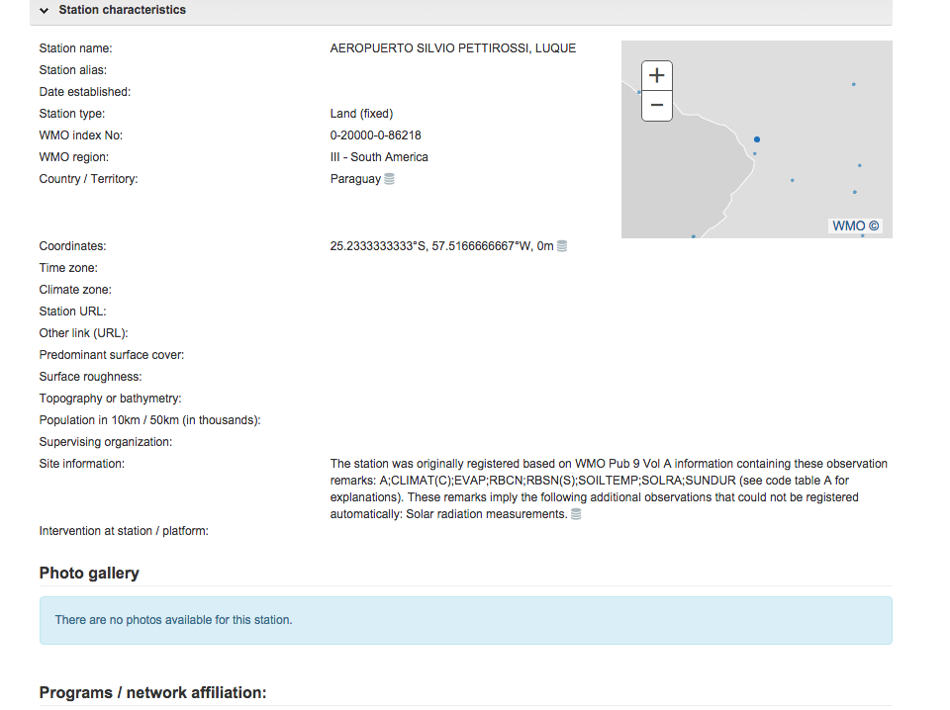

Slide 21
Plan for transition from Vol.A to OSCAR/Surface
Transition period: December 2015 - Dec 2017.
In December 2015, National Focal Points will be given the opportunity to decide between:
providing their WIGOS metadata directly via OSCAR
continuing to provide their metadata through existing WMO procedures
Uploads will be possible through:
user editing via the web interface, and
machine to machine interfaces/web service
At that point (Dec 2015), OSCAR will become the official repository of WIGOS metadata, and will serve as the source for Vol. A

Slide 22
Plans for transition from Vol.A (Cont.)
OSCAR can generate reports similar to the existing Vol. A flat-files available on the WMO website. The new “Vol. A report” will maintain all current column headings but may not contain information in all columns.
Station information provided to WMO via current Vol. A procedures will be used to update WIGOS metadata in OSCAR.
Protocol and format for feeding information by batch-process into OSCAR to be completed by mid-2016
By December 2017, transition to OSCAR completed; Vol. A will officially cease to exist and related procedures used to maintain station information will be discontinued

Slide 23
Legacy VolA Format
VolA field | Difference in OSCAR export file | Comment
RegionId | same
RegionName | almost the same | English only
CountryArea | almost the same | English only, sort order different. Textual changes possible
CountryCode | different | ISO3 instead of number code
StationId | WIGOS ID | Built according to Attachment 2.1 of the WIGOS Manual approved by WMO 17th Congress.
IndexNbr | same
IndexSubNbr | same
StationName | same
Latitude | same
Longitude | same
Hp | same
HpFlag | empty
Hha | same
HhaFlag | empty
PressureDefId | Almost the same | an entry for "mean sea level" was added
SO-1 | empty
SO-2 | empty
SO-3 | empty
SO-4 | empty
SO-5 | empty
SO-6 | empty
SO-7 | empty
SO-8 | empty
ObsHs | empty
UA-1 | empty
UA-2 | empty
UA-3 | empty
UA-4 | empty
ObsRems | empty
Differences between standard Volume A flatfile and OSCAR based «legacy» Volume A

Slide 24
What Members will need to do:
Comply with the WMO Technical Regulations; WMO-No. 49, Volume I, Part I – WIGOS and the Manual on WIGOS:
Keep records of WIGOS metadata
For those observations that are exchanged internationally:
Exchange also the associated WIGOS metadata
Review the information in OSCAR/Surface
Keep entries in OSCAR/Surface up to date
The more accurate and up-to-date the information in OSCAR/Surface is, the more useful it will be!

Slide 25
Outlook Phase I (OSCAR/Surface)
Operational processing of machine-based sources (GAW and related archives, JCOMMOPs, WMO Radar DB)
Development and implementation of WMDS exchange format for machine-to-machine import/export
OGC/ISO-compliant
XML, JSON, CSV?
“Vol A”-legacy export format
Phase-out of Vol A (by end of 2017)

Slide 26
Outlook Phase II (subject to available resources)
ABOS/AMDAR interface
Interface OSCAR/Space with OSCAR/Surface
Other data sources for OSCAR/Surface, e.g.
OSCAR/Analysis (“critical review”) component
Upper air soundings from ships (ASAP) | Road weather stations | Tide gauges (all)
Remote sensing profiling stations | Urban stations | Aerosol Optical Depth
Lightning detection systems | Research Vessels | Ground-based space weather observing stations
All hydrological Stations (WHOS) | Rigs & Platforms, Automatic Sea Stations | Partner AWS
Ground water stations | Profiling gliders | Webcams

Slide 27
Final words on OSCAR/Surface
WG-TDI Members and National WIGOS Focal Points are strongly encouraged to test out OSCAR at:
https://oscar.meteoswiss.ch/OSCAR//index.html
and to provide their feedback to
tproescholdt@wmo.int

Slide 28
WIGOS Station Identifiers
WMO Technical Regulations:
WMO observing stations and platforms shall be uniquely identified by a WIGOS station identifier.
Members shall issue WIGOS station identifiers for observing stations and platforms within their geographic area of responsibility that contribute to a WMO or co-sponsored programme and shall ensure that no WIGOS station identifier is issued to more than one station.
Note: Members may issue WIGOS station identifiers for observing stations and platforms within their geographic area of responsibility that do not contribute to a WMO or co-sponsored programme, provided that the operator has committed to providing and maintaining WIGOS metadata.
Before issuing a station identifier, Members should ensure that the operator of a station or platform has committed to providing and maintaining WIGOS metadata for that station or platform.
In OSCAR: automatic generation of WIGOS Station ID if not already present

Slide 29
WIGOS Station Identifiers
Component | Description | Initial Range – series 0 (Stations)
WIGOS Identifier Series | This is used to distinguish between different systems for allocating identifiers. It allows future expansion of the system so that entities do not have to be issued with new identifiers if the structure of the WIGOS identifiers proves unable to meet future requirements. Different values of the WIGOS Identifier Series may correspond to different structures of the WIGOS identifier. Initial permitted range: 0-14 | 0
Issuer of Identifier | A number that is used to distinguish between identifiers issued by different organizations. It is allocated by WMO to ensure that only one organization can create a given WIGOS station identifier. | 0-65534
Issue Number | An identifier that an organization responsible for issuing an identifier may use to ensure global uniqueness of its identifiers. For example, allocating one issue number for hydrological stations and another for voluntary climate observing stations would enable the managers of the two networks to issue Local Identifiers independently without needing to check with each other that they were not duplicating identifiers. | 0-65534
Local Identifier | This is the individual identifier issued for each entity. An organization issuing identifiers must ensure that the combination of Issue Number and Local Identifier is unique; in that way global uniqueness is guaranteed. | 16 characters
The convention for writing the WIGOS identifier (in the context of WIGOS) is:
<WIGOS Identifier series>-<Issuer of Identifier>-<Issue Number>-<Local Identifier>
Note: as an example the WIGOS Identifier would be written as 0-513-215-5678.
WIGOS Identifier series | Issuer of Identifier | Issue Number | Local Identifier
0 | 513 | 215 | 5678

Slide 30
III. WIGOS Data Quality Monitoring System (WDQMS)
Real-time monitoring of performance (data availability and data quality) of all WIGOS components, searchable by region, country, station type, period, updated regularly (e.g. GOS every 6 hours)
This will allows us to monitor regional and national (actually station-level) performance of all WIGOS components, and analyse trends over time
Pilot project with ECMWF and NCEP is underway
Delayed mode monitoring of data quality as measured against reference sources of information.
Fault management system for tracking and mitigation of performance issues.

Slide 31
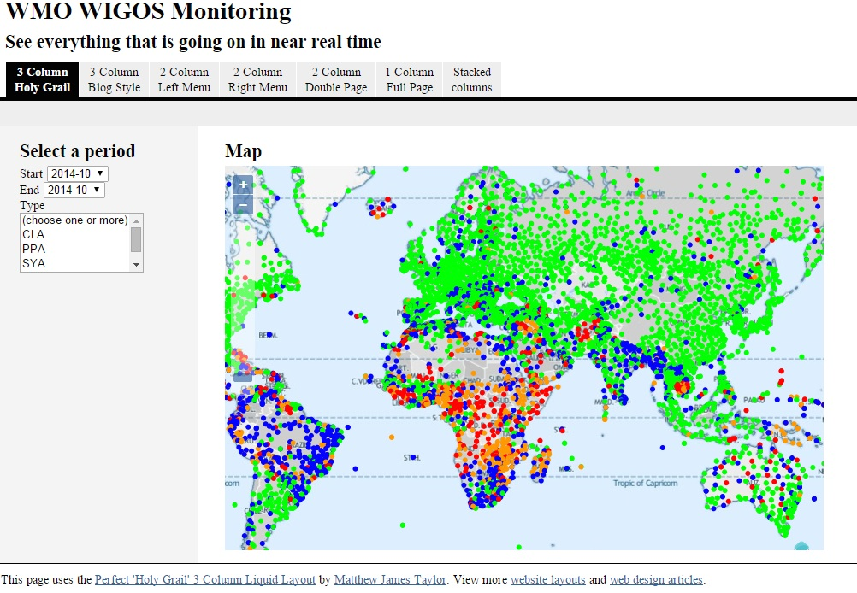

Slide 32
IV. Regional WIGOS Centers
Members already now requesting guidance and support from the WIGOS PO; some of this could be provided more efficiently and effectively by a regional entity, e.g. WIGOS Regional Centers
General role of WRC would be to monitor, coordinate and support the implementation activities in the Region (or sub-Region)
Specific areas of responsibility may be any or all of the following:
Regional support for OSCAR/Surface.
Regional support for WIGOS Data Quality Monitoring System, including
Data availability.
Data quality
Fault management, i.e. follow-up with data providers in case of data availability or data quality problems.
Regional network design.
Regional coordination of WIGOS implementation activities and projects.
…
The RWC concept will be developed further during the next two years

Slide 33
V. National Implementation, Coordination and Governance Mechanisms
Members requesting guidance on
Development of National Partnership agreements
Integration of third-party data from government partners
Integration of third-party data from research/academia
Integration of third-party data from the commercial sector
Quality Management approaches
Data policy issues
…
Response to these requests will be formulated in the roadmap for the WIGOS Pre-operational Phase

Slide 34
Summary and Conclusions
WIGOS global framework is now in place and will be further developed during the Pre-operational Phase (2016-2019)
Increased emphasis on Regional and National activities
At the technical level, OSCAR/Surface and the WIGOS Data Quality Monitoring Systems are the two most important element with a near-term impact on Members
Some WIGOS priorities for Region III already identified and translated into implementation projects
Further development and ongoing support is needed; not all Members in Region are active and engaged in the projects
Regional WIGOS Centers expected to play important role
The WIGOS Project Office is ready to help regional and national implementation efforts succeed in any way it can

