Slide 1
OSCAR/Surface - Frequencies
Jörg Klausen
MeteoSwiss
Co-chair ICG-WIGOS TT-WMD
Chair OPAG EPAC ET-WDC
SG-RFC-1-2015 | Payerne | 22 Sep 2015

Slide 2
Acknowledgments
Project Team at MeteoSwiss
Jürg Mannes, Lucia Cappelletti, Bertrand Calpini, Marc Musa, Martin Brändli, Lars Koppa, Sascha Spreitzer, Christian Walder, Estelle Grüter, Marc Leutenegger, Stefan Sandmeier, Martin Schäfer, Alex Rubli, Claudia Sigg, Markus Abbt, Walter Brunelli , Josefa Mettler, …
Project Team at WMO
Wenjian Zhang, Lars Peter Riishojgaard, Etienne Charpentier, Timo Pröscholdt, …
Project Team at European Dynamics
Nassos Michas, Christina Kaskoura, Martin Ulmann, Lia Christou, Nektaria Pappa, …
ICG-WIGOS, TT-WMD
Sue Barrell, Bertrand Calpini, …
Brian Howe, Karl Monnik, Joe Swaykos, Tony Boston, Uli Looser, Ercan Büyükbas, Zhao Licheng, Antonio Mestre, Tim Oakley, Steve Foreman, Dean Lockett, Luis Nunes, Roger Atkinson, …
JCOMMOPS, GAW WDCs, NDACC, ET-WDC, …
Financial contributions
Federal Department of Foreign Affairs, MeteoSwiss, WMO, Met Norway

Slide 3
Outline
Motivation
About observations …
WIGOS RRR
WIGOS Metadata Standard (WMDS)
Current status
Web application
User management and security
Data integration
Outlook
Going where?
Acknowledgments

Slide 4
Motivation

Slide 5
About observations …
«We cannot manage what we cannot measure» (J. Butler)
Observations are needed
What’s the meaning of «42»?
Basic metadata are needed for any use of data
Observations can be used in different ways
For adequate use of data, adequate information about the data is critical
The whole is more than the sum of the pieces
Smart co-location / combination of observations has a much larger potential than single observations

Slide 6
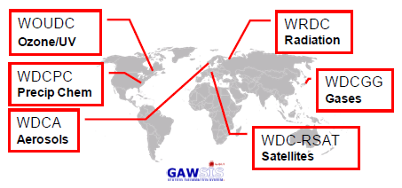
Why OSCAR/Surface?
WIGOS = WMO Integrated Global Observing System
Need comprehensive overview of Members’ capabilities
Existing catalogues provide essential services, but
only sub-sets of global capabilities
limited or very specialized metadata models
No history of observing systems
Pub 9 Vol A needs improvement
only internationally used synoptic and upper-air stations
very limited information on individual stations/platforms
WIGOS RRR needs information on surface-based capabilities to complement space-based capabilities

Slide 7
WIGOS RRR (RRR = Rolling Review of Requirements)
WIGOS RRR process needs to know about capabilities
Analysis
«Critical Review»
Improved services for society
Guidance for Action
Surface-based observing systems
RRR
Capabilities
Requirements
Space-based observing systems
Notes:
Recently discovered a thorough analysis of Vol A, by

Slide 8
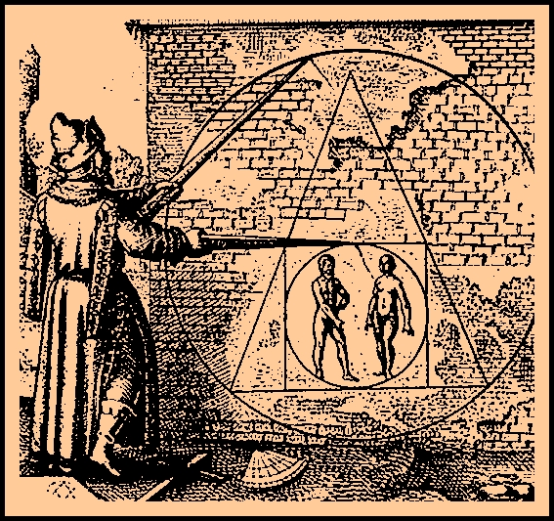
WIGOS Metadata Standard
Principles
Scope
… or, how to square the circle
Enable adequate use of observations
Timestamp every piece of metadata
For all internationally exchanged observations
For all types of observations
Metadata updates in a timely/useful manner
Applicable to all disciplines
Acceptable to and applicable by all Members
Forward-looking but also respecting legacy
Observed variable
Purpose of observation
Station/platform
Environment
Instruments and method of observation
Sampling
Analysis/processing and reporting
Data quality
Ownership and data policy
Contact

Slide 9
Current Status

Slide 10
Web Application
Industry-standard technology stack
Oracle DB, ArcGIS
JEE, AngularJS
Safe and secure, traceable
Publicly available for anonymous use
Management console for registered users

Slide 11
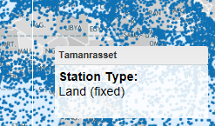
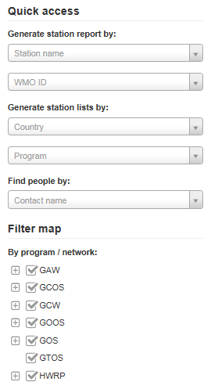
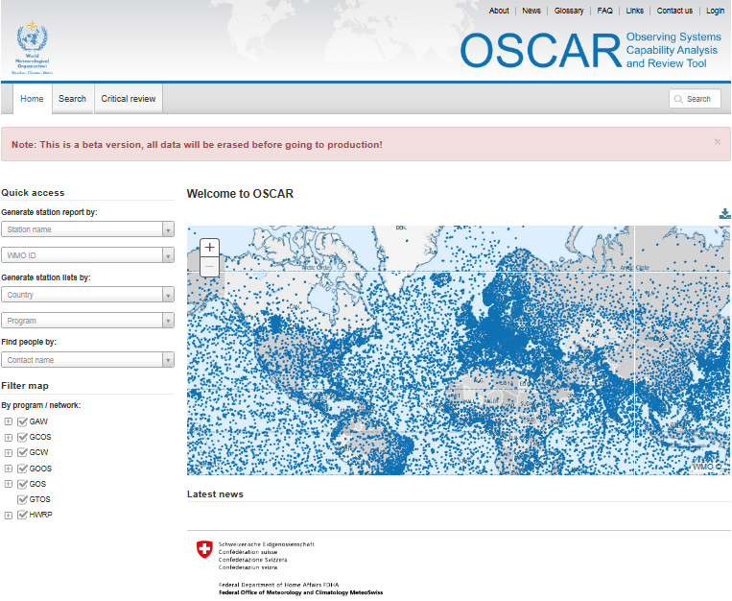
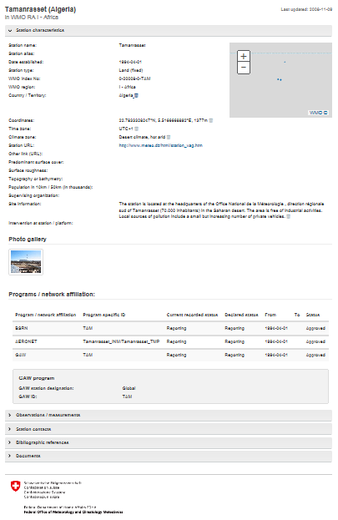
OSCAR quick access & reports
Quick access
&
Map filter
+ click
=
Detailed station report

Slide 12
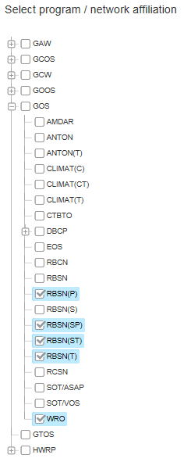
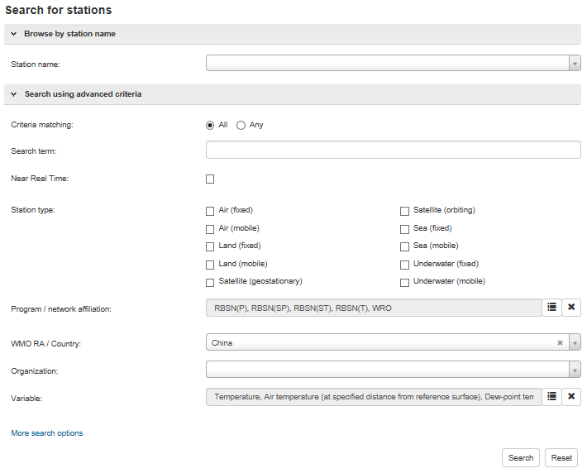
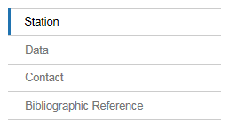
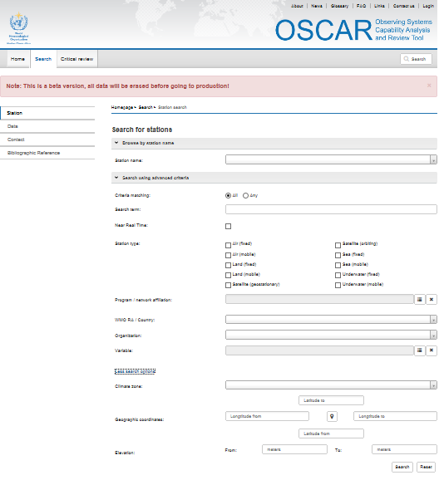
OSCAR search
Various search targets
Instruments (soon)
Finely tuned search

Slide 13
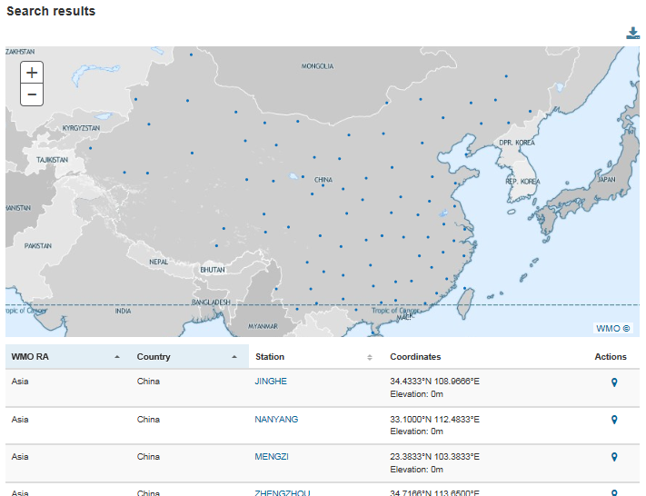
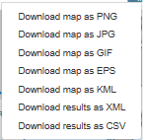
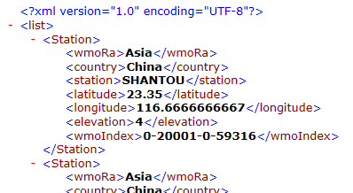
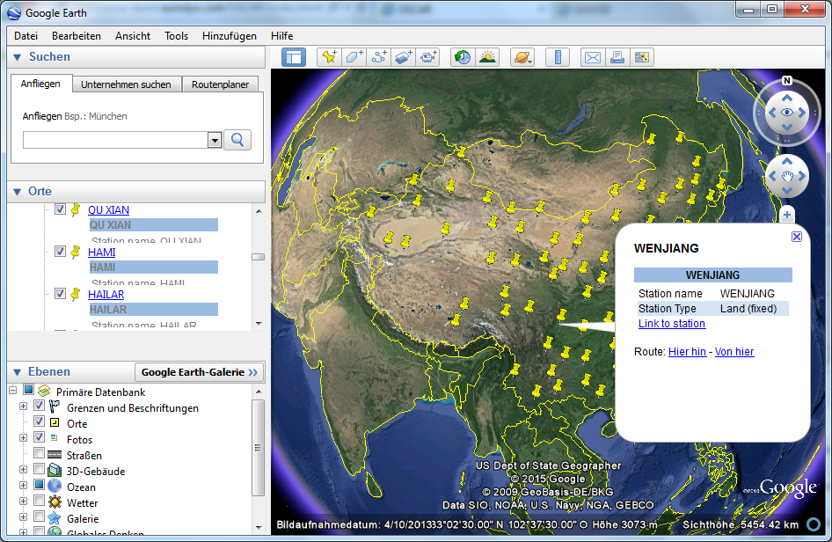
OSCAR search results
Download for further analysis
Integration with GoogleEarth

Slide 14
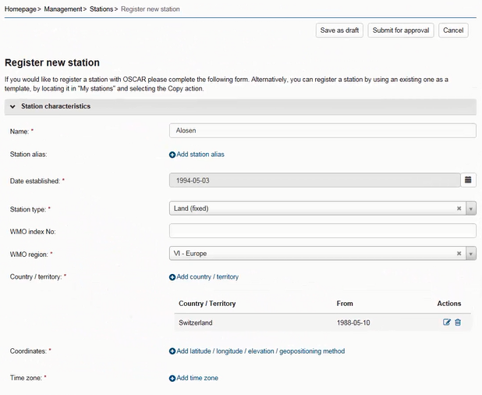
OSCAR management console
Stations
Basic characteristics
Photos
History
Observations
Location
Variable
Methods
Instruments
Quality and uncertainty
History
Contacts
Bibliographic references

Slide 15
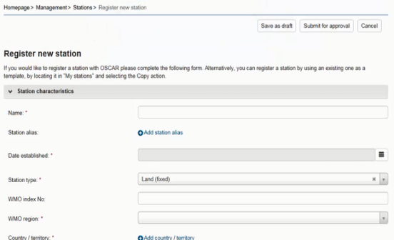
Security and user management
Authentification by identity provider (Swiss Government)
Authorization within application based on «trust-relationships» and various «user roles»
Register
Edit all stations in country
Also: register new contact
Admin
NFP
Edit assigned stations
Also: register new contact
Station contact

Slide 16
Data integration
# stations
1’053
13’026
11’387
762
GAWSIS
Metadata for the Global Atmosphere Watch
WMO Pub 9 Vol A
Catalogue of synoptic and upper-air stations of GOS
JCOMMOPS
Marine element of GOS / GOOS
WMO Radar DB
World-wide radars
Amdar
Coming soon …

Slide 17
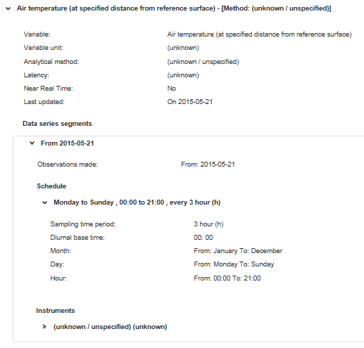
What you can do for OSCAR
Review your stations, correct and complement information on observations
Unit: unknown
Method: unknown
Latency: unknown
Uncertainty: unknown
… more unknown
Instrument: unknown

Slide 18
«Frequencies» in OSCAR
At present, basic capabilities to document frequencies used
Min, max, bandwidth for
Emission
Sensing
Telecoms
Requirements not very clear
Use-cases should be provided to motivate further development work
What kinds of frequencies and related attributes need to be documented?
What kinds of searches are needed?
What kinds of reports are needed?
What web service end points are needed?

Slide 19
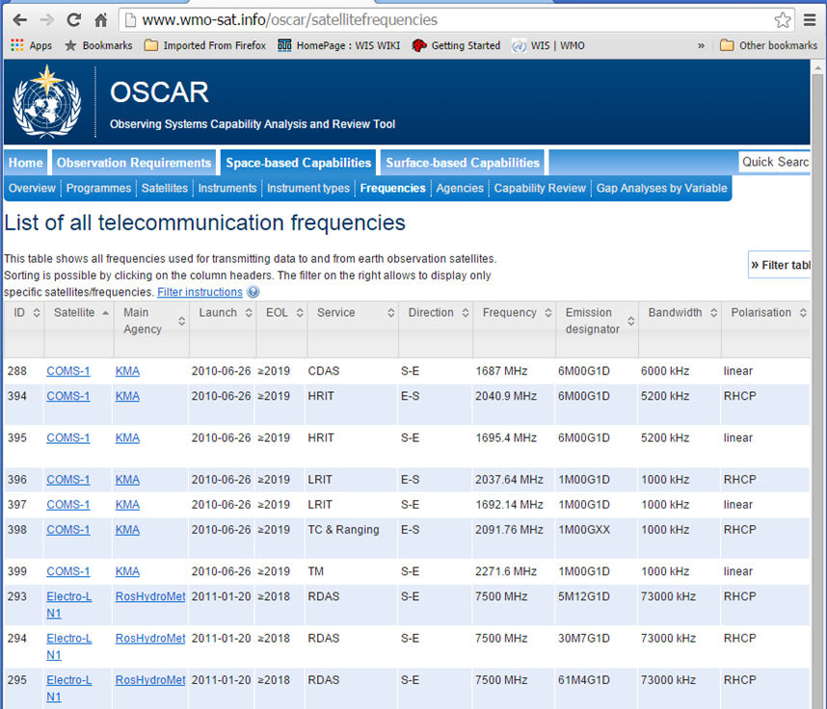
«Frequencies» in OSCAR/Space

Slide 20
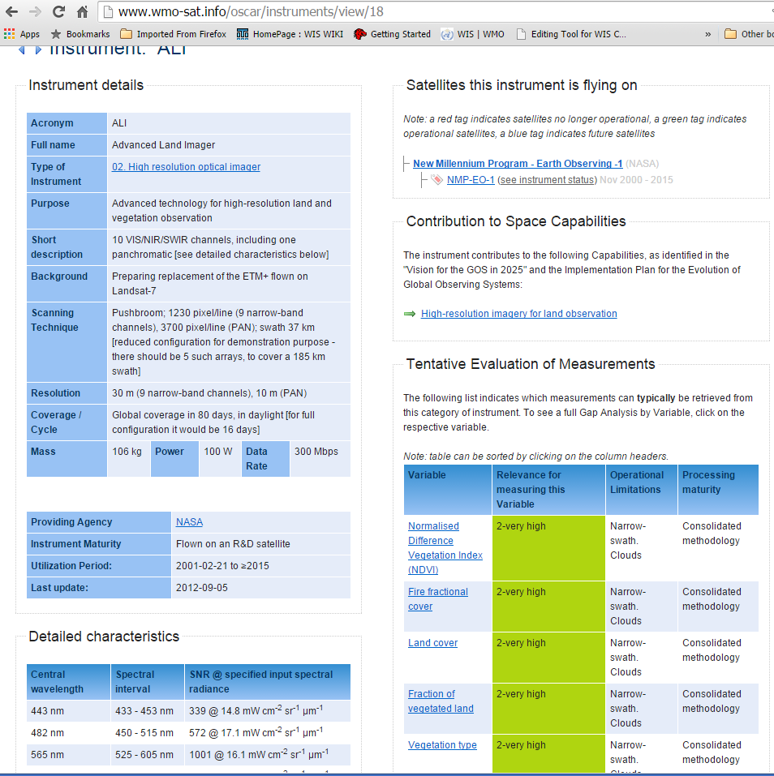
«Frequencies» in OSCAR/Space

Slide 21
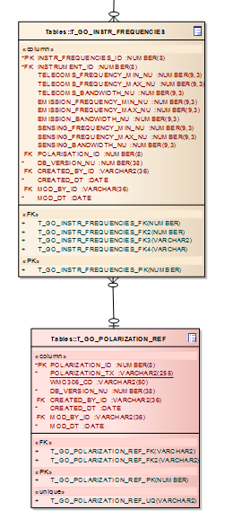
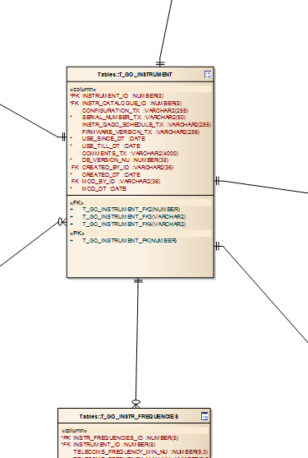
«Frequencies» in OSCAR

Slide 22
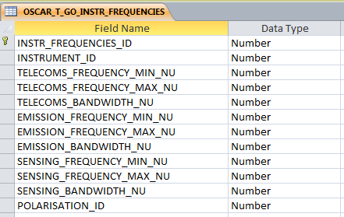
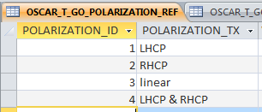
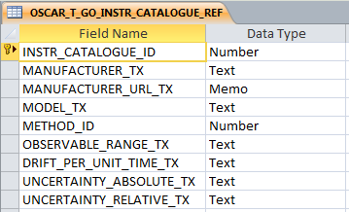
«Frequencies» in OSCAR

Slide 23
Outlook

Slide 24
Outlook
Thorough beta-testing of functionalities
Quality control of migrated information
Implement batch upload/download functionality of «Vol A» information → Phase-out of «Vol A»
More adequate map projection and higher-resolution maps
Develop ABOS/AMDAR-specific parts
Operationalize OSCAR/Surface (by 2015/Q4)
Integrate wind profilers
Extend functionalities (subject to further funding)
Integrate «Requirements» module
Integrate «Space» capabilities module
Agree and develop algorithms for RRR

Slide 25
Thanks for your attention!
Web-based platforms for the WMO Integrated Global Observing System
_ covering land, air, ocean and space
_ documenting stations and observations, and their histories
_ enabling comparison of requirements and capabilities (RRR)
_ facilitating network planning
_ applicable to all WMO Application Areas
_ supporting your service to society!
coming now …
oscar.wmo.int/surface

Slide 26
Supplementary material

Slide 27
Data Integration «Vol A» 1. Basics
All stations integrated with territory, positions
New WMO identifier from old WMO index and sub-index
ObsRems (as character string under station description)
Station class (from ObsRems)
A (aerodrome), AGRIMET (agromet station), C (coastal), HD/A (helideck, offshore), HU/FC (hurricane, tropical cyclone or typhoon forecast centre), HY/A (seaplane base), L (lightship), LH (lighthouse), M (mountain station), R/FC (River forecast centre), TI/WA/FC (Tidal wave forecast centre)

Slide 28
Data Integration «Vol A» 2. Observations
Surface observation program (from WMO No. 544)
Manned station
“Pressure", "Wind (direction and speed)", "Air temperature", "Humidity", "Present weather", "Past weather", "Cloud amount", "Type of cloud", "Height of cloud base", "Visibility“
Automatic station (from “AUT” flag in ObsRems)
“Pressure", "Wind (direction and speed)", "Air temperature", "Humidity“, “Precipitation (yes/no)”
Barometer height (from HA) for observation “pressure”
Additional observations (from ObsRems)
40 variables (only well defined variables integrated)
Upper-air observations (from UA-1 … UA-4)
«R»: PTU, wind
«P», «W», «WP»: wind

Slide 29
Data Integration «Vol A» 3. Schedules
Surface
Consider synoptic schedules (from SO-1 … SO-8)
Consider (semi-)hourly observations (from ObsHs)
Consider some constraints concerning weekdays (from ObsRems)
Upper-Air
Consider upper-air schedules (from UA-1 … UA-4)
Consider some constraints concerning weekdays (from ObsRems)
Schedules are formally correct, but can be redundant
No schedules for «additional» observations (too little information available)

Slide 30
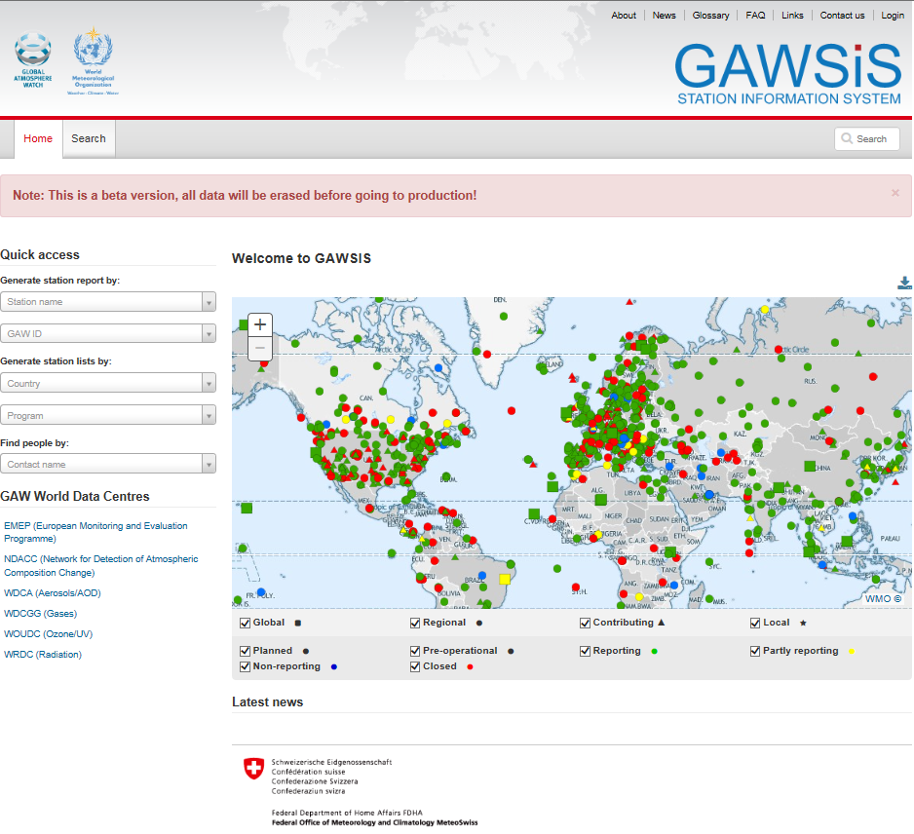
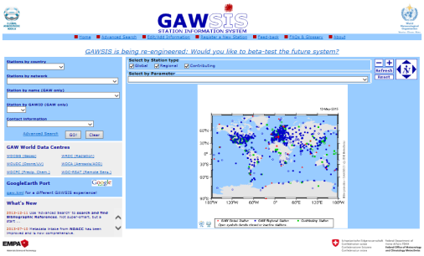
https://gawsisdepl.meteoswiss.ch/GAWSIS
WIGOS metadata standard-compliant
Historization
GO LIVE in 2015/Q3
Please sign up for Beta-testing!

Slide 31
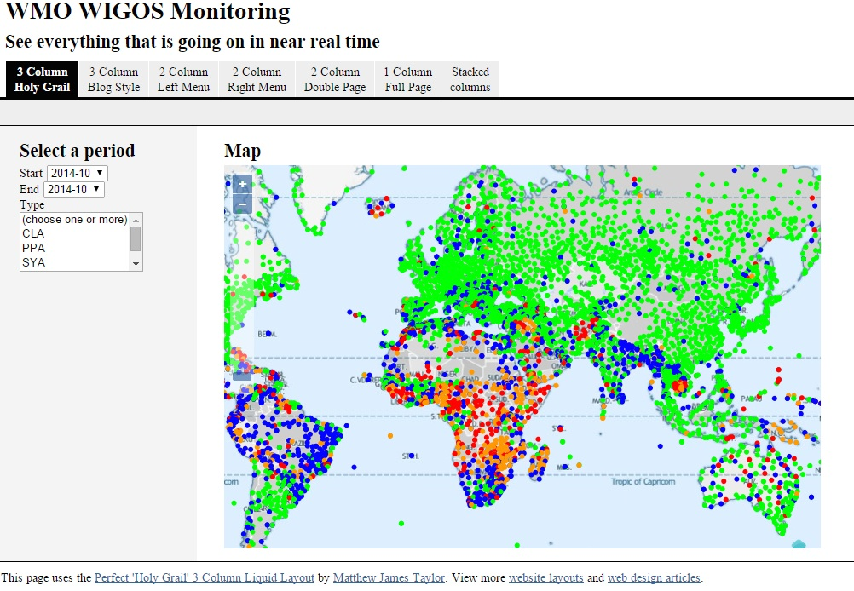
Source: Sue Barrell, Cg-17 WIGOS side event

