Slide 1
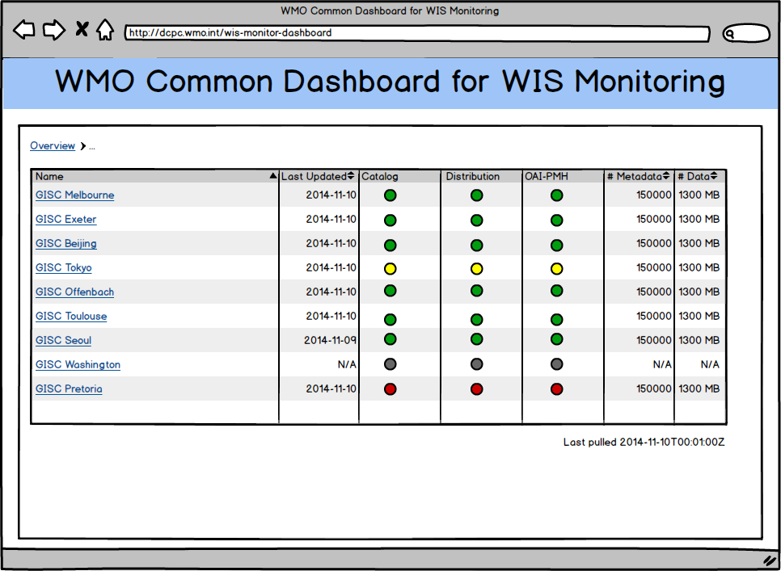
Overview of the WIS Monitoring Project
Introduction
Some introductory texts (The WIS Monitoring Project is to define regulations and guidelines for monitoring tasks …)
DCPC
GISC
GISC
DCPC
DCPC
GISC
NC
NC
NC
JSON
JSON
JSON
JSON
GISC
DCPC
JSON over
HTTP (pull)
NC
GISC Area of Responsibility
WMO Common
Dashboard
JSON
DCPC
JSON over HTTP (pull)
DCPC
GISC
Aggregate
Display
DCPC
DCPC
JSON
GISC
Monitor
Aggregate
Monitor
Display
NC
NC
HTTP
NC
NC
HTTP
GISC
DCPC
Monitor
NC
Users
The Architecture of the WIS Monitoring Project
The complete WIS monitoring network includes all three types of Centres (GISC, DCPC and NC).
The WMO Command Dashboard (WCD) is responsible for gathering monitoring information via JSON messages from GISCs and publishing the results through web pages.
Each GISC in turn needs to gather and aggregate monitoring information from its area of responsibility (DCPCs and NCs) and publish the results through web pages.
The receiver of the monitoring information is responsible for initialize pull requests for the information, while the provider must ensure the presence of the information before the agreed time.
Information is exchanged at least once per day.
All information exchanged is in format of JSON.
Simplified Architecture for WIS Monitoring Pilot
The pilot focuses on a limited set of system stats and involves mainly the GISCs.
The WMO Command Dashboard (WCD) is a product of the pilot project aiming to demonstrate and justify the design, architecture and technologies.
GISC
GISC
GISC
WMO Common
Dashboard
Users
monitor.json
{ "centre": "GISC ABCD", "metrics": { "services": { "catalogue": { "status": true }, "distribution_system": { "status": true }, "oai_pmh": { "status": true } }, "cache_24h": { // ... ... }, "metadata_catalogue": { // ... ... } }, "gisc_properties": { "events_url": "http://gisc_abcd.org/events.json", "centres_inAoR_url": "http://gisc_abcd.org/centres.json", }, "timestamp": "2015-05-11T00:00:01Z", // ... }
The Exchanged Monitoring Information
JSON over HTTP (pull request)
Three JSON files, one mandatory and two optional (mandatory JSON elements and file are emphasized with bold font in the follow list)
monitor.json
Services status (catalogue, distribution, OAI-PMH)
Snapshot of content holdings @ 00 UTC (number of total metadata, data, placeholder metadata, etc.)
Accumulated daily network traffics from (number of insertion/update, deletion)
Metadata about the GISC (name, contact, etc.) and the JSON file (version, timestamp, etc.)
Addresses of other two monitoring JSON files
centres.json
Accumulated daily data/product traffics from each centres in GISC's area of responsibility
events.json
Events announcement (duration of maintenance, down time, etc.)
centres.json
{ "centres": [ { "count": 100, "volumesize": 80000, "centre": "Centre X" } // ... ... ] // ... ... }
events.json
{ "events": [ { "id": 1, "title": "...", "text": "... ...", "start": "2015-05-30T00:00:00Z", "end": "2015-05-31T00:00:00Z" } // ... ... ] // ... ... }

