Slide 1
WIGOS Framework Implementation Plan (WIP)
WMO Region III Workshop on WIGOS
Asuncion, May 14 2014
Dr L.P. Riishojgaard,
WIGOS Project Manager, WMO Secretariat

Slide 2
Outline
WMO
WIGOS Implementation Plan
Ten key activity areas of the WIP
Activities at the global level
(Regional Implementation Plan, R-WIP-III, will be covered by Jose Arimatea)
Specific focus on items 1, 3 and 7 (Management, Observing System Network Design, and the WIGOS Information Resource)

Slide 3
WIGOS Framework Implementation Plan (WIP)
CONTENTS
KEY ACTIVITY AREAS
Management of WIGOS implementation
Collaboration with WMO co-sponsored observing systems & international partners
Design, planning and optimized evolution
Observing System operation and maintenance
Quality Management
Standardization, system interoperability and data compatibility
The WIGOS Operational Information Resource
Data and metadata management, delivery and archival
Capacity development
Communications and outreach
Introduction and Background
Key Activity Areas for WIGOS Implementation
Project Management
Implementation
Resources
Risk Assessment / Management
Outlook
Annexes

Slide 4
WIGOS Key areas
Management of WIGOS Implementation / operation
Collaboration with co-sponsors and partners
To oversee, guide and coordinate WIGOS
Data discovery, delivery & archival
Design, planning and optimised evolution
To ensure supply of and access to WIGOS observations
To plan, implement and evolve WIGOS component systems
Observing system operation & maintenance
Quality Management
To facilitate and support the operation of WIGOS
Communications and outreach
Capacity Development
Operational Information Resource
Standardization, interoperability & compatibility

Slide 5
1. Management of WIGOS implementation
WMO
WIGOS Implementation Plan, Table 2 (selected items):
Develop/Revise/Update WMO Regulatory Material to include WIGOS Regulations
Incorporate technical aspects of WIGOS implementation and continuing evolution into existing/new TCs and RAs working structures and procedures
Develop Regional WIGOS Implementation Plans (R-WIPs)

Slide 6
Current WIGOS Management Structure and Activities
ICG-WIGOS oversees implementation, representation from
All Technical Commissions
All Regional Associations
Three Task Teams under ICG-WIGOS:
Regulatory Material
Technical Regulations, Manual on WIGOS currently out for review ; sent to all PTCs per decision made at PTC-2015
Metadata
Feeding into Regulatory Material, but at a slower pace; TT-WMD will wrap up the initial version of the WIGOS metadata standards this week
Quality Management
Team first met in Geneva April 23-24; initial focus on monitoring of observational data quality

Slide 7
2. Collaboration with WMO co-sponsored observing systems and international partners
WMO
WIP, Table 2 (selected items):
Develop guidance, mechanisms and procedures for engagement, coordination and collaboration with partner organizations (to be used on all, global, regional and national levels)
Develop Collaboration framework for the Architecture for Climate Monitoring from Space (ACMS)

Slide 8
3. Design, planning and optimized evolution
WIP, Table 2:
Complete RRR practices, procedures, responsibilities and mechanisms for all systems and agreed application areas
Many activities ongoing already, mostly at the global level, under the auspices of CBS, OPAG-IOS, and IPET-OSDE
WMO

Slide 9
Rolling Review of Requirements
The RRR is the WMO process for vetting and recording user requirements for observational data and matching them against existing and planned capabilities, resulting in a gap analysis that can be used for network design activities
The RRR is supported by three key databases of OSCAR, the Observation Systems Capabilities and Review tool :
OSCAR/Requirements, in which requirements are stated by application area, “technology free”, formulated in geophysical variables, not in terms of measurands
OSCAR/Space, listing satellite capabilities
OSCAR/Surface, list surface-based capabilities (not yet developed)
Close collaboration between WMO and Meteo-Suisse on developing, hosting and maintaining the OSCAR databases; WMO will remain the owner of the information content

Slide 11
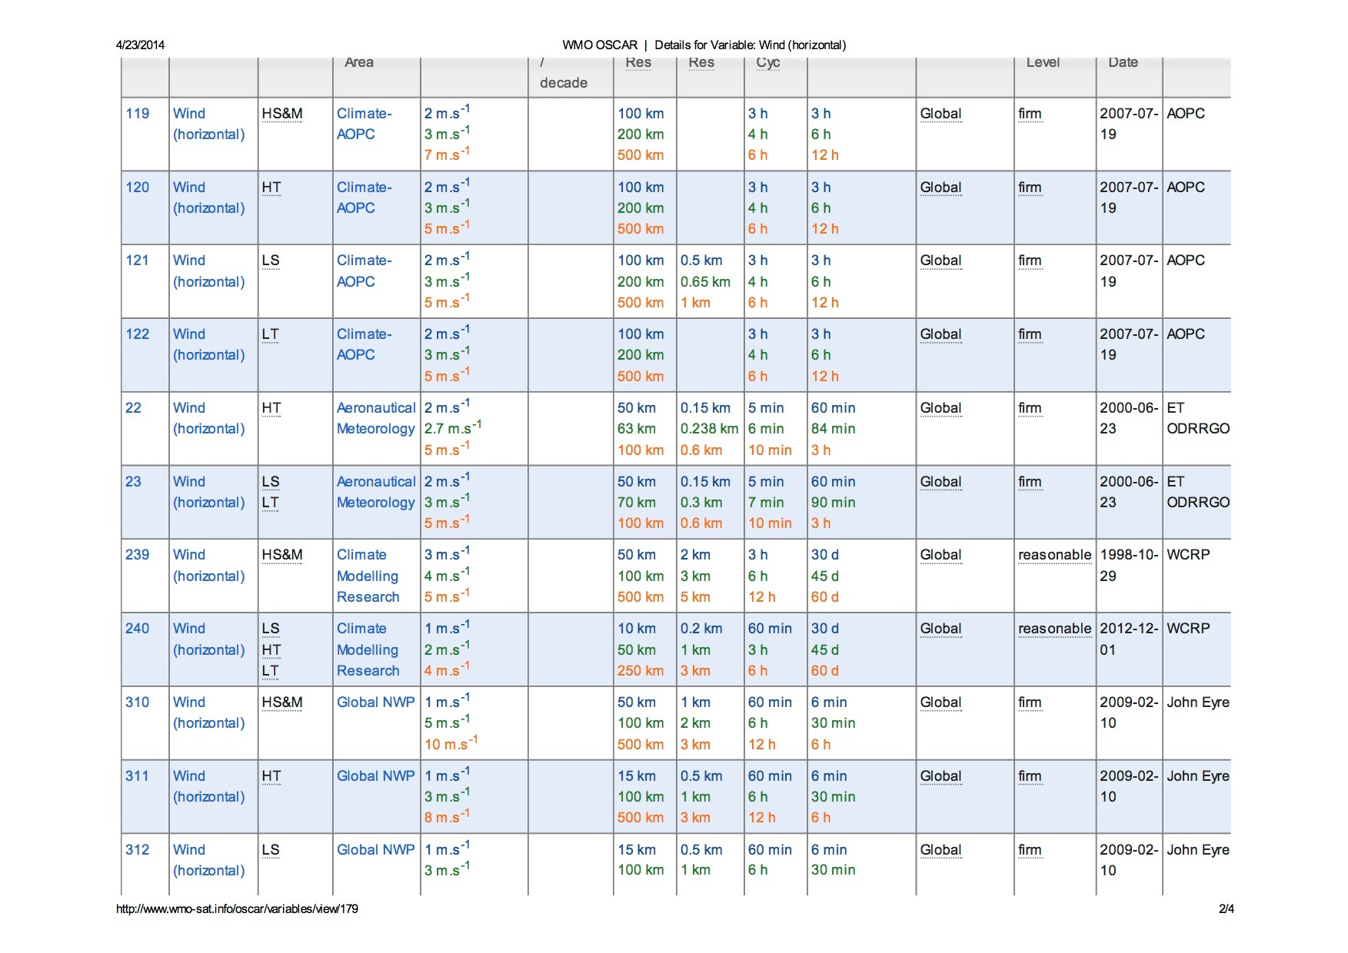

Slide 12
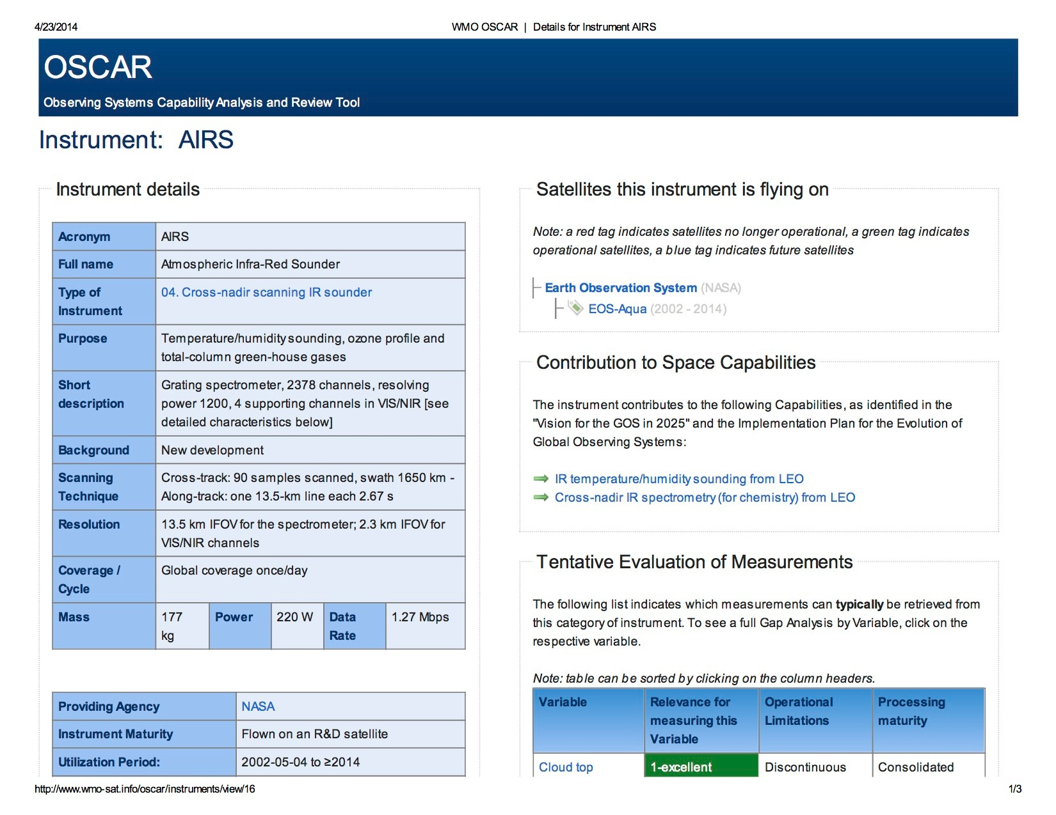

Slide 13
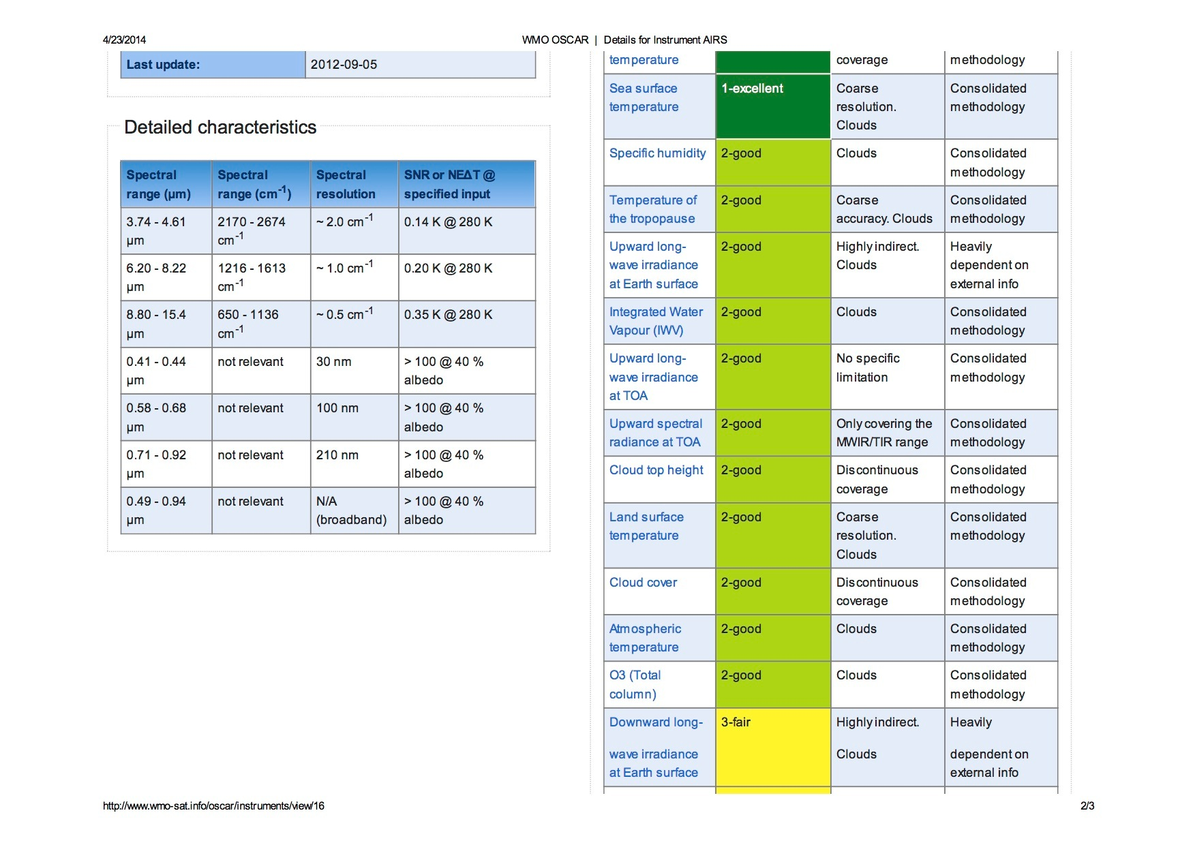

Slide 14
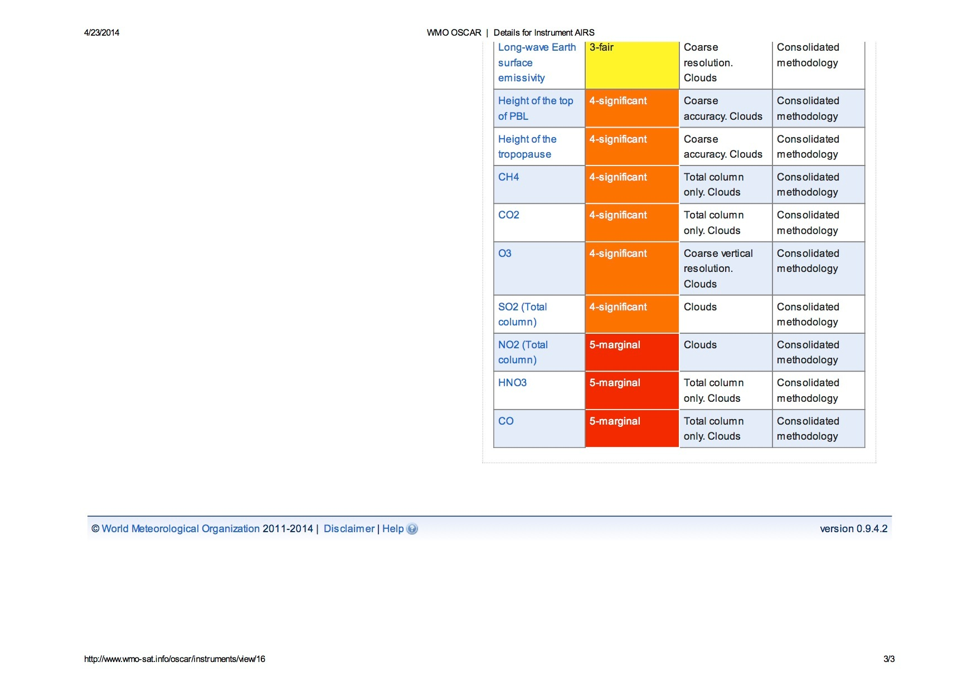

Slide 15
4.) Observing System operation and maintenance
WMO
WIP, Table 2:
Develop guidance, mechanisms and procedures for improved integration of observational data and products
One specific action proposed under WIP elements 3, 4, and 5 at ICG-WIGOS-3 is a serios of “WIGOS Workshops on Automated Weather Stations”, covering the life cycle of the network (design, procurement, installation, calibration, maintenance, operation, etc.), arranged region by region,

Slide 16
5.) Quality Management
WMO
WIP, Table 2:
Develop WIGOS Quality Management guidance, mechanism, practices and procedures
ICG-WIGOS-3: Initial focus on revising and modernising the operational monitoring of observational data quality

Slide 17
6. Standardization, system interoperability and data compatibility
WMO
WIP, Table 2:
Develop guidance for WIGOS standards
Document the implemented standard and recommended practices and procedures on instruments, methods of observation, data products, etc.

Slide 18
7.The WIGOS Operational Information Resource
WMO
WIP, Table 2:
Design and develop the WIGOS Information Resource (WIR)

Slide 19
WIGOS Information Resource (WIR)
One-stop shop for WIGOS information
Regulatory Material (searchable)
Standards and best practices
Other guidance material
Outreach and communication
Meeting documents and meeting reports
Databases to support the WMO Rolling Review of Requirements (RRR)
Most of the information available in English only at this point
http://www.wmo.int/pages/prog/www/wigos/wir/index_en.html

Slide 20
8. Data and metadata management, delivery and archival
WMO
WIP, Table 2:
Develop WIGOS metadata standards, practices and procedures

Slide 21
9. Capacity development
WMO
WIP, Table 2:
Develop a WIGOS Capacity Development (WCD) strategy including education and training
Assistance provided to Members regarding WIGOS implementation
Develop WIGOS related guidelines and training materials and other relevant documentation
Mobilize resources for WIGOS implementation

Slide 22
10. Communications and outreach
WMO
R-WIP-I:
Develop an effective WIGOS communications and outreach strategy
Develop communications and outreach materials

Slide 23
Summary and Conclusions
WMO
WIGOS Implementation Plan (WIP)
Ten key activity areas, each with a set of activities listed, ranging from generic to very specific
This structure (“list of ten”) is repeated in the Regional WIP for Region III (R-WIP-III)
Workshop to review and endorse R-WIP-III, and make the initial steps from generic to specific elements of plan

