Slide 1
WIGOS
The WMO Foundation for Meeting the Observing Needs of Weather, Climate, Water and Environmental Services
Region III Workshop on WIGOS Asuncion, May 14 2014
Dr L.P. Riishojgaard,
WIGOS Project Manager, WMO Secretariat

Slide 2
Outline
What is WIGOS and why do we need it?
WIGOS Framework & Implementation:
WIGOS Key Activity Areas
Regional level
National level
Initial example of possible WIGOS Focus Areas/
Conclusions
WMO

Slide 3
What is WIGOS?
A framework for integrating all WMO observing systems and WMO contributions to co-sponsored observing systems.
A WMO Strategic Priority Area
Together with the WMO Information System (WIS), WIGOS is a WMO contribution to GEOSS.
WIGOS is not:
Replacing or taking over existing observing systems, which will continue to be 'owned' and operated by a diverse array of organizations and programmes, national as well as international.

Slide 4
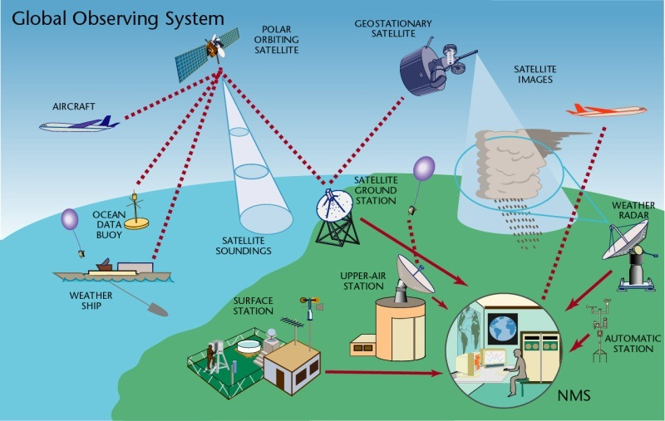
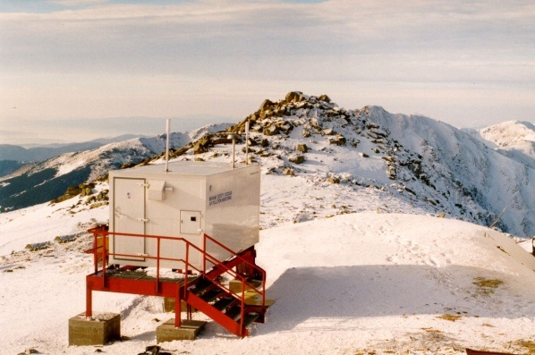
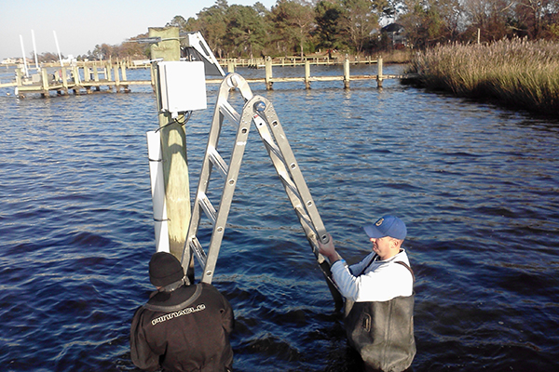
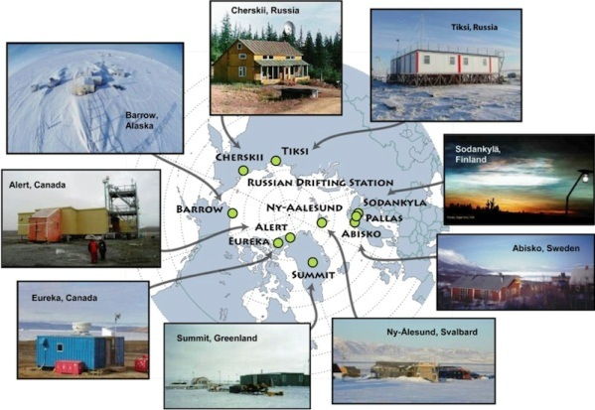
WIGOS Component Systems
Global Observing System
(WWW/GOS)
Observing component of Global Atmospheric Watch (GAW)
WMO Hydrological Observations
(including WHYCOS)
Observing component of Global Cryosphere Watch (GCW)

Slide 5
Why WIGOS?
The mandate of modern NMHSs (Met Services) is much broader now than it was when WWW and the GOS were created, e.g.
Climate monitoring, climate change, mitigation
Air quality, atmospheric composition from urban to planetary scales
Oceans
Cryosphere
Water resources
Advances (scientific and technical):
Observing technology
Telecommunications
Numerical modeling and data assimilation
Increased user demand to access and use observations in decision making

Slide 6
Why WIGOS (continued)?
Shortcomings of the current situation:
Observing networks/systems not sustainable and stable,
Design and planning not well coordinated,
Observing standards not respected (and in some cases not well defined)
Databases not integrated or interoperable, including metadata,
Deficiencies in Quality Management (maintenance, monitoring, reporting, ...)
Lack of qualified and trained staff;
Through coordinated data sharing and networks/systems development, Members will be better equipped to address existing deficiencies and to meet future challenges

Slide 7
WIGOS Implementation
The WIGOS framework is implemented to enable the integration, interoperability, optimized evolution and best practice operation for all WMO observing systems and WMO contribution to co-sponsored systems.
WIGOS relies on the WMO Information System (WIS) for continuous and reliable access to observational data and products, and associated metadata.
Notes:
Framework that describes processes, principles, procedures and practices to be included in the WMO Technical Regulations (WMO-No. 49) & Guides on WIGOS and other relevant documentation;

Slide 8
WIGOS Framework Implementation Plan (WIP)
CONTENTS
KEY ACTIVITY AREAS
Management of WIGOS implementation
Collaboration with WMO co-sponsored observing systems & international partners
Design, planning and optimized evolution
Observing System operation and maintenance
Quality Management
Standardization, system interoperability and data compatibility
The WIGOS Operational Information Resource
Data and metadata management, delivery and archival
Capacity development
Communications and outreach
Introduction and Background
Key Activity Areas for WIGOS Implementation
Project Management
Implementation
Resources
Risk Assessment / Management
Outlook
Annexes

Slide 9
WIGOS Key areas
Management of WIGOS Implementation / operation
Collaboration with co-sponsors and partners
To oversee, guide and coordinate WIGOS
Data discovery, delivery & archival
Design, planning and optimised evolution
To ensure supply of and access to WIGOS observations
To plan, implement and evolve WIGOS component systems
Observing system operation & maintenance
Quality Management
To facilitate and support the operation of WIGOS
Communications and outreach
Capacity Development
Operational Information Resource
Standardization, interoperability & compatibility

Slide 10
Implementation Steps - Regional Level
Identify major issues of the Region (& its Sub-regions): observational challenges, critical gaps and solutions against the identified services priorities of the Region/Sub-regions;
Indicate the best/appropriate working approach for the Region / Sub-region taking advantage of on-going/planned initiatives, activities, groupings, projects (synergy of them) to address requirements, needs, priorities & associated challenges, respecting specifics of each Subregion;
Propose potential solutions against the identified services priorities of the Region/Sub-regions;

Slide 11
Implementation Steps - Regional Level
Develop R-WIP:
Identify implementation activities for WIGOS Key Activity Areas;
Align R-WIP with major regional / subregional & national activities and on-going national/bilateral/subregional projects;
Align R-WIP-I with all WMO Priorities (GFCS-IP, CB/CD, DRR), and GCOS-IP, EGOS-IP;
Propose bilateral or multilateral Sub-regional projects, or inter-regional projects (e.g. between RA III & IV);
Align with existing funding and look for funding opportunities;
Identify appropriate mechanism for implementation of agreed tasks and projects.
Identify resources and gaps

Slide 12
Regional WIGOS Implementation Plan
for Region III (R-WIP-III)
Draft RWIP-III exists
The plan is to have R-WIP-III adopted by the RA-III Session in Sepyember 2014
The key element of the R-WIP is section 2, listing the ten main activity areas of the WIGOS implementation, with a regional focus
Two main goals of the present Workshop:
to review and endorse this plan
to start the process of translating the plan into concrete WIGOS implementation steps of particular relevance to the sub-region

Slide 13
What are the main challenges in WIGOS for South America?
That is for the Workshop to map out!
One example: Design and performance of the upper-air network over the region
According to the Fifth WMO Impact Workshop (Sedona, 2012), the radiosonde and AMDAR network are both among the five most important observing systems overall
One of the few direct measurements of winds
Especially in the tropics, wind measurements are indispensable; flow cannot readily be inferred from temperature measurements
These data are important for all WMO members, not just for the sub-region itself

Slide 14
Impact of GOS components on 24-h ECMWF Global Forecast skill
(courtesy of Erik Andersson, ECMWF)
In spite of impact of satellite data, conventional upper air data remain extremely important for NWPW skill

Slide 15
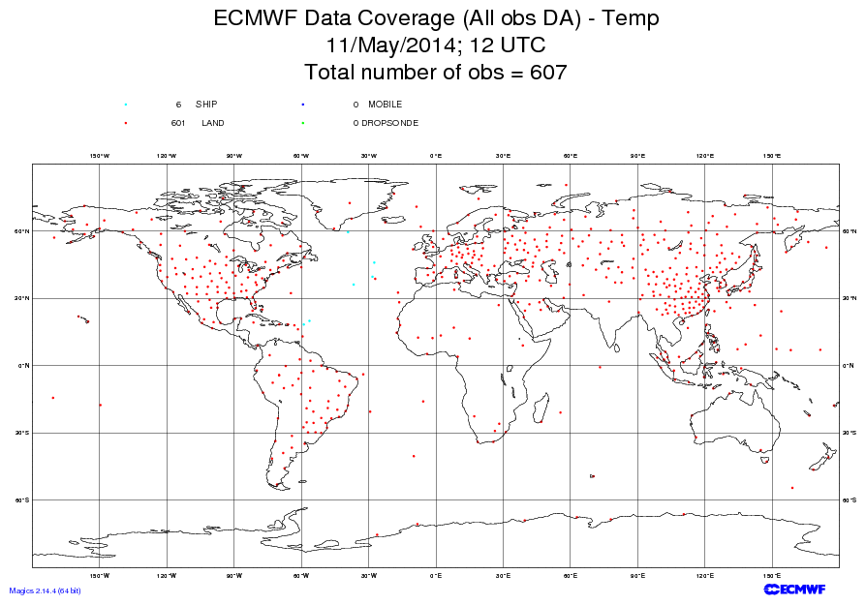

Slide 17
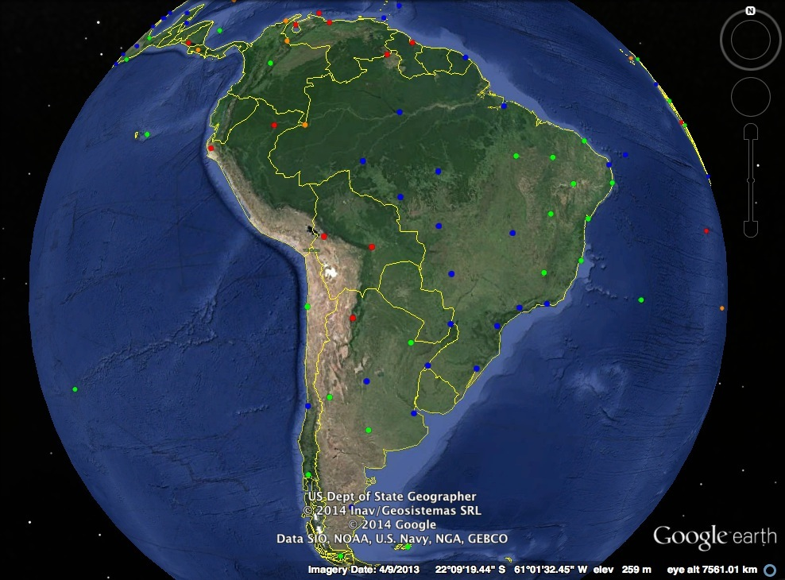

Slide 18
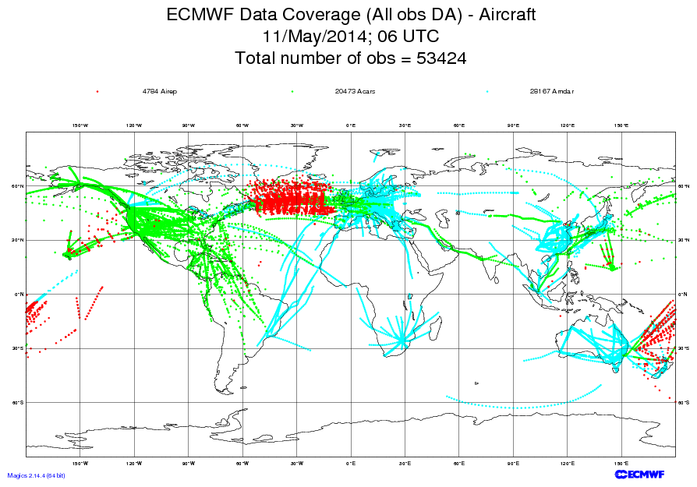

Slide 19
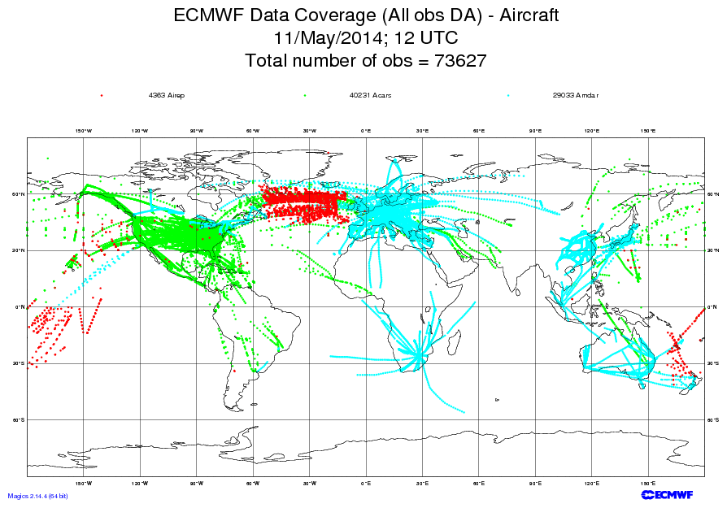

Slide 20
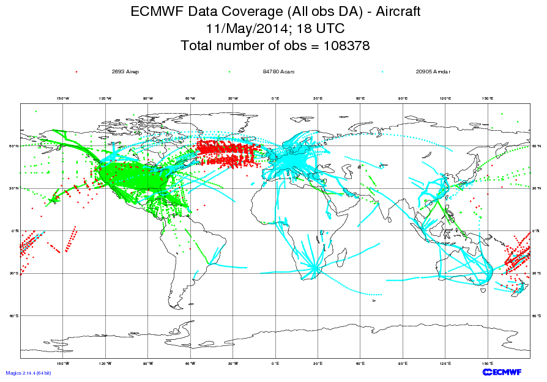

Slide 21
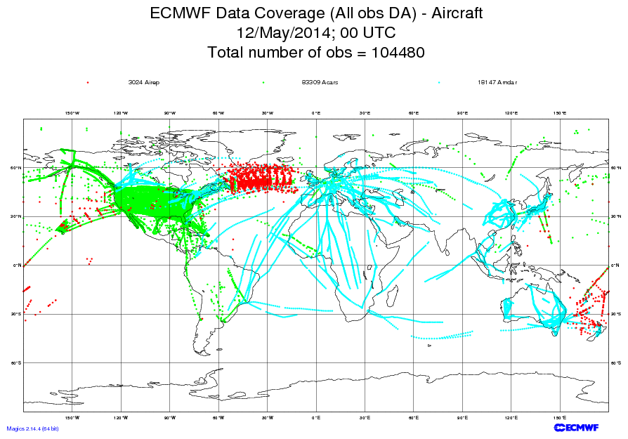

Slide 22
Example WIGOS question to the Workshop:
Should we take steps to mitigate this situation?
Should we redesign the network?
Perhaps fewer stations, supplemented by better AMDAR coverage?
Telecommunications issues

Slide 23
What does WIGOS mean at a National level?
N-WIGOS must be aligned with national needs/priorities (strategic and operational):
NMS Strategy & Plan drive N-WIP
N-WIP has to take such a Strategy & Plan into account and built on it
N-WIP must be consistent with:
WIP and R-WIP (Key Activity Areas),
GCOS-IP, EGOS-IP, GFCS-IP;

Slide 24
National leadership through WIGOS
WIGOS and WIS provide means & opportunities:
To enhance national observing networks for benefit of all users
To enhance sharing and accessibility of observations
To reinforce central role of NMHS through partnerships & a network of networks
To strengthen national mandate and authority
Strong national coordination & cooperation will assist in building strong regional coordination & cooperation

Slide 25
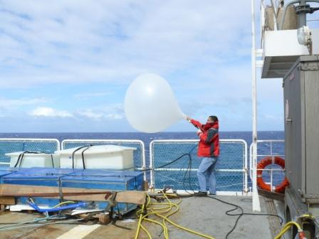
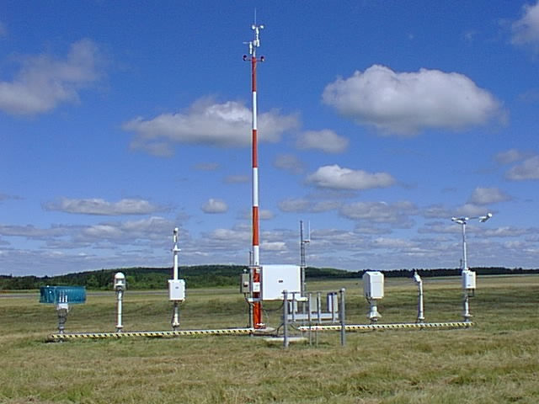
Observing Practices & Procedures
Standards and recommendations for instruments and methods of observation;
All aspects of observations and observing systems:
establishment and installation;
management and operation;
maintenance, inspection and supervision;
delivery & sharing of observations;
data and metadata management (pre-processing & processing, QC, monitoring, remedial actions, …)
Data Quality: 'fit-for-purpose' ideal
Documenting known quality is key.

Slide 26
In conclusion…
WIGOS will not fix all problems of current national/regional observing systems/networks, but
WIGOS will lay down a framework that allows Members to start addressing the current problems in a systematic, coordinated, sustainable, efficient and effective way.

