Slide 1
World Meteorological Organization (WMO) Observing and Information Systems Department WMO Information System (WIS)
WMO
The WMO Information System (WIS)
RA III WG-ITD
May 2014
WIS-Help@wmo.int
Notes:
This presentation is an overview of WIS. There is a one-page handout on this topic available as well.
It will explain why WIS is required by WMO, and what are its expected benefits.
It will note how the Global Telecommunication System (GTS) serves the WMO mission in collecting and exchanging data.
We will see that WIS is being implemented in two parallel parts: WIS Part A and WIS Part B.
It will explain that there are three catagories of WIS Centres, with somewhat distinct roles in moving data and metadata from raw observations to delivered products.
We will also see that WIS requires a comprehensive 24-hour "cache" of data intended for global dissemination, and a comprehensive metadata catalog covering a broad range of data and information across all WMO and cooperating programmes.
It will explain how the WIS Technical Compliance Specifications define the interoperability of WIS implementations across WIS Centres.
It will also show that the WIS architecture is interoperable with the high-level architecture of major systems involving WMO.
First, we will begin with a note about the mission of WMO.

Slide 2
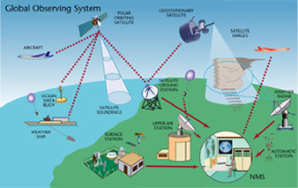
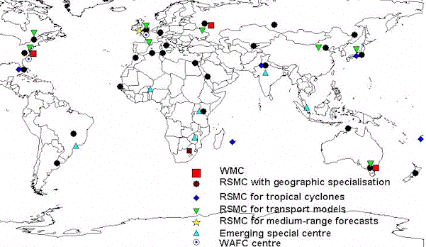
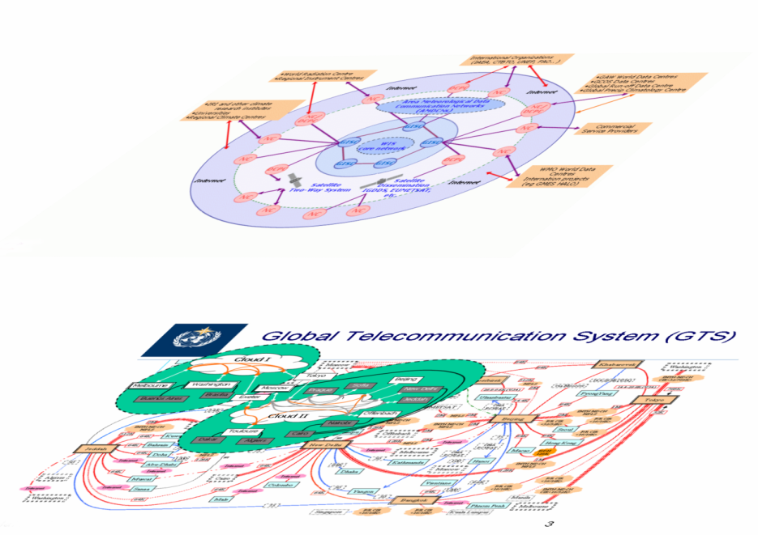
The World Weather Watch extended to all WMO Programmes
GDPFS
WIGOS
WIS / GTS
Partnerships
WMO Programmes
Long Live International Cooperation (Mr Bah, President of WMO RA I)
Notes:
People are very familiar with the World Weather watch and its three pillars. The GOS, the GDPFS and the GTS
However, initiatives like WIGOS recognize we have increasing partnership and that the WWW components are contributing to all WMO programmes. One way to look at this is to see it as follows
WMO Programmes are responsible for what WMO does.
Observing systems traditionally were the GOS but we now see that we need to look more closely for our observation needs across programmes and scales. This composite observing system based on the GOS is WIGOS
Data processing and forecasting enhance the observations to create guidance for all programmes
And to meet all programmes needs we have to engage our partners and other contributing systems
WIS and the GTS are the glue that brings all this together

Slide 3
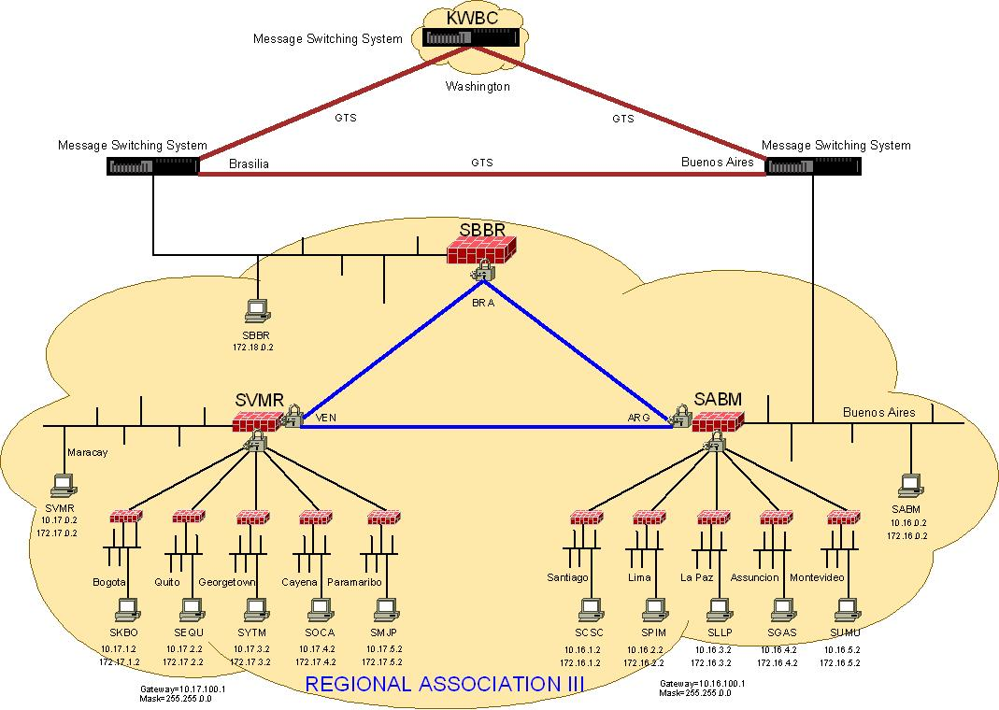
Notes:
From the beginning of WMO, dependable and timely data exchange has been crucial.
Like early telegraph and telephone systems, operators would route data messages over dedicated lines using systems dedicated to WMO. This is the WMO Global Telecommunication System (GTS), partially diagrammed here.
For RA III, this diagram, was updated for RA III – 15th session in 2010 and needs to be updated.

Slide 4
Vision of WIS
WMO Members decided that WIS will:
Use international industry standards
Build on the Global Telecommunication System (GTS), with a smooth and coordinated transition;
Provide operational and time-critical data exchange, as well as data access and retrieval services;
Support all WMO and related international programmes.
Notes:
In 2003, the member nations of WMO decided that WIS will :
Use international industry standards for protocols, hardware and software;
Build on the existing WMO Global Telecommunication System (GTS), with special attention to a smooth and coordinated transition;
Provide operational and time-critical data exchange, as well as data access and retrieval services;
Support all WMO and related international programmes.

Slide 5
Implementation of WIS (Cg-XV, 2007)
WIS is evolving in two parallel parts:
Part A: GTS continued consolidation and further improvements for data and products delivery
Time-critical and operation-critical delivery based on real-time “push” via dedicated telecommunications
Timely delivery based on delayed mode “push” via combination dedicated + public networks
Part B: extension of services through flexible data discovery, access and retrieval services, as well as flexible timely delivery
Notes:
WIS is evolving in two parallel parts:
Part A: GTS continued consolidation and further improvements for data and products delivery
Time-critical and operation-critical delivery based on real-time “push” via the dedicated telecommunications network
Timely delivery based on delayed mode “push” via a combination of dedicated and public networks
Part B: extension of services through flexible data discovery, access and retrieval services, as well as flexible timely delivery

Slide 6
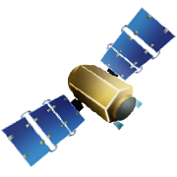
GTS structure
RTH
Regional Telecommunication Hub
NMC
National Metrological Centre
MTN
Main Telecommunication Network
RMTN
Regional Meteorological Telecommunication Network
NMC
NMC
NMC
MTN
RTH
NMC
RTH
RTH
RTH
RTH
NMC
RTH
RTH
NMC
NMC
RMTNs
NMC
NMC

Slide 7
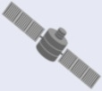
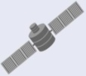
Types of Centres: GISCs, DCPCs, and NCs
World Radiation Centre
Regional Instrument Centres
International Organizations (IAEA, CTBTO, UNEP, FAO.. )
GAW World Data Centres
GCOS Data Centres
Global Run-off Data Centre
Global Precipitation Climatology Centre
IRI and other climate research institutes
Universities
Regional Climate Centres
Internet
DCPC
NC
NC
Internet
Area Meteorological Data
Communication Networks
(AMDCNs)
NC/ DCPC
NC/ DCPC
GISC
NC
Commercial Service Providers
NC
GISC
WIS
core network
GISC
KEY:
NC
NC
DCPC
DCPC
GISC
GISC
NC = National Centres
GISC = Global Information System Centres
DCPC = Data Collection or Production Centres
WIS Networks include:
A Core Network and GISC area networks (AMDCN)
Satellite Dissemination IGDDS, EUMETSAT, etc.
WMO World Data Centres
Internation projects (eg GMES HALO)
WMO World Data Centres
Internation projects (eg GMES HALO)
Internet
Satellite Two-Way System
Internet
NC
NC
NC
NC
Notes:
WMO Member countries will implement and operate WIS, using existing centres with some additional or modified capabilities.
In operational terms, WIS encompasses three types of centres.
Global Information System Centres (GISCs),
Data Collection or Production Centres (DCPCs) and
National Centre (NCs)
Existing National Meteorological and Hydrological Centres become WIS NCs. Special thematic centres such as Climate or Hydrological centres can also be NCs. Global, regional centres such as World Weather Watch RSMCs and RTHs, are categorised as DCPCs. The main difference between an NC or DCPC is their principal focus. NCs have primarily a national focus and DCPCs have an international focus.
NCs and DCPCs collect, disseminate, add value to, and archive regional or programme-specific data and products. NCs and DCPCs must maintain catalogues of their holdings and services, either at their centre or at a host site such as their Principal GISC. Appropriate parts of these catalogues are uploaded to or harvested by GISCs who host the WMO Discovery Metadata Catalogue.
GISCs also hold and distribute copies of at least 24 hours of WMO data and products intended for global distribution.
Designation and certification processes differ between, GISCs, NCs and DCPCs as described in the Manual on WIS.

Slide 8
The MTN and WIS Core Network
RMDCN
GISC
Moscow
IMTN
GISC
Exeter
GISC
Beijing
GISC
Tokyo
GISC
Offenbach
GISC
Seoul
GISC
Toulouse
WIS Core Network
GISC
Jeddah
GISC
Casablanca
GISC
Tehran
GISC
Pretoria
GISC
New Delhi
GISC
Washington
GISC
Brasilia
GISC
Melbourne
Notes:
Now WMO is taking a step beyond managing data messages.
In committing to WIS, WMO has moved to an overarching approach based on managing the data and information.
The core network of WIS is the MTN, but not all GISCs are on the RMDCN run MTN yet.
New centres on the MTN include Pretoria and Casablanca. GISCs Jeddah, Tehran and Brasilia are still working on their connection to the RMDCN NG

Slide 9
WIS Compliance Specifications
Existing centres within WMO Member States may apply for designation as one of the functional centres forming the core infrastructure of WIS:
Global Information System Centres (GISCs)
Data Collection or Production Centres (DCPCs)
National Centres (NCs)
Designation requires a statement of compliance with WIS requirements
The Manual on WIS (WMO No 1060) is the authoritative source for specifications applicable to WIS GISCs, DCPCs, and NCs
The Manual on WIS also lists centres and their Principal GISC
Notes:
Existing centres within WMO Member States may apply for designation as one of the three types of WIS Centers.
As of 2013, WMO Members have proposed 15 GISC's and about 121 DCPC's and over 220 NCs. The totals around 360 and is expected to grow as Climate and Hydrology centres join WIS.
To be officially designated as a WIS Centre requires a demonstrated capability to implement the WIS Compliance Specifications There are specific procedures for having a candidate WIS Centre endorsed by WMO Expert Teams.
Although Members may still nominate to provide a GISC, CBS believes that 15 GISCs is enough unless new technology allows a way to operate more GISCs and meet the interchange requirements without increasing operating costs to existing GISCs.
In contrast, Members are encouraged to identify further NCs and DCPCs to enrich the overall data holdings and services available to WMO Members.

Slide 10
Interoperability and WIS Networking
National Centres (NCs)
Data and Product Users
Global Information System Centres (GISCs)
Data Collection or Production Centres (DCPCs)
Notes:
Architecturally, WIS can be viewed as a Service Oriented Architecture implemented primarily through communications networks. The WIS Compliance Specifications concern primarily network services that occur at interfaces between communicating WIS components.
By focusing on interoperability at these interfaces, WIS greatly reduces the complexity otherwise evident across the diverse systems. It also minimizes impacts on any given component system other than at its WIS interfaces. This is very important because the component systems are built and managed independently.
Here is a high‑level architectural view of the major parts of WIS. Interoperability opportunities are shown as arrows to users and among GISCs, DCPCs, and NCs.
WIS Compliance Specifications focus on the points of those arrows--the touch points where WIS components must interoperate.

Slide 11
WIS and Selected WMO Observing and Data Exchange Systems
WMO Information System (WIS)
Global Observing System (GOS)
Global Atmosphere Watch (GAW)
Global Terrestrial Observing System (GTOS)
Global Ocean Observing System (GOOS)
Global Climate Observing System (GCOS)
Global Earth Observations System of Systems (GEOSS)
WMO Integrated Global Observing System (WIGOS)
World Climate Programme (WCP)
Global Framework for Climate Services (GFCS)
World Hydrological Cycle Observing System (WHYCOS)
Global Cryosphere Watch (GCW)
Notes:
WMO developed a consensus on exactly how the WIS architecture would be applied to its major systems (coloured green in this diagram), and certain other systems in which WMO is a major partner (here colored yellow). New systems such as the GFCS and GCW have been added in recent years. WIS remains the glue that brings them together as well as providing certain standards and practices for their own usage. You see here that the WMO Priority areas of GFCS and WIGOS are highlighted in pink

Slide 12
Global Observing System (GOS)
Global Observing System of WWW (operated by NMHS's)
WWW Global Observing System (WWW GOS)
WMO Global Telecommunications System (GTS) and Regional
Telecommunication
Hubs (also known as WIS DCPC's)
observations (satellite and surface)
Data and Product Users
inter-comparison and validation
National Meteorological Centres (also known as WIS NC's )
WMO Information System (WIS)
WIS Global Information System Centres (GISC's)
Notes:
WMO’s Global Observing System provides observations of the state of the atmosphere and ocean surface.
These observations are used for the preparation of weather analyses, forecasts, advisories and warnings, and for climate monitoring and environmental activities carried out under programmes of WMO and other relevant international organizations.
GOS is operated by National Meteorological Services, national or international satellite agencies, and involves several consortia.
The most common data formats in this area are GRiB (GRIdded Binary) and BUFR (Binary Universal Form for the Representation of meteorological data). In addition to these binary encoded formats, WMO uses the character encoded CREX (Character Representation for EXchange of data).
WMO's GTS is part of WIS. GTS Regional Telecommunications Hubs (WIS DCPC's) support external interfaces for data access. The National Meteorological Centres (WIS NC's) also support interoperability with external systems.
Here, some common services for data exchange are OpenDAP (Open-source Project for a Network Data Access Protocol) and Thredds (Thematic Real-time Environmental Distributed Data Services).

Slide 13
World Hydrological Cycle Observing System (WHYCOS)
World Hydrological Cycle Observing System (WHYCOS)
regional Hydrological Cycle Observing Systems (HYCOSs)
Data and Product Users
National Hydrological Services (also known as WIS NC's)
Global Data Centres (also known as WIS DCPC's)
WMO Information System (WIS)
WIS Global Information System Centres (GISC's)
Notes:
WMO’s Hydrological Observations, including the World Hydrological Cycle Observing System (WHYCOS), focuses on strengthening cooperation among National Hydrological Services, and coordinating measurement and collection of surface and ground water data, from networks of hydrological and meteorological stations.
External interfaces for data discovery, access, and retrieval include National Hydrological Services (WIS NC's), and Global Data Centres (WIS DCPC's) such as the Global Runoff Data Center.
Data holdings are available through each of the Hydrological Cycle Observing Systems that comprise WHYCOS.
Although there may be not much international standardization of hydrology data, it seems there is a growing awareness of the need for it.
Some hydrological data is being disseminated using WaterML, an XML schema created by the Consortium of Universities for the Advancement of Hydrologic Science.

Slide 14
Global Atmosphere Watch (GAW)
Global Atmosphere Watch (GAW)
Observing systems contributing to GAW
World Data Centres (also known as WIS DCPC's)
Data and Product Users
National Centers (includes WIS NC's)
GAWSIS Web site
WMO Information System (WIS)
GAW Web site
WIS Global Information System Centres (GISC's)
Notes:
The Global Atmosphere Watch (GAW) strengthens the ability to predict climate, weather and air quality, by maintaining and applying global, long-term observations of the chemical composition and selected physical characteristics of the atmosphere.
External interfaces for data discovery, access, and retrieval are at the GAW Web site, and the GAW World Data Centres (WIS DCPC's):
Ozone & UV
Greenhouse Gases
Aerosols
Radiation
The Global Atmosphere Watch Station Information System (GAWSIS) is a prime focal point for data accessibility.
Pilot projects are underway on the interoperability of GAW World Data Centres and access services, including data in the format known as NetDCF (Network Common Data Form).

Slide 15
World Climate Programme (WCP)
WIS National Centres (operated by NMHS's)
World Climate Programme (WCP)
National Climate Data Management Systems
National Climate Forecast Systems
Data and Product Users
Regional Climate Centers (WIS DCPC's)
World Climate Data Centres (WIS DCPC's)
Global Climate Forecast Producing Centres (WIS DCPC's)
WMO Information System (WIS)
WIS Global Information System Centres (GISC's)
Notes:
The World Climate Program (WCP) coordinates activities in climate data collection, monitoring, research, prediction, applications and training. WCP facilitates climate data and metadata collection through various global climate observing systems, and climate data should be available through international exchange.
WCP also assists in implementing Regional Climate Centers.
External interfaces for data discovery, access, and retrieval include:
National Meteorological Services,
Regional Climate centers,
World Climate Data Centers and
Global Climate Forecast Producing Centers.
WCP requires access to a wide variety of data in many different formats, especially given the need to deal with archived data.

Slide 16
Global Climate Observing System (GCOS)
Global Climate Observing System (GCOS)
GCOS Baseline and Comprehensive Networks, and Satellites
Global Observing System Information Centre [Web portal] (DCPC)
Data and Product Users
GCOS and related Monitoring and Analysis Centres (includes WIS DCPC's)
Observations
Product Generation
WMO Information System (WIS)
WIS Global Information System Centres (GISC's)
Notes:
The Global Climate Observing System (GCOS) is co-sponsored by WMO, the UNESCO Intergovernmental Oceanographic Commission (IOC), the United Nations Environment Programme (UNEP), and the International Council for Science (ICSU).
GCOS focuses on the comprehensive observations required for monitoring climate, detecting change, assessing the impacts, and improving models of the climate system.
The GCOS programme facilitates the taking of the needed observations by national or international organizations in support of their own requirements as well as of common goals.
GCOS builds on, and works in partnership with, other existing and developing observing systems such as the WMO Global Observing System and Global Atmosphere Watch, the Global Ocean Observing System, and the Global Terrestrial Observing System.
GCOS has many external interfaces that are opportunities for interoperability: the Global Observing System Information Centre, GCOS Monitoring and Analysis Centres, and the many specific Atmosphere, Ocean, and Terrestrial Networks for observations, related data centres and archives designated relevant to climate.

Slide 17
Global Ocean Observing System (GOOS)
Global Ocean Observing System (GOOS)
Observations
WMO Global Telecommunications System (GTS)
Data and Product Users
Product Generation
JCOMM Data Portals (also known as WIS DCPC's )
IODE Ocean Portal (also known as a WIS DCPC )
WMO Information System (WIS)
WIS Global Information System Centres (GISC's)
Notes:
The Global Ocean Observing System (GOOS) focuses on sustained observations of the oceans, generation of oceanographic products and services, and interaction between research, operational, and user communities.
GOOS is designed to: monitor, understand and predict weather and climate; describe and forecast the state of the ocean, including living resources; improve management of marine and coastal ecosystems and resources; mitigate damage from natural hazards and pollution; protect life and property on coasts and at sea; and, enable scientific research.
GOOS is implemented by member states via their government agencies, navies and oceanographic research institutions, working together in a wide range of thematic panels and regional alliances.
Key external interfaces providing opportunities for interoperability are: the WMO GTS, the Joint WMO/IOC Technical Commission for Oceanography and Marine Meteorology (JCOMM) Data Portal, and the International Oceanographic Data and Information Exchange (IODE) Ocean Data Portal.
The Ocean Data Portal includes "Ocean Teacher": an extensive set of online learning modules that include data management and metadata as well. Here, the metadata describes as course prerequisites and learning objectives. This is just one example that the WIS discovery function must deals with much more than geospatial metadata.

Slide 18
Global Terrestrial Observing System (GTOS)
Global Terrestrial Observing System (GTOS)
Calibration / Validation
Terrestrial Ecosystems Monitoring Sites (TEMS)
Data and Product Users
Observations
GTOS Data Centres Directory
GTOS Resources Directory
WMO Information System (WIS)
National Centres
WIS Global Information System Centres (GISC's)
WIS Data Collection or Production Centres (DCPC's)
Notes:
The Global Terrestrial Observing System (GTOS) is a programme for observations, modelling, and analysis of terrestrial ecosystems to support sustainable development. GTOS facilitates access to information on terrestrial ecosystems so that researchers and policy makers can detect and manage global and regional environmental change.
External interfaces for data discovery, access, and retrieval include the GTOS Data Centres Directory, the GTOS Resources Directory, and the Terrestrial Ecosystems Monitoring Sites (TEMS) database.
Here I would mention the Geonetwork opensource project which is being applied broadly in this area, including the TEMS database among many others. We anticipate that many of the WIS Centres will be using Geonetwork as a portal for access to maps and other geospatial data resources.

Slide 19
Global Earth Observations System of Systems (GEOSS)
Earth System Models
Global Earth Observations System of Systems (GEOSS)
Other Data Sources
GEOSS Clearinghouse / Broker
Data and Product Users
Earth Observation Systems
WMO Information System (WIS)
National Centres
WIS Global Information System Centres (GISC's)
Data Collection or Production Centres (DCPC's)
Notes:
The WIS Architecture is very similar to the GEOSS Architecture as agreed in the GEOSS 10 Year Plan and Reference Document.
The primary interface for interoperability between WIS and GEOSS occurs at the GEOSS Data Broker which acts as a Clearinghouse.
Because both GEOSS and WIS adopted the same ISO standard search service, WIS GISC's can search the GEOSS Clearinghouse and WIS catalogs are searchable by users of GEOSS Clearinghouse.
Interestingly, the discovery metadata flow between GEOSS Portal and WIS GISCs is different. GEOSS chose to harvest all WMO Discovery Metadata and serve this information from its own system. WIS has chosen not to harvest and host the entire GEOSS catalogue but to use the GEOSS Search and Retrieval by URL standard (SRU) based on ISO 23950 supported by GEOSS and WIS. SRU allows WIS users to search the GEOSS catalogue by passing the search question to the GEOSS server via the SRU interface. This means that GISCs do not have to scale their capacity to store GEOSS metadata which is something over which they would have had no control. Also, much of WMOs metadata is available through GEOSS so management would also be more complex.
It is important to note that data and product users can access WIS GISC's and DCPC's either directly or by a referral from GEOSS. The same is true of all WIS Centres: broader catalogues and access portals supplement but need not replace existing catalogs or portals.

Slide 20
WMO Priority Areas
WIS is critical to the following priority initiatives of WMO
WIGOS Framework
WMO Integrated Global Observing System
WIS provides the interoperability layer as well as providing WIS data exchange and discovery
GFCS
Global Framework for Climate Services
WIS supports the Climate Services Information System (CSIS Pillar), and
Observations and Monitoring Pillar
Expected Result 1 & 2 – Services and Disaster Risk Reduction
WIS enables Members and decision makers access to authoritative, high quality weather, climate and water information
Notes:
In order to better understand the reasons for WIS and its benefits, it is worth considering the role WIS plays in WMO’s operational and critical services that underlie all Members NMHS and Climate activities. In particular, we have spoken of several observing systems under WMO and with their partners. WIGOS provides a framework that effectively integrates these observing systems as if they were one in the terms of coordination and planning. WIS provides the interoperability layer of WIGOS as well as making it easier for earth observing systems to share information across WMO.
Global Framework for Climate Services is especially dependent on WIS in its observation and monitoring pillar just as WIGOS is. It is also dependent on WIS and its interoperability set of standards and practices for its Climate Services Information Systems which not only need to incorporate WIS and other WMO activities but take advantage of WIS’s heritage and learning to make the CSIS an efficient and effective information management system in its own right facilitating the providing of Climate services.
Similarly, Expected Results 1 and 2 of WMO 2012-15 Strategic Plan clearly depend on WIS to enhance the ability of Members and their decision makers to access authoritative, high quality weather, climate and water information. WIS will make it easier for increasing the visibility of NMHS and WMO as the authoritative soruce and make it easier to access WMO information.

Slide 21
Benefits of WIS
In addition to improving efficiency, WIS:
Enhances collection of and access to critical data
Catalogues all WMO data, products & services
Enhances availability of operational and time-critical data and products at all national centres
Opens up GTS to other types of data
Exploits technology innovation
Provides more agile subscription services
Notes:
Now I would like to close by noting what WMO Members expect to gain from WIS:
- WIS enhances the collection of critical data needed to monitor and predict aspects of the environment, including hazards
- WIS catalogs the full range of data and products, simplifying search and assuring equitable access per WMO policies
- WIS enhances the availability of time-critical data and products at centres in all nations, ensuring the effective provision of services to their populations and economies
- WIS opens up GTS to other types of environmental data so that all programmes have stronger infrastructure support
WIS exploits opportunities as they become available with technology innovation.
An immediate benefit to many will be the enhance subscription services which will allow users to monitor WIS catalogues and subscribe to data, products and services

Slide 22
Current Status
Global (360 Centres)
RA III (20 Centres)
GISCs – 15 (14 audited)
NCs – 223
DCPCs – 122
CBS (220 NCs & 81 DCPCs)
CHy (2 & 2)
CCl (0 & 14)
Other (1 & 28)
Expected to grow as WIGOS and GFCS bring more partnerships
GISCs - 1
NCs – 13
DCPCs – 6
CBS (13 & 3)
CHy (0 & 0)
CCl (0 & 0)
Other (0 & 3) (CAeM, CIMO, CAS)
Note RICs not auto DCPCs

Slide 23
Under review by CBS
Competencies
http://wis.wmo.int/doc=2739
Learning guide
http://wis.wmo.int/doc=2741
CBS has developed a set of competencies that identify what WIS centres need staff to be able to do.
A learning guide assists trainers in identifying what needs to be addressed and what resources are available

Slide 24
Competencies
Infrastructure
Manage the physical infrastructure
Manage the operational applications
Data
Manage the data flow
Manage the data discovery
External interactions
Manage WIS centre-centre interactions
Manage user interactions
Operational service
Manage the operational service

Slide 25
1. Why WIS is required and what are its expected benefits 2. How the Global Telecommunication System (GTS) serves the WMO mission in collecting and exchanging data 3. Why WIS Part A and WIS Part B are implemented in parallel 4. How the three types of WIS Centres (GISC, DCPC, NC) move data and metadata from observation to product delivery
Review of Key Points
Notes:
Here is a brief summary of the key points in this presentation:
1. Why WIS is required and what are its expected benefits 2. How the Global Telecommunication System (GTS) serves the WMO mission in collecting and exchanging data 3. Why WIS Part A and WIS Part B are implemented in parallel 4. How the three types of WIS Centres (GISC, DCPC, NC) move data and metadata from observation to product delivery

Slide 26
5. Why GISCs maintain a comprehensive 24-hour "cache" of data intended for global dissemination 6. Why GISCs maintain a comprehensive metadata catalog 7. How WIS Technical Compliance Specifications define the interoperability of WIS Implementations across WIS Centres 8. Why the WIS architecture is interoperable with the high-level architecture of major systems involving WMO (e.g., WIGOS, GOS, GCW, GAW , WHYCOS, GOOS, GTOS, WCP, GCOS, GFCS, GEOSS)
Review of Key Points
Notes:
5. Why GISCs maintain a comprehensive 24-hour "cache" of data intended for global dissemination 6. Why GISCs maintain a comprehensive metadata catalog 7. How WIS Technical Compliance Specifications define the interoperability of WIS Implementations across WIS Centres 8. Why the WIS architecture is interoperable with the high-level architecture of major systems involving WMO (e.g., WIGOS, GOS, GCW, GAW , WHYCOS, GOOS, GTOS, WCP, GCOS, GFCS, GEOSS)
This concludes my presentation, and I welcome your questions.

Slide 27
WIS Reference Documents
WMO Technical Regulation Vol I. (WMO No 49)
Manual on the WMO Information System (WMO No 1060)
Guide to the WMO Information System (WMO No 1061)
These and other important documents such as the “Designation Procedures for GISCs and DCPCs” can be found on the WIS web site:
http://www.wmo.int/wis
Notes:
You can find the key reference documents about WIS at this URL.
The primary document is the Manual on WIS (WMO No 1060) published in January 2012 as an addition to the WMO Technical Regulation 49 (Technical Regulations, Volume I: General Meteorological Standards and Recommended Practices). It was further updated at EC-65 with the addition of CBS 16 changes including all the discovery metadata information. Recommended practices and clarifications are provided in the Guide to the WMO information (WMO No 1061) which was updated at CBS 15 in 2012 and published following approval at EC-65.
Other useful reference documents are the "WIS Compliance Specifications“ and Functional Architecture. These contain the interface specifications I have just presented, plus some more general aspects of WIS and were the basis of the Manual and Guide on WIS.
Tech Reg 49 Volume I - http://library.wmo.int/opac/index.php?lvl=notice_display&id=14073
Manual on WIS – WMO No 1060 – http://library.wmo.int/opac/index.php?lvl=notice_display&id=9254
Guide to WIS – WMO No 1061 - http://library.wmo.int/opac/index.php?lvl=notice_display&id=6856

