Slide 1

World Meteorological Organization (WMO)
Observing and Information Systems Department
WMO Information System (WIS)
WMO
Overview of Discovery, Access, and Retrieval (DAR) in the
WMO Information System (WIS)
Prepared by
WIS Project Office
WIS-Help@wmo.int
Notes:
This presentation will give an overview of Discovery, Access and Retrieval (DAR), a function that is essential to the objectives of WIS.

Slide 2
Presentation Outline
What is the objective of WIS DAR?
What is the general approach?
What do we mean by interoperability?
How does interoperable search work?
What can be accomplished with WIS DAR?
How do we implement WIS DAR?
Notes:
This presentation follows this general outline:
What is the objective of WIS DAR?
What is the general approach?
What do we mean by interoperability?
How does interoperable search work?
What can be accomplished with WIS DAR?
How do we implement WIS DAR?

Slide 3
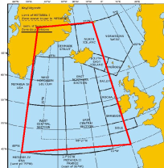

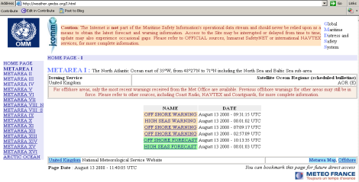
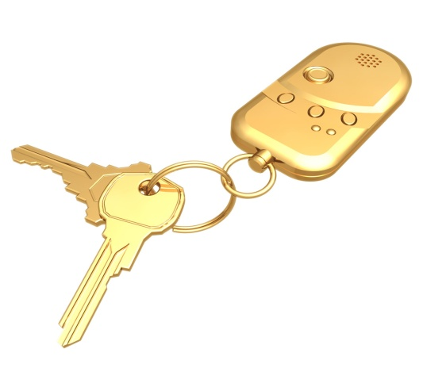
GISC – DAR service
Search Request
marine warnings in area bounded by 40W to 10W and 45N to 70N
Search Results
User searches for metadata then retrieves information from data custodian
Information request to custodian
http://weather.gmdss.org/I.html
Centre publishes metadata to GISC DAR catalogue
Retrieve information
Security/authentication/authorization and even charging is managed by each service provider
NC/DCPC information access service
Notes:
Note that the WIS diagrams are functional descriptions. Information paths will vary. For instance, a user finding information in the GISC catalogue will be directed to the data custodian, most likely a DCPC or NC to access the information. In this way, all the security, charging and volume measurements are managed at the data download stage by the custodian, not by the GISC. For instance, using the Global Marine Distress Signal System (GMDSS), a user could be directed to the GMDSS web site as follows:
The GMDSS publishes its metadata to the GISC catalogue (advising it has forecasts and warnings for Metarea One)
The user wants to search the metadata and retrieve information (for example “marine warnings in area bounded by 40W to 10W and 45N to 70N”)
The user searches the GISC DAR service for information (ie sends a search request to the GISC)
The DAR returns a list of solutions to the user (such as a sorted list of possible marine forecasts and warnings registered at the GISC – several of which point to the website http://weather.gmdss.org/I.html)
The user selects a solution and visits the custodians centre, in this case the GMDSS website
The centre then downloads the data to the requestor
Security, authentication, authorization and even charging mechanisms are managed by the centre. WIS does not try to enter into financial actions or, outside of collaborative virtual organisation agreements, try to pass user roles or validation to the custodian.

Slide 4
What is the objective?
Make
it easier
to discover data and information
Notes:
The objective of the WIS DAR function is simple:
Make it easier to discover data and information.
This applies in at least two distinct ways: We want to make data and information easier to find by "internal searchers": experts, managers, and decision makers across the full breadth of WMO Members and associated organizations.
Also, we want to make WMO holdings more easily found by "external searchers": people everywhere who could make good use of this data and information, perhaps by including pointers to these holdings in discovery services of their own.

Slide 5
What is the general approach?
Use common standards focused on search interoperability
Notes:
The general approach for accomplishing the DAR objective is to use common standards, especially standards focused on search interoperability.
The concept of "search interoperability" is perhaps not familiar. I will explain a bit about that next.

Slide 6
Presentation Outline
What is the objective of WIS DAR?
What is the general approach?
What do we mean by interoperability?
How does interoperable search work?
What can be accomplished with WIS DAR?
How do we implement WIS DAR?
Notes:
Let's start with: What do we mean by interoperability?

Slide 7
Interoperability
Definition:
differences among systems
are not a barrier to a task
that spans those systems
"What few things
must be the same
so that everything
else can be different"
Notes:
Here is a simple definition: Interoperability is when differences among systems are not a barrier to a task that spans those systems
.
It is important to recognize that having two interoperable systems is not the same as having one integrated system.
Integration is concerned with eliminating difference among parts so that the system works as a single unit.
In the case of two interoperable systems, we expect that the systems will remain different, perhaps very different. Yet, these systems can be made to work together to achieve some particular task that spans the two systems. This is the key feature of interoperability: a task is achieved without requiring the systems to eliminate their differences.
Electric plug adapters are an example of interoperability. An adapter can let your electric appliance work even with power outlets designed for a different type of plug.
This quote, attributed to Michael Tiemann of RedHat, expresses nicely the sentiment behind interoperability. We are looking for "What few things must be the same so that everything else can be different"

Slide 8
Syntax and Semantics
Semantics deals with the meaning
of a symbol in some language
Syntax deals with handling of symbols independent of their meaning
Notes:
In the fields of data processing and information systems, designers of interoperable solutions usually need to distinguish between syntax and semantics.
Semantics deals with the meaning of a symbol in some language, whereas syntax deals with the handling of symbols independent of their meaning.
Information and communications technology has always supported many different mechanisms for manipulating the syntax of data and information.
Global organizations with a complex mission, such as WMO, need solutions that accommodate a wide diversity in data and information syntax. Table Driven Code Forms (TDCF) is an example of a syntax standard derived and managed by WMO.

Slide 9
Interoperability with Syntax
Structure Types, e.g.,
  sub-element is part of element
  record is part of file
  table has three dimensions
Data Types, e.g.,
  integers or decimal numbers ...
  dates, times, coordinates ...
  text, images, sound ...
Indicating structure in an instance, e.g.,
  start-position, length
  mark-up with start-end tagging
Notes:
Interoperability at the syntax level can focus on the different ways to define structure (e.g., elements, element groups, records) or the different ways to define data type (e.g., numbers, dates, text).
There are also a variety of standard ways to associate structure and type descriptions with particular instances of data. A database schema, an ASN.1 specification, a File Description, or an XML schema are common example. These may reference a format description file that is external to the data, and may be tied together through a reference mechanism such as a MIME Type. Other format descriptions are actually embedded with the data as a single object, which is sometimes called a "self-describing file format". NetCDF is a example of such a format.
Another broad distinction among syntax description methods concerns how structural information is expressed within a data instance. Recently, start-stop tag "mark-up" approaches have become popular, although the more efficient "start position, length" approaches are still very common.
We should also note that some syntax description mechanisms have the ability to distinguish bits as individual data elements, whereas others have whole characters as their smallest distinguishable data element. The smallest distinguishable element is often referred to as "atomic". The atomic level of XML (Extensible Markup Language), for example, is a Unicode character while a single bit is the atomic level of ASN.1 (Abstract Syntax Notation).
Syntax interoperability across WMO is a matter being addressed by the Inter-program Expert Team on Data and Metadata Interoperability. Their recommendations would impact various parts of the WIS technical specifications, and the "Retrieval" part of the WIS DAR function.

Slide 10
Interoperability with Semantics
"semantic mapping" associates concepts
that are close enough for the purpose:
What type is it?
Who made it?
What is its name?
document
author
title
e-mail
from
subject
news article
by-line
headline
file
owner
file name
scientific data set
principal investigator
data set name
biological specimen
collector
organism name
spatial coverage
originator
title
Notes:
I'd like to focus now on how we accomplish interoperability with semantics.
The key technique is "semantic mapping". This technique simply associates concepts to each other in those cases where the concepts are close enough in meaning for the purpose at hand.
Let's look at a typical interoperable search task: finding items based on "title" and "author".
We notice immediately that the concept of "title" is not always carried in an actual metadata element called "title". In the case of an e-mail message, the field closest to the "title" concept is actually called "subject". Also, where a document would have an "author" element, the closest concept among e-mail message elements is the "from" field.
Here are a few more examples that make for a simple semantic map:
a news article may have a "headline" and a "by-line"; a file may have a "file name" and "owner", a scientific data set may have a "data set name" and a "principle investigator"; a biological specimen may have an "organism name" and a "collector"; a map may have a "title" and an "originator".
This mapping may seem pretty simple and obvious. That's because real people do this kind of concept association naturally--concept generalization is inherent in how humans think. All we are doing here is applying that skill to the processing available in today's computer systems.
But, we need to be careful with this technique. Remember that interoperability is always defined in terms of a particular task to be accomplished. There is no such thing as completely interoperable
systems--systems can only be interoperable for a particular purpose.
For instance, this example semantic map says that a "principal investigator" is equivalent to an "author". That is usually true for the purpose of interoperable search. But, for other purposes, the distinction between those terms may be very important and people might strongly object to treating them as equivalent..

Slide 11
Interoperability and Discovery Metadata
Index Names | Description
serverChoice | The set of one or more indexes from any context sets known to the server.
title name | The name of the information resource.
author creator | The name of the originator of the information resource.
description abstract | The text describing the information resource.
keywords | The group of words or phrases describing the information resource.
date publicationDate | The date of publication of the information resource.
beginningDate | The start date of the period associated with the information resource.
endingDate | The end date of the period associated with the information resource.
bounds | The set of geographic coordinates that delimit the coverage of the information resource.
contactOrganization | The name of the organization acting as contact for the information resource.
rights copyright useConstraints | The text describing the constraints on use of the information resource.
accessConstraints | The text describing the constraints on access of the information resource
linkage | The identifier of the address of the cross-referenced information resource. Note: By convention on the Internet, the identifier is expressed as a URN or URL.
publisher distributor | The name and other information associated with the party acting as distributor of the information resource product.
type | The code identifying the medium of the information resource product.
lastModificationDate | The date of modification of the locator record of the information resource.
Notes:
Experts in information retrieval have registered the semantics of thousands of search index concepts.
Here is an extract from such a register, where you see that we have not only the common name of the index but a precise definition.
A small number of these indexes are very common across most search facilities, and these are essentially bibliographic indexes: Title, Author, Abstract, Subject, Date. To these indexes, we must add geographic bounds which is important when searching for data in particular places on the Earth.
Because it is important that the semantics are precise, the definition of the element follows the ISO 11179 standard for Metadata Registries. This makes the definitions simple to read yet structured in a way that exposes relationships among the concepts underlying each index.

Slide 12
Presentation Outline
What is the objective of WIS DAR?
What is the general approach?
What do we mean by interoperability?
How does interoperable search work?
What can be accomplished with WIS DAR?
How do we implement WIS DAR?
Notes:
We have seen that the objective of the WIS DAR function is to make it easier to discover data and information.
We have also seen that this is to be accomplished using standards focused on search interoperability.
We understand that interoperability can be achieved by looking for "What few things must be the same so that everything else can be different".
And, we know about the technique of "semantic mapping".
So, let's take a look at how search works in general and then we can see how interoperable search is implemented in the WIS DAR function.

Slide 13

Information Items Have Characteristics
Who
made it?
What type
is it?
What is
its name?
Where is
it stored?
Is it free?
Notes:
Finding something is easy if there are only a few items where we
are looking, or if the particular item we want has an obviously unique characteristic.
The hard problem is finding a small group of relevant items within a very large group of items, and the items we want have no obviously unique characteristic.
For any information item that has not been lost forever, there must be some information available about its characteristics. Typical characteristics of interest to searchers are: Who made it?,
What type is it? What is its name? Where is it stored?
As we have seen, characteristics like these can be generalized as concepts such as Author, Type, Title, Data Center, and so on.

Slide 14

Characteristics Can Be Indexed
Searching works on indexes of "documents"
Documents may be
Web pages,
entries in
catalogs or
directories,
...
any resource
Web
Index
Bibliographic
Records
Search
Catalogs,
Directories
Data
Index
Notes:
Indexes are used to find relevant items within a large store of items. The word index at the back of a textbook is a good example of an index. It simply lists the pages on which any particular topic occurs. A library author catalog works in much the same way: it lists the books by any particular author.
Most large scale searching uses techniques of Information Retrieval, a discipline related both to computer science and to information science. Information Retrieval can be used for finding any kind of data or information resource:
Searching in information retrieval terms works on indexes of "documents". These may be Web pages, data sets, maps, faces, music, and any entry in just about any kind of catalog or directory.
Google (hyperlinked resources)
Chemical Abstracts Service (catalysts)
Convera (faces)

Slide 15
Indexes are Key to Searching
Indexes characterize "content" or "context"
Content implies patterns with a document
(e.g., words, word clusters, place names, ...)
Context implies patterns beyond a document
(e.g., hyperlinks, lineage, usage...)
Notes:
Appropriate indexes are the key to efficient and effective searching.
In general, indexes can characterize either "content" or "context".
A content index works on patterns that actually exist within a document, including any embedded metadata (e.g., words,
word clusters, place names, ...)
A context index works on patterns that exists outside of the actual
(e.g., hyperlinks, lineage, user search history, citations in news articles...)
There are very many clever approaches to help searchers find relevant information, especially on the Internet where the relevance challenge is great but there are many kinds of context to exploit.
Yet, even with the great variety of "search algorithms", it happens that there is not so much variety in how the actual search query is expressed. That is where we find the opportunity for "interoperable search".
But first, let's see what a successful search looks like from an Information Retrieval perspective.

Slide 16
The Result of Searching
A search result set ("hit list") contains documents satisfying selection criteria
  e.g. the word "oil" occurs in the document title
  and the word "water" does not occur in the title
A search result set is rank ordered, typically
using "relevance ranking" or date/time
Note: Search technologies often compete on ranking algorithms--may be trade secrets
Notes:
If you execute a database query, the answer you get is simply all of the database records that match your filter expression.
That is not what happens with Information Retrieval. A successful search returns a search result set. This set (usually encountered first as a "hit list") contains pointers to documents that satisfy the search selection criteria compared to the contents of the indexes.
For example, a search selection criteria may specify documents where the word "oil" occurs in the document title and the word "water" does not occur in the title.
An Information Retrieval search result set is rank ordered according to sorting criteria, typically using "relevance ranking" or date/time.
As we have seen, search technologies often compete on their ranking algorithms, which may be trade secrets.

Slide 17
Using Interoperable Search
No single search technology handles all types of sources (meteorological data, geospatial data, chemical data, multi-media data, ...)
"Interoperable search" can span multiple, separately operated information indexes:
  an index of Web pages, an catalog of weather observations, a directory of technical reports,
  a catalog of library holdings, etc.
Notes:
Recall that we want to make data and information easier to find by "internal searchers" and also make WMO holdings more easily found by "external searchers", including discovery services operated by others.
Interoperable search is essential to WIS, given that no single search technology handles all types of WMO data and information sources (meteorological data, geospatial data, chemical data, multi-media data, ...).
Web portals using interoperable search can help searchers discover resources across separately operated information discovery servers: a catalog of weather observations, an index of Web pages, a directory of technical reports, a catalog of library holdings, etc.
So, how does "interoperable search" actually look in practice?

Slide 18
WIS DAR Interoperable Search
SRU Server
http://wis.bom.gov.au/openwis-user-portal/srv/en/main.home/portal.sru?operation=searchRetrieve&version=1.1&query="TIGGE" and keywords all weatherObservations and geo.bounds within/partial/nwse"-10 -90 -40 -160“ &startRecord=1 &maximumRecords=10 &&
Key words
Search words.
latitude, longitude
boundaries
Notes:
Here we see an example interoperable search query, as specified in the WIS DAR function (WIS Technical Specification 8).
This is a high-level service interface that uses the interoperable search standard, ISO 23950 SRU (Search and Retrieve by URL).
This kind of interface is probably very familiar, as it uses standard Web "HTTP" service with the CGI (Common Gateway Interface),
a convention for HTTP services widely used with "Web forms".

Slide 19
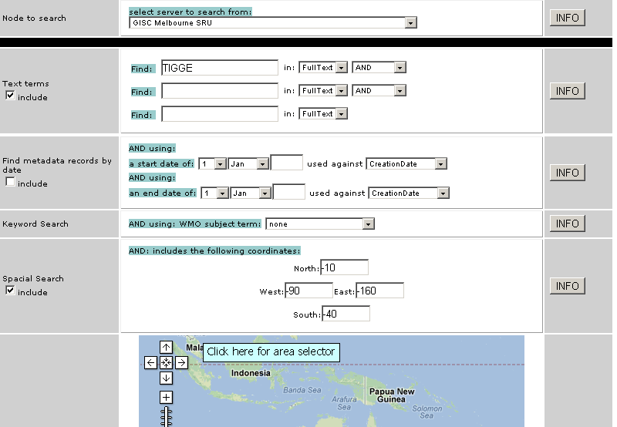
WIS SRU Training Page – change the elements to see how the SRU query changes
Each GISC has its own style and search for internal,
SRU is for interoperable search with other GISCs or Systems such as GEOSS,
Try our GISCs at
www.wmo.int/giscs
Notes:
This is our WIS SRU training page. Each GISC has its own style and search for internal, SRU is for interoperable search with other GISCs or Systems such as GEOSS.
A link to all GISCs is at www.wmo.int/giscs. Visit them and experiment with the internal search and see how each acts a little differently. Try their SRU search and you will see that these too behave quite differently. With SRU, the main difference is the xml style control that they offer.
You can even add a search on your on web page to use SRU to provide search of WIS from your GISC.

Slide 20
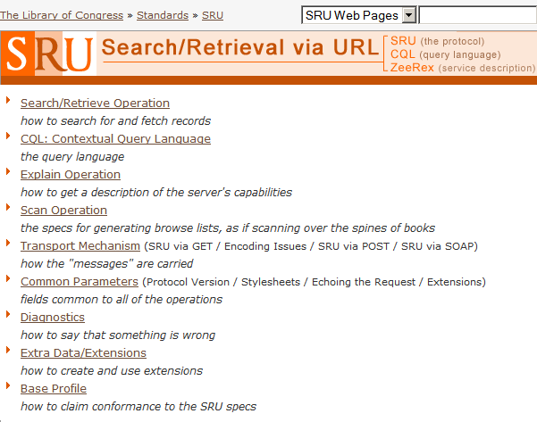
WIS DAR Interoperable Search
http://www.loc.gov/standards/sru/specs/
Notes:
The WIS DAR interoperable search standard, ISO 23950, is a
long-standing international standard used by libraries worldwide for searching online catalogs, and it also used in many national and international Clearinghouses and directories.
You may be aware that the Open Geospatial Consortium (OGC)
is developing a new specification for catalog searching, called
OGC Catalog Search for the Web (CSW). WIS has developed gateway freeware that accommodates CSW clients so that any
WIS-compliant server also supports this new OGC specification.

Slide 21
Presentation Outline
What is the objective of WIS DAR?
What is the general approach?
What do we mean by interoperability?
How does interoperable search work?
What can be accomplished with WIS DAR?
How do we implement WIS DAR?
Notes:
Let's look at some examples of what can be accomplished with WIS DAR.

Slide 22
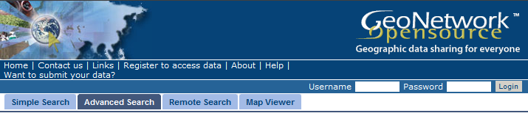

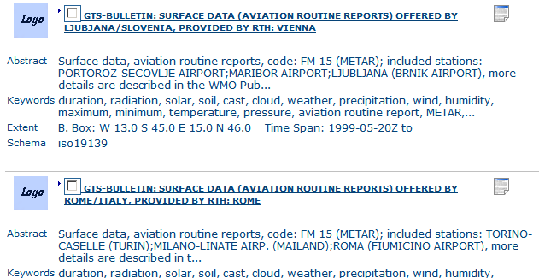
Expose GTS Data via Metadata
Notes:
A primary objective of WIS is to expose the full set of GTS data available across WMO.
Here is a simple portal showing how that data can be found through standard metadata and WIS DAR interoperable search.

Slide 23
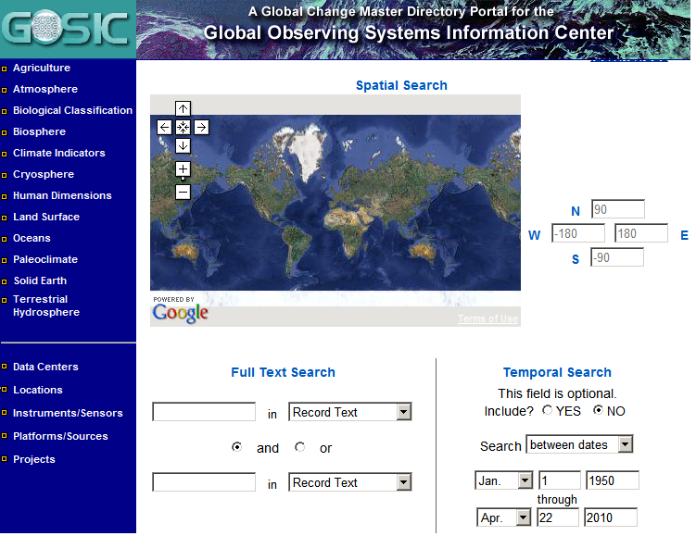
Interoperable with GCOS, GOOS, GTOS
Notes:
Another objective of WIS is to be interoperable with the major international systems in which WMO collaborates.
Here, we see a search portal that spans GCOS (Global Climate Observing System), GOOS (Global Ocean Observing System),
and GTOS (Global Terrestrial Observing System).
Through interoperable search, this portal can include all other
WMO data offered thought WIS. Conversely, a WIS portal can include all of the GCOS, GOOS, and GTOS metadata through
WIS DAR interoperable search.

Slide 24
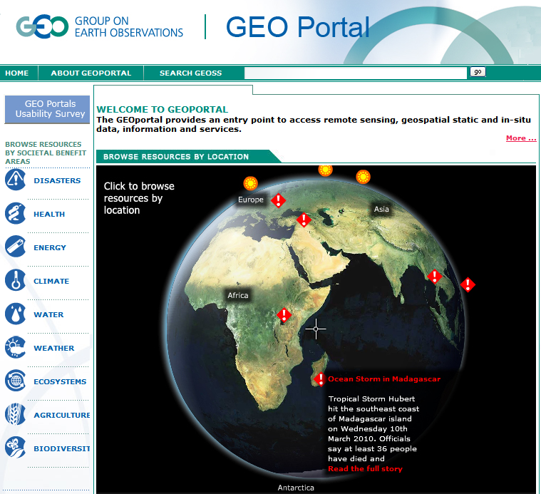
Interoperate with External Portals
Notes:
There are many data portals around the world that can take advantage of WMO data and information resources because of the WIS DAR interoperable search. Here we see one of the portals to the Global Earth Observations System of Systems (GEOSS).

Slide 25
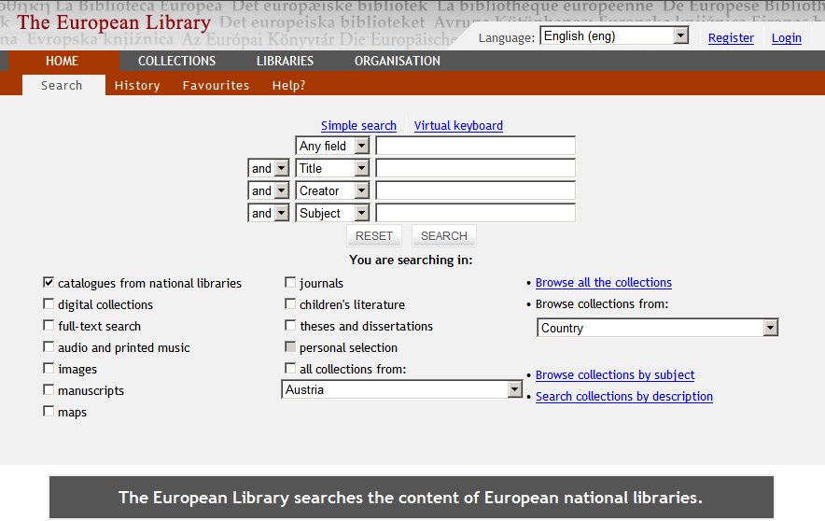
Interoperate with Library Catalogs
Notes:
Because WIS adopted the network search standard used by libraries worldwide, the DAR function is interoperable with library catalogs.

Slide 26
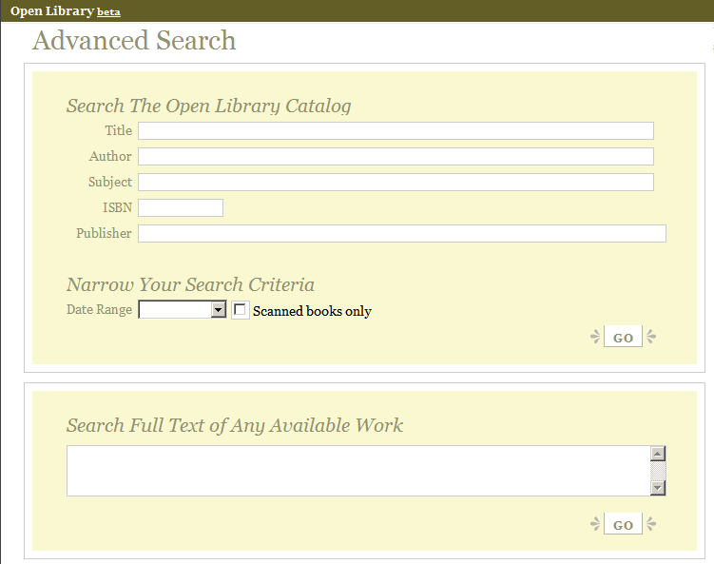
Retrieve Open Library Content
Notes:
And, many libraries are making the full content of books available online for free as well.

Slide 27
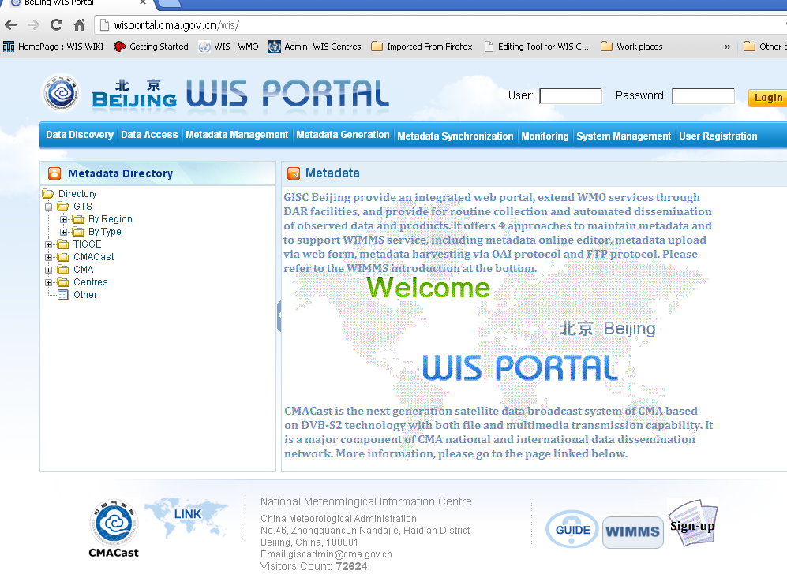
GISC Beijing

Slide 28
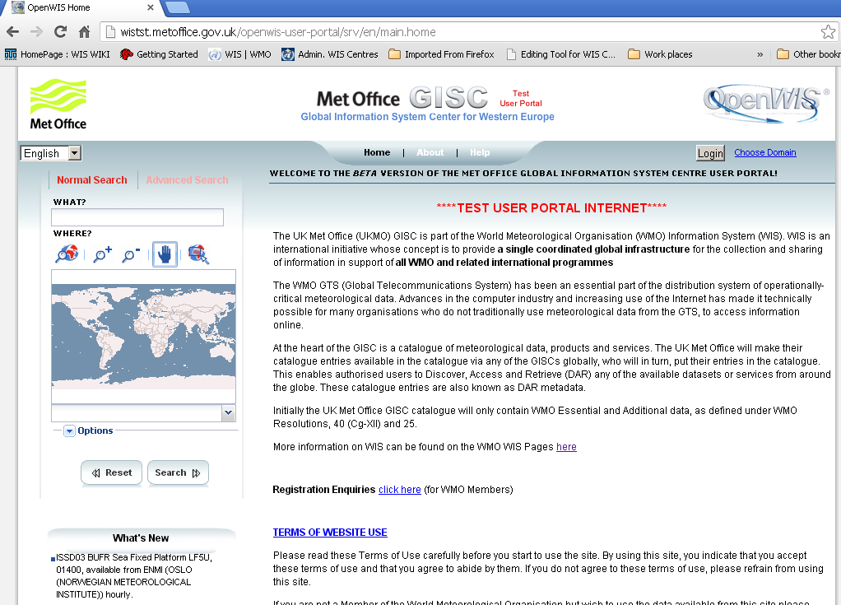
GISC Exeter

Slide 29
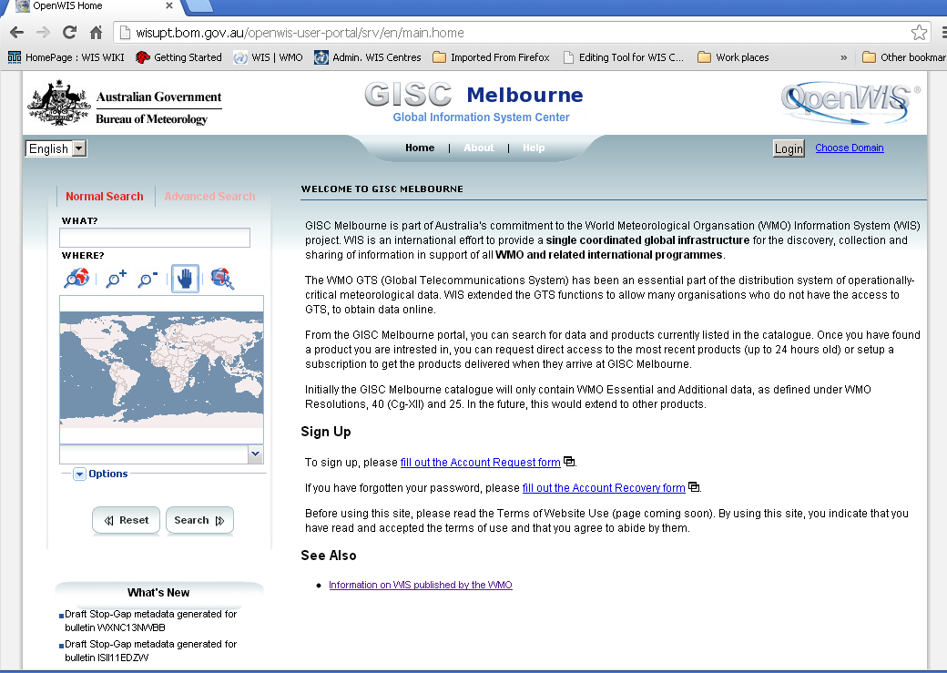
GISC Melbourne

Slide 30
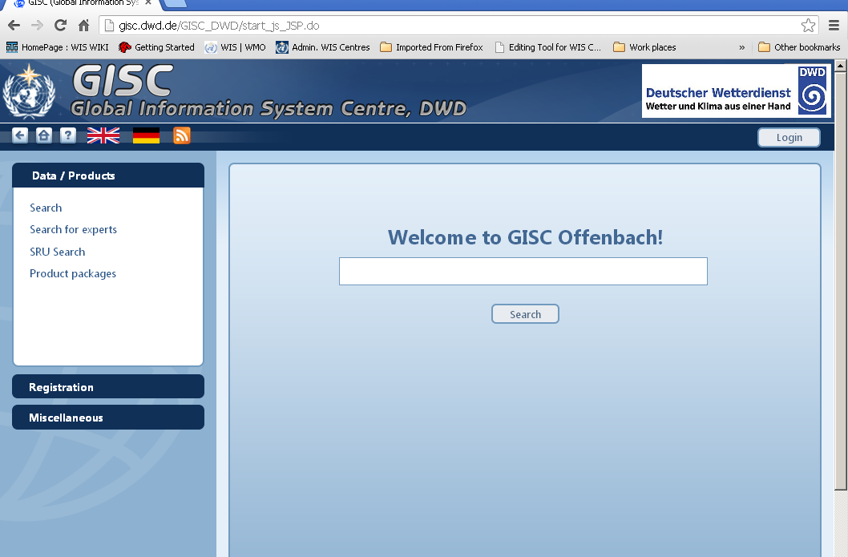
GISC Offenbach

Slide 31
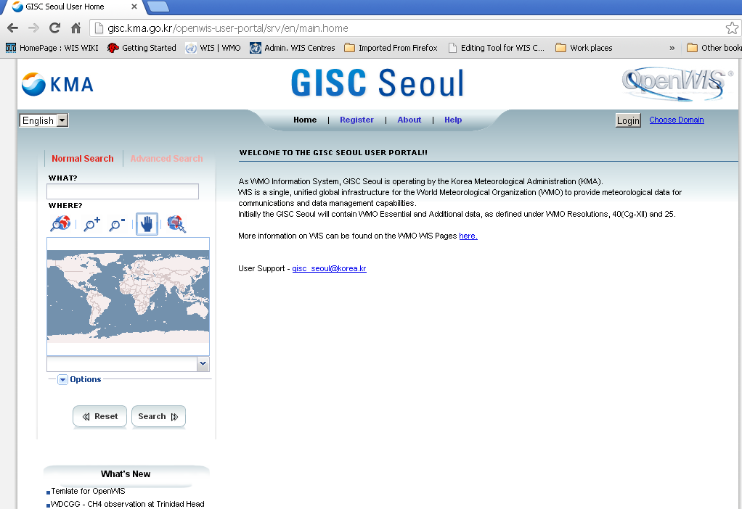
GISC Seoul

Slide 32
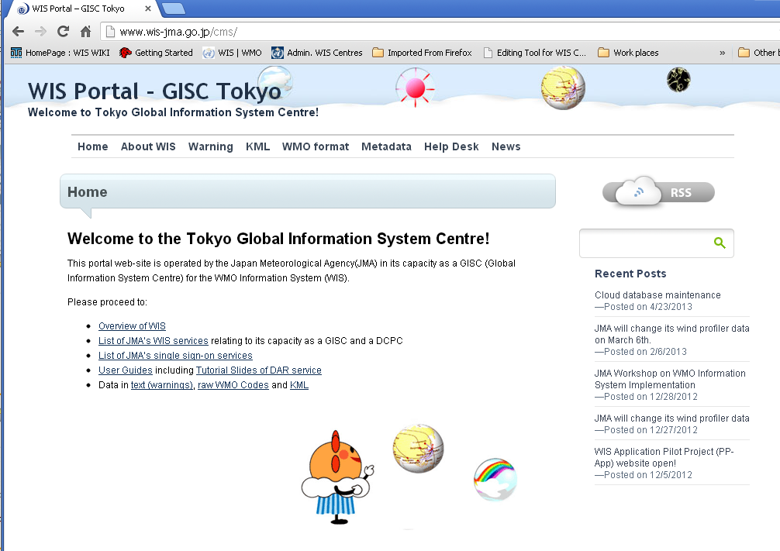
GISC Tokyo

Slide 33
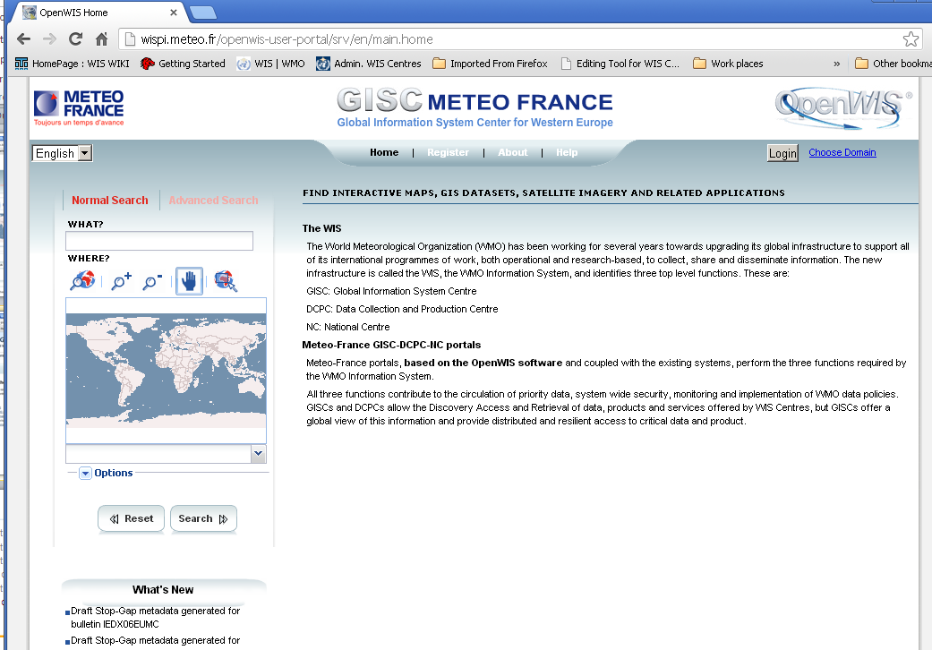
GISC Toulouse

Slide 34
Presentation Outline
What is the objective of WIS DAR?
What is the general approach?
What do we mean by interoperability?
How does interoperable search work?
What can be accomplished with WIS DAR?
How do we implement WIS DAR?
Notes:
Now, I'd like to turn to a very practical question:
How do we implement WIS DAR?

Slide 35
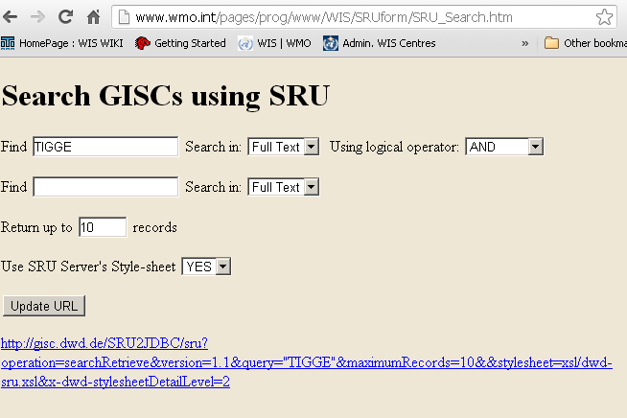
Anybody can add WIS search to their Web Site
Visit http://www.wmo.int/pages/prog/www/WIS/SRUform/SRU_Search.htm
And copy the source java script to create your own SRU URL generator and add to your web site.
Notes:
Visit the above address then you can copy the java script for creating the SRU text and send that to the server of your choice. Alternatively you can construct the same type of logic in your own preferred script eg PHP as done in our training page

Slide 36
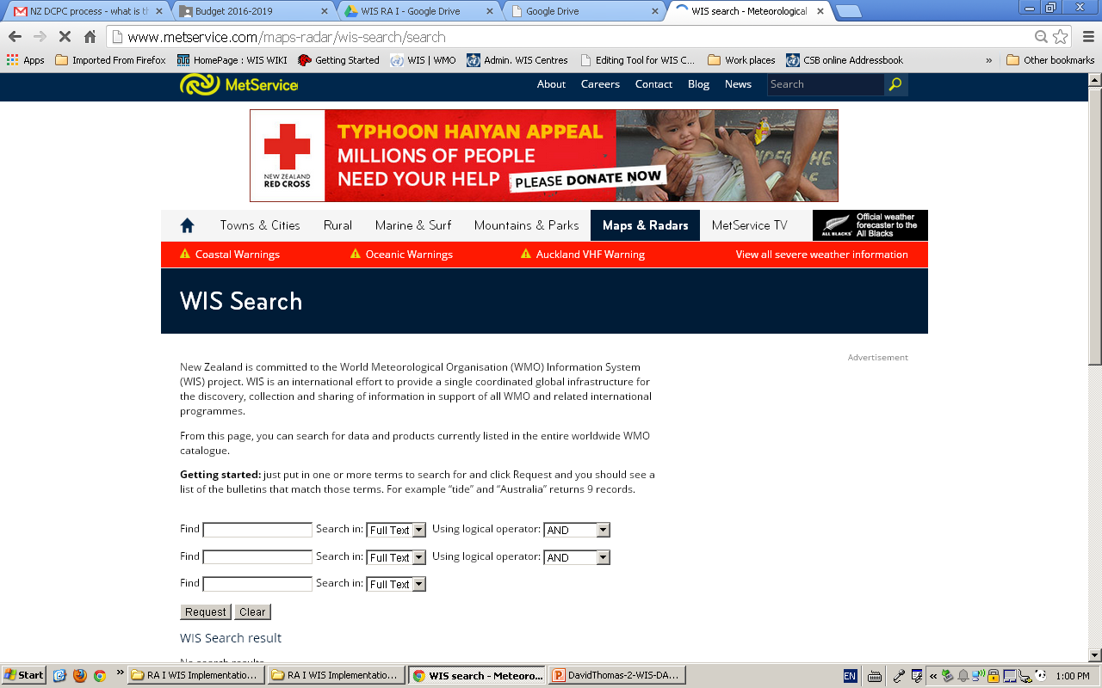

Slide 37
WIS Compliance Specifications
To be registered in the Manual on WIS as a WIS Centre (GISC, DCPC, or NC) a centre must comply with relevant WIS Technical Specifications described in Part IV.
The WIS DAR interface is defined in Manual on WIS Part 4.9, Technical Specification 8, requires that the WIS Centre exposes to the Internet an interoperable search interface compliant with ISO 23950 SRU
http://wis.bom.gov.au/openwis-user-portal/srv/en/main.home/portal.sru?
operation=searchRetrieve&version=1.1&query="TIGGE" and keywords
all weatherObservations and geo.bounds within/partial/nwse“
-10 -90 -40 -160“ &startRecord=1 &maximumRecords=10 &&
Notes:
As you know, existing centres within WMO Member States may apply for designation as a WIS centre. Each WIS Centre must demonstrate its ability to implement the WIS Compliance Specifications.
The WIS DAR interface is defined in Manual on WIS Part 4.9, Technical Specification 8, requires that the WIS Centre exposes to the Internet an interoperable search interface compliant with ISO 23950 SRU using SRU Contextual Query Language (CQL) level 2
Furthermore, it requires that in addition to full text search, a WIS-compliant SRU server shall search at least eight indexes as character strings (abstract, title, author, keywords, format, identifier, type and Coordinate Reference System (CRS)); at least five
indexes as ordered dates (creationDate, modificationDate, publicationDate, beginningDate, endingDate); and the index “bounds” as geographic coordinates (decimal degrees and space delimited, in the following order: north, west, south, east) .

Slide 38
ISO 23950 SRU Adapters, Gateways, etc.
Various technology solutions (freeware and commercial) are available to add ISO 23950
SRU to existing search mechanisms
The Geonetwork Opensource freeware has
ISO 23950 SRU support built-in
Older services supporting classic ISO 23950 (sometimes known as "Z39.50") can use the freeware YAZ Gateway to support SRU
If you need to support OGC CSW, use the
free SRU-CSW gateway developed by WMO
Notes:
Various technology solutions (freeware and commercial) are available to add ISO 23950 SRU to existing search mechanisms.
A typical approach is to add SRU to an ODBC or JDBC database query populated with metadata. Another approach is to add an
SRU adapter to the advanced search API offered by Google,
Yahoo, and other search services.
For those who need a metadata maintenance tool as well,
the Geonetwork Opensource freeware has ISO 23950 SRU
support built-in.
Older services supporting classic ISO 23950 (sometimes
known as "Z39.50") can use the freeware YAZ Gateway
to support SRU
If you need to support the OGC CSW interface, use the free
SRU-CSW gateway developed by WMO and operated by
the U.S. Federal Geographic Data Committee.

Slide 39
http://wis.wmo.int/page=srudocumentation
Notes:
You can find useful documents about implementing the WIS DAR interface at this URL.

Slide 40
1. What is the objective of WIS DAR?
2. What is the general approach?
3. What do we mean by interoperability?
4. How does interoperable search work?
5. What can be accomplished with WIS DAR?
6. How do we implement WIS DAR?
Review of Key Points
Notes:
Here is a brief summary of the key points addressed in this presentation:
1. What is the objective of WIS DAR?
2. What is the general approach?
3. What do we mean by interoperability?
4. How does interoperable search work?
5. What can be accomplished with WIS DAR?
6. How do we implement WIS DAR?
This concludes my presentation, and I welcome your questions.

