Slide 1
Status Report of RTH Tokyo
Yoritsugi OHNO and Kentaro TSUBOI
Japan Meteorological Agency (JMA)
ET-CTS meeting at 18th - 21st March 2014, in Brasilia (INMET)

Slide 2
GTS Connections (1)
Topics:
Establishment of direct link with Offenbach, Oct. 2012
Entire replacement of MSS, Oct. 2013
Migration the previous RMDCN (Orange Business Services) to RMDCN-NG (Interoute); Feb 2014
Météo-France and JMA will establish the direct link in a short time.

Slide 3
GTS Connections (2)
64K
Khabarovsk
GISC Tokyo (RTH Tokyo)
128K
Seoul
100M
10M x 2
2M
RMDCN MPLS
Network
(Interoute)
MPLS
Network
(NTT-COM)
Internet
DAR Users
50M
Bangkok
Washington
4M
New Delhi
128K
NMHS users of MTSAT Imagery and High-resolution GSM
Melbourne
2M
20M
EUMETSAT
Hong Kong
1M
Beijing
8M
20M
Exeter
Manila
64K
Offenbach
50M

Slide 4
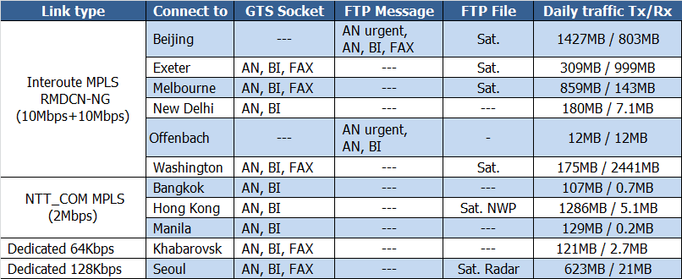
GTS Connections (3)
25th February 2014
http://www.jma.go.jp/jma/jma-eng/jma-center/rth/GTS_upgrades.html

Slide 5
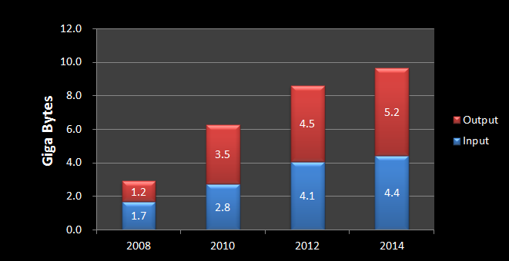
Daily Volume (1)
Text, Binary, FAX message and File

Slide 6
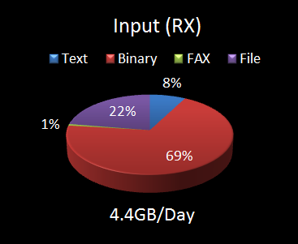
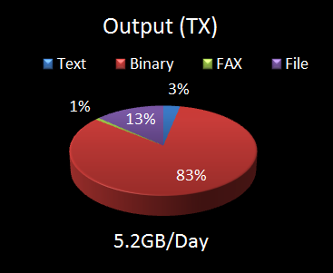
Daily Volume (2)
Occupancy rate (each channel)

Slide 7
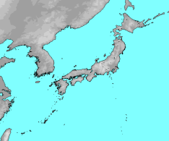
Establishment of the DRS
JMA has a plan to establish the Disaster Recovery Site (DRS) at west side of Japan in 2015.
This geographical location is expected to provide continuous service when the serious disaster is occurred.
This DRS will be constructed based on the same system design-architecture as RTH Tokyo and will be connected to MPLS networks.
JMA will ask neighboring centers to make arrangements for our new IP address and preliminary connectivity test in 2015.
RMDCN-NG
Osaka
Tokyo
500Km
AMDCN

Slide 8
Thank you!
http://www.wis-jma.go.jp/
http://www.jma.go.jp/jma/indexe.html

Slide 9
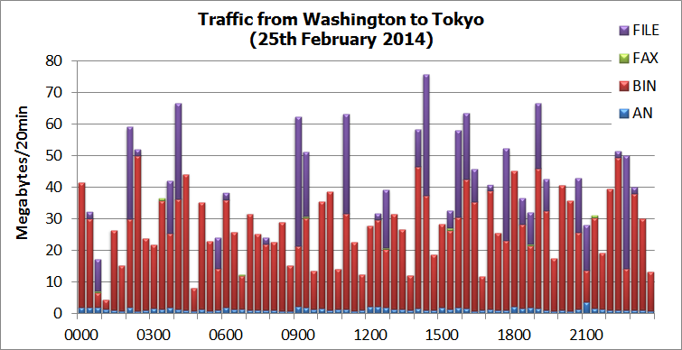
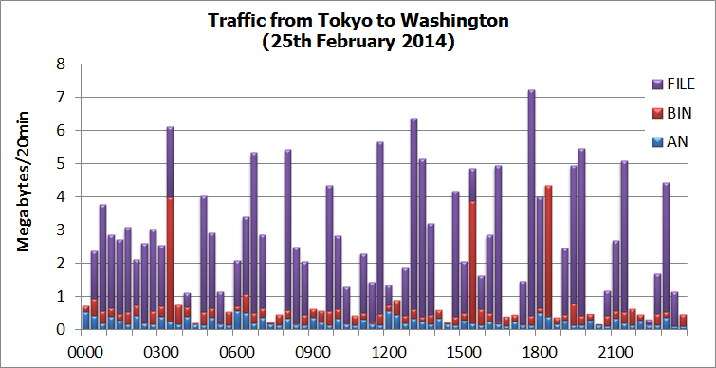
2.4GB/Day
175MB/Day

Slide 10
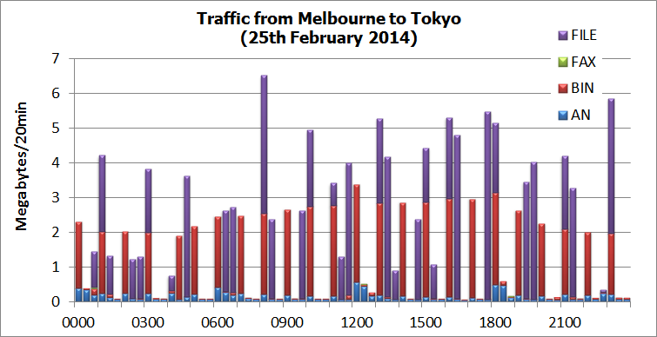
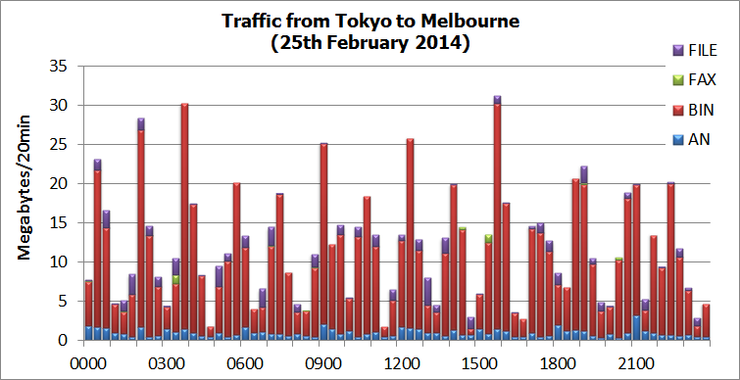
143MB/Day
859MB/Day

Slide 11
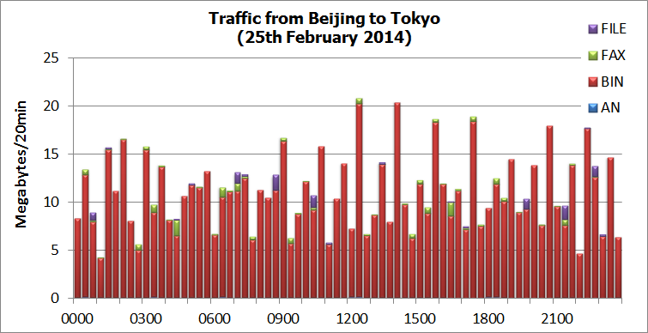
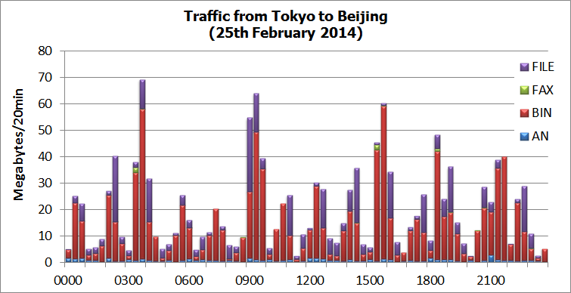
803MB/Day
1.4GB/Day

Slide 12
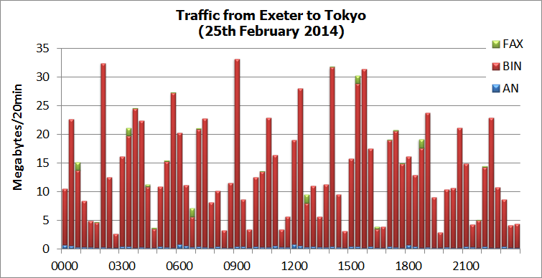
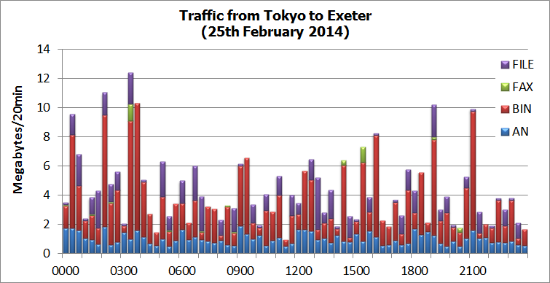
1GB/Day
309MB/Day

Slide 13
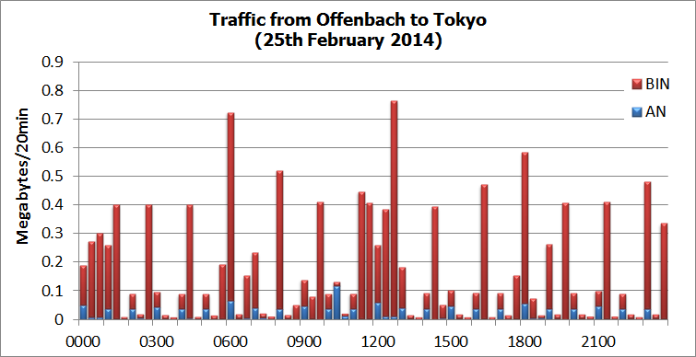
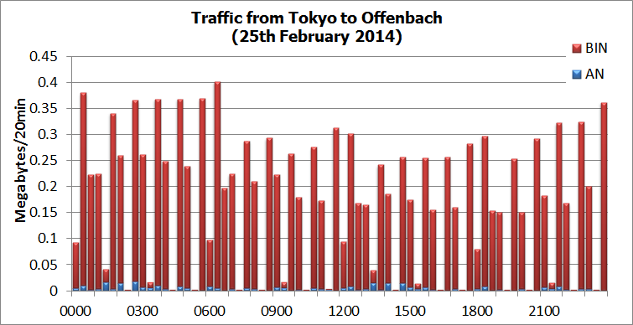
12MB/Day
12MB/Day

Slide 14
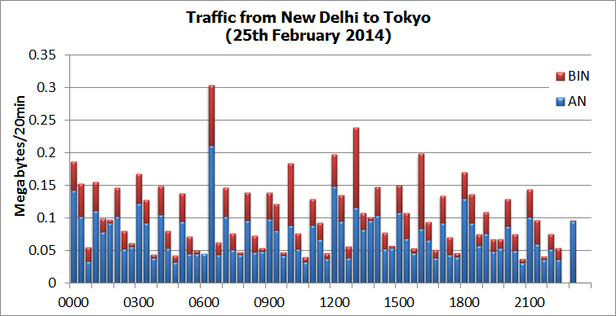
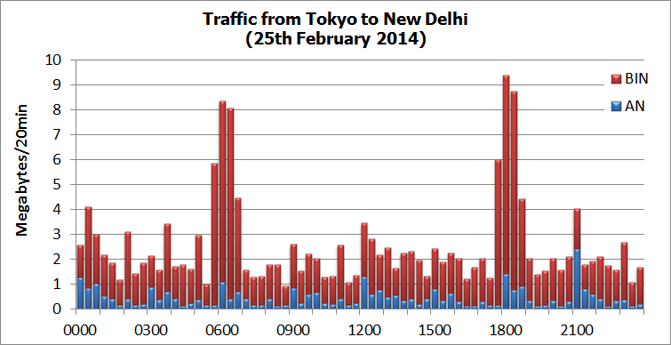
7MB/Day
180MB/Day

Slide 15
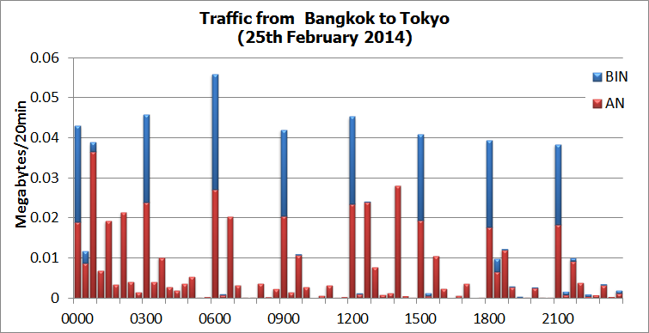
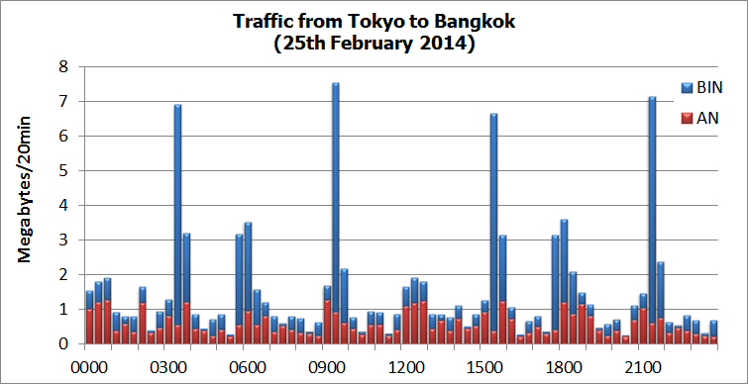
0.7MB/Day
107MB/Day

Slide 16
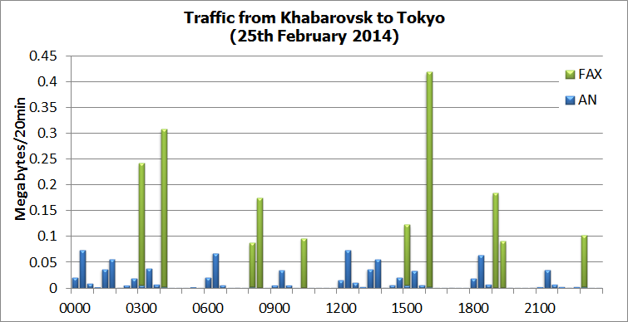
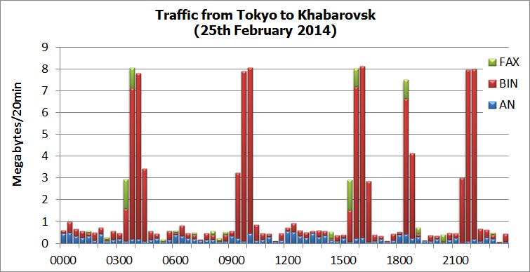
2.7MB/Day
121MB/Day

Slide 17
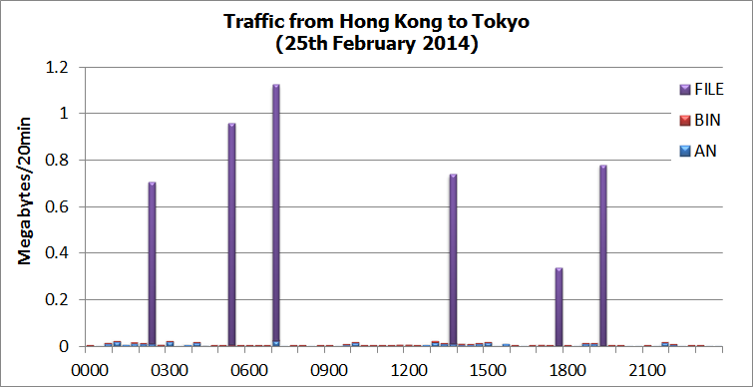
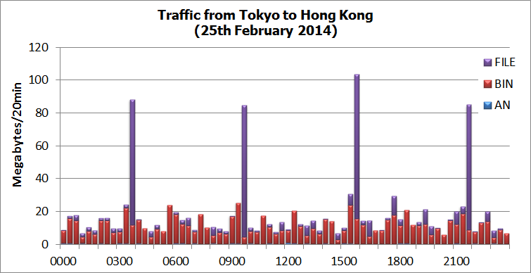
5MB/Day
1.3GB/Day

Slide 18
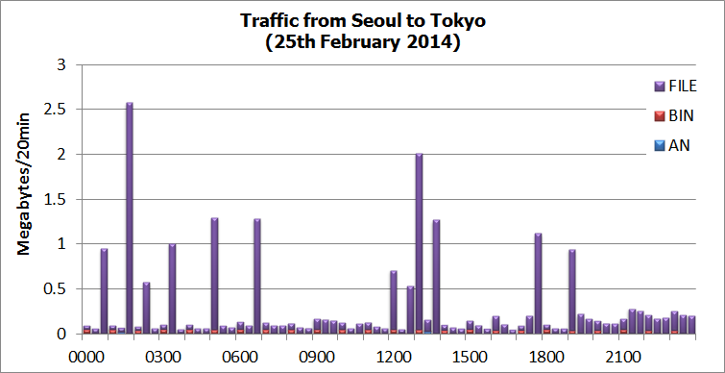
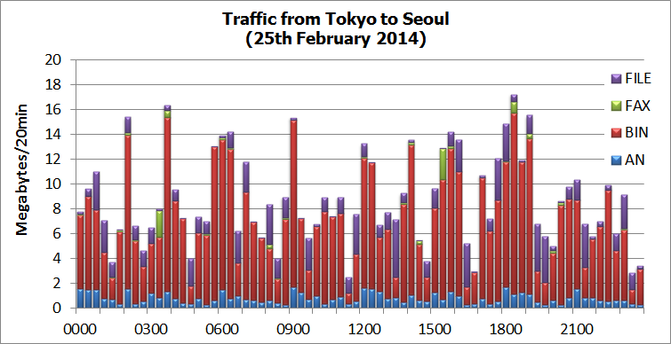
21MB/Day
623MB/Day

Slide 19
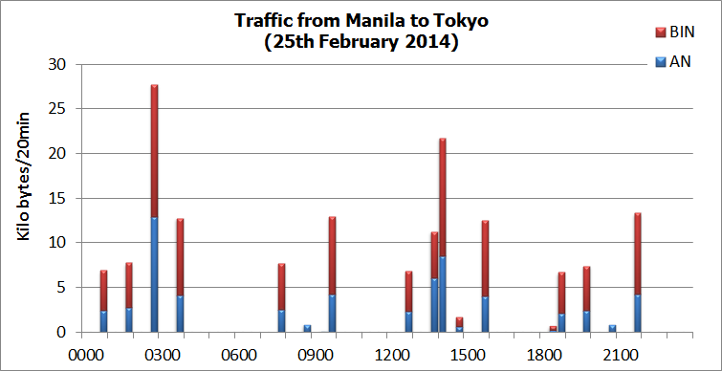
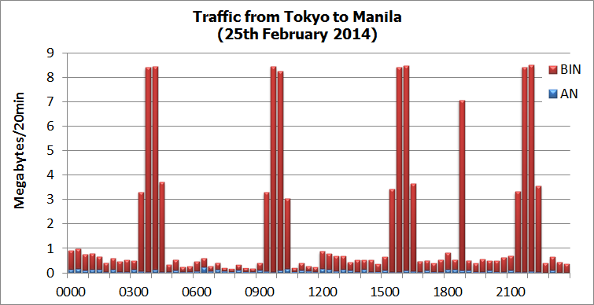
0.2MB/Day
129MB/Day

Slide 20
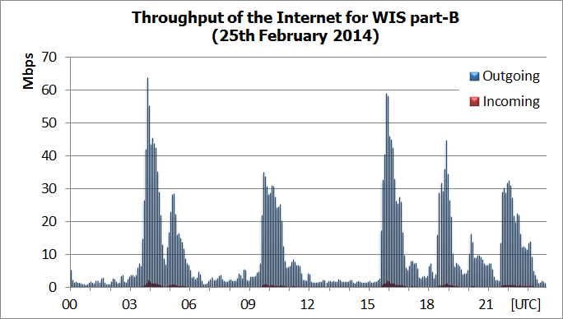
WIS part-B Internet Traffic
Downloading data
236GB/Day
Bandwidth 100Mbps

