Slide 1
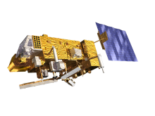
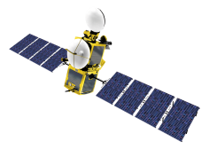
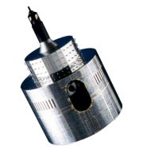
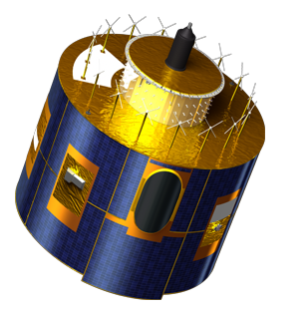
EUMETSAT Perspectives on Inter GISC Communication
(ET-CTS 2014 Doc 19)
Lotharr.Wolf@eumetsat.int
Anthony.Patchett@eumetsat.int
Guillaume.Aubert@eumetsat.int
Colum.Grant@eumetsat.int

Slide 2
Recalling Requirements on the InterGISC data exchange
The data shall be exchanged according to the timeliness criteria
Assess the volume of the data to be exchanged
What kind of data shall be exchanged
The exchange shall be compliant to the operational monitoring matrix (reliability, completeness etc.

Slide 3
Layered approach
In acknoledgement of the ET-CTS and TT ToRs the following approach is proposed:
I) Data exchange model/architecture layer
The logical data distribution concept that meets the WIS requirements on cache exchange
II) Application layer
Software that implements the architecture described in the data exchange layer
III) Protocol layer
The protocols that could be used for communication
IV) Transport media
The actual network which in most cases here would probably be RMDCN or Internet in some cases

Slide 4
Path of analysis…
To begin on the „Data exchange model/architecture layer“ and analyse each high-level concept for strengths-weaknesses. As a result of the analysis some concepts might already be discarded:
Potential architecture topologies to optimize data exchange while guaranteeing reliability and availability of the data cache
N-point to point connection model
Decentralised meshed model with minimised number of connections
Broadcast models
Torrent models
Data shared models (e.g. clouds)
Unidirectional, multi-directional exchange strategies
...

Slide 5
…capitalise on existing infrastructure, architectures and concepts…
The evolved view on the data exchange model could then be verified to what extend it can:
... Benefit or supports existing infrastructure and concepts
... Allows maximum flexibility to the individual centres in their approach to implementation (e.g. Individual developments, procurements etc.)
... Allows involvement of industry in support to procurements (to have global diversity in industry, not just one company offering it)
... Minimize the necessity to have an co-ordinator or moderator role in the solution
... Does support the requirements and needs expressed by the operational monitoring matrix

Slide 6
…then followed by…
Analysis of available protocols that could be used or combined on those architectural models e.g.
ftp
http
Multicast based on IGMP V3 (SSM vs. ASM)
OAI-PMH
Bittorend
...
Produce also here a pro-con analysis per protocol including impact analysis on the network layer

Slide 7
…market survey…
Once a promising concept has been evolved based on a data exchange model and recommended protocols to be used
Market survey to investigate availability of related application software that can support the implemention
Alternatively...
Survey on software that might exist to support the data exchange interface specification
Or...
Specification of software requirements suitable for outsourcing

Slide 8
…discuss with ET-WISC and support prototype
Once a proposed model has been defined following above structured approach we would recommend to start a prototype initiative with some volunteers.
Based on the experience gained by the prototype a concluding recommendation could then be given.

Slide 9
EUMETSAT support
The topic of InterGISC communication for the purpose of populating the 24hrs Cache is in the responsibility of the GISCs but of major importance for WIS overall.
EUMETSAT is comitted to contribute to this in the areas of our expertise:
Support in generation of data exchange model/architecture
Protocol analysis in particular for multicast, OAI-PMH, tcp/ip
Network impact analysis
Market surveys
Verification and Validation of prototype activities

