Slide 1
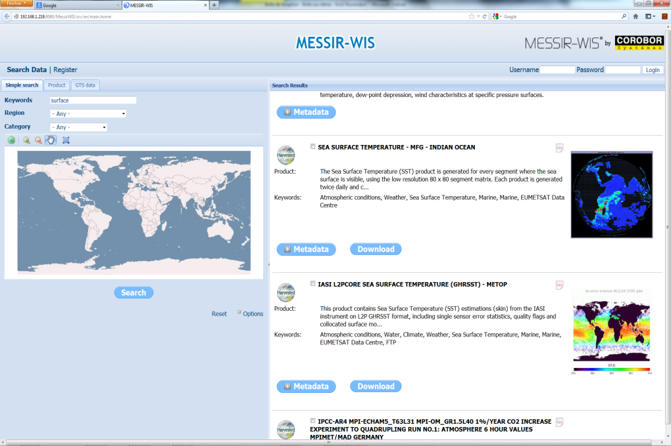
GTS is moving to WIS. MESSIR-WIS makes WIS easy
and builds your GISC, DCPC or NC.
MESSIR-WIS allows for a smooth transition from existing GTS MESSIR-COMM on 52 sites to WIS
MESSIR-WIS is a powerful and easy solution for WMO members to participate to the WIS as a GISC, a DCPC or an NC.
MESSIR-WIS combines the power of GeoNetwork with specific COROBOR add-on modules dedicated to the Meteorological community

Slide 2
MESSIR-WIS Key Features
WMO WIS compliance
Supports all of the 15 functional requirements (WIS Technical Specifications) for GISC, DCPC and NC operations.
User friendly metadata editor to edit and create product descriptions
Compatible with WMO and ISO standards: WMO Core Profile 1.3, ISO19115/ISO19119/ISO19110/ISO19139, Dublin Core…
DAR catalogue to discover and find meteorological products by their description and geographical location
Metadata harvesting using OAI-PMH protocol (client and server functions)
Data retrieval and Subscription management to receive selected products on routine basis
Customer and user management for access control

Slide 3
MESSIR-WIS Solution | Capitalize on existing
Existing AMSS
Existing Databases
MESSIR-COMM
MESSIR-XBASE
MESSIR-CLIM
GTS Message Switching
Data Collection
Data Distribution
Central Database
Quality Control
Multi-level Access
SQL
Climate Database
Quality Control
Standard reports
Other countries
MESSIR-WIS
NC 1
Metadata Management
WIS-compliant Web Portal
Data and products search and retrieval
NC 2
NC 3
Catalogue
Uploading
metadata
Data
pulled
Search/Browse/Subscribe
Data pushed to users
Internet
GISC
WIS users

Slide 4
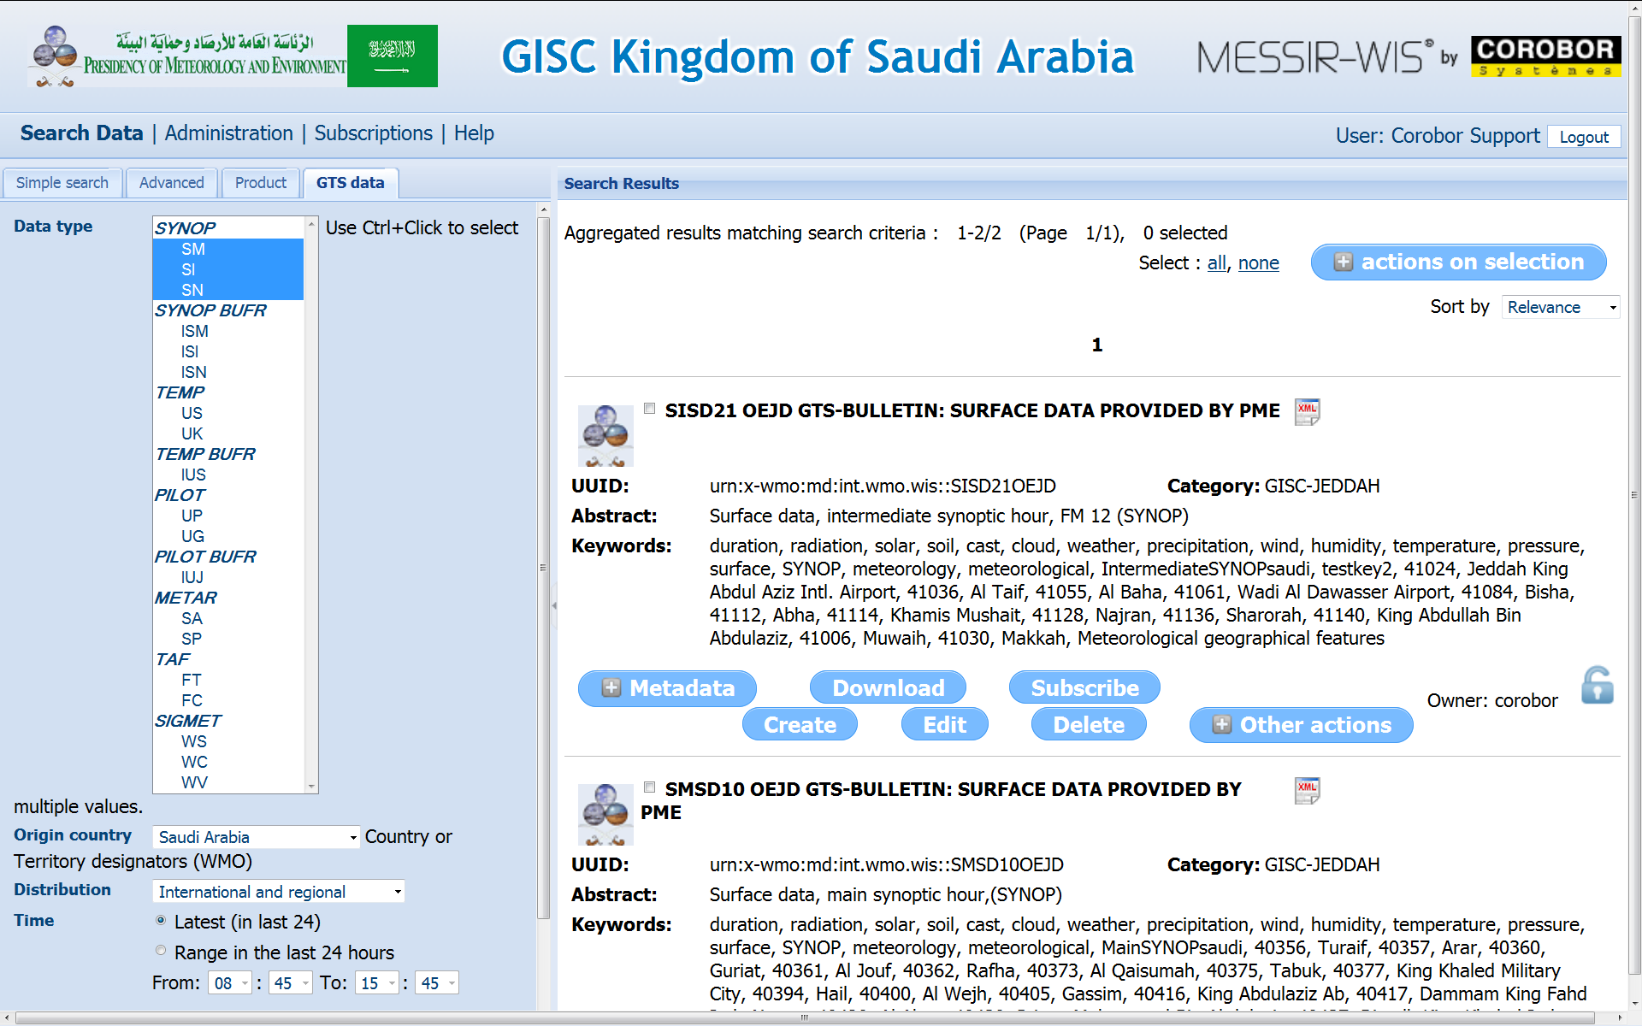
MESSIR-WIS Strong Points
Site proven solution : Site-proven and WMO-audited on several GISC / DCPC / NC sites
Easy installation and integration to existing systems and database
User-friendly graphical user interface for administration and operations
Publish your own products with few mouse clicks
Extensive COROBOR consultancy and training package, making the WIS easy and facilitating your integration to the WIS / WMO community

Slide 5
MESSIR-WIS associated services
Site delivery of turnkey solution including hardware, software and services
Factory and onsite training of administrators and users
Consultancy services for staff training, change management and capacity building for the implementation of WIS at regional and national level.
Assistance for WMO Audit preparation and during WMO audit
Customization of web pages and graphical charter
Maintenance and Long term support
Hotline

