Slide 1
ET-WISC, Beijing China, 15-18 July, 2013
Short Report on WIS
in KMA
(Doc 74)
Sunghoi HUH
Korea Meteorological Administration
Republic of Korea

Slide 2
Quick view on KMA WIS
KMA WIS
GISC Seoul
DCPC for WAMIS : World Agricultural Meteorological Information System
DCPC for LC-LRFMME : Lead Centre for Long-Range Forecast Multi-Model Ensemble
DCPC for NMSC : National Meteorological Satellite Centre
* Core software is OpenWIS, and minor and some useful functions have been modified by KMA such as metadata monitoring
Operational centres
(since March 2013)
- GISC Seoul(gisc.kma.go.kr)
- DCPC NMSC(dcpc.nmsc.kma.go.kr)
Operational centres
(since March 2014)
DCPC WAMIS
DCPC LC-LRFMME
GISC Seoul WIS Workshop(Dec. 2012) in Jeju, Republic of Korea
Capacity Building and Sharing WIS status
WMO and WIS Experts, User and related Countries

Slide 3



WIS Implementation(GISC Seoul)
Implementation on operational GISC Seoul
  10 servers and SAN Storage (with File shared system)
  User portal via internet & RMDCN (HTTP, FTP, Email)
  Metadata Sync and Cache Replication via internet & RMDCN
GISC Seoul Architecture
Internet
User
HTTP/FTP/email
RMDCN
User
Metadata Sync
RMDCN
Internet zone
HTTP/FTP/email
Cache Replication (by FTP)
RMDCN zone
Server name: Installed Applications
SSO
#1,2
UP
#1,2
AP
#1,2
WAS
#1,2
DB/
LDAP
#1,2
UP: User Portal, Staging Post(Tomcat)
AP: Admin Portal(Tomcat)
SSO: (JBOSS) OpenAM (Security)
WAS: (JBOSS) Data Service, Management Service, Ftp Replication
DB: PostgreSQL, Solr, OpenDS
  Service flow
  Data flow
SAN
Storage
FTP
Internal Zone
GTS
MSS/FSS
Storage

Slide 4
Status of KMA WIS
Registered data of KMA
  SYNOP, TEMP, SHIP, BUOY, TAF, CLIMAT, METAR etc
Status of connection:
  OAI-PMH (on the public Internet)
    Metadata Harvesting from operational GISCs
  Cache replication(RMDCN, Internet)
    GISC Toulouse, GISC Offenbach, GISC Tokyo

Slide 5
Metadata Set
OAI SET | Metadata | OAI SET | Metadata
WIS-GISC-SEOUL | 137 | WIS-GISC-OFFENBACH | 29,807
WIS-GISC-TOULOUSE | 1,869 | WIS-GISC-BEIJING | 63,632
WIS-GISC-EXETER | 15,224 | WIS-GISC-TOKYO | 23,978
WIS-GISC-MELBOURNE | 948
Total | 136,513
Cache data Set
Centre | file | volume | Network
GISC Offenbach | 16,346 | 116MB | RMDCN
GISC Toulouse | 13,981 | 331MB | RMDCN
GISC Tokyo | 61,542 | 700MB | Internet

Slide 6
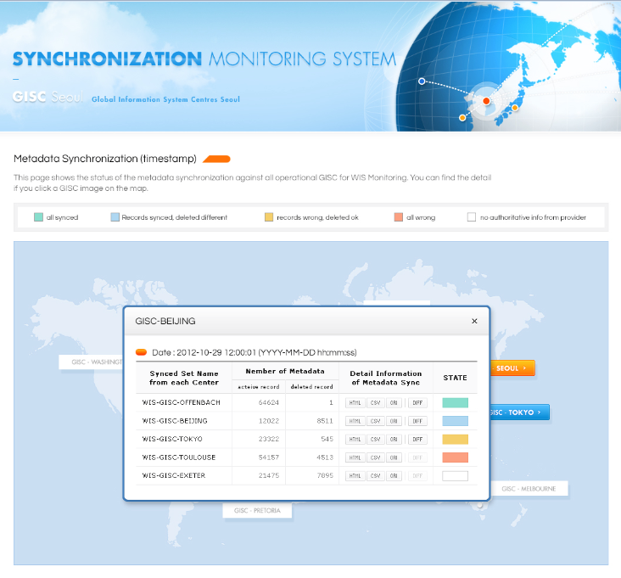
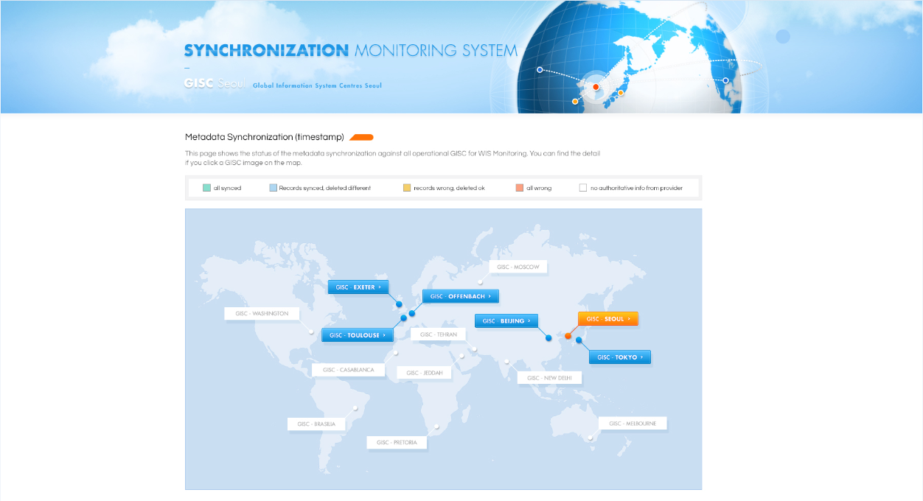
Monitoring function
Metadata Sync monitoring between GISCs
  Selecting a GISC on the map to display the status of metadata synchronization (number of active metadata and deleted metadata, status of sync)

Slide 7
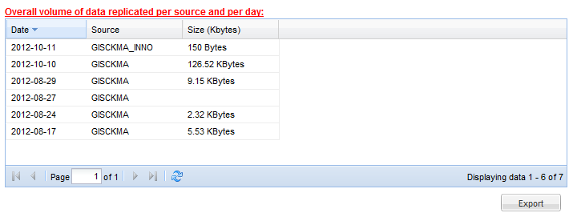
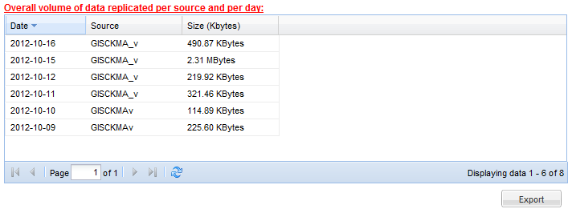
Monitoring function
Cache replication : data volume and lists between GISCs
Overall volume of data transmitted (via replicator) per source and per day
Print
Excel
Print
Excel

Slide 8
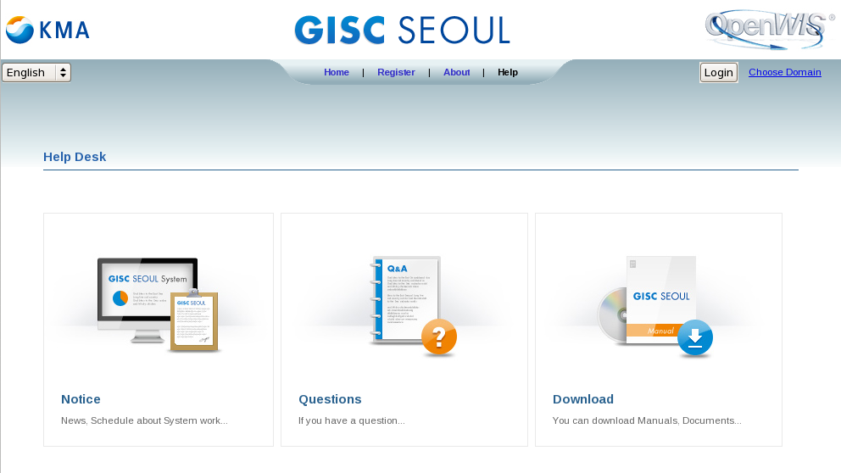
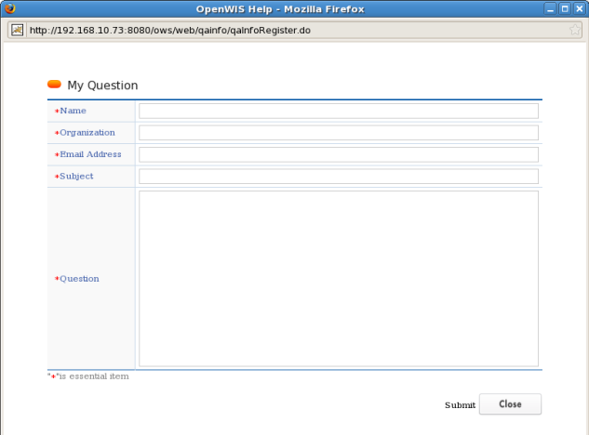
  Supplemented functions
    Download
      downloading manual, guidance and related documents on WIS
    Notice
      notices on schedule, news and so on
    Questions
      send questions to get the answer by email

Slide 9
WIS Plan in 2013
Upgrade the GISC Seoul functionalities
  GUI: user portal UI
  Search : SRU search, logical operators
  GIS : implementing GIS functions for cache data
  etc : upgrading the cache data management function, TDCF migration
Implementing DCPCs (WAMIS, LC-LRFMME)
; OpenWIS
  Data and metadata for DAR service, which are to be harvested via GISC Seoul
  Harvesting WAMIS data from GEOSS clearing house

Slide 10
감사합니다
感謝
Thanks you

