Slide 1
AvXML version 1.0 RC1
Logical Model Teleconference
(Europe, 2013-01-11)
Aviation XML version 1.0 Release Candidate 1:
information seminar
(WMO METCE & ICAO IWXXM)
Jeremy Tandy
(on behalf of TT-AvXML)

Slide 2
Agenda
Session Objectives
Overview of AvXML 1.0RC1 components
Regulatory & geographic information standards context
Observations and measurements: a generic framework
WMO METCE model
OGC Observable Property Model
ICAO Weather Information Exchange Model & relationship with WMO METCE
WMO Meteorological Basic Types model
Publishing WMO code-tables as web-accessible resources
Worked XML examples; METAR, VA SIGMET
Questions & answers

Slide 3
Seminar objective
This seminar is intended to enable participants to provide feedback and review for release candidate 1 (RC1) of the Aviation XML standard currently in conjoint development by WMO & ICAO in order to support Amendment 76 of ICAO Annex 3 Regulation
The objective of the session is to provide sufficient expertise to participants to enable their independent review of the proposed Aviation XML standard following the completion of this seminar
The deadline for submission of feedback is 1st Feb 2013

Slide 4
Components of Release Candidate 1
AvXML 1.0RC1 is published for review at the WMO wiki:
http://www.wmo.int/pages/prog/www/WIS/wiswiki/tiki-index.php?page=METCE-1.0RC1
AvXML 1.0 RC1 includes:
Release notes
Conceptual model (UML)
Enterprise Architect Project File (EAP)
XMI format
HTML documentation package (requires local deployment)
XML Schemas
Published online
Compressed file bundle
Java bindings for XML Schemas
Simple tutorial describing METAR and VA SIGMET XML instances

Slide 5
Further information on Release Candidate 1
FAQ page:
http://www.wmo.int/pages/prog/www/WIS/wiswiki/tiki-index.php?page=METCE-1.0RC1-FAQ
Moderated public review comments:
CBS-TT-AvXML Google Group
Note that comments on AvXML 1.0RC1 should be submitted to the Google group using a subject line beginning with the text “[1.0RC1-feedback]”

Slide 6
AvXML 1.0 standard development schedule
[1st Feb 2013] 1.0RC1 review closes
[1-8 Feb 2013] 1.0RC1 feedback clarification
[Feb-Mar 2013] Amendments incorporated for 1.0RC2
[Mar 2013] 1.0RC2 published for review
Note that further information and training sessions are planned for the ‘4th Workshop on the use of GIS in meteorology’ to be hosted at ECMWF, Reading, UK in early March 2013
[July 2013] AvXML 1.0 published

Slide 7
Technical regulation: Meteorological Service for International Air Navigation
ICAO Annex 3 / WMO No. 49 II
Meteorological Service for International Air Navigation
Management of data exchange standards in support of meteorological services for international air navigation (OPMET) are delegated by ICAO to WMO
WMO No. 306 Vol I.1
Manual on Codes
Part A – Alphanumeric Codes

Slide 8
Amendment 76 to ICAO Annex 3 (Nov 2013)
ICAO Annex 3 / WMO No. 49 II
Meteorological Service for International Air Navigation
Amendment 76 (2013) to ICAO Annex 3 shall, for states in a position to do so to, permit bilateral exchange of OPMET data via XML
TAF
METAR/SPECI
SIGMET
WMO No. 306 Vol I.1
Manual on Codes
Part A – Alphanumeric Codes

Slide 9
Model-driven data exchange standards
ICAO Annex 3 / WMO No. 49 II
Meteorological Service for International Air Navigation
« formalised as »
Application Schema
(aka ‘conceptual model’)
TAF
METAR/SPECI
SIGMET
********
****
*******
XML Schema 1.0
Schematron .
« conforms to »
********
SCH
**
*******
**********
**
FullMoon
Validatable data products
*********
« derived from »
*********
Technology independent description of content and structure of information to be exchanged for a given application
Validation schema and rules

Slide 10
ICAO Weather Information Exchange Model (IWXXM)
Formal representation of ICAO Annex 3 reports as UML model:
TAF, METAR/SPECI and SIGMET
ICAO Annex 3 / WMO No. 49 II
Meteorological Service for International Air Navigation
« formalised as »
common
dataTypes
iwxxm
metarSpeci
Sigmet
taf
ICAO Weather Information
Exchange Model
TAF
METAR/SPECI
SIGMET
« derived from »
« conforms to »
IWXXM
SCH
SCH

Slide 11
Simple Aeronautical Features (SAF)
Simplified representations of aviation features (runway, aerodrome, flight information region, air traffic services unit)
… simplified, referenceable versions of existing AIXM constructs
…developed in a cross-domain manner with AIXM and FIXM developers (aeronautical information and flight information groups)
ICAO Annex 3 / WMO No. 49 II
Meteorological Service for International Air Navigation
« formalised as »
common
dataTypes
iwxxm
metarSpeci
Sigmet
taf
ICAO Weather Information
Exchange Model
TAF
METAR/SPECI
SIGMET
« derived from »
« conforms to »
IWXXM
SCH
« imports »
« imports »
Simple Aviation Features
saf
« derived from »
SAF
SCH

Slide 12
Air Traffic Management information framework:
geographic information standardisation
AIR TRAFFIC MANAGEMENT INFORMATION
TAF
METAR/SPECI
SIGMET
AIXM
FIXM
IWXXM
SAF
SCH
Aeronautical Information Exchange Model
Flight Information Exchange Model
Weather Information Exchange Model
Aviation XML is based on International Standards for representing geographic information: Geography Markup Language
GML/XML
GML
Geographic Information / Geomatics standards
ISO 19103 Conceptual schema language
ISO 19107 Spatial schema
ISO 19108 Temporal schema
ISO 19111 Spatial referencing by coordinates
ISO 19115 Metadata
ISO 19156 Observations and measurements
ISO 19136
Geography Markup Language

Slide 13
ISO 19156 Observations and measurements
AIR TRAFFIC MANAGEMENT INFORMATION
ISO 19156 ‘Observations and measurements’ provides a conceptual schema for observations and the features involved in sampling when making observations
The model is specifically designed to support the exchange of information describing both the observing event and the results of the observation between different scientific and technical communities
TAF
METAR/SPECI
SIGMET
AIXM
FIXM
IWXXM
SAF
SCH
Aeronautical Information Exchange Model
Flight Information Exchange Model
Weather Information Exchange Model
Geographic Information / Geomatics standards
ISO 19103 Conceptual schema language
ISO 19107 Spatial schema
ISO 19108 Temporal schema
ISO 19111 Spatial referencing by coordinates
ISO 19115 Metadata
ISO 19136
Geography Markup Language
ISO 19156 Observations and measurements
OMXML
OGC #10-025
Notes:
Note: to ensure compatibility with earlier versions of WXXM, the ICAO requirement to WMO mandated the use of ISO 19156 Observations and measurements

Slide 14
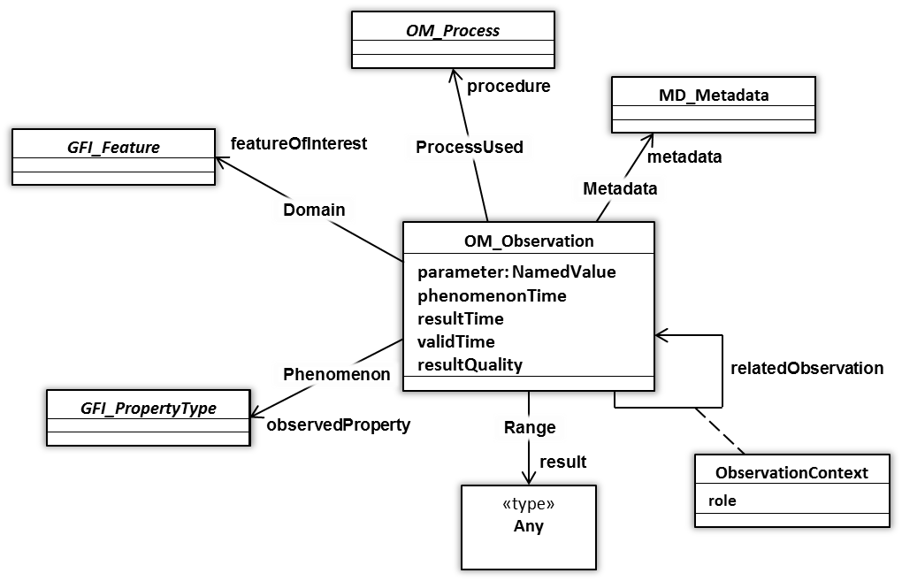
ISO19156 Observations and measurements
OM_Observation: an EVENT whose RESULT is an estimate of a value of some PROPERTY of some THING obtained using a specified PROCEDURE …
Notes:
ISO 19156 ‘Observations and measurements’ provides a conceptual schema for observations and the features involved in sampling when making observations, and specifically designed to support the exchange of information describing both the observing event and the results of the observation between different scientific and technical communities.

Slide 15
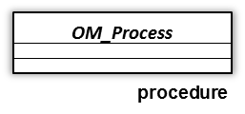
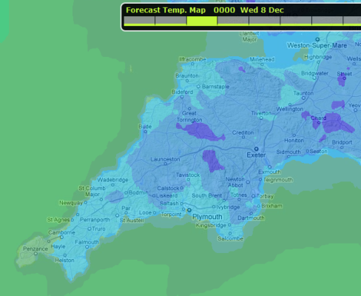
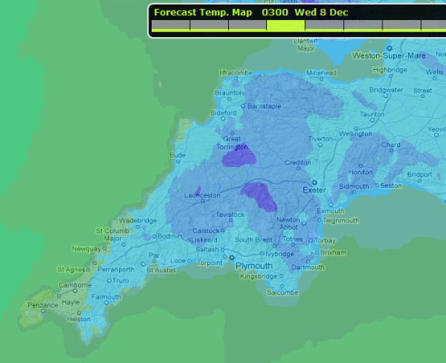
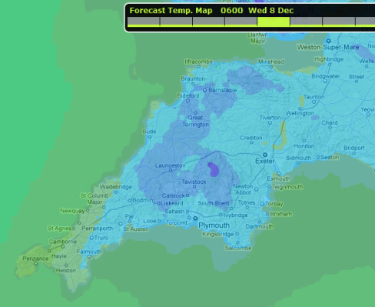
ISO19156 Observations and measurements:
also suitable for numerical simulations – including forecasts
forecast : OM_Observation
parameter.name = “analysisTime”
parameter.value = 2010-05-06T00:00Z
phenomenonTime.begin = 2010-05-06T00:00Z
phenomenonTime.end = 2010-05-09T12:00Z
resultTime = 2010-05-06T04:30Z
validTime [optional – not specified]
resultQuality [optional – not specified]
OM_Process can describe a numerical simulation to ESTIMATE a value in the future (e.g. a FORECAST)
5-May
6-May
7-May
8-May
9-May
12Z
00Z
12Z
00Z
12Z
00Z
12Z
00Z
12Z
00Z
result
Notes:
Whilst the name of the model invokes a particular concept to meteorologists (e.g. ‘observation’, the measurement of physical phenomena with an instrument or sensor – disjoint from the concept of ‘forecast’) it is important to consider the semantics of the model. The class OM_Observation is defined as ‘an estimate of the value of some property of some Thing using some specified Process’. The process may be an instrument/sensor (directly) measuring some physical parameter or a numerical simulation predicting future values. Thus the ‘Observations and measurements’ conceptual model may be used to represent both observations and forecasts.

Slide 16
Profiling ISO 19156 O&M
ISO 19156 ‘Observations and measurements’ provides a generic framework for describing both the observing event and the results of the observation. It is applicable to a wide range of scientific and technical domains.
The generic nature of this standard means that it requires further specialisation to constrain aspects of the model …

Slide 17
METCE: Modèle pour l’Échange des informations sur le Temps, le Climate et l’Éau
WMO Logical Data Model:
… provides foundation of generic meteorological concepts, phenomena and entities upon which domain- industry- or community-specific Application Schema can be built
… based on conceptual modelling framework from ISO 19100 series
… scope intended to match WMO UN mandate: weather, climate and water
… intended to complement existing WMO Table-Driven Code Forms
IWXXM
SAF
SCH
METCE
SCH
Geographic Information / Geomatics
Notes:
Note: to ensure compatibility with earlier versions of WXXM, the ICAO requirement to WMO mandated the use of ISO 19156 Observations and measurements

Slide 18
METCE: specialisations of OM_Observation
Does the data collected (e.g. the ‘result’) from the Observation event:
Vary in space and or time?
«FeatureType»
OM_Observation
Describe multiple physical properties?
(ISO 19156)
+result
«Type»
Any
«FeatureType»
OM_ComplexObservation
«FeatureType»
OM_DiscreteCoverageObservation
(ISO 19103)
(ISO 19156)
+result
(ISO 19156)
+result
«Type»
Record
«Type»
CV_DiscreteCoverage
WMO METCE
(ISO 19103)
(ISO 19123)
«FeatureType»
SamplingObservation
«FeatureType»
ComplexSamplingMeasurement
«FeatureType»
SamplingCoverageMeasurement
No
Yes
Yes
B
A
Q
No
Notes:
WMO METCE provides three specialised types of OM_Observation; each of which enforce the constraints that 'featureOfInterest' shall refer to an entity of type SF_SpatialSamplingFeature (from ISO 19156), or subclass thereof, and 'procedure' shall refer to an entity of type Process (from WMO METCE), or subclass thereof.
SamplingObservation: subclass of OM_Observation providing a general purpose observation type;
ComplexSamplingMeasurement: subclass of OM_ComplexObservation for use where the observation event is concerned with the evaluation of multiple measurands at a specified location and time instant or duration - the result of this observation type shall refer to an entity of type Record (from ISO 19103), or subclass thereof; and
SamplingCoverageMeasurement: subclass of OM_DiscreteCoverageObservation for use where the observation is concerned with the evaluation of measurands that vary with respect to space and/or time - the result of this observation type shall refer to an entity of type CV_DiscreteCoverage (from ISO 19123).
Note:
SamplingCoverageMeasurement is based in the «informative» SamplingCoverageObservation (from ISO 19156)
The term ‘measurement’ is used in the name of two of the Classes in an attempt to mitigate pre-existing interpretations of the semantics from ‘observation’

Slide 19
Which type of OM_Observation?
Does the data collected from the Observation event:
Vary in space and or time?
«FeatureType»
OM_Observation
Describe multiple physical properties?
(ISO 19156)
METAR
Routine observations at specific locations (aerodromes) for an instant in time
Parameters:
Air temperature
Dew-point temperature
Altimeter setting
Runway friction coefficient
Runway contamination
Runway deposits
… etc. …
+result
METAR observation results:
_DO NOT_ vary in time or space – instantaneous observation at fixed location; and
_DO_ describe multiple physical properties (count = 27!)
… use ComplexSamplingMeasurement
«Type»
Any
IWXXM
«FeatureType»
OM_ComplexObservation
«FeatureType»
OM_DiscreteCoverageObservation
(ISO 19103)
(ISO 19156)
+result
(ISO 19156)
+result
«Type»
Record
«Type»
CV_DiscreteCoverage
WMO METCE
(ISO 19103)
(ISO 19123)
«FeatureType»
SamplingObservation
«FeatureType»
ComplexSamplingMeasurement
«FeatureType»
SamplingCoverageMeasurement
No
Yes
Yes
B
A
Q
No

Slide 20
Common constraints applicable to all WMO METCE Observation types
All specialisations of OM_Observation defined in WMO METCE require:
association role ‘featureOfInterest’ shall be of type SF_SpatialSamplingFeature
association role ‘procedure’ shall be of type Process (from WMO METCE)
«FeatureType»
GFI_FeatureType
«FeatureType»
OM_Observation
«FeatureType»
Process
+featureOfInterest
+procedure
(ISO 19156)
(ISO 19156)
(ISO 19156)
«FeatureType»
OM_ComplexObservation
(ISO 19156)
+result
«Type»
Record
WMO METCE
(ISO 19103)
«FeatureType»
SF_SpatialSamplingFeature
«FeatureType»
ComplexSamplingMeasurement
«FeatureType»
Process
+featureOfInterest
+procedure
(ISO 19156)

Slide 21
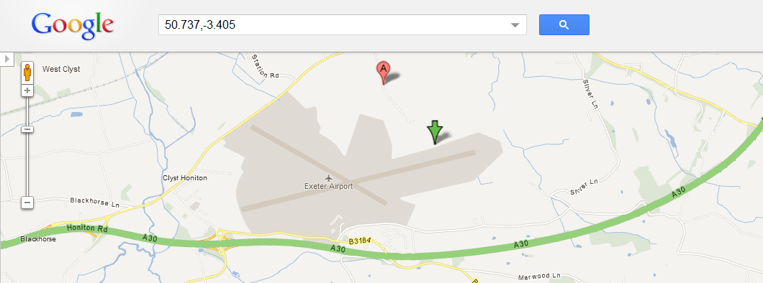
SamplingFeature as OM_Observation.featureOfInterest
In meteorology, we define a sampling regime that enables us to observe, measure or simulate the real-world. Sampling Features (from ISO 19156 ‘Observations and measurements’) provide a way to characterise this sampling regime and the relationship to the real-world.
84579:NamedPlace
name = “Exeter Airport”
03839:SF_SamplingPoint
:ComplexSamplingMeasurement
+sampledFeature
+featureOfInterest
+shape
:Point
@srsName “EPSG:4326”
pos = “50.737 -3405”
Notes:
Meteorological observations or forecasts clearly relate to the real world. For example, we may observe the weather for Exeter or provide a weather forecast for the ‘North Atlantic European’ area. However, there is a level of abstraction to resolve:
An observation of the weather for the city of Exeter happens at some representative location within the city or some representative locale nearby
The forecast domain for ‘North Atlantic European’ is specified so that it covers the areas for which a forecast is required
In each case, the ‘observation’ event relates to some sampling regime that is a proxy for the real entity of interest (e.g. the site of the weather station, or the extent of the forecast domain). The observation or forecast is not directly related to real-world entities.
ISO 19156 ‘Observations and measurements’ provides a conceptual model for describing this layer of indirection: Sampling Features. Further specialisations of Sampling Feature are provided based on spatial topology (SF_SpatialSamplingFeature and sub-types thereof).
In all cases identified thus far in meteorology, it appears useful to describe an observation, measurement or forecast with respect to the sampling regime (e.g. the Sampling Feature) and indirectly refer to the real-world entity for which the Sampling Feature is a proxy.
Spatial Sampling Features are considered an essential part of WMO METCE: all observations, measurements and forecasts of meteorological phenomena shall define the ‘featureOfInterest’ as a concrete sub-type of SF_SpatialSamplingFeature.

Slide 22
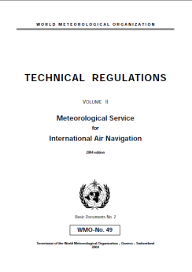
Process: a concrete implementation of OM_Process
The abstract OM_Process class (from ISO 19156) is used to define the process(es) involved in generating an observation.
An instance of OM_Process may be a specific instrument or sensor, a human observer executing a set of instructions, a simulator or process algorithm.
Process (from WMO METCE) provides a concrete implementation of OM_Process supporting the following requirements:
(i) reference to supporting documentation, (ii) specification of configuration parameters, (iii) specification of the measurement resolution and/or measurement range for each measurand.
:CompositeMeasurementContext
count = “27”
metar-observation-procedure
:Process
documentationRef = “http://wis.wmo.int/procedure=MetarOb”
:ComplexSamplingMeasurement
+context
+procedure
+context [27]
:MeasurementContext
measurand = “AirTemperature”
uom = “Celsius”
measuringInterval = “-40 to 60”
resolutionScale = “1”
:MeasurementContext
measurand = “MSLP”
uom = “hPa”
measuringInterval = “600 - 1100”
resolutionScale = “0”
‘documentationRef’ provides link to online documentation describing the procedure, in this case
WMO No. 49 II pg. 71
:MeasurementContext
measurand = “WindSpeed”
uom = “m/s”
measuringInterval = “0.6 - 75”
resolutionScale = “1”
:MeasurementContext
measurand = “GustSpeed”
uom = “m/s”
measuringInterval = “0.6 to 75”
resolutionScale = “1”
:MeasurementContext
measurand = “WindDirection”
uom = “degree true”
measuringInterval = “0 - 360”
resolutionScale = “-1”
:MeasurementContext
measurand = “Visibility”
uom = “Celsius”
measuringInterval = “0 - 20000”
resolutionScale = “-2”
Notes:
Class 'OM_Process' (related to OM_Observation via the 'Procedure' Association) is used to define the process(es) involved in generating an observation.
An instance of OM_Process is often an instrument or sensor (perhaps even a sensor in a given calibrated state), but it may be a human observer executing a set of instructions, a simulator or process algorithm. The 'Procedure' should provide sufficient information to interpret the result of an observation; thus if a sensor is recalibrated or its height above local ground is changed, a new instance of OM_Process should be created and associated with subsequent observations from that sensor (at least until the sensor is changed again).
Predominantly we expect the Process instance to be externally published / defined and 'static' (e.g. perhaps changing less often than once per month due to amendments to operational protocols etc.).
The WMO 'Process' class provides a concrete implementation of the abstract OM_Process class (from ISO 19156). In order to ensure a consistent implementation of the abstract OM_Process class, *ALL* Application Schema based on WMO METCE shall use the WMO Process class (or sub-class thereof) to describe the observation procedure.
The implementation is intended to support the following requirements:
reference to supporting documentation (ProcessDocumentation); e.g. online documentation describing the procedure in detail;
specification of parameters that remain fixed within a particular configuration of the procedure (Configuration); a soft-typed approach is used here following the pattern adopted for OM_Observation/parameter;
specification of the resolution [1] with which each observed physical phenomenon is measured; and
specification of the measuring interval [2] of the instrument or sensor for each observed physical phenomenon.
[1] Resolution: smallest change in a quantity being measured that causes a perceptible change in the corresponding indication (from the 'International vocabulary of metrology' [http://www.bipm.org/utils/common/documents/jcgm/JCGM_200_2008.pdf])
[2] Measuring interval: set of values of quantities of the same kind that can be measured by a given measuring instrument or measuring system with specified instrumental uncertainty, under defined conditions (from the 'International vocabulary of metrology' [http://www.bipm.org/utils/common/documents/jcgm/JCGM_200_2008.pdf])

Slide 23
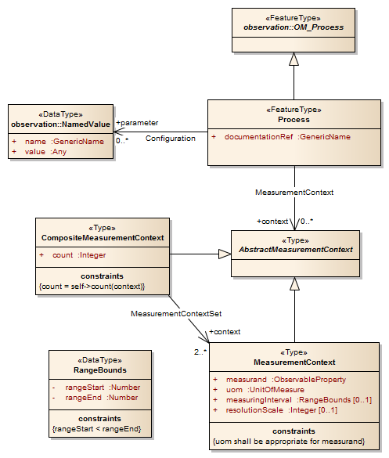
UML Class diagram for METCE:Process
The MeasurementContext/measurand property is specified as type “ObservableProperty”
This _may_ be implemented as a simple reference to an existing definition of a physical property such as ‘AirTemperature’ (e.g. from an authoritative controlled vocabulary published online such as NASA SWEET)
However, in many situations it is desirable to formally describe constraints and/or statistical qualification of such abstract physical properties
:MeasurementContext
measurand = “AirTemperature”
uom = “Celsius”
measuringInterval = “-40 to 60”
resolutionScale = “1”

Slide 24
OPM: Observable Property Model
The Observable Property Model (OPM) has been developed under the leadership of Dominic Lowe (UK) within the OGC ‘Sensor Web Enablement’ Standards Working Group & INSPIRE Thematic Working Group
As an interim measure, a stable version of this information is managed under the governance of WMO
Discussions between WMO and OGC regarding the management and maintenance of the authoritative version of OPM are pending
Given that OPM is likely to be managed under a different governance regime, the model has been factored into a separate Application Schema
IWXXM
SAF
SCH
METCE
OPM
SCH
Geographic Information / Geomatics

Slide 25
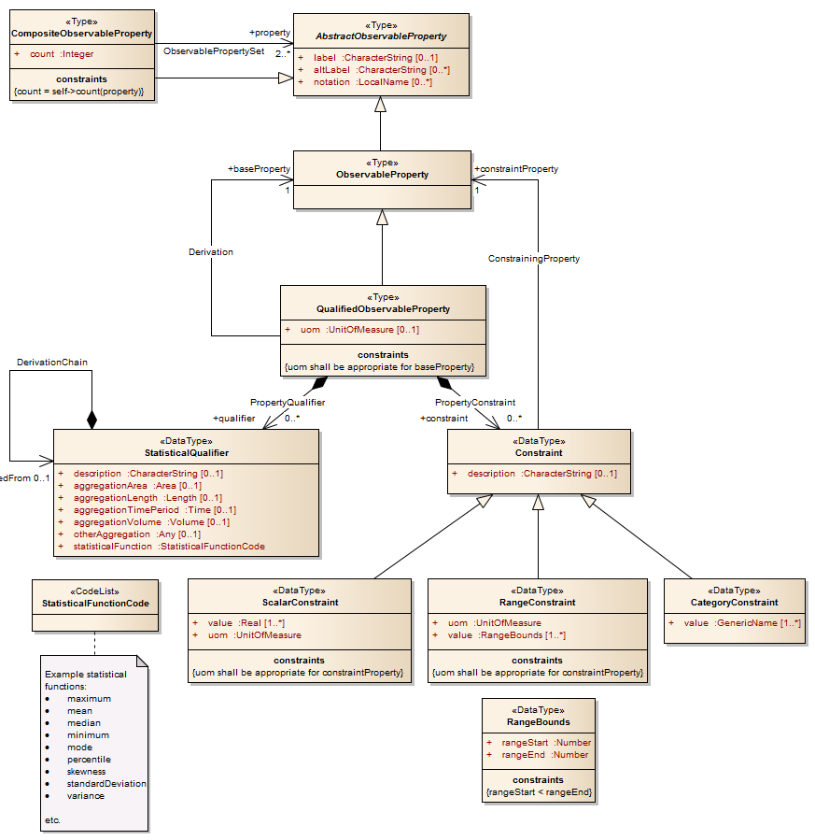
OPM: Observable Property Model
The Observable Property Model enables observed physical properties to be aggregated into composite properties (CompositeObservableProperty) and for any qualification or constraint relating to the observed physical properties to be explicitly described (QualifiedObservableProperty).
:NamedValue
name = “http://data.wmo.int/def/metce/property”
:ComplexSamplingMeasurement
+parameter
+value
AirTemperature
:ObservableProperty
MeanSeaLevelPressure
:ObservableProperty
:CompositeObservableProperty
count = “7”
WindSpeed
:ObservableProperty
GustSpeed
:ObservableProperty
WindDirection
:ObservableProperty
Visibility
:ObservableProperty
+property [7]
PresentOrForecastWeather
:ObservableProperty

Slide 26
Observable Property Model: qualifying observed properties
The “Observable Property model” (OPM) enables each physical property to be qualified according to the specific observation context …
e.g. within a METAR, the property ‘wind speed’ is formally defined as the mean wind speed within the 10-minute period preceding the observation
WindSpeed
:ObservableProperty
+baseProperty
meanWindSpeed
:QualifiedObservableProperty
label = “Mean wind speed during a 10-minute period”
+qualifier
:Time
@uom = “min”
value = 10
:StatisticalQualifier
description = “Mean value during a 10-minute period”
meanValue
:StatisticalFunctionCode
+aggregationTimePeriod
+statisticalFunction

Slide 27
WMO governance of definitions: WMO No. 306 Manual on Codes
The Code-Tables underpinning WMO Table-Driven Code Forms (GRIB and BUFR) are WMO’s crown jewels …
Decades of expert effort have gone into establishing authoritative terminologies to describe meteorological phenomena
WMO CBS stressed the importance of ensuring a strong linkage between the TDCF Code-tables and the WMO data models. [CBS-Ext.(10)]
‘Strong linkage’: a critical objective for TT-AvXML

Slide 28
Publication of web-accessible definitions for meteorology
As the UN’s authoritative voice on weather, water and climate it within WMO’s mandate to publish authoritative on-line definitions of meteorological phenomena and properties
Each ‘concept’ will be assigned an HTTP URI identifier within the wmo.int domain based on existing codes and structures from the WMO code-tables
It is anticipated that in RC2 the definitions of those physical properties required to support International Air Navigation will resolve to useful information …
http://data.wmo.int/def/grib2/codeflag/4.2/0.2.1
Excerpt from GRIB2 Code- and Flag-tables

Slide 29
A note on the use of OM_Observation/observedProperty
OM_Observation/observedProperty is intended to enable semantic or thematic classification of observations – a high-priority requirement for discovery and data fusion.
observedProperty has a cardinality of 1; each observation may only observe a single property.
observedProperty need not be modelled as a GF_Property (General Feature Model, ISO 19109) – one only needs to reference an appropriate definition for the physical property being observed; e.g. for the METAR example, the observed physical property may be “ObservedPropertiesForMETAR/SPECI”.
One can either re-use an existing well-known definition, or mint your own.
http://data.wmo.int/def/observableProperty/metarSpeci/observation
:GF_PropertyType
title = “Observed properties for METAR and SPECI
(Meteorological Aerodrome Reports)”
:OM_Observation
+observedProperty

Slide 30
Specifying a composite observedProperty
However, often observation events record information about _MULTIPLE_ physical properties.
OPM enables each of the physical properties observed to be aggregated into single composite entity that can be referenced from the OM_Observation.
As each physical property is explicitly listed, the OM_Observation can be indexed according to those physical properties supporting discovery based on individual physical property types rather than the aggregate property referenced by OM_Observation/observedProperty.
http://data.wmo.int/def/observableProperty/metarSpeci/observation
:CompositeObservableProperty
label = “Observed properties for METAR and SPECI
(Meteorological Aerodrome Reports)”
count = “27”
:OM_Observation
+observedProperty
+property [27]
AirTemperature
:ObservableProperty
MeanSeaLevelPressure
:ObservableProperty
WindSpeed
:ObservableProperty
GustSpeed
:ObservableProperty
WindDirection
:ObservableProperty
Visibility
:ObservableProperty
PresentOrForecastWeather
:ObservableProperty

Slide 31
Closer examination of IWXXM relationship to METCE
IWXXM
SAF
SCH
*****
METCE
OPM
SCH
Geographic Information / Geomatics

Slide 32
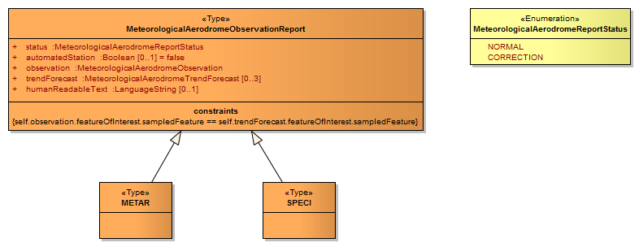
MeteorologicalAerodromeObservationReport
Note: please refer to the model documentation for more details

Slide 33
MeteorologicalAerodromeObservation
IWXXM further specialises the ComplexSamplingMeasurement (from METCE) to formalise the technical regulation; specifically to further constrain ‘result’ and ‘featureOfInterest’
Note: review of the model should focus on the specialised Record types for TAF, METAR/SPECI and SIGMET in order to validate that they correctly formalise the technical regulation from ICAO Annex 3 / WMO No. 49 II

Slide 34
Aside: serialisation OM_Observation sub-types –
use of OMXML pattern
IWXXM further specialises the ComplexSamplingMeasurement (from METCE) to formalise the technical regulation; specifically to further constrain ‘result’ and ‘featureOfInterest’
IWXXM METAR/SPECI
The GML/XML encoding for sub-types of OM_Observation follows the pattern defined in:
OGC #10-025
‘Observations and measurements v2.0 – XML implementation’
«FeatureType»
MeteorologicalAerodromeObservation
constraints
self.featureOfInterest.sampledFeature.oclIsKindOf(Aerodrome)
self.result.oclIsKindOf( MeteorologicalAerodromeObservationRecord)
<iwxxm:observation>
<om:OM_Observation gml:id="...">
<om:type
xlink:href="http://data.wmo.int/def/observationType/iwxxm/1.0RC1/MeteorologicalAerodromeObservation"
xlink:title="MeteorologicalAerodromeObservation"/>
…
<om:result>
<iwxxm:MeteorologicalAerodromeObservationRecord … />
</om:result>
</om:OM_Observation>
</iwxxm:observation>
Note: review of the model should focus on the specialised Record types for TAF, METAR/SPECI and SIGMET in order to validate that they correctly formalise the technical regulation from ICAO Annex 3 / WMO No. 49 II

Slide 35
Detailed review of Record structure
The properties included within the Record generally are drawn from one of four categories …
A boolean (true/false) that is used to indicate the presence or absence of a condition defined in the ICAO Annex 3 / WMO No. 49 II technical regulation; e.g. CAVOK

Slide 36
Aside: serialisation of properties as XML attributes – GML encoding extension
The properties included within the Record generally are drawn from one of four categories …
To improve readability of the resulting XML we have introduced an encoding extension to support serialisation as XML attributes.
Both class and property within the model are amended with tagged value …
IWXXM METAR/SPECI
«Type»
MeteorologicalAerodromeObservationRecord
tagged values:
acceptXMLAttribute = “true”
A boolean (true/false) that is used to indicate the presence or absence of a condition defined in the ICAO Annex 3 / WMO No. 49 II technical regulation; e.g. CAVOK
+ ceilingAndVisibilityOK : Boolean [ tagged values: allowXMLAttribute = “true” ]
+ airTemperature : AirTemperature
+ dewpointTemperature : DewPointTemperature
+ qnh : AltimeterSetting
<complexType name="MeteorologicalAerodromeObservationRecordType">
<complexContent>
<extension base="gml:AbstractGMLType">
<sequence> … </sequence>
<attribute name="ceilingAndVisibilityOK" type="boolean" use="required"/>
</extension>
</complexContent>
</complexType>
<iwxxm:MeteorologicalAerodromeObservationRecord ceilingAndVisibilityOK="false" gml:id="...">

Slide 37
Detailed review of Record structure
The properties included within the Record generally are drawn from one of four categories …
An identifiable entity; e.g. ‘runway’ (from SAF) or ‘volcano’ (from METCE)

Slide 38
Detailed review of Record structure
The properties included within the Record generally are drawn from one of four categories …
A physical property which is expressed as a measurement (including the unit of measurement); e.g. air temperature

Slide 39
Detailed review of Record structure
The properties included within the Record generally are drawn from one of four categories …
A physical property, phenomenon or other condition that is expressed as a nominal value drawn from a controlled vocabulary; e.g. runway deposit type

Slide 40
Provision of a re-usable palette of physical property classes
WMO already maintains a vast array of property definitions and code-tables in support of the WMO Table-Driven Code Forms (e.g. GRIB and BUFR)
WMO seeks to re-use these existing definitions & code-tables to:
ensure that the TDCF data-formats are harmonised with this ‘model-driven’ approach
mitigate increases in maintenance effort from maintaining additional data-exchange standards
ensure that consistent semantics are employed in Application Schema describing meteorological phenomena.

Slide 41
Met-basic: meteorological basic types
Met-basic provides:
a palette of quantity value classes specialising Measure (from ISO 19103), or subclasses thereof, for meteorological, hydrological and oceanographic physical properties; and
a palette of «CodeList» classes for expressing nominal values of meteorological, hydrological and oceanographic physical properties.
These classes describing meteorological, hydrologic and oceanographic quantity values and nominal property values are derived from the WMO code-tables and governed by WMO.
Currently, Met-basic _ONLY_ includes properties required to support International Air Navigation. In future iterations, it is expected that all terms from WMO TDCF will be included.
IWXXM
SAF
SCH
METCE
OPM
Met-basic
SCH
Geographic Information / Geomatics

Slide 42
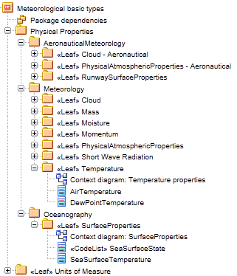
Met-basic package organisation
The physical properties defined in Met-basic are organised according to the scheme used in WMO FM-92 (GRIB):
discipline | category | parameter
Met-basic includes an additional “Aeronautical Meteorology” discipline and properties drawn from BUFR (usually relating to code-lists) that have no equivalent in GRIB2 (e.g. sea surface state; BUFR 0 22 061)
Note: model documentation provides a brief description of each property and identifies the source code-table from the WMO No. 306 Manual on Codes

Slide 43
Aside: specialisation of Measure (from ISO 19103) –
GML encoding extension
The physical properties defined in Met-basic are organised according to the scheme used in WMO FM-92 (GRIB):
discipline | category | parameter
Met-basic includes an additional “Aeronautical Meteorology” discipline and properties drawn from BUFR (usually relating to code-lists) that have no equivalent in GRIB2 (e.g. sea surface state; BUFR 0 22 061)
ISO 19103 Basic types
Quantity-value classes from WMO Met-basic specialise Measure (or sub-types thereof) from ISO 19103.
However, the rules for Application Schema prohibit specialisation of classes from ISO 19103.
Therefore WMO Met-basic is an _EXTENSION_ to standard GML; it is _NOT_ specified as an Application Schema itself.
Measure
+ value : Number
WMO Met-basic
Note: model documentation provides a brief description of each property and identifies the source code-table from the WMO No. 306 Manual on Codes
AirTemperature
+ uom : UomTemperature
<complexType name="AirTemperatureType">
<simpleContent>
<extension base="gml:MeasureType"/>
</simpleContent>
</complexType>
Notes:
Not an application schema

Slide 44
Aside: specialisation of Measure (from ISO 19103) –
usage in Application Schema and GML documents
The physical properties defined in Met-basic are organised according to the scheme used in WMO FM-92 (GRIB):
discipline | category | parameter
Met-basic includes an additional “Aeronautical Meteorology” discipline and properties drawn from BUFR (usually relating to code-lists) that have no equivalent in GRIB2 (e.g. sea surface state; BUFR 0 22 061)
IWXXM METAR/SPECI
Within ApplicationSchema referencing meteorological physical properties, use Types from Met-basic in the same way as Measure (and sub-types thereof) from ISO 19103.
«Type»
MeteorologicalAerodromeObservationRecord
+ ceilingAndVisibilityOK : Boolean
+ airTemperature : AirTemperature
+ dewpointTemperature : DewPointTemperature
+ qnh : AltimeterSetting
Note: model documentation provides a brief description of each property and identifies the source code-table from the WMO No. 306 Manual on Codes
<complexType name="MeteorologicalAerodromeObservationRecordType">
<complexContent>
<extension base="gml:AbstractGMLType">
<sequence>
<element name="airTemperature" type="met-basic:AirTemperatureType“/>
…
</sequence>
<attribute … />
</extension>
</complexContent>
</complexType>
<iwxxm:airTemperature uom="http://opengis.net/def/uom/UCUM/0/Cel">
27
</iwxxm:airTemperature>
Notes:
Not an application schema

Slide 45
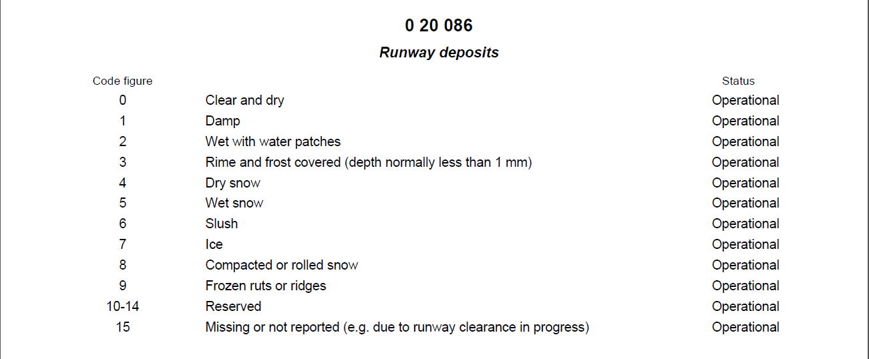
WMO code-tables published as web-accessible resources
To complement the WMO model, terms from WMO Code-tables are in the process of being published as web-accessible resources.
It is anticipated that these web-accessible resources will be available for RC2.
Each code-table and each term will be assigned HTTP URIs which resolve to useful information about those entities; e.g. human-readable web-pages or machine-readable content.
http://data.wmo.int/def/bufr4/codeflag/0-20-086
Note: at a minimum, a code-list resource will define the members of the code-list
http://data.wmo.int/def/bufr4/codeflag/0-20-086/6
Excerpt from BUFR edition 4 Code- and Flag-tables
Notes:
Note: the format provided when the HTTP URI is resolved will be determined using HTTP Content Negotiation

Slide 46
Binding «CodeList» classes to controlled vocabularies
A «CodeList» class is used to indicate that permissible values for a property or attribute are taken from a specific controlled vocabulary governed externally to the model.
Each «CodeList» carries two additional tagged values:
vocabulary: used to refer to the authoritative list of terms using an HTTP URI. This authoritative list may be implemented as a GML dictionary, SKOS concept scheme etc.
extensibility: indicates the governance regime applied to evaluation of terms used as values of the <CodeList> class; "none", "narrower" or "any". Basically, "none" implies _ONLY_ terms from the specified code list are permitted, "narrower" implies you can use terms with more refined definitions (e.g. narrower semantics), and "any" implies that anything goes and the specified code list is simply a recommendation!
Once published as web-accessible resources, the WMO code-tables can be specified as the controlled vocabulary for «CodeList» classes.
Crucially, note that in line with best practice, «CodeList» resources are managed externally to the model; in this case using existing WMO governance processes.
WMO Met-basic
«CodeList»
RunwayDeposits
tagged values:
vocabulary = “http://data.wmo.int/def/bufr4/codeflag/0-20-086”
extensibility = “none”

Slide 47
Aside: additional tagged values for «CodeList» classes –
GML encoding extension
<complexType name="RunwayDepositsType">
<annotation>
<appinfo>
<vocabulary> http://data.wmo.int/def/bufr4/codeflag/0-20-086 </vocabulary>
<extensibility> none </extensibility>
</appinfo>
<documentation>
Type of deposit on runway. See WMO No. 306: - WMO Code table 0919; and - BUFR Code table 0 20 086
</documentation>
</annotation>
<complexContent>
<extension base="gml:ReferenceType"/>
</complexContent>
</complexType>
WMO Met-basic
«CodeList»
RunwayDeposits
tagged values:
vocabulary = “http://data.wmo.int/def/bufr4/codeflag/0-20-086”
extensibility = “none”
Serialisation of «CodeList» classes follows practice from GML 3.3; gml:ReferenceType is used as extension base. Tagged values are included in schema documentation for developer reference.

Slide 48
Aside: additional tagged values for «CodeList» classes –
usage in Application Schema and GML documents
IWXXM METAR/SPECI
Within ApplicationSchema referencing meteorological code-tables, use Types from Met-basic. GML documents use XLINK to refer to the terms from the necessary code-table.
«DataType»
AerodromeRunwayState
+ runway : Runway [0..1]
+ cleared : Boolean [0..1]
+ contamination : RunwayContamination [0..1]
+ snowClosure : Boolean [0..1]
+ depositType : RunwayDeposits [0..1]
+ depthOfDeposit : DepthOfDeposit [0..1]
+ brakingAction : BrakingAction [0..1]
+ frictionCoefficient : FrictionCoefficient [0..1]
<complexType name=“AerodromeRunwayStateType">
<sequence>
…
<element name=“depositType" type="met-basic:RunwayDepositsType">
<annotation>
<documentation>
The type of runway deposit, such as damp conditions, wet snow, or ice. WMO 306: Table 0919
</documentation>
</annotation>
</element>
…
</sequence>
</complexType>
<iwxxm:depositType
xlink:href="http://data.wmo.int/def/bufr4/codeflag/0-20-086/1" xlink:title=“Damp"/>

Slide 49
Validation of code entries within data products
TAF
METAR/SPECI
SIGMET
IWXXM Validation Services
Given that each WMO code-table required to support international air navigation services will be published as web-accessible resources, it is anticipated that IWXXM will include the facility to validate that a term given in a data product (e.g. a GML instance of TAF, METAR or SIGMET) _IS_ a member of the appropriate code-list as defined in the conceptual model.

Slide 50
Aside: implementation of constraints as schematron –
embedded in XSD documents; extension to FullMoon
<element name="AerodromeHorizontalVisibility"
substitutionGroup="gml:AbstractObject" type="iwxxm:AerodromeHorizontalVisibilityType">
<annotation>
<documentation> An aggregation of horizontal visibility conditions typically reported together at an aerodrome, including the prevailing visibility and minimum visibility. </documentation>
<appinfo>
<sch:pattern xmlns:sch="http://purl.oclc.org/dsdl/schematron"
name="AerodromeHorizontalVisibility1">
<sch:rule context="//iwxxm:AerodromeHorizontalVisibility">
<sch:assert
test="(if( exists(iwxxm:minimumVisibility) ) then exists(iwxxm:minimumVisibilityDirection) else true())">
AerodromeHorizontalVisibility: Minimum visibility and the direction must be reported together
</sch:assert>
</sch:rule>
</sch:pattern>
</appinfo>
</annotation>
</element>
IWXXM METAR/SPECI
«DataType»
AerodromeHorizontalVisibility
constraints
if( self.minimumVisibility NOT NULL ) minimumVisibilityDirection NOT NULL
+ prevailingVisibility : PrevailingVisibility
+ minimumVisibility: VisibilityAero[0..1]
+ minimumVisibilityDirection : Angle [0..1]
…

Slide 51
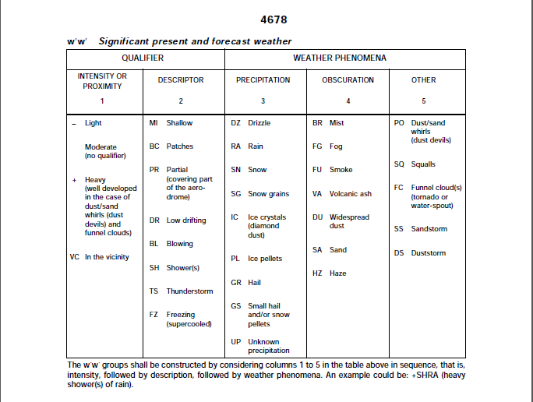
WMO No. 306 Vol I.1 Code-table 4678 Significant Weather
Code-table 4678 is organised into 5-categories from which terms can be combined to form appropriate significant weather codes (e.g. +DZSNRA 'Heavy' 'Drizzle', 'Snow' and 'Rain') where meteorologically valid.
Excerpt from WMO No. 306 Vol I.1

Slide 52
WMO No. 306 Vol I.1 Code-table 4678 Significant Weather
Assessment of significant weather codes to determine their validity is complex. As a result, the GML/XML implementation of METAR/SPECI and TAF will use a register of predefined codes for significant weather. Validation of significant weather codes can then be simply achieved by checking whether the term appears on within the register.
The register containing the complete set of valid terms derived from code-table 4678 shall be published by WMO as a web accessible resource. The URI of this register shall be:
http://data.wmo.int/def/306/4678
Each of the valid significant weather codes will also be assigned an HTTP URI within the namespace of the register using familiar codes for the significant weather terms; e.g.
(light) ‘drizzle’: http://data.wmo.int/def/306/4678/-DZ
(moderate) ‘drizzle’: http://data.wmo.int/def/306/4678/DZ
(heavy) ‘drizzle’: http://data.wmo.int/def/306/4678/+DZ
(moderate) ‘showers’ ‘in vicinity’: http://data.wmo.int/def/306/4678/VCSH
PLEASE HELP DETERMINE THE COMPLETE SET OF VALID COMBINATIONS
Excerpt from WMO No. 306 Vol I.1
Notes:
Also note:
The technical regulation places a set of additional restrictions on the use of terms from code-table 4678 for recent and forecast weather: only a subset of the valid combinations may be used.
To cater for this restriction, three additional registers are defined whose members are the specific subset of terms permitted for use in METAR/SPECI and TAF for:
recent weather - <http://data.wmo.int/def/49-2/AerodromeRecentWeather>
present weather - <http://data.wmo.int/def/49-2/AerodromePresentWeather>
forecast weather - <http://data.wmo.int/def/49-2/AerodromeForecastWeather>
Each of these registers is intended to support the business rules defined in the ICAO technical regulation for meteorology (ICAO Annex 3 / WMO No. 49 Volume 2) hence their URIs are allocated within the <http://data.wmo.int/def/49-2> namespace.
The members of these registers shall be the subset of applicable terms from the <http://data.wmo.int/def/306/4678> register.
For example, the term <http://data.wmo.int/def/306/4678/TS> ("Thunderstorm") is a member of the "Recent weather" register <http://data.wmo.int/def/49-2/AerodromeRecentWeather>.

Slide 53
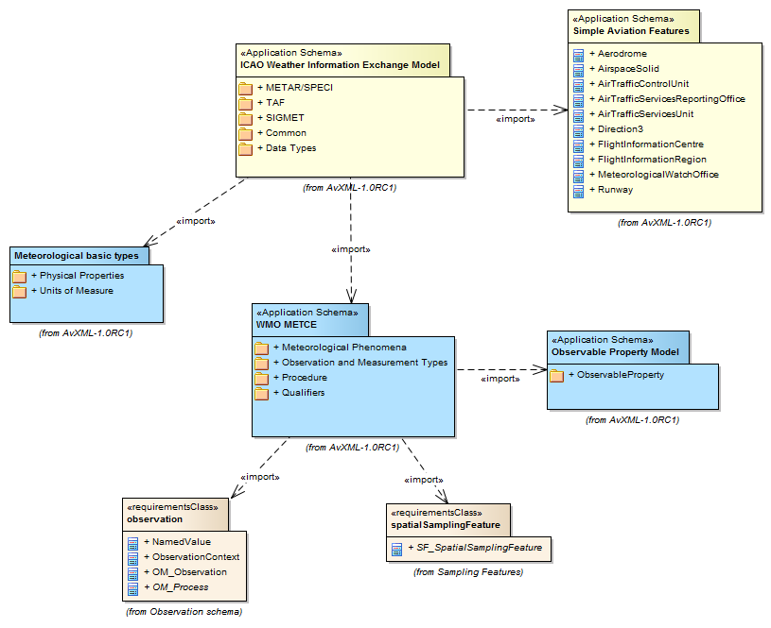
AvXML 1.0RC1 model overview
Please use the HTML documentation, EA Project file or XMI export to browse the remaining aspects of the model – paying particular attention to how the components from IWXXM implement the technical regulation from ICAO Annex 3 / WMO No. 49 II

Slide 54
Worked example 1: XML encoded simple METAR
METAR FOR KARLOVY VARY AIRPORT, MIDDAY 25-JULY-2007

Slide 55
Worked example 2: XML encoded VA SIGMET
VA SIGMET FOR SHANWICK OCEANIC FLIGHT INFORMATION REGION, 16:00Z 25-MONTH-YEAR

Slide 56
AvXML 1.0 standard development schedule
!
!
[1st Feb 2013] 1.0RC1 review closes
[1-8 Feb 2013] 1.0RC1 feedback clarification
[Feb-Mar 2013] Amendments incorporated for 1.0RC2
[Mar 2013] 1.0RC2 published for review
Note that further information and training sessions are planned for the ‘4th Workshop on the use of GIS in meteorology’ to be hosted at ECMWF, Reading, UK in early March 2013
[July 2013] AvXML 1.0 published

Slide 57
Any questions?
AvXML 1.0RC1 release page:
http://www.wmo.int/pages/prog/www/WIS/wiswiki/tiki-index.php?page=METCE-1.0RC1
Please provide your AvXML 1.0RC1 feedback and comments to the CBS-TT-AvXML Google Group
comments on AvXML 1.0RC1 should be submitted to the Google group using a subject line beginning with the text “[1.0RC1-feedback]”

Slide 58
Thank you

Slide 59
READ request for '0-20-086':
GET /def/bufr4/codeflag/0-20-086 HTTP/1.1
Host: data.wmo.int
Accept: application/ld+json,application/json
Accept-Language: en-gb
HTTP/1.1 200 OK
Date: Sat, 24-Nov-2012 21:18:41 GMT
Last-Modified: Sat, 24-Nov-2012 20:47:03 GMT
Content-type: application/ld+json
{
"@context": {
"reg": "http://purl.org/linked-data/registry#",
"rdfs": "http://www.w3.org/2000/01/rdf-schema#",
"owl": "http://www.w3.org/2002/07/owl",
"dct": "http://purl.org/dc/terms/",
"skos": "http://www.w3.org/2004/02/skos/core#"
},
"@graph": [
{
"@id": "http://data.wmo.int/def/bufr4/codeflag/0-20-086",
"@type": [
"reg:Register",
"skos:ConceptScheme"
],
"rdfs:label": {
"@value": "Runway deposits (Scheme)",
"@language": "en"
},
"dct:description": {
"@value": "BUFR Code-table 0-20-086: Runway deposits.",
"@language": "en"
},
"reg:inverseMembershipPredicate": "skos:inScheme",
"reg:containedItemClass": "http://data.wmo.int/def/bufr4/b/20/086",
"reg:owner": "http://www.wmo.int/foo/agent/data-representation-metadata-and-monitoring#id",
"reg:manager": "http://www.wmo.int/foo/agent/ashimazaki.#id",
"owl:versionInfo": "1"
},
{
"@id": "http://data.wmo.int/def/bufr4/codeflag/0-20-086/0",
"@type": "http://data.wmo.int/def/bufr4/b/20/086",
"skos:prefLabel": {
"@value": "Clear and dry",
"@language": "en"
},
"skos:topConceptOf": "http://data.wmo.int/def/bufr4/codeflag/0-20-086",
"skos:inScheme": "http://data.wmo.int/def/bufr4/codeflag/0-20-086"
},
{
"@id": "http://data.wmo.int/def/bufr4/codeflag/0-20-086/1",
"@type": "http://data.wmo.int/def/bufr4/b/20/086",
"skos:prefLabel": {
"@value": "Damp",
"@language": "en"
},
"skos:topConceptOf": "http://data.wmo.int/def/bufr4/codeflag/0-20-086",
"skos:inScheme": "http://data.wmo.int/def/bufr4/codeflag/0-20-086"
},
{
"@id": "http://data.wmo.int/def/bufr4/codeflag/0-20-086/2",
"@type": "http://data.wmo.int/def/bufr4/b/20/086",
"skos:prefLabel": {
"@value": "Wet with water patches",
"@language": "en"
},
"skos:topConceptOf": "http://data.wmo.int/def/bufr4/codeflag/0-20-086",
"skos:inScheme": "http://data.wmo.int/def/bufr4/codeflag/0-20-086"
},
{
"@id": "http://data.wmo.int/def/bufr4/codeflag/0-20-086/3",
"@type": "http://data.wmo.int/def/bufr4/b/20/086",
"skos:prefLabel": {
"@value": "Rime and frost covered (depth normally less than 1 mm)",
"@language": "en"
},
"skos:topConceptOf": "http://data.wmo.int/def/bufr4/codeflag/0-20-086",
"skos:inScheme": "http://data.wmo.int/def/bufr4/codeflag/0-20-086"
},
{
"@id": "http://data.wmo.int/def/bufr4/codeflag/0-20-086/4",
"@type": "http://data.wmo.int/def/bufr4/b/20/086",
"skos:prefLabel": {
"@value": "Dry snow",
"@language": "en"
},
"skos:topConceptOf": "http://data.wmo.int/def/bufr4/codeflag/0-20-086",
"skos:inScheme": "http://data.wmo.int/def/bufr4/codeflag/0-20-086"
},
{
"@id": "http://data.wmo.int/def/bufr4/codeflag/0-20-086/5",
"@type": "http://data.wmo.int/def/bufr4/b/20/086",
"skos:prefLabel": {
"@value": "Wet snow",
"@language": "en"
},
"skos:topConceptOf": "http://data.wmo.int/def/bufr4/codeflag/0-20-086",
"skos:inScheme": "http://data.wmo.int/def/bufr4/codeflag/0-20-086"
},
{
"@id": "http://data.wmo.int/def/bufr4/codeflag/0-20-086/6",
"@type": "http://data.wmo.int/def/bufr4/b/20/086",
"skos:prefLabel": {
"@value": "Slush",
"@language": "en"
},
"skos:topConceptOf": "http://data.wmo.int/def/bufr4/codeflag/0-20-086",
"skos:inScheme": "http://data.wmo.int/def/bufr4/codeflag/0-20-086"
},
{
"@id": "http://data.wmo.int/def/bufr4/codeflag/0-20-086/7",
"@type": "http://data.wmo.int/def/bufr4/b/20/086",
"skos:prefLabel": {
"@value": "Ice",
"@language": "en"
},
"skos:topConceptOf": "http://data.wmo.int/def/bufr4/codeflag/0-20-086",
"skos:inScheme": "http://data.wmo.int/def/bufr4/codeflag/0-20-086"
},
{
"@id": "http://data.wmo.int/def/bufr4/codeflag/0-20-086/8",
"@type": "http://data.wmo.int/def/bufr4/b/20/086",
"skos:prefLabel": {
"@value": "Compact or rolled snow",
"@language": "en"
},
"skos:topConceptOf": "http://data.wmo.int/def/bufr4/codeflag/0-20-086",
"skos:inScheme": "http://data.wmo.int/def/bufr4/codeflag/0-20-086"
},
{
"@id": "http://data.wmo.int/def/bufr4/codeflag/0-20-086/9",
"@type": "http://data.wmo.int/def/bufr4/b/20/086",
"skos:prefLabel": {
"@value": "Frozen ruts or ridges",
"@language": "en"
},
"skos:topConceptOf": "http://data.wmo.int/def/bufr4/codeflag/0-20-086",
"skos:inScheme": "http://data.wmo.int/def/bufr4/codeflag/0-20-086"
},
{
"@id": "http://data.wmo.int/def/bufr4/codeflag/0-20-086/15",
"@type": "http://data.wmo.int/def/bufr4/b/20/086",
"skos:prefLabel": {
"@value": "Missing or not reported (e.g. due to runway clearance in progress)",
"@language": "en"
},
"skos:topConceptOf": "http://data.wmo.int/def/bufr4/codeflag/0-20-086",
"skos:inScheme": "http://data.wmo.int/def/bufr4/codeflag/0-20-086"
}
]
}

Slide 60
READ request for item #6 within '0-20-086':
GET /def/bufr4/g/0-20-086/6 HTTP/1.1
Host: data.wmo.int
Accept: application/ld+json,application/json
Accept-Language: en-gb
HTTP/1.1 200 OK
Date: Sat, 24-Nov-2012 22:37:59 GMT
Last-Modified: Sat, 24-Nov-2012 22:26:09 GMT
Content-type: application/ld+json
{
"@context": {
"reg": "http://purl.org/linked-data/registry#",
"rdfs": "http://www.w3.org/2000/01/rdf-schema#",
"owl": "http://www.w3.org/2002/07/owl",
"dct": "http://purl.org/dc/terms/",
"skos": "http://www.w3.org/2004/02/skos/core#",
"wmo": "http://data.wmo.int/def/bufr4/core#",
"xsd": "http://www.w3.org/2001/XMLSchema#"
},
"@id": "http://data.wmo.int/def/bufr4/codeflag/0-20-086/6",
"@type": "http://data.wmo.int/def/bufr4/b/20/086",
"skos:prefLabel": {
"@value": "Slush",
"@language": "en"
},
"skos:definition": {
"@value": "Snow or ice on the ground that has been reduced to a soft watery mixture by rain, warm temperature, and/or chemical treatment.",
"@language": "en"
},
"skos:topConceptOf": "http://data.wmo.int/def/bufr4/codeflag/0-20-086",
"skos:inScheme": http://data.wmo.int/def/bufr4/codeflag/0-20-086
}

