Slide 1
Status of GISC Tokyo
GISC Tokyo/JMA

Slide 2
Capacity Building
WIS workshop in Tokyo in November 2014
  WIS Competency based training
  Developed each backup plan
Onsite technical meeting at centres in AoR of GISC Tokyo
  April 2014 Viet Nam
  April 2014 Philippines
  June 2014 Myanmar
  March 2015 Thailand
  March 2015 Cambodia
  October 2015 Laos (next week)

Slide 3
GISC Backup update (1)
GISC Beijing
GISC Backup between Beijing and Tokyo is in pre-operational by using GTS and Internet DAR service. (The details are shown in item 9.1)
GISC Melbourne
  Signed letters on GISC backup agreement were officially exchanged in March 2012.
  Tokyo has two options for AoR of Melbourne;
  option 1: Existing GTS based backup
  option 2: Internet based backup
  Both options are already running in backup with Beijing and Offenbach.

Slide 4
GISC Backup update (2)
GISC Offenbach
  Using internet file transfer
  Warm backup is recommended but some centers choose cold backup
GISC Tokyo
GISC Offenbach
HTTPS file upload
FTP put
Internet
cache
cache
DCPC
NC
DCPC
NC
NC
NC
NC
NC
GISC Tokyo AMDCN
GISC Offenbach AMDCN

Slide 5
GISC Brasilia
In August 2015, metadata synchronization was started.
In early October 2015,
GISC Brasilia and GISC Tokyo has started exchanging global exchange data via the Internet. (pre-operational)
  Monitoring page for files received via the Internet
  http://www.wis-jma.go.jp/iwgmonitor/iwgmonitor.jsp
Internet
HTTPS file upload
GISC Tokyo
GISC Brasilia
Tokyo’s DAR service
cache
cache
DCPC
NC
DCPC
NC
NC
NC
NC
NC
GISC Tokyo AMDCN
GISC Brasilia AMDCN

Slide 6






DCPC Bangkok, DCPC Space Weather
  DCPC Bangkok (RTH) and DCPC Space Weather (NICT, Japan) were approved at 17th Cg.
DCPC Bangkok and GISC Tokyo are working on metadata management/provision in AoR of RTH Bangkok. (Manual on WIS, 3.6.8)
Metadata Flow in AoR of GISC Tokyo
NC
Thailand
NC
Myanmar
NC
Lao PDR
NC
Vietnam
NC
Cambodia
NC
Philippines
NC/DCPCs
Japan
NC
Thailand
NC
Myanmar
NC
Lao PDR
NC
Vietnam
NC
Cambodia
NC
Philippines
NC/DCPCs
Japan
DCPC (RTH)
Bangkok
DCPC (RTH)
Bangkok
DCPC Space Weather
(NICT, Japan)
GISC
Tokyo
GISC
Tokyo

Slide 7
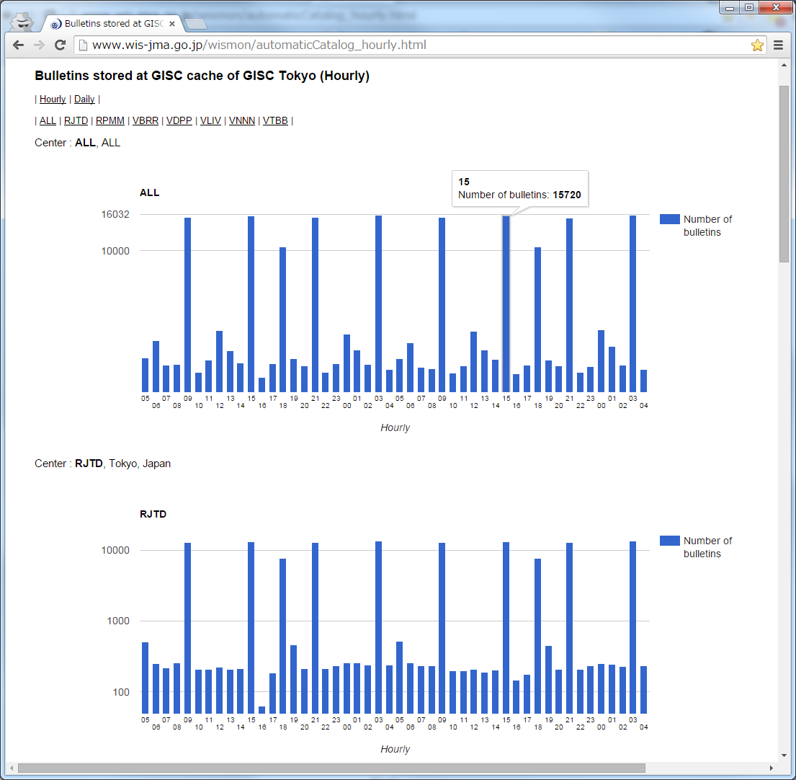
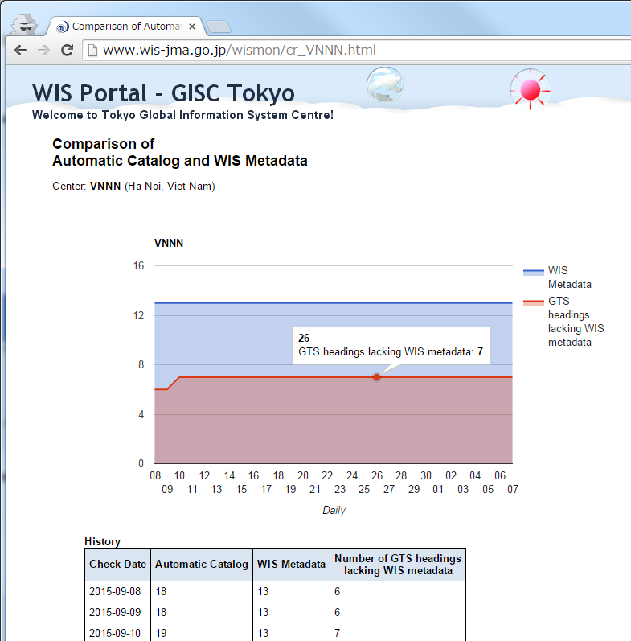
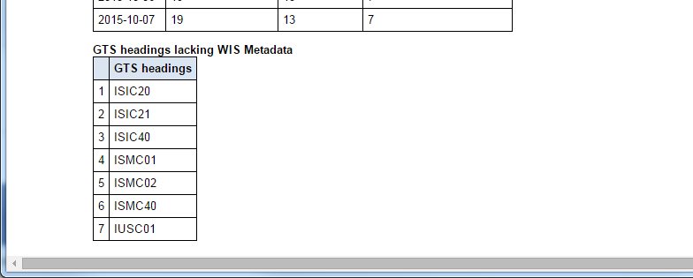
Monitoring (e.g. cache & metadata )
Bulletins stored at GISC Tokyo’s cache
(Hourly & Daily)
Comparison of
received GTS bulletins and metadata
…
Check GTS headings lacking WIS Metadata
Check GTS headings lacking WIS Metadata
http://www.wis-jma.go.jp/wismon/automaticCatalog_hourly.html
http://www.wis-jma.go.jp/cms/monitoring/

Slide 8
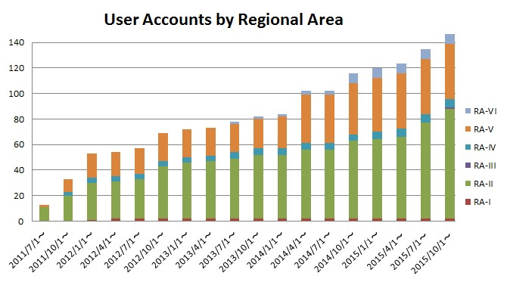
Status of user registration

Slide 9
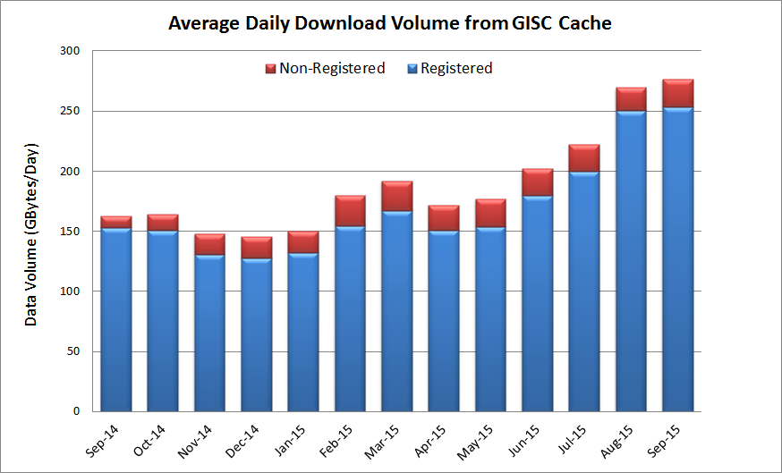
Average Daily Download Volume from GISC Cache
Started Himawari-8 satellite products on 7th July 2015

Slide 10
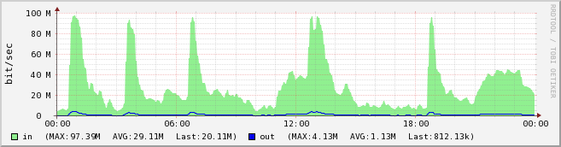
Daily Download Volume From GISC Tokyo
Numerical Weather Prediction Products

Slide 11
Network Diagram of GISC Tokyo
64K
Khabarovsk
GISC Tokyo (RTH Tokyo)
128K
Seoul
100M
10M x 2
2M
RMDCN MPLS
Network
(Interoute)
MPLS
Network
(NTT-COM)
Internet
DAR Users
50M
Bangkok
Washington
4M
New Delhi
128K
NMHS users of MTSAT Imagery and High-resolution GSM
Melbourne
2M
20M
EUMETSAT
Hong Kong
1M
Beijing
16M
20M
Exeter
Manila
64K
Toulouse
Offenbach
50M
50M

Slide 12
DRS: Disaster Recovery Site
・Osaka site has been in operation since 3 March 2015
・Some centres finished a connection test
and started backup operation
・JMA is scheduling a connection test for other centres
500 Km
Tokyo
Osaka

Slide 13
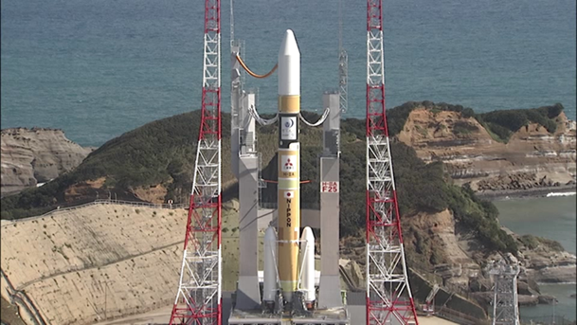

Himawari-8
Himawari-8 was successfully launched on 7 October 2014.
GISC Tokyo has started providing Himawari-8 products since 7 July 2015.
  SATAID service( Satellite imagery): WIS portal
  Atmospheric Motion Vectors(AMV): GTS, WIS portal
  Clear Sky Radiance(CSR) : GTS, WIS Portal

Slide 14





Himawari Data Distribution via HimawariCloud (Internet)
Himawari-8/9
http://www.data.jma.go.jp/mscweb/en/himawari89/cloud_service/cloud_service.html
raw data
(level 0)
(c) WIS Portal
(d) JDDS
SATAID files
MTSAT compatible HRIT files
HimawariCloud
(a)
JMA
all Imagery Data
in full specification
NMHSs
Interval: 10 minutes (full disk); 2.5 minutes (target area)
Number of bands: 16 (VIS 3, NIR 3, IR 10)
Spatial resolution: VIS: 0.5-1km; NIR: 1-2km;
IR: 2km
True-color images (composites of 3 visible bands) in PNG
(b)
Archive
Server
historical data
Domestic Users
Researchers
HimawariCloud: for NMHSs (account: 1 agency / nation)
Archive Server: for Non-Profit R&D Users operated by Japanese Science Group
WIS Portal and (d) JDDS: for NMHSs

Slide 15
Summary
Mr Kentaro Tsuboi reported the current status of GISC Tokyo and a WIS workshop was held in Tokyo in November 2014, focusing on WIS competency and developing a backup plan.
He also reported the progress of the GISC Backup of Tokyo, between GISC Offenbach, Beijing and Melbourne. The meeting noted that the backup procedures have performed effectively during a system failure.
Mr Tsuboi informed that GISC Tokyo started exchanging data with GISC Brasilia via internet as pre-operational in October 2015. The meeting noted that DCPC Bangkok (RTH) and DCPC Space Weather (NICT, Japan) were approved at 17th Cg. DCPC Bangkok is working on metadata management in the AoR of RTH Bangkok.
Mr Tsuboi introduced a disaster recovery site of GISC Tokyo, Osaka site has been in operation since March 2015. Some centres finished a connection test while JMA is scheduling a test for other centers.
He also introduced a new satellite of JMA, Himawari-8 was launched on 7 October 2014 and its products have been provided via GISC Tokyo portal and/or GTS since 7 July 2015.

