Slide 1
Direct Broadcast Network (DBNet) for
Near Real-Time Relay of LEO Satellite Data
(From RARS to DBNet)
Mikael Rattenborg and Jérôme Lafeuille
WMO Space Programme

Slide 2
Talking points
From RARS to DBNet
Outline of DBNet
DBNet User Requirements, current and future
DBNet data traffic projection

Slide 3
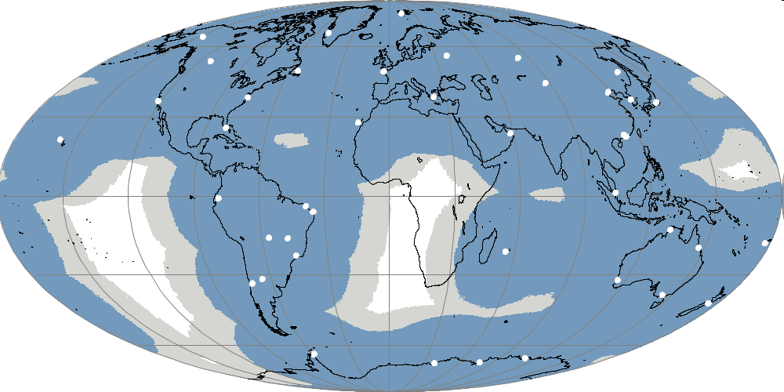
Initial WMO RARS concept and objective
Global availability of near real-time ATOVS data received by a collection of Direct Broadcast stations distributed around the world
Ensuring global consistency by using common software (AAPP), standardized coding and file naming, and quality monitoring
Dissemination by the WMO GTS or otherwise (e.g. satellite broadcast)
Initial goal:
NOAA and Metop ATOVS (L1b)
from 90% of the globe
available on the GTS in 30 min
ATOVS= HIRS, AMSU-A, AMSU-B, MHS

Slide 4
RARS/ATOVS implementation status
http://www.wmo.int/pages/prog/sat/rars_en.php
Regional components | January 2009 | March 2014 | March 2015 (TBC)
EARS | 10 stations 23% | 15 stations 40% | 15 stations 40%
Asia-Pacific | 14 stations 28% | 15 stations 29% | 17 stations 33%
South-America | 5 stations 10% | 8 stations 14% | 7 stations 13 %
Overall network | 29 stations 61% | 38 stations 75% | 39 stations 80%
The percentages are the fraction of the globe (except polar caps) above which the DB signal emitted by a SSO satellite is received by at least one station of the RARS network

Slide 5
Typical Timeliness monitored in Tokyo (JMA) http://ds.data.jma.go.jp/mscweb/data/rars/index.html
Overall latency between start of reception and availability in Tokyo through the GTS is of the order of 15-20 minutes in most cases for Asia-Pacific RARS/ATOVS data
Receiving
Processing
Transferring

Slide 6
WMO, CGMS and ITWG Discussions on RARS evolution
2012: RARS Implementation Group & ITSC-18 RARS sub-group:
CGMS-41 (Tsukuba, July 2013)
April 2014: RARS Technical Subgroup at ITSC-19 (Jeju) actions
Sept. 2014: CBS Extraordinary session
CGMS-42 (Guangzhou, May 2014)
Extend RARS to hyperspectral sounders &possibly other sensors
Coordinate RARS, EARS, NOAA DBRTM initiatives with a view to define common technical specifications (incl. product definition, processing, codes/format, procedures, notification..)
Describe these common specifications in a WMO Technical Guide

Slide 7
From RARS to DBNet
Coordination meeting in Geneva, 11-13 March 2015
Participation:
  RARS Asia-Pacific (KMA, IMD, JMA, BoM, CMA, Meteo-France)
  RARS South America (SMN Argentina)
  RARS Europe/EARS (EUMETSAT)
  RARS central monitoring unit (EUMETSAT NWPSAF)
  NOAA DBRTN project
  WMO Secretariat (SAT, WIS)
Chaired by Anthony Rea (BOM, Asia-Pacific RARS coordinator)
Reviewed status of RARS, outstanding issue, NOAA DBRTN initiative
Considered high-level specifications for new services (NPP, Metop, JPSS, FY-3)
  can evolve with user needs, potential addition of other sensors
Areas of harmonization/standardization required to support new services
Agreed to rebrand the overall initiative as
“DBNet”

Slide 8
Talking points
From RARS to DBNet
Outline of DBNet
DBNet User Requirements, current and future
DBNet data traffic projection

Slide 9
Towards a Guide on DBNet
A Guide to DBNet is being developed to record the DBNet specifications, standard practices, and coordination mechanisms
Prompts useful discussions on the best practices to be adopted
Draft to be presented to APSDEU-NAEDEX
and ITSC-20 (Oct 2015)
Will serve as reference for implementing the DBNet services
It should be a living document. Sections on future services can be added or refined later
First version submitted to WMO CBS (2016)

Slide 10
DBNet Components
DBNet is composed of regional networks coordinated by regional or sub-regional nodes and a global DBNet Coordination Group
Global monitoring of product consistency is performed by the NWPSAF
Regional Network | Regional or Sub-regional Node
DBNet - EUMETSAT | EUMETSAT
DBNet - Asia-Pacific | JMA
 | BoM
DBNet - South America | INPE
 | SMN Argentina
DBNet - NOAA | NOAA

Slide 11
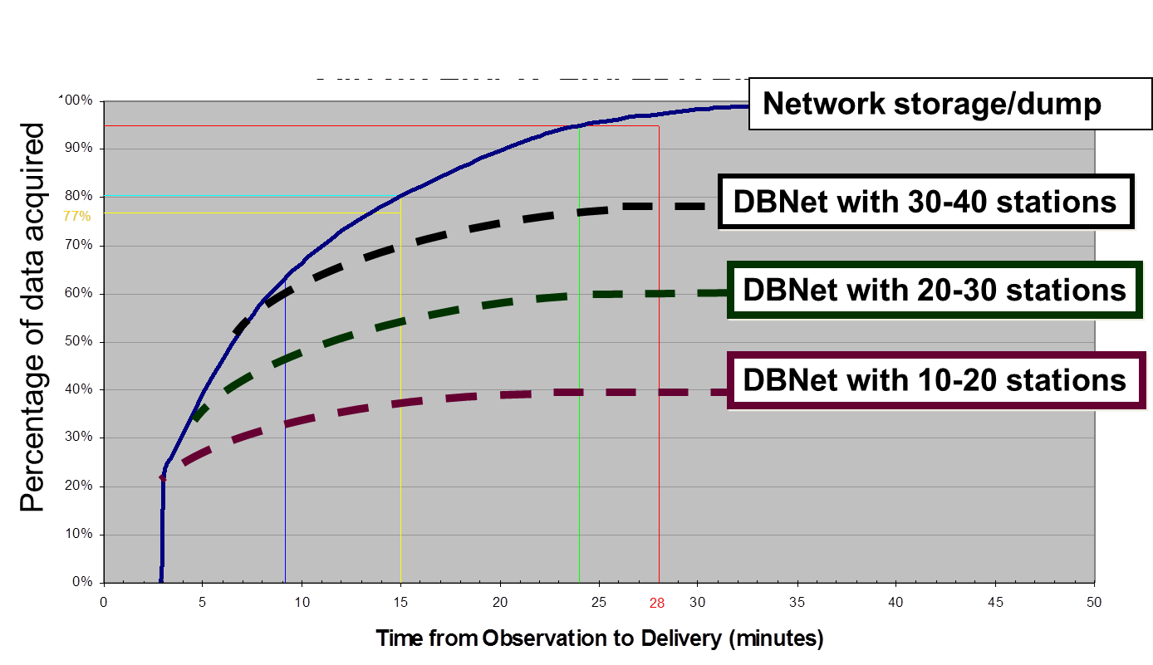
High-level Service Specifications
Should address: Products, Timeliness, Availability, Coverage
Established with user bodies (ITWG, APSDEU-NAEDEX, IPET-SUP)
Most requirements applicable to every station
The “Coverage” is a requirement applicable at the network level.
Schematic illustration of the impact of «Coverage» of a regularly distributed network

Slide 12
Current and potential DBNet services
Each DBNet regional network contributes to one or more “Services”.
A DBNet Service consists of Direct Broadcast acquisition, processing and relay of a certain category of satellite data
RARS (ATOVS) will remain, as one of the DBNet Services
Note: Radio Occultation has been excluded due to non-feasibility of local processing
Categories of services | Services/Instruments
IR/MW sounding | RARS (AMSU-A, MHS, HIRS) ATMS, VASS (MWTS, MWHS, IRAS)
Hyperspectral IR sounding | CrIS, IASI, HIRAS
IR/VIS imaging | VIIRS, AVHRR, MERSI
Scatterometry | ASCAT
MW imagery | MWRI

Slide 13
DBNet Areas of harmonisation/standardisation
DBNet Network Management
  Operational monitoring
  Implementation planning
  User information
Common DBNet Standards and Recommended Practices
  Acquisition
  Product Processing (AAPP, CSPP etc.)
  Product Coding, Format and Distribution
  DBNet Product Registration and Discovery
Specific Standards for Groups of DBNet Services
  IR/MW sounding
  IR/VIS imaging
  Hyperspectral IR Sounding
  Scatterometry

Slide 14
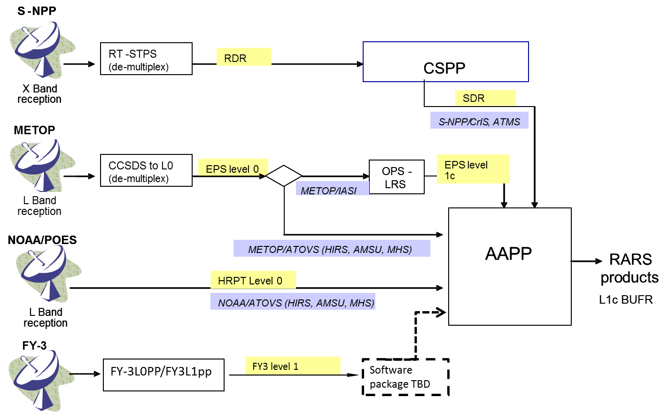
Common processing software suite and orbital elements for product consistency

Slide 15
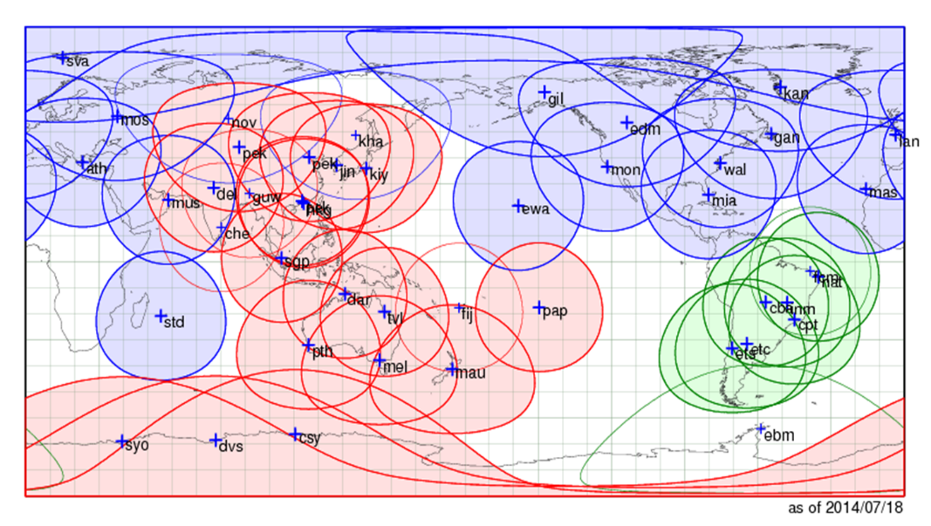
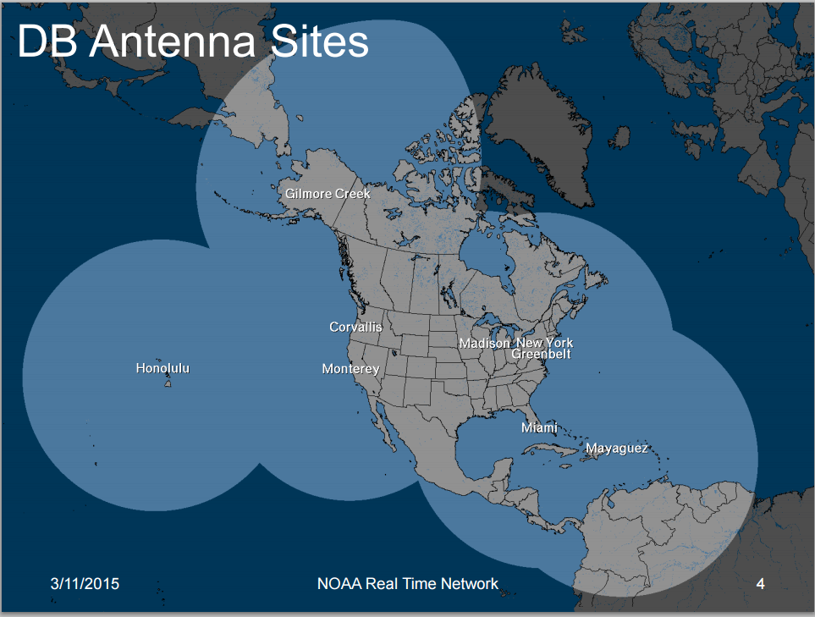
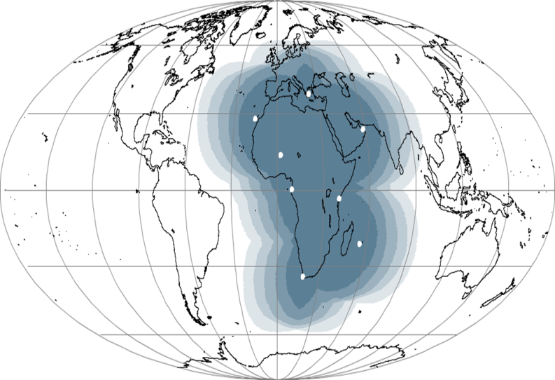
DBNet (coverage evolution)
Current network (ATOVS)
Potential DBnet Africa
(ACMAD project supported by EC, ATOVS)
New NOAA Realtime Network (CrIS, ATMS, IASI)

Slide 16
DBNet Services Implementation Status
Categories of Services | Services (Instruments) | Routinely available
IR/MW sounding | ATOVS (AMSU-A, MHS, HIRS), ATMS, VASS (MWTS/2, MWHS/2, IRAS) | ATOVS globally ATMS (EUM + US)
IR/VIS imaging | VIIRS, AVHRR, MERSI | VIIRS and AVHRR (EUM)
Hyperspectral IR sounding | CrIS, IASI, HIRAS, AIRS | CrIS (EUM + US) IASI (EUM)
Scatterometry | ASCAT, Wind RAD | ASCAT (EUM)
MW imagery | MWRI

Slide 17
Talking points
From RARS to DBNet
Outline of DBNet
DBNet User Requirements, current and future
DBNet data traffic projection

Slide 18
DBNet High-Level Service Specifications
Category of Service | Driving Application | Products | Data latency goal/threshold | Availability | Coverage
IR/MW sounding | Global and High-Resolution NWP | Level 1 brightness temperatures | 20 min/ 30 min | 95% | 90%
IR/VIS imaging | Nowcasting | Level 1 radiance /reflectivity | 10 min/ 20 min | 95% | 30%
Hyperspectral IR sounding | Global and High-Resolution NWP | Level 1 radiances and PC scores | 20 min/ 30 min | 95% | 60%
Scatterometry | NWP, Nowcasting and Ocean applications | backscatter cross-sections | 20 min/ 30 min | 95% | 50% (of oceanic areas)
MW imagery | NWP, Nowcasting, | Level 1 brightness temperatures | 20 min/ 30 min | 95% | 30%

Slide 19
NWP Centers needs for DBNet data
NWP Center/ Category of Service | BoM | CMA | DWD | ECMWF | EC | JMA | KMA | Météo France | NCEP
IR/MW sounding
IR/VIS imaging
Hyperspectral IR sounding
Scatterometry
MW imagery

Slide 20
Datafile sizes for individual DBNet Services
Category of Service | Service | Typical size (Mb) per satellite pass and DBNet station
IR/MW sounding | ATOVS (Metop + POES) | 0.2 (AMSU), 0.3 (HIRS), 0.6 (MHS)
 | ATMS (NPP) | 1.5
 | VASS (FY-3) | 1.2 (MWHS), 0.3 (MWTS), 0.3 (IRAS)
IR/VIS imaging | AVHRR (Metop + POES) | 20
 | VIIRS (S-NPP) | 220 (M-band), 30 (DN-band)
 | MERSI (FY-3) | TBD
Hyperspectral IR sounding | IASI (Metop) | 15
 | CRiS (S-NPP) | 10
 | HIRAS (FY-3) | TBD
Scatterometry | ASCAT (Metop) | 1.4
 | WINDRAD (FY-3) | TBD
MW imagery | MWRI (FY-3) | TBD

Slide 21
DBNet satellite configuration (reviewed annually)
Satellite | Orbit and satellite status (D=descending, A=ascending) | Instrument health | Global data availability | Direct broadcast transmission | DBNet priority (H/M/L)
Suomi NPP | NOAA Prime Polar PM 1330A | Good | 1 dump per orbit | Good (X-band). | H
Metop-B | Primary AM service. 0930D | Good | Very good: Arctic and Antarctic dumps | Good (L-band) | H
NOAA-19 | Prime NOAA PM. Close to S-NPP 1400A/0200D | Good | 1 dump per orbit | Good (L-band) | H
NOAA-18 | Has drifted to an early morning orbit 1700A/0500D | Good. HIRS degraded | Some blind orbits | Good (L-band) | H
Metop-A | Same orbital plane as Metop-B 0930D | Good | 1 dump per orbit | Limited geographically due to radiation issues | M
NOAA-15 | Close to NOAA-18 0530D | Poor. AMSU-B and HIRS not working. AMSU-A is still useful. | Some blind orbits. Low priority in NESDIS L1 processing. | Poor signal strength (L-band), can only be received by large dishes | L
FY-3C | 1030D | MWTS-2 not working, MWHS-2 OK. | Significant delays | Good (L-band for sounders, X-band for MERSI) | L

Slide 22
DBNet User Requirements
It is proposed to reflect the DBNet High-Level Service Specifications in the APSDEU-NAEDEX Requirements Baseline
  Include IR/MW sounding, HiRes IR sounding and scatterometry
  Include DBNet availability in field “availability” for each instrument entry
  Include specific need for DBNet data in field “Usage and Plans” for each NWP center
  Should µ-wave imaging be included?
Alternative would be to create separate entries for DBNet data
  This was done before APSDEU-NAEDEX requirements were migrated from Word to Excel
  Could however create inconsistencies between entries for the same instrument

Slide 23
Talking points
From RARS to DBNet
Outline of DBNet
DBNet User Requirements, current and future
DBNet data traffic projection

Slide 24
DBNet Data Traffic Projections
Due to the challenging timeliness requirements and to the significant volume of new services a detailed data traffic projection is needed for WIS capacity planning
Such an analysis must identify
  NWP centers requesting to receive the different data sets (with time evolution) -> to be provided by APSDEU-NAEDEX
  Originating centers (DBNet regional network nodes)
  Typical file sizes (per DBNet service)
  When and how often the data need to be exchanged (assuming a certain satellite configuration, evolving with time)
  Timeliness requirement (as recorded in the DBNet high-level specification).

Slide 25
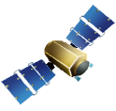

Satellite
Broadcast
10MB
N x 10MB
User centres with limited connectivity
WIS Core Network
(e.g. RMDCN)
10MB
User centres
User centre with high connectivity
DBNet station
Node
GTS hub
User centre
Notes:
25
RMDCN: Regional Meteorological Data Communication Network

Slide 26
Daily DBNet data volumes (EUMETSAT)
Service | DAILY DATA VOLUME (MB) | DAILY DATA VOLUME (%)
ATOVS (5 Satellites) | 650 | 5%
AVHRR (Metop-A/B) | 2500 | 19%
ASCAT (Metop- A/B) | 158 | 1%
IASI (Metop-A/B) | 1200 | 9%
Nowcasting products from NWC SAF | 800 | 6%
ATMS (S-NPP) | 80 | 1%
CRiS (S-NPP) | 375 | 3%
VIIRS (S-NPP) | 7500 | 56%
Total | 13GB | 100%

Slide 27
DBNet data traffic projection
WMO (Jérôme Lafeuille) has developed a dataflow analysis tool for DBNet
Input data
  List of stations and list of satellites with orbit characteristics
  Processed data volumes for most challenging DBNet services
Output
  Rate of DBNet data injected into core WIS network (mean and max over 5 minute slots)
First future scenario simulated
  50 DBNet stations (including EARS, APRARS, SA RARS, NOAA)
  Services: Metop-B/IASI, SNPP/CrIS in 2016-2018, FY-3/HIRAS >2020
  Gradual implementation 28 stations in 2016 to 48 in 2020

Slide 28
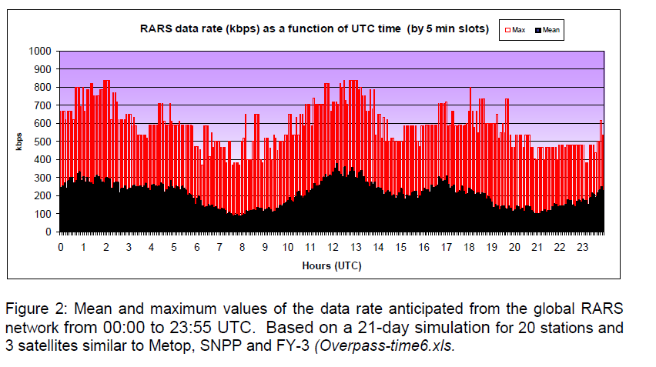
DBNet data traffic projection, first simulation in 2013 (20 stations)

Slide 29
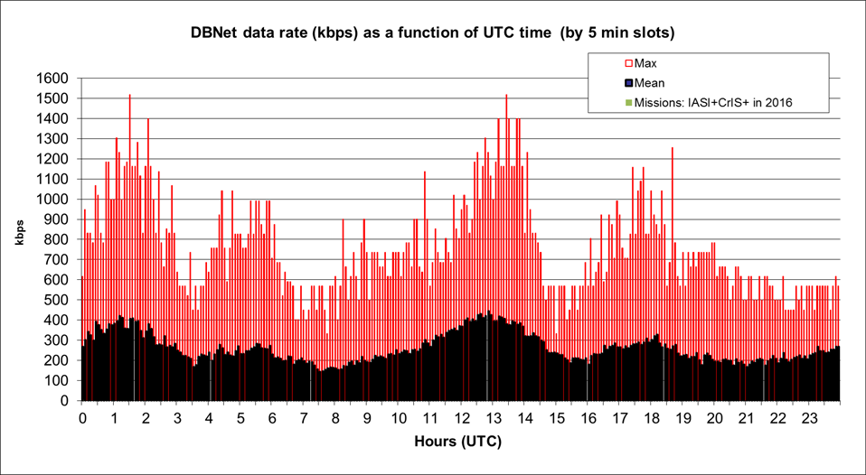
DBNet data traffic projection, updated simulation: (1) 28 stations IASI-CrIS
28 stations
Peak 1300 kbps
Mean: 212 kbps

Slide 30
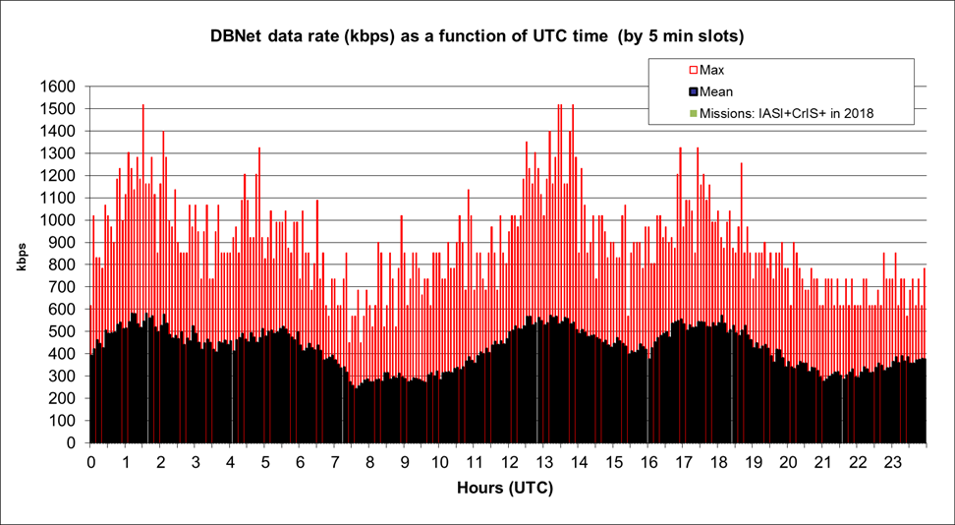
DBNet data traffic projection, results of updated simulation : (2) 47 stations – IASI-CrIS
28 stations
Peak 1300 kbps
Mean: 348 kbps

Slide 31
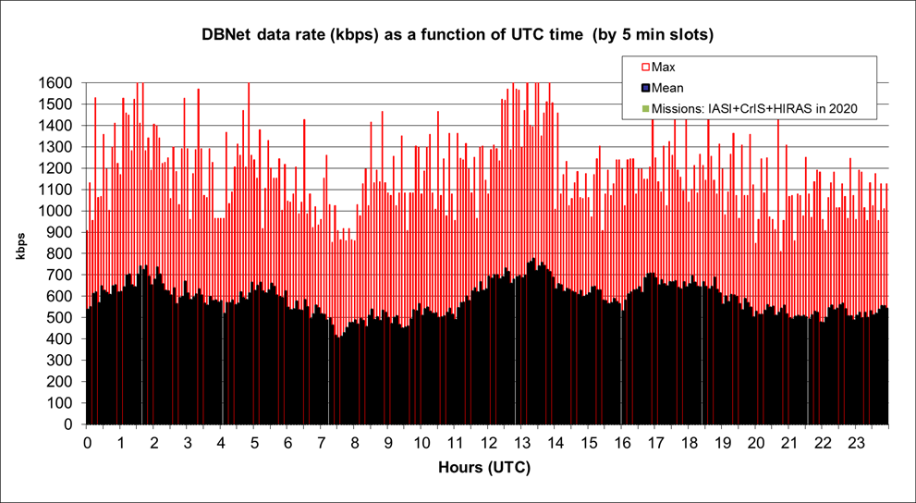
DBNet data traffic projection, results of updated simulation : (3) 48 stations – IASI-CrIS-HIRAS
48 stations
Peak 1775 kbps
Mean: 588 kbps

Slide 32
DBNet data traffic projection
Simulations are only aiming to provide a “reasonable estimate”
Further scenarios can however be analyzed
  New services (imagery, scatterometer data)
  Updated implementation plan (including DBNet Africa)
  Network optimization (station location, removal of overlaps)
Simulations will be provided to WIS for capacity planning
  It should be noted that similar traffic projections do not currently exist for the global satellite data and products

Slide 33
APSDEU-NAEDEX considerations
  APSDEU-NAEDEX is requested to
    Confirm the high-level DBNet Service Specifications
    Confirm the inclusion of the DBNet Services in the APSDEU/NAEDEX Requirements Baseline
      Should µ-Wave imaging be included?
    Confirm inputs to the NWP Center / DBNet Service matrix
    Provide comments to the satellite priorities list
    Provide guidance to refine the traffic simulation
  This information will be included in the detailed DBNet data traffic projections to be provided by the DBNet group to WIS

Slide 34
Thank you for your attention!

Slide 35
RARS network acquisition based on Direct Broadcast
Compared to SafetyNet type complete acquisition
(Schematic)
Network storage/dump
Percentage of data acquired
DBNet with 30-40 stations
DBNet with 20-30 stations
DBNet with 10-20 stations

