Slide 1
WIS and GCI/GEOSS interoperability project
Stefano Nativi
(02 Oct 2015)

Slide 2
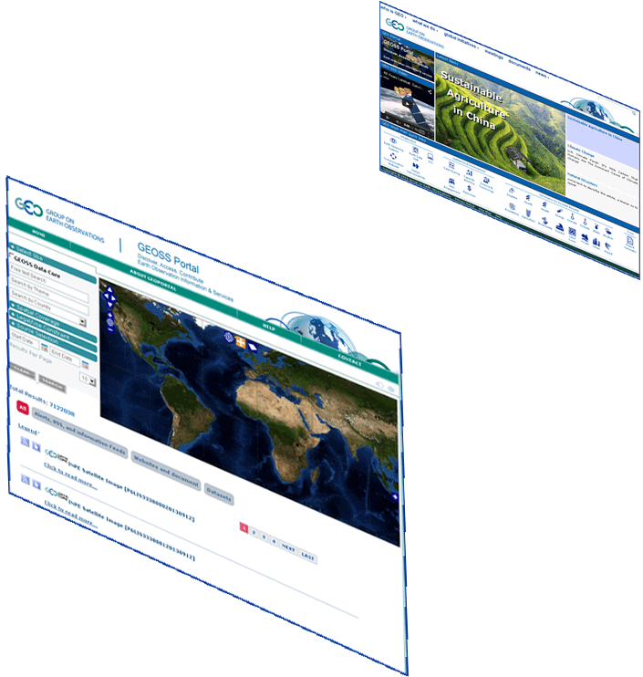
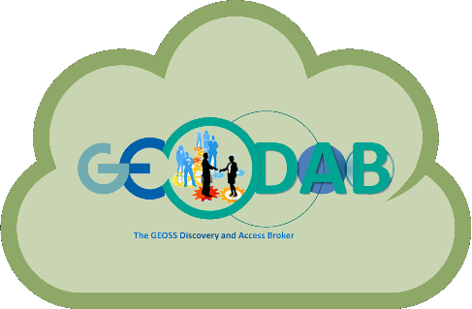
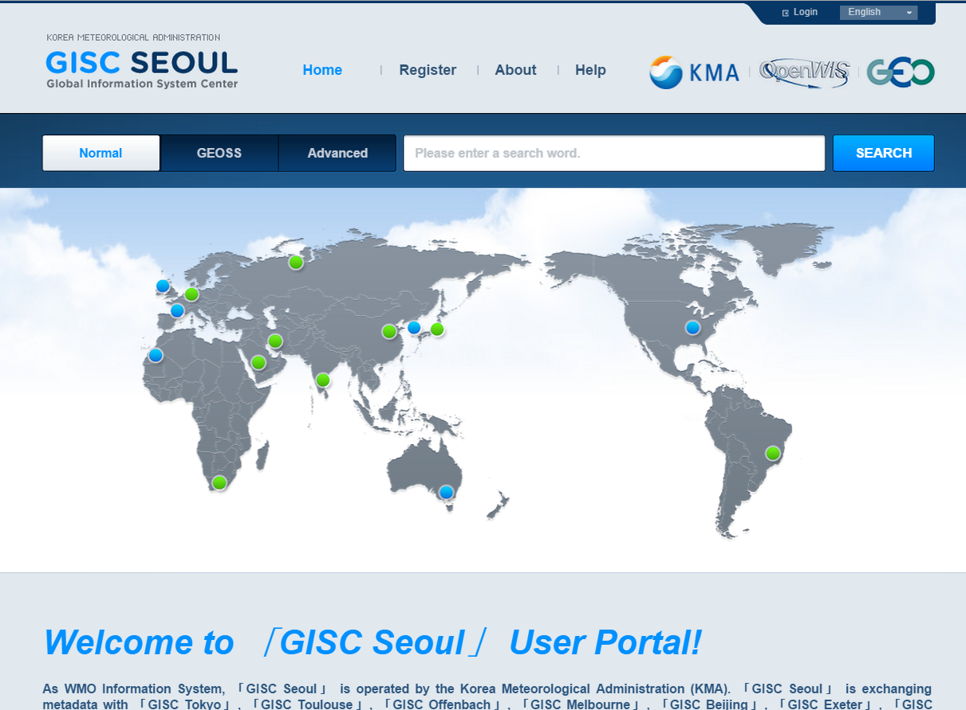
WIS ← → GEOSS interoperability
GEO Home Page
GEOSS Community Portals
About 120
Supply Systems
GEOSS Portal
Brokering Framework
Registry (CSR)
WIS
(DWD node)
Semantic engines
GCI
.. .
WIS
(KMA node)
Data Providers Brokered (capacities, systems, networks, etc.)

Slide 3
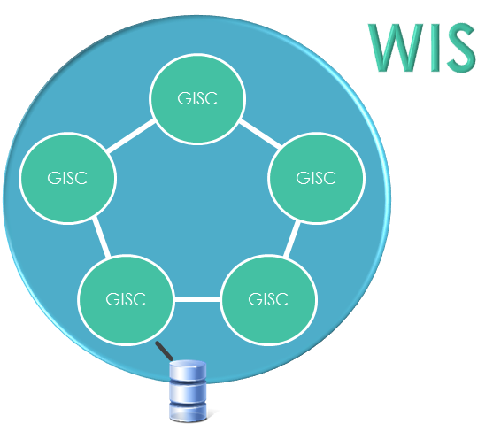
GEOSS Metadata content
Transform to WIS compliant ISO 19139 schema
Supplement metadata on Time Stamp (for creation, deletion, update, etc.)
Expose the OAI-PMH extended interface (including optional features, ala WIS)
World Wide Web
WIS-OAI-PMH (with optional features)
KMA Harvester
WIS (KMA node) harvester and Portal

Slide 4
Interoperability agreements
WIS (KMA node) interoperability with the DAB is achieved by means of the OAI-PMH interface
DAB implements OAI-PMH Version 2.0 including support to optional features such as “deleted records” and “set”
DAB exposes through the extended OAI-PMH interface (called WIS-OAI-PMH by the DAB) only those records that are compliant with the WIS ISO 19139 profile –using the validator provided by the DWD
KMA node periodically harvests the GEOSS metadata content through the DAB WIS-OAI-PMH interface.
The use of the “selective harvesting” feature (which allows to retrieve only updated records) is recommended
DAB instance runs on the EC2 cloud of Amazon Web Services (AWS), providing the necessary scalability

